Slide 1
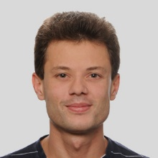
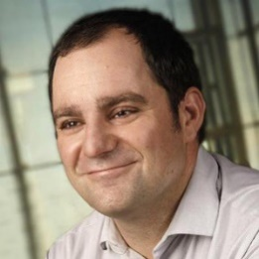
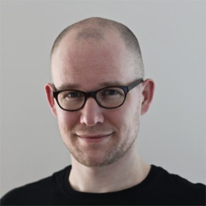
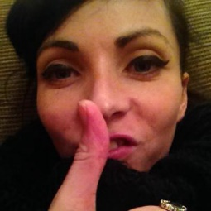
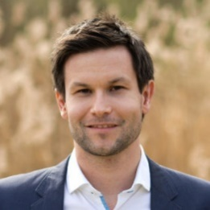



From
Visual Exploration to Storytelling and Back Again
Samuel Gratzl
Alexander Lex
@alexander_lex
Nils Gehlenborg
@nils_gehlenborg
Nicola Cosgrove
@nicola_lady
Marc Streit
@marc_streit
Notes:
Thanks for the introduction and welcome to my talk. This is joint work done together with Alex Lex, Nils Gehlenborg, Nicola Cosgrove, and Marc Streit

Slide 2
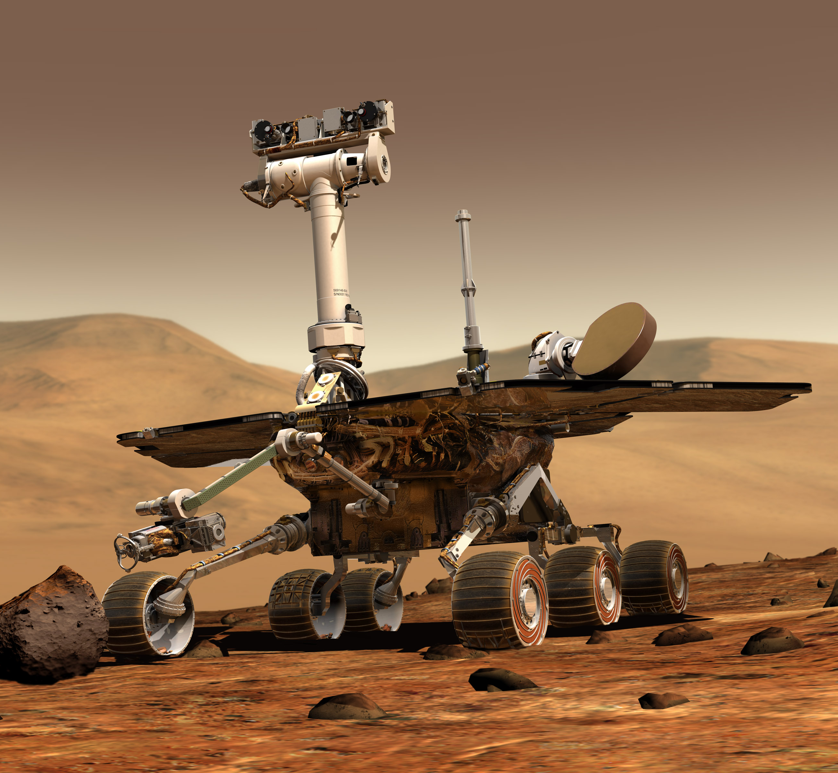
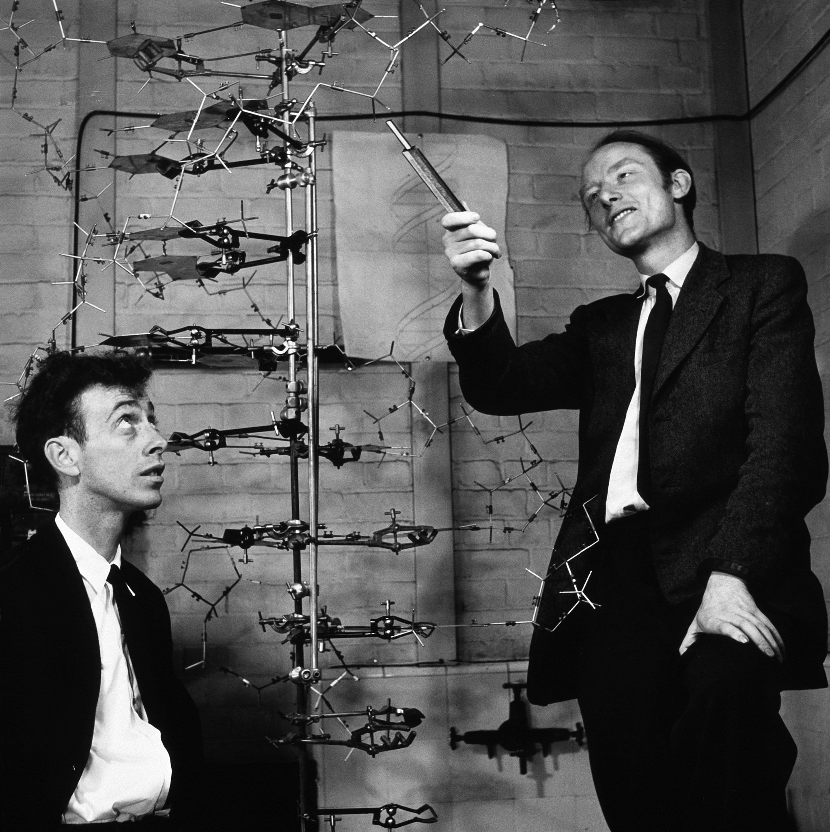
Exploration
Presentation
Notes:
Two world of visualization.

Slide 3
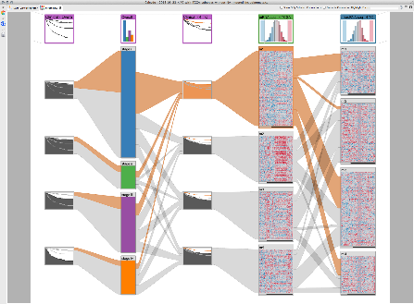
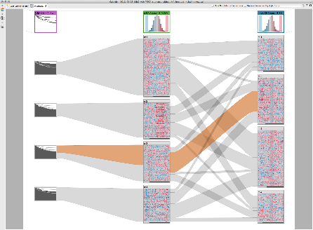
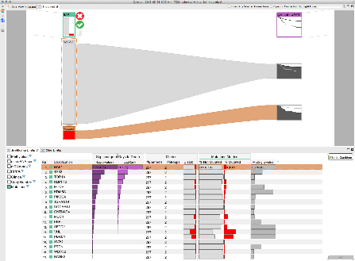
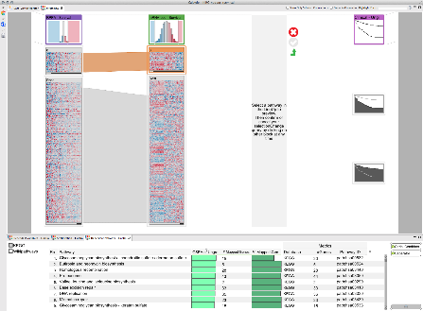
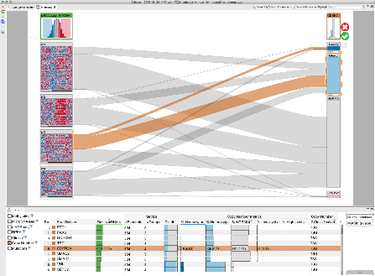
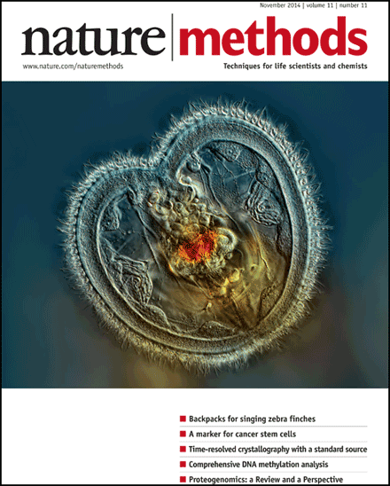

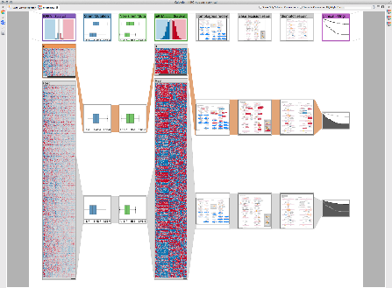
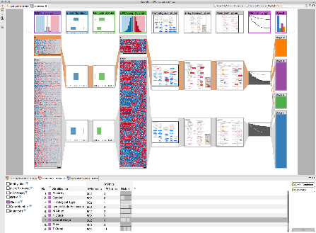
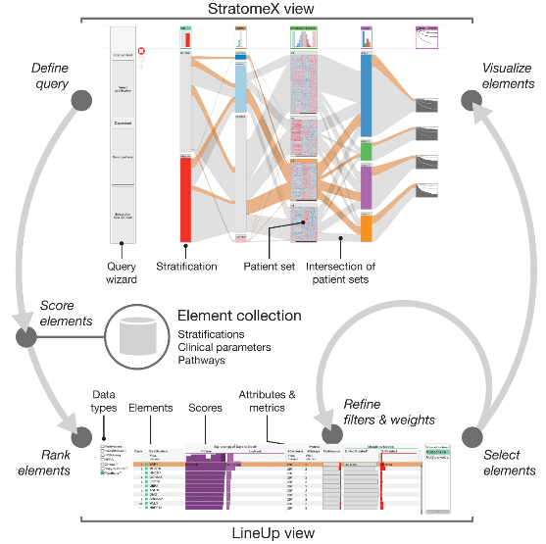
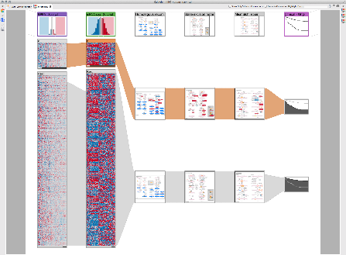
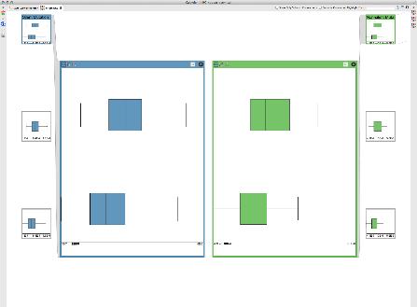
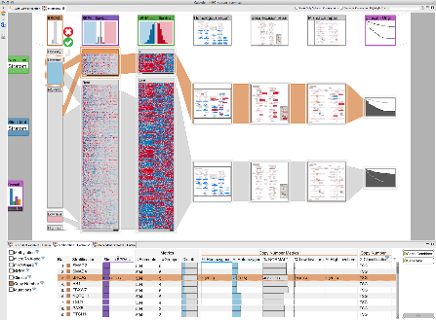
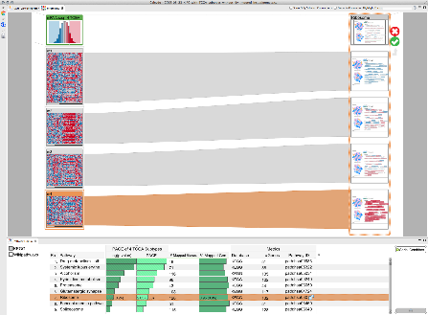
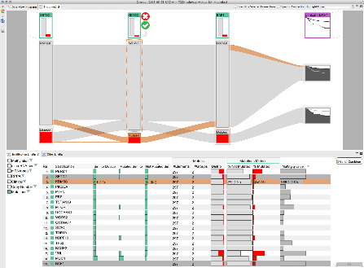
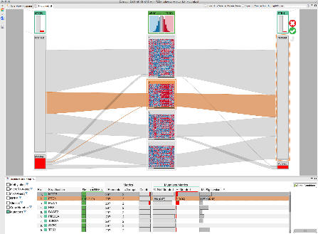
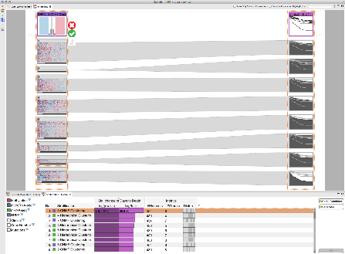
Guided visual exploration of genomic stratifications in cancer
Marc Streit, Alexander Lex, Samuel Gratzl, Christian Partl, Dieter Schmalstieg, Hanspeter Pfister, Peter J. Park, and
Nils Gehlenborg,
Nature Methods 11, 9 (2014), 884–885
Notes:
Let me tell you a story about a paper that we published two years ago. It was about a guided visual exploration technique for cancer stratifications. Don‘t worry, I don‘t wanna go into details. But my point is that we showed that our technique works by a use case in this domain. And how do you present such a visual use case in a paper? Yes, with a series of screenshots. Actually quite some. And a video to see the exploration in action. But it didn‘t feel right, although we put a lot of effort it in, we weren‘t sure that we can show the real and foremost whole story.
But it hasn‘t to be a complex biological use case in which the exploration and presentation are separated.

Slide 4
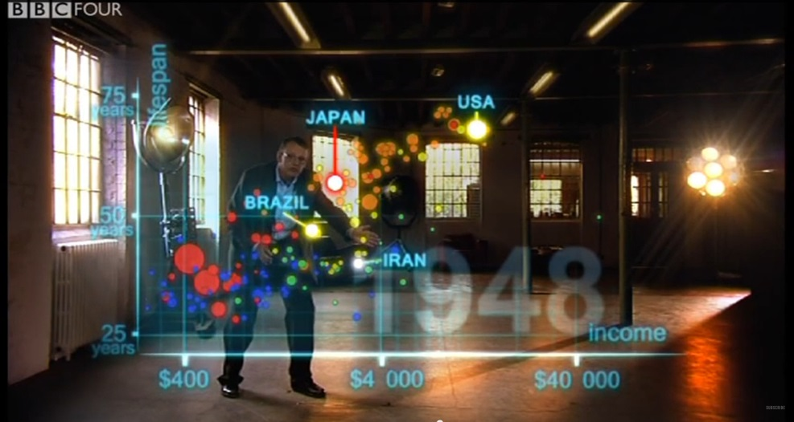
gapminder.org
Notes:
I’m sure you all know Hans Roslings famous videos in which he explained us the world using GapMinder. This is a screenshot of one of his talks in which he tells us a story. However, that is what it is, an authored story what was found in the visual exploration, presented in a appealing way. It is not the real exploration, just the highlights.
We can summarize this process how to get from a visual exploration to a presentation in the following workflow

Slide 5
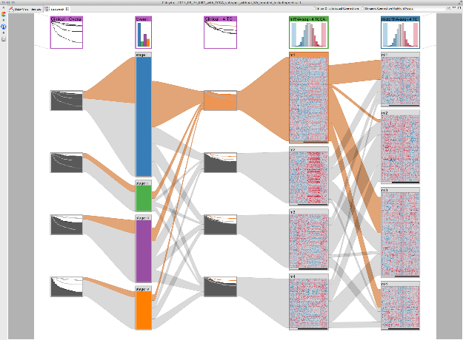
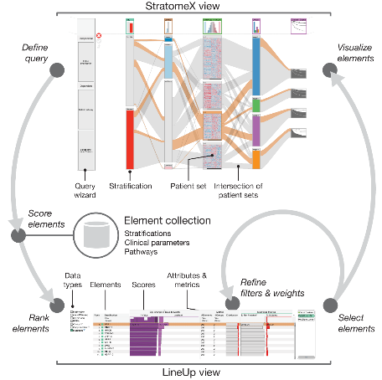


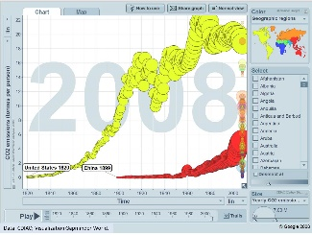

Authoring
finding
figure
video
Exploration
Presentation
Exploration
Presentation

Slide 6
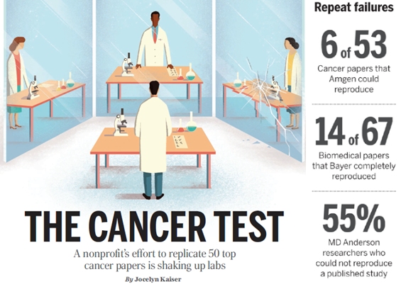
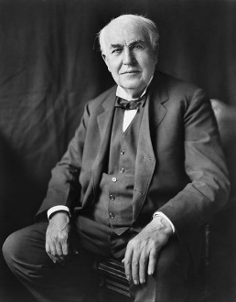
Authoring
Issues
fraction/selection of the exploration
tell just the „good“ parts
no back link
  „I have not failed. I've just found 10,000 ways that won't work”
    Thomas A. Edison
finding
figure
video
Exploration
Presentation
https://en.wikipedia.org/wiki/File:Thomas_Edison2.jpg
  J. Kaiser, “The Cancer Test,” Science, vol. 348, no. 6242, pp. 1411–1413, 2015.
Notes:
However, there are several issues with this separated workflow. You will always just see a fraction a selection of the real exploration. You switch between tools and therefore you have to make some comprimises to accomplish this. Another severe issuse is that you usually just tell the „good“ parts of the exploration. How you discovered the finding in the shortest and direct way. So, you are leaving out the numerous tries in which you didn‘t find something. However, these failed tries are an important part of the whole story.
As Thomas Alva Edision once said: „I have not failed. I‘ve just found 10000 ways that won‘t work.“ I mean that sometimes the knowledge that nothing is in the data is important, just telling the good parts would ignore that.
The final important issue is that there is no back link from presentation to exploration. I‘m talking about how to reproduce a presented use case and finding. The bad thing is that ths issue of reproducibility is quite serious.
An article about the cancer test was quite shoking. Only 6 out of 50 important cancer papers could be fully reproduced. That‘s terrible.
We can summarize the issues by asking the following question:

Slide 7
continue
How to reproduce the presented exploration?
alter
Notes:
How to reproduce, continue, and alter the presented exploration?
Let me rephrase it

Slide 8
How to go from
visual exploration to storytelling
and back again?
Notes:
How to go from visual exploration to storytelling and back again?
In this talk I‘m presenting one possible approach for answering this question

Slide 9
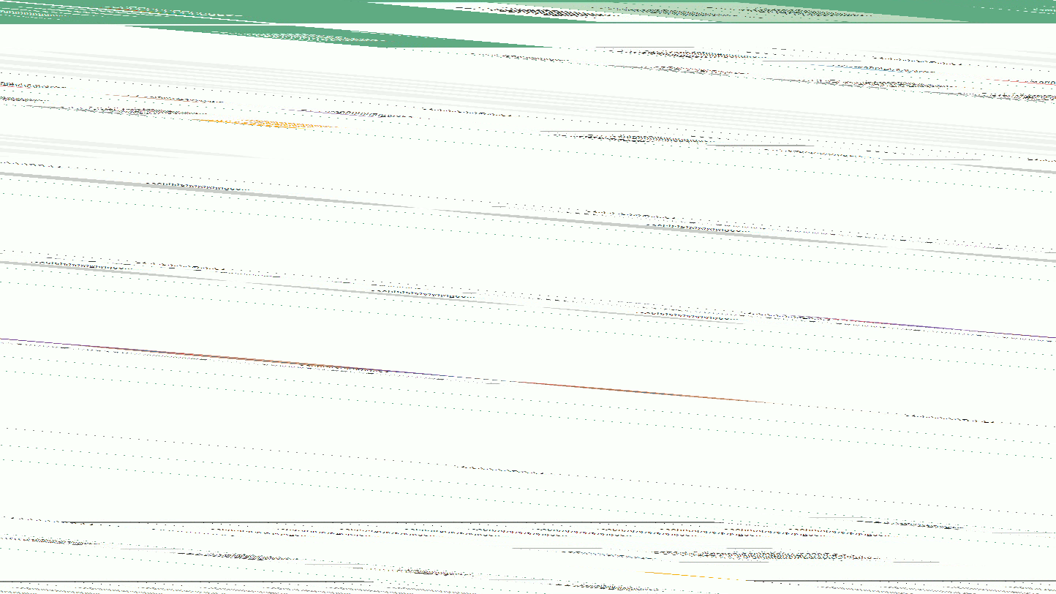
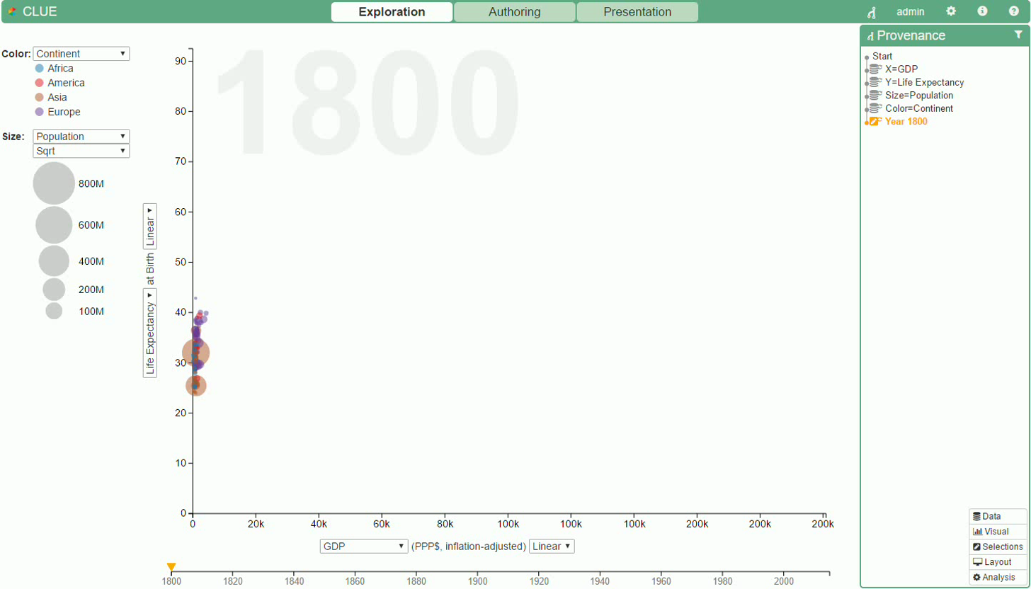

Slide 10
C apture
L abel
U nderstand
E xplain
visualization driven explorations based on automated recorded provenance data.
L
U
C
E
Notes:
We present CLUE. A framework for capturing, labeling, understanding, and explaining visualization driven exploration based on automated recorded provenance data. We propose a framework in which all actions performed during the visual exploration are stored in a central component forming a provenance graph of the exploration. However, the fundamental change is that stories build based on the exploration are based on the provenance graph, too.

Slide 11
Vistories
visual data stories
visual histories
stories consisting of authored subset of the provenance graph
Notes:
We therefore call such stories: Vistories. Vistories are visual data stories that consist of an authored subset of the provenance graph. So, what will be presented in not an artifical selection or view on the exploration. But an improved subset of it. An important aspect is that you can‘t alter the exploration and its provenance but just improve it, for example by adding annotations or skipping redundant steps. The great thing about Vistories are now that you can directly go back from presentation to exploration since each slide in the story corresponds to a state in the exploration.
Lets take a look how a user can navigate within this framework

Slide 12
Authoring
Exploration
Presentation
Notes:
Let’s start with the regular flow. A user starts in the exploration mode and is there a while till she discovers something. Meanwhile all actions are tracked in the provenance graph. To communicate and present the finding she switches to the authoring mode to create a Vistory out of it. She selects the important intermediate actions that lead to the finding and annotate them and build a story out of it. Afterwards, the Vistory will be presented, e.g. to colleagues.
So far so good. Have you ever experienced the situation when you are presenting something and the one colleague raises his or her hand and asks: “Have you ever thought of using a different algorithm, selection, or whatever“ With CLUE you can answer: lets try it out. You start entering the framework at the presentation mode, switching back to exploration, jump to a different branch in the provenance graph and give it a try. Awesome.
So, CLUE combines two different aspects: provenance graph recording and storytelling. These two areas form also the related work of this work.

Slide 13
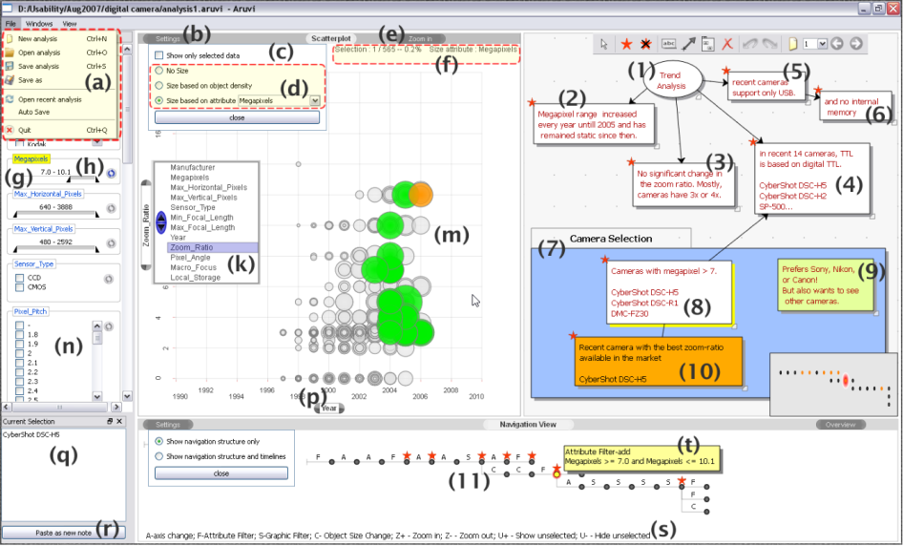
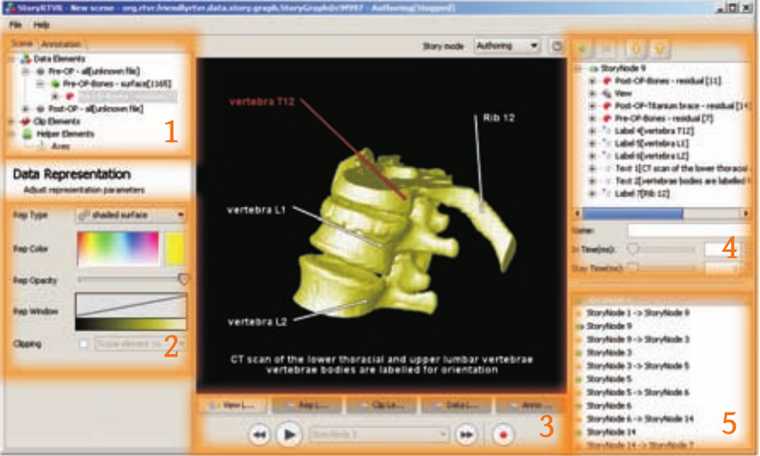
Shrinivasan and van Wijk, 2008
Supporting the Analytical Reasoning Process in Information Visualization
Wohlfahrt and Hauser, 2007
Story Telling for Presentation in Volume Visualization
Notes:
There are two important piece of related work in these areas. In the paper by „Shrinivasan and van Wijk“ they authors propose a visual exploration system in which also all actions are tracked along with a dedicated knowledge view where the user can create an ontology of the findings and related them to certain states in the exploration. However, there are no dedicated storytelling features to present the story. But we believe that creating similar storylines as we currently do is an important aspect. The opposite is in the paper by „Wohlfahrt and Hauser“. They propose a technique in which the user can record a set of interactions with a volume renderer, annotate and in the end present it in a story fashion. However, the important difference is that the user has to actively trigger the record button. While this looks like a small change it means that you usually already have to know what you wanna present. In CLUE everything is tracked by default and you select what to present afterwards.
But lets go on and take a look what is actually needed to realize the CLUE framework

Slide 14
Authoring
Provenance Graph Recording
Provenance Graph Visualization
Story Editor Visualization
Exploration
Presentation
Notes:
We identified three components that are needed besides the visual exploration application itself. First, the central component to record, store, and manage the provenance graph. Second, the stored provenance graph needs to be visualized. A visualization of it is used in two modes. In the exploration mode for orientation and within the authoring mode for selection. Last, a component to create and show stories is needed. Similarly these component is needed in the authoring as well as the presentation mode.
Let‘s take a closer look at it.

Slide 15
Provenance Graph Recording
action-centered bi-partite graph
a state is determined by the action sequence from the root
Notes:
We store the provenance data in an action-centered bi-partite graph. An ontology how different node types are related to each is show below. We do not store whole state but just record actions that lead to it. So, a state is finally determined by the action sequence that need to be executed from the root. Besides the main two node types: action and state there are additional helper ones: object representing datasets, visual elements and so on and and a slide representing slide in a vistory.

Slide 16
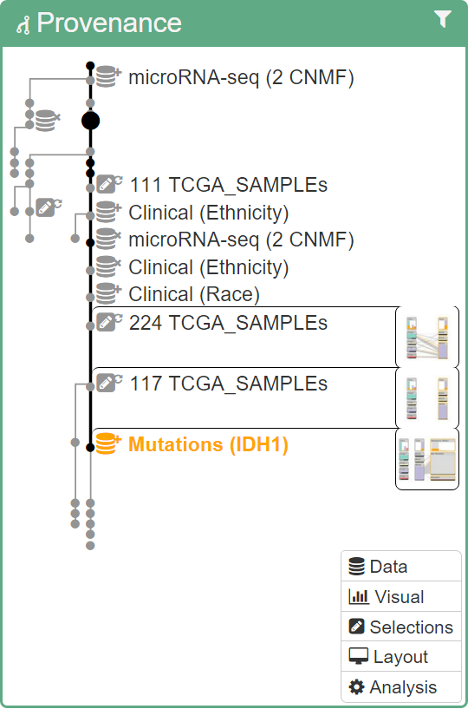
Provenance Graph View
degree-of-interest driven skewed node-link diagram
  node = state
  link = action
purpose
exploration: orientation, navigation
authoring: selection
Notes:
We visualize the provenance graph in degree-of-interest driven skewed node link diagram. A node represents a state and a link an action in the bipartite graph. The graph is skewed as shown in the right such that the currently active state along with all its direct ancestors are right aligned. The degree-of-interest assigned to each node is used to represent it in different level-of-details ranging from a simple dot to a full description along with a preview screenshot.
The view has different purposes depending on the mode it is shown. In The exploration mode it is used to give the user orientation and navigation, while in the authoring mode it is used to select the states that the vistory should consist of.
Lets take a look how to interact with the view

Slide 17


Slide 18
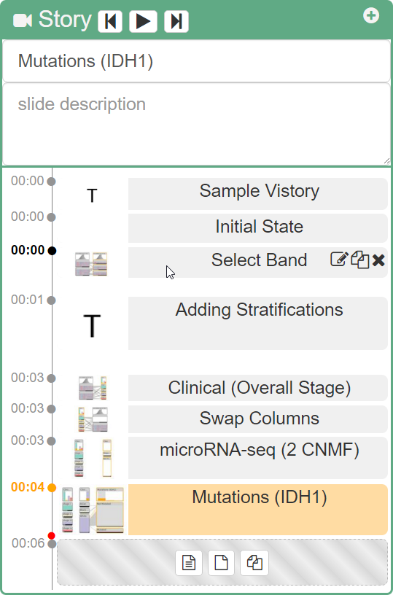
Story Editor View
define one or multiple Vistories
  select provenance states
  annotations (text, frame, arrow)
  timing information
purpose
authoring: definition, annotation
presentation: orientation, navigation
Notes:
The remaining missing story editor view is used to define one or multuple Vistories. That includes selecting states in the provenance graph and drag them to the story editor view. Annotate states using text boxes, frames or arrows and define timing information for an automated replay.
Similarly to the provenance graph the purpose of the view depends on the current mode. In authoring it is for defining the story and in presentation mode for orientation and navigation within the current Vistory.
Lets again take a look

Slide 19
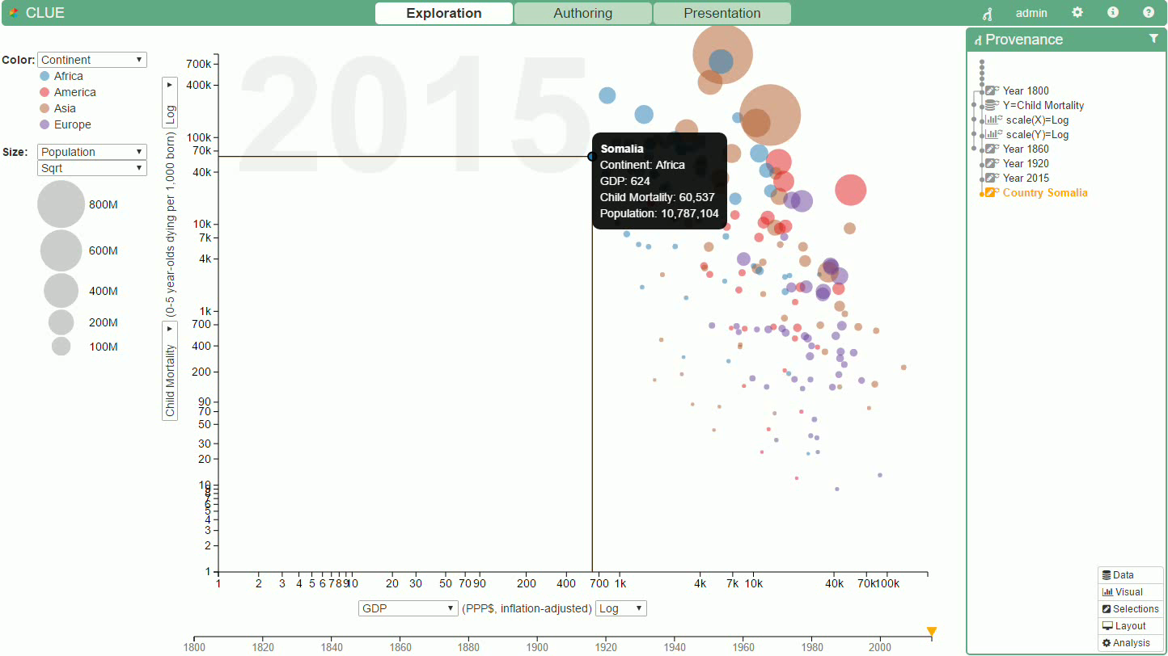

Slide 20
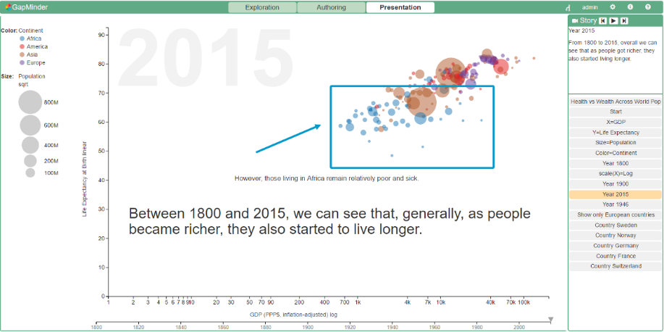
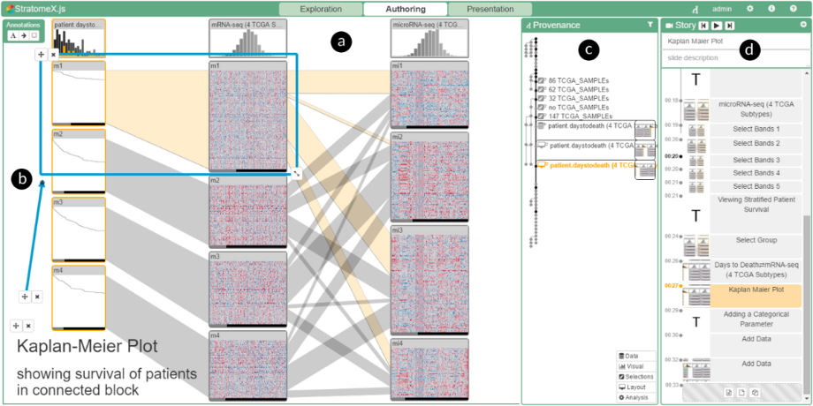
Usage Scenarios
Gapminder
StratomeX
http://vistories.org/v/gapminder
http://vistories.org/v/stratomex
Notes:
We showed the usage of our framework in two usage scenarios. One were we tell a simple story using GapMinder and the order in which we reproduce parts of our own Nature Methods paper mentioned at the beginning of this talk. However, the real important part of this slide are the two links down there. If you open the link in your chrome webbrowser you should see the exact same state as shown in the picture, you should see, play, around, and modify the Vistory.
How does it work

Slide 21
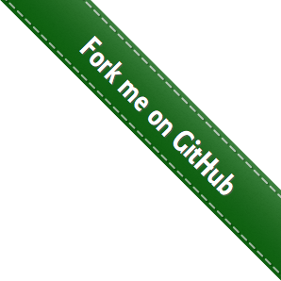

Implementation
wrapper library around Caleydo Web applications
requires: command design pattern
open source (BSD license)
http://github.com/Caleydo/caleydo_clue
Notes:
We didn‘t restrict our implementation to these two usage scenarios but implemented it as a general wrapper library around Caleydo Web application. It is open source and hosted on Github. However, in order to record the actions in the graph the application needs to support this by using the command pattern.

Slide 22
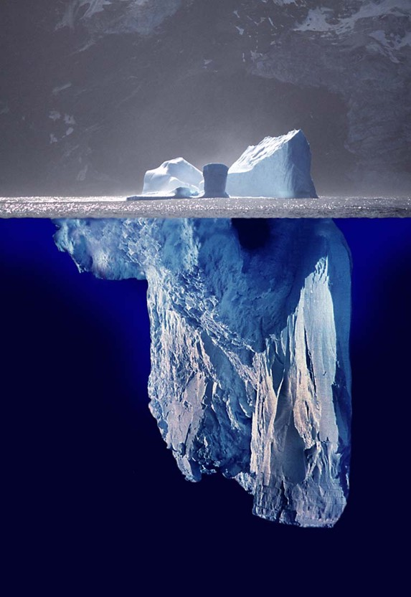
what is tracked
visual exploration actions
what not
datasets
data processing / wrangling
application
meta provenance
https://en.wiktionary.org/wiki/File:Iceberg.jpg
Notes:
While the whole current framework suggests a huge step towards reproducibility there is still plenty of things to do. You may know when someones refers to the tip of the iceberg. Well, here we have a similar situation. To be fully reproducible and to capture the whole provenance there are more things to track. CLUE currently suggests to track the visual exploration actions only. However, there is more. Including the datasets that may change over time, like adding new rows, the data wrangling and processing applied to them. The application itself, since bugs could be fixed or features added it may have influence on the reproduciblity. Finally what is not currently tracked is how the user interacts with the provenance, how vistories are created and so on. We refer to this as meta provenance, since it is provenance data about the provenance. However, capturing the whole provenance requires the interleaving of multiple disciplines and was out of scope for the current project.

Slide 23
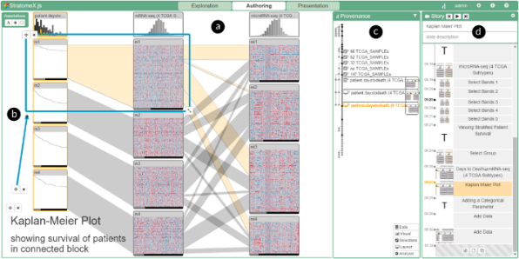
C apture
L abel
U nderstand
E xplain
a framework for reproducible, shareable, and communicable visual explorations
Notes:
To sum up, we presented CLUE a fraemwork for reproducibile, shareable, and communiciable visual exploration. In future work, we plan to focus on two aspects: First, we want to analyse the recorded provenance graph to support and guide the user. Imagine that the systems automatically tells you that you have seen as similar state, a similar selection in a different branch or that most of the times the following action was the following one. We can also use it to better understand how users do visual explorations at al. The other thing is a vision that I want to share with you.

Slide 24
Provenance Graph Analysis
support user
similar states
possible next actions
insights
usage patterns
exploration strategies

Slide 25

vistories.org
visual explorations tracked like source code
provenance part of the supplementary material
use case figures have a DOI linking to their Vistory
Notes:
Imagine that all visual explorations are tracked like source code. That provenance data is part of every paper as supplementary material. That each use case figure is not just a figure but contains a DOI that points to the vistories platform that reproduce the exact same figure along with the whole provenance right away. A platform at which reviewers and readers can not just see the exploration but also play and extend it.

Slide 26
efficient
collaborative
sustainable
Notes:
Wouldn‘t such a platform make our whole science more efficient, collaborative, and in the long run sustainable? Thanks

Slide 27
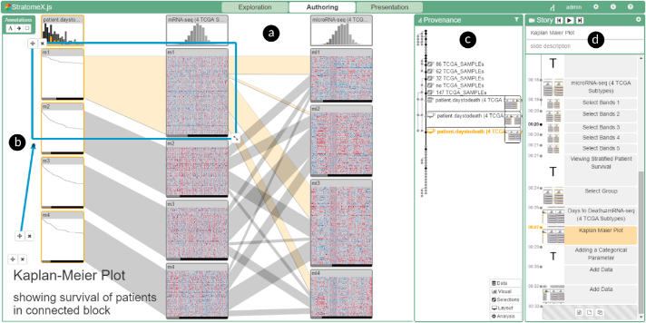










From Visual Exploration to Storytelling and Back Again
Samuel Gratzl, Alexander Lex, Nils Gehlenborg, Nicola Cosgrove, and Marc Streit
contact@caleydo.org
http://clue.caleydo.org
caleydo.org
github.com/Caleydo
twitter.com/caleydo_org

