Slide 1



Connecting The Dots Showing Relationships in Data and Beyond
Marc Streit¹, Hans-Jörg Schulz², Alexander Lex³
VisWeek Tutorial 2012
Johannes Kepler University Linz, Austria
University of Rostock, Germany
Harvard School of Engineering and Applied Sciences, Cambridge, MA, USA

Slide 2
Motivation
Common task in data analysis and many kinds of information intensive work:
Compare, evaluate and interpret related pieces of information
Notes:
Reveal relationships, patterns, and connections

Slide 3
Let‘s start with a little game…

Slide 4






Do you know this guy?
Wally
Walter
Waldo
Holger
…
http://www.classicmedia.tv/pr/whereswaldo/
Notes:
Well, his name depends from where you are… Let‘s call him wally

Slide 5
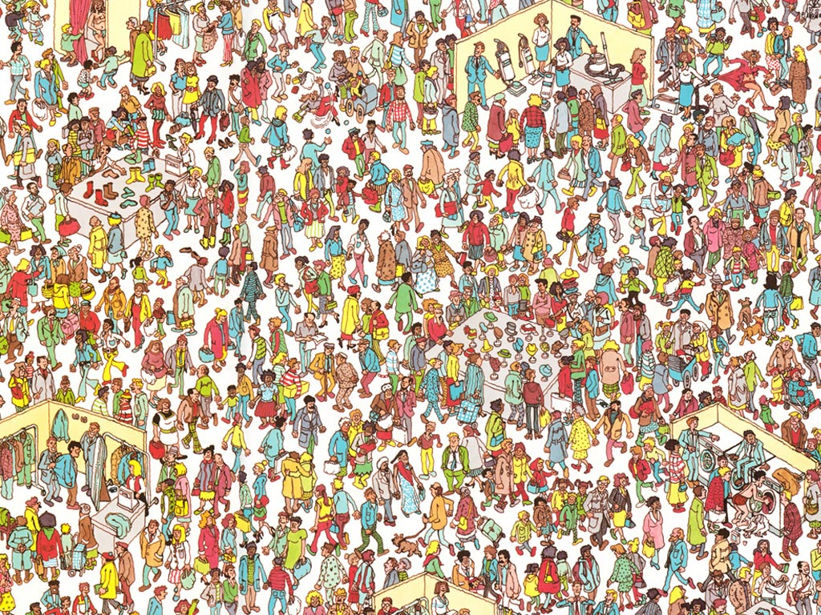
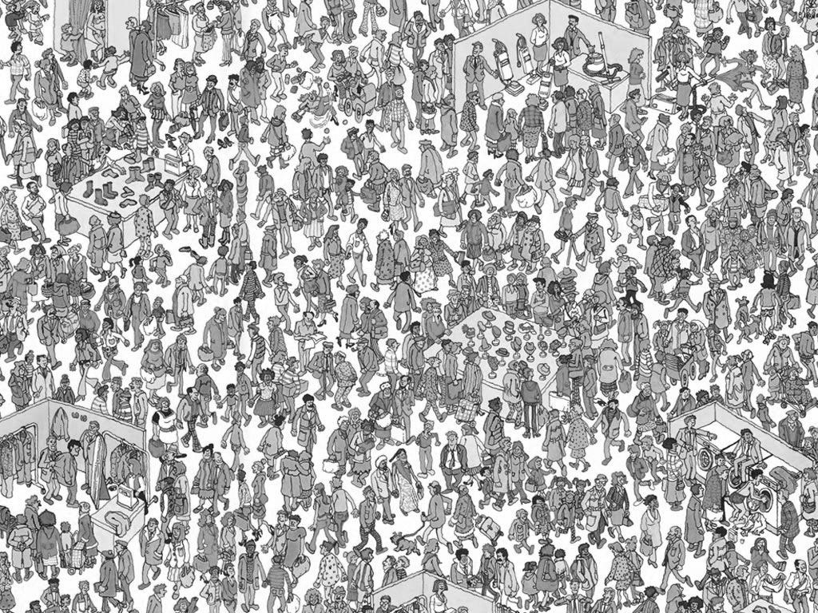

Search Task
http://www.findwaldo.com/fankit/graphics/
Notes:
Transition: Let‘s try an easier one…

Slide 6

%
http://tomsvision.wordpress.com/tag/wheres-wally/

Slide 7

In case you wanna have a tattoo…

Slide 8
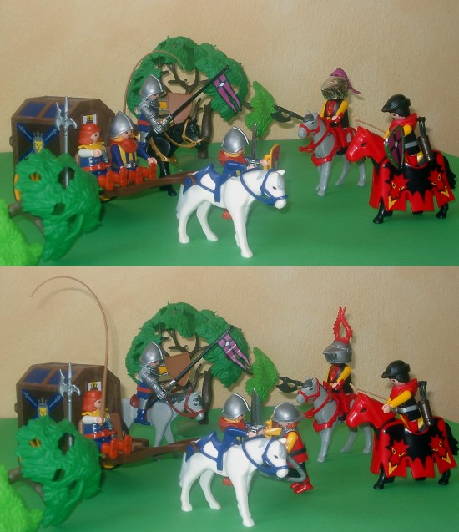
Spot the differences
Comparison Task
Notes:
Comparing, correlating, iterpreting connected pieces of information

Slide 9
What‘s the Problem?
Finding, comparing and interpreting information is error-prone and tedious
→ Support human

Slide 10
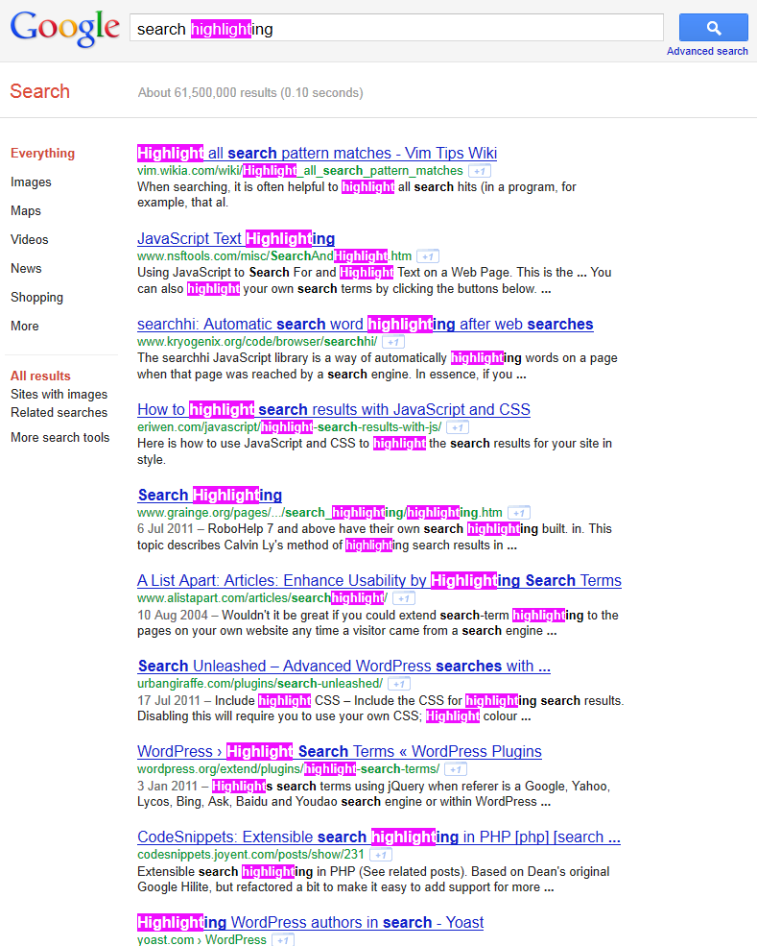

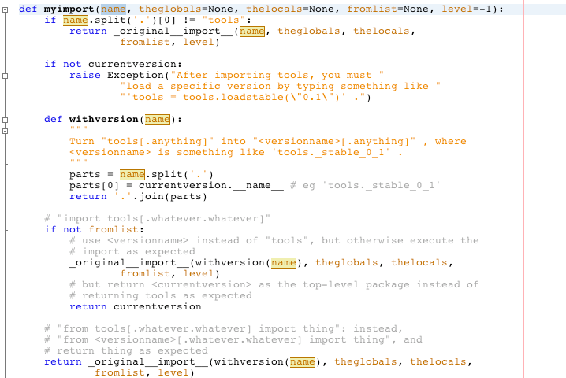
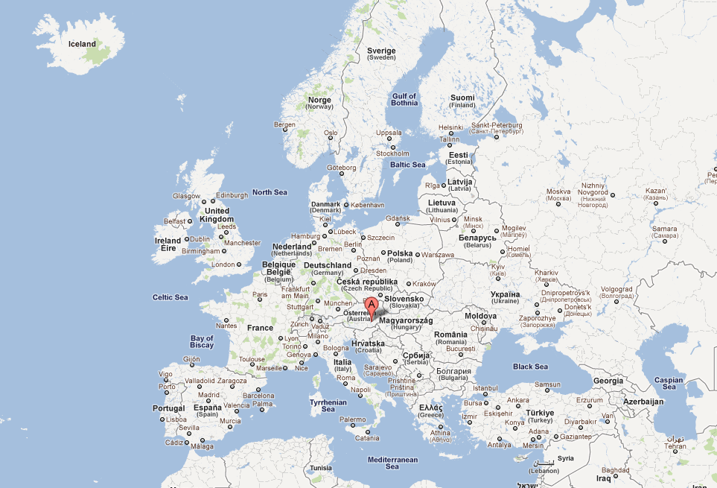

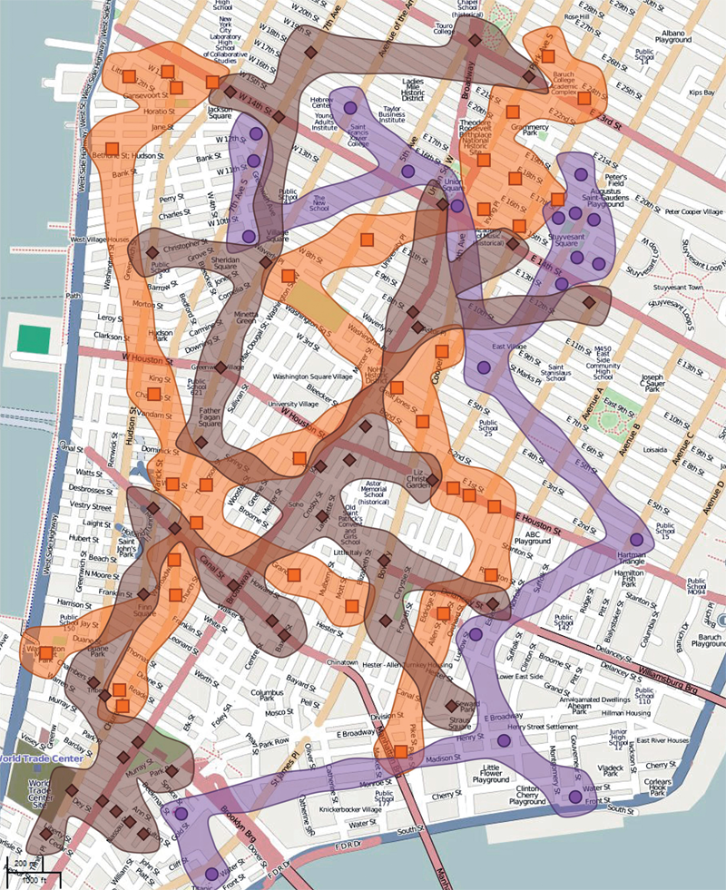

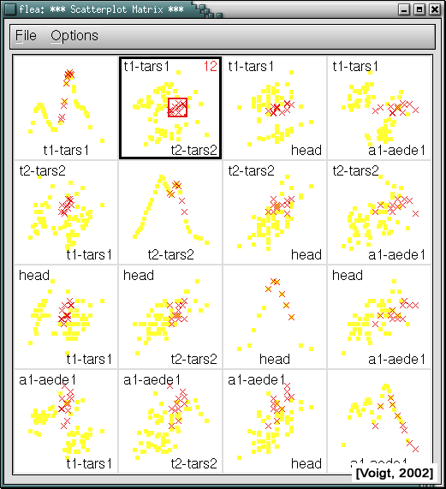
Java Eclipse
Google Maps
Mozilla Firefox
Make things stand out
[Collins ‚09]
Notes:
In real world situations we often want things to stand out…
…
If you use computers, you also find hilighting often… Synchronized visual highlighting
Well-known technique used to assist this task

Slide 11
Overview
PART 1: What to link? Defining Common Relations
PART 2: How to link?
Representing Relation on View Level
PART 3: When to link? Cases in which Linking is Beneficial

Slide 12
Overview
PART 1: What to link? Defining Common Relations
PART 2: How to link?
Representing Relation on View Level
PART 3: When to link? Cases in which Linking is Beneficial

Slide 13
Part I: What to Link?
Entities/Elements (what is linked?) – data items, clusters, datasets…
Cardinality (how many are linked?) – binary or n-ary (n>2)
Domain (where do the links stem from?) – data, view, interaction

Slide 14
About Ourselves: Hans-Jörg Schulz
MSc+PhD in Rostock (Topic: Graph Visualization)
Currently researcher at the University of Rostock working on visualization of heterogeneous data (funded by the German Research Foundation DFG)
What he does when the DFG is not looking:
tree visualization survey: http://treevis.net
visualization design spaces
visualization for the biological domain

Slide 15
Overview
PART 1: What to link? Defining Common Relations
PART 2: How to link?
Representing Relation on View Level
PART 3: When to link? Cases in which Linking is Beneficial

Slide 16
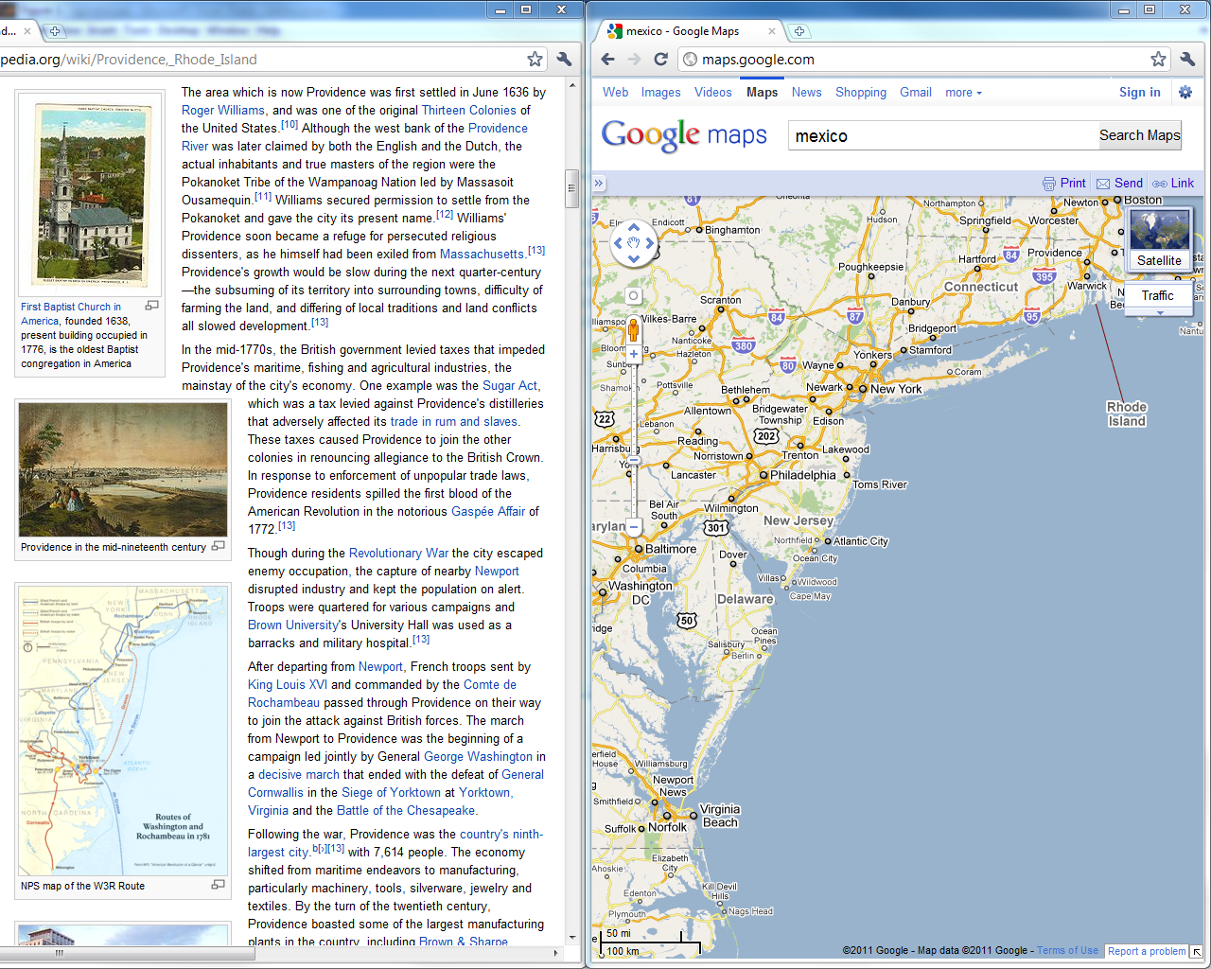
Notes:
Base representation
various highlighting techniques around

Slide 17
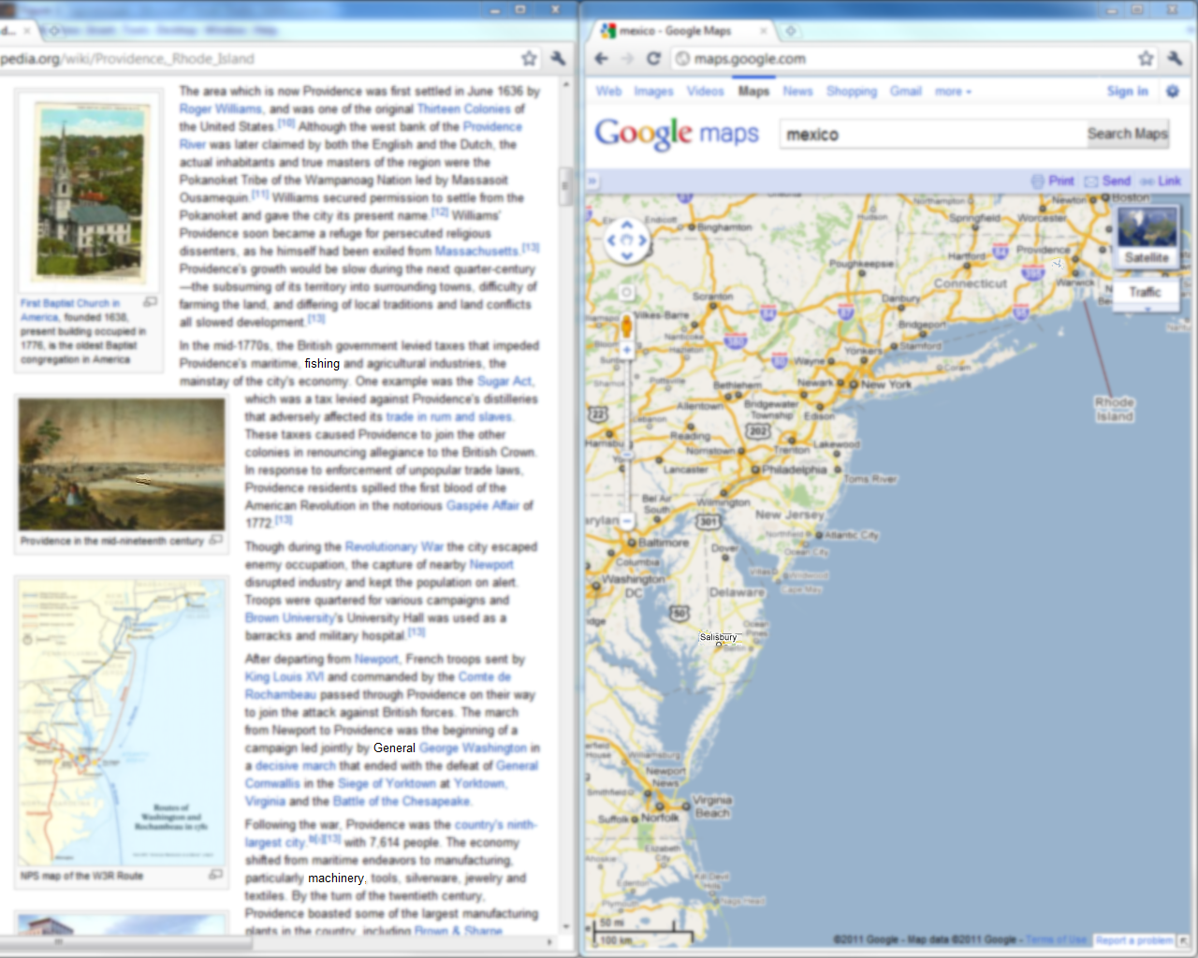
Blur Background

Slide 18
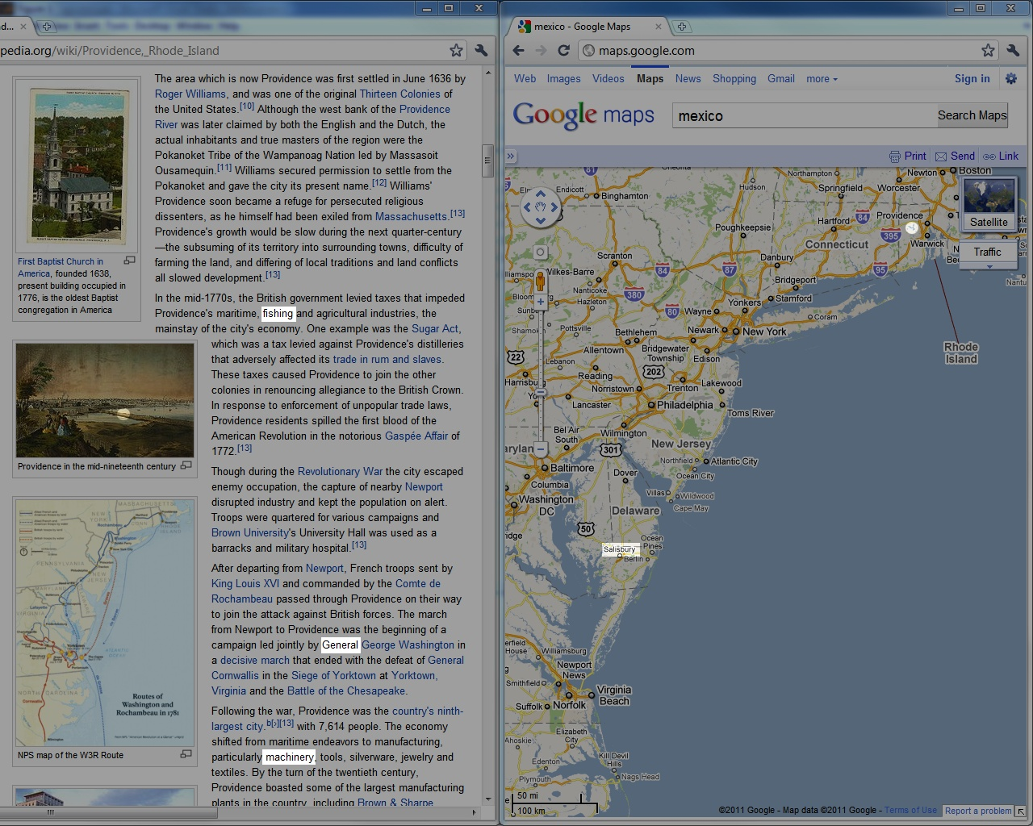
Darken Background

Slide 19
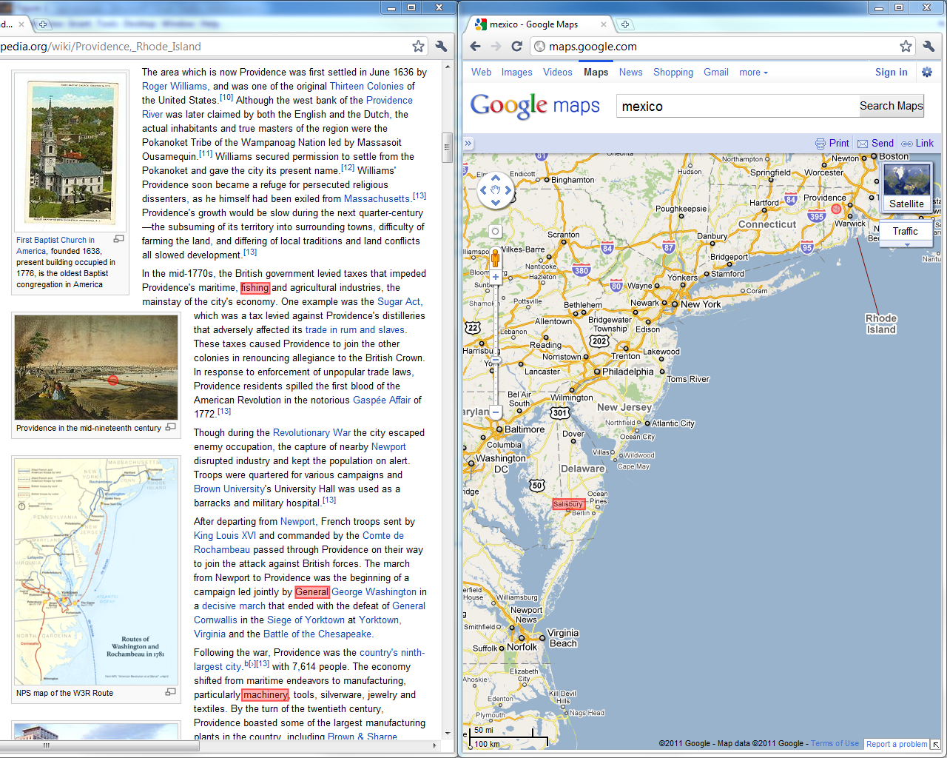
Change Color

Slide 20
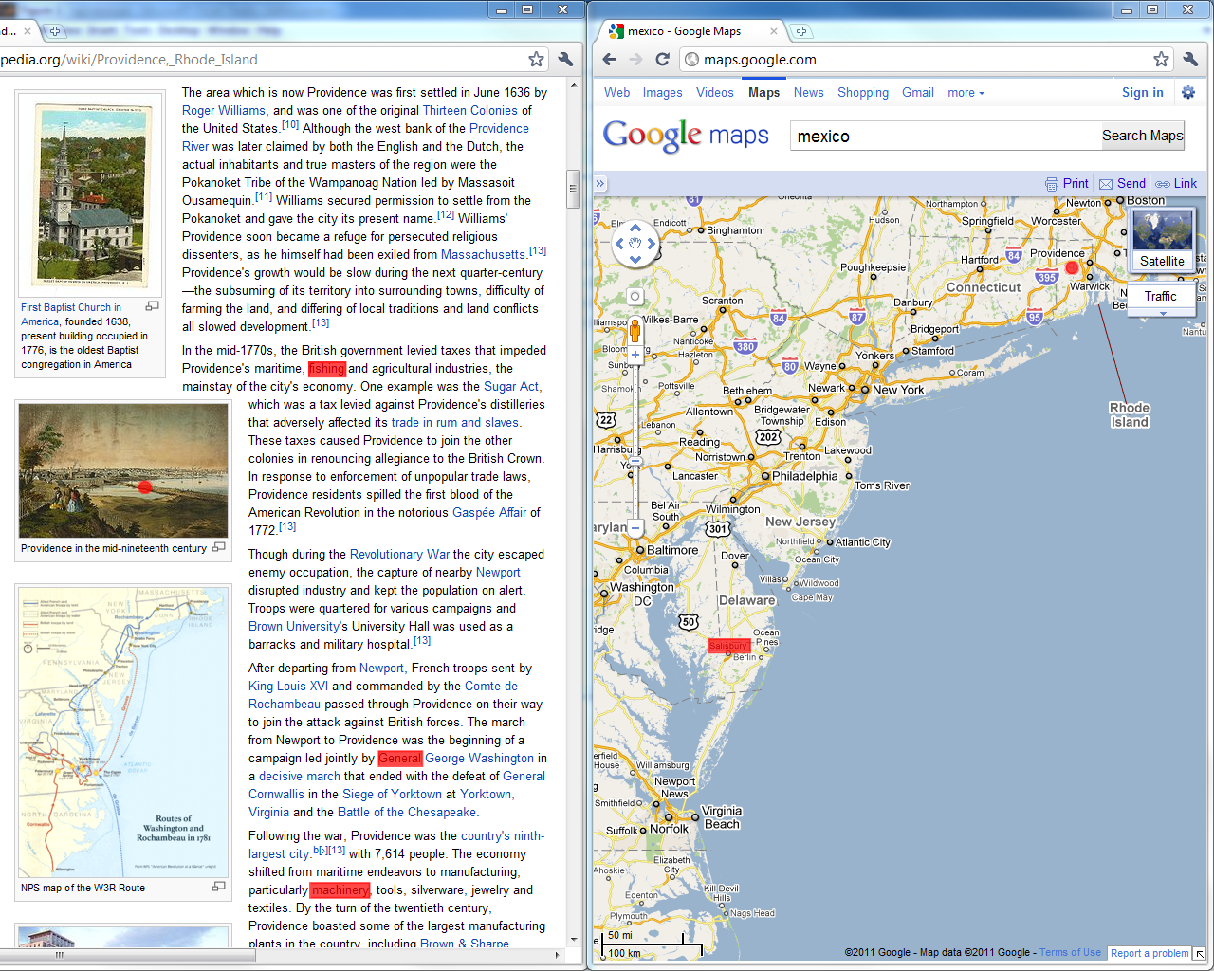
Blinking

Slide 21

Visual Linking
Notes:
Advantages for big screens (oder auch bei blinking)

Slide 22
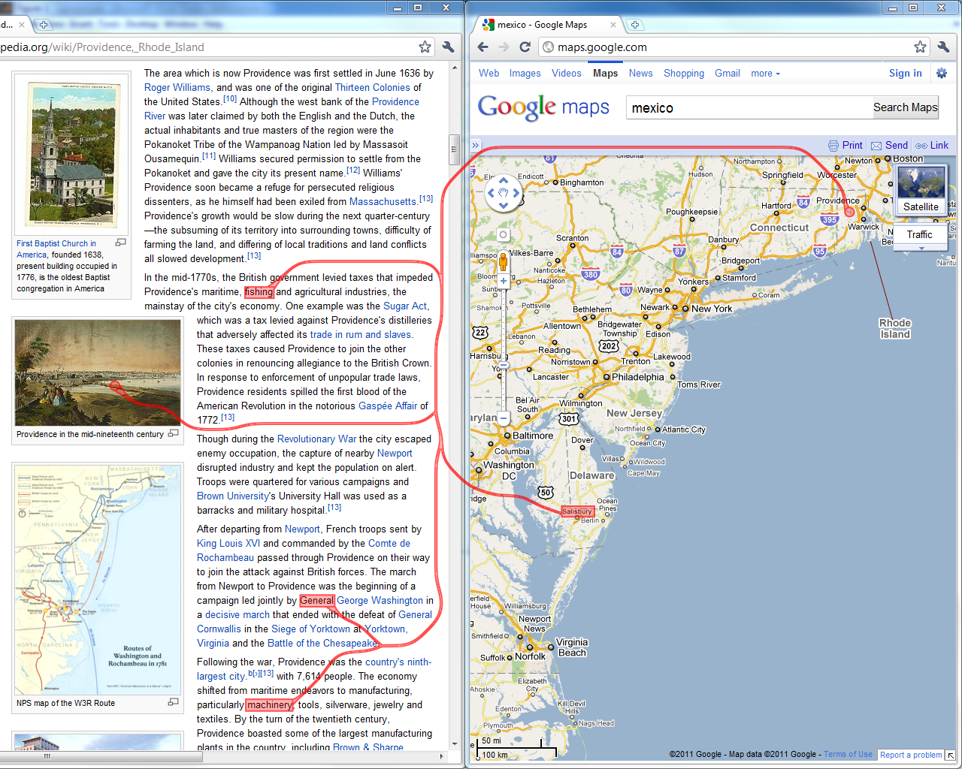
Routed Visual Linking

Slide 23
Part II: How to Link?
Similarity (Gestalt principle, Wertheimer 1923)
Proximity (Gestalt principle, Wertheimer 1923)
Connectedness (Palmer&Rock 1994)

Slide 24
About Ourselves: Alex Lex
PhD from Graz University of Technology
Post-doctoral Researcher at VCG@Harvard
Research Topics:
Visualizations with applications in molecular biology
Visual linking

Slide 25
Overview
PART 1: What to link? Defining Common Relations
PART 2: How to link?
Representing Relation on View Level
PART 3: When to link? Cases in which Linking is Beneficial

Slide 26


Part III: When to link?
Display 1
Display 2
Application 1
Application 2
Application 3
View 1
View 2
View 3
View 4
User 1
User 2
User 3

Slide 27
About Ourselves: Marc Streit
PhD from Graz University of Technology
Assistant Professor at Johannes Kepler University Linz
Visiting Researcher at Harvard Medical School
Research Topics:
Visual Analysis of Heterogeneous Data Focus: Biomolecular Data
Visual Linking
Caleydo (www.caleydo.org)

Slide 28
Overview
PART 1: What to link? Relations on Data, View, and Interaction Level
PART 2: How to link?
Representing Relation on View Level
PART 3: When to link? Application Areas that Benefit from Linking

Slide 29
Schedule
2:15 – 3:15 Part I: What to Link?
3:15 – 3:40 Part II: How to Link?
3:40 – 4:15 Coffe break
4:15 – 4:50 Part II: How to Link?
4:50 – 5:50 Part III: When to link?

Slide 30
What‘s your background?
Notes:
FEEL FREE TO INTERRUPT US AND ASK QUESTIONS

Slide 31
What‘s Next: What to Link by HANSI

Slide 32
Part I: What To Link?
Speaker: Hans-Jörg Schulz

Slide 33
Linking What Belongs Together
Fulfilling the criterion of being expressive, we want to link “stuff” that it is
Related, Associated, Connected, Affiliated,…
“When two objects, qualities, classes, or attributes, viewed together by the mind, are seen under some connexion, that connexion is called a relation.” —Augustus De Morgan (1858)

Slide 34
Linking What Belongs Together
Disclaimer: There appear to be cases in which the opposite is useful/done.
The EIRTEE*-Scenario
*Everything-Is-Related-To-Everything-Else

Slide 35
Relations
Definition: Relations assign true/false to a k-tuple.
Aspects to consider:
the cardinality k
the elements of the tuple
the domain in which the relation is defined

Slide 36
Relations: Cardinality
Cases:
k=0: tautology (TRUE) + contradiction (FALSE)
k=1: unary (property)
k=2: binary (is not necessarily a 1:1 relation!)
k>2: n-ary with n>2

Slide 37
Relations: Elements
We define relations over (some part of) data.
We assume a simple hierarchical data model:
{attrib₁,…,attrib_{i}} = data item
{item₁,…,item_{j}} = data cluster
{cluster₁,…,cluster_{k}} = data set
{set₁,…,set_{l}} = data landscape
The tuple elements are drawn from these levels.

Slide 38
Relations: Elements
A set of elements is defined by a granularity and a scope.
While the granularity defines the level of detail of the relation, scope defines its extent.
For example, relations can be established between data clusters (granularity), which are drawn either from an individual data set or from multiple data sets of a data landscape (scope).
Relation Scope level > Relation Granularity

Slide 39
Relations: Domain
While the relation is defined over the data domain, it may stem from any of the following:
Data Domain
View Domain
Interaction Domain
To identify the original Relationship Domain can sometimes be hard: Is data related because it is jointly interacted with, or is it jointly interacted with because it is related?

Slide 40
Relations put Together
Domain
Data
View
Interaction
Cardinality
binary
n-ary with n>2
Elements = Granularity + Scope
Data attributes
Data items
Data clusters
Data sets
Data landscape

Slide 41
Relationships: Other Aspects
Inherent vs. Derived
Transitivity, Directionality, Strength
Multiple relationships Example: coauthorship, citation, co-citation,…
Running between different
Data tuples, Data tables, Data bases
Graphical objects, Views, Applications

Slide 42
Relationships: Interrelations
Under certain circumstances, it is possible to transform relationships. For example:
n-ary relations on data item level → binary relations on data cluster level
(via the 1:n inclusion relation between items and cluster)

Slide 43
Relationships: Interrelations
Under certain circumstances, it is possible to transform relationships. For example:
n-ary relations on data item level → binary relations on data cluster level
relations derived from interaction domain → relations from data domain, if interaction logs are considered as additional data set
(via the 1:n inclusion relation between items and cluster)

Slide 44
Relationships: Examples
Example # | Description | Domain | Granularity | Scope | Cardinality
1 | ARGOIs | Data | Attributes | Data set | binary
2 | Graphs | Data | Items | Data set | binary
3 | Hypergraphs | Data | Items | Data set | n-ary
4 | Clustered Data | Data | Items | Data set | n-ary
5 | Matchmaker/VisBricks | Data | Clusters | Data set | binary
6 | StratomeX | Data | Clusters | Landscape | binary
7 | StratomeX: DVI | Data | Data Sets | Landscape | binary
8 | Spatial Treemaps | View | Attributes | Data set | binary
9 | Stack‘n‘Flip | Interaction | Data sets | Landscape | binary

Slide 45
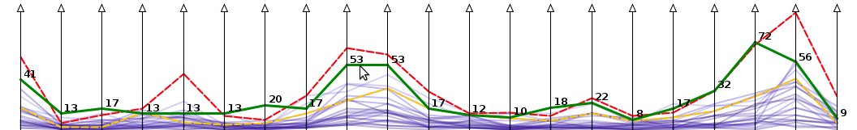
Example #1: ARGOIs
(Domain: Data, Elements: Attributes in Data Set, Cardinality: binary)
Relationship: two attributes are related, iff they belong to the same data tuple
Common visual representation: ParCoords
Image taken from Tominski+Schulz (2012)

Slide 46
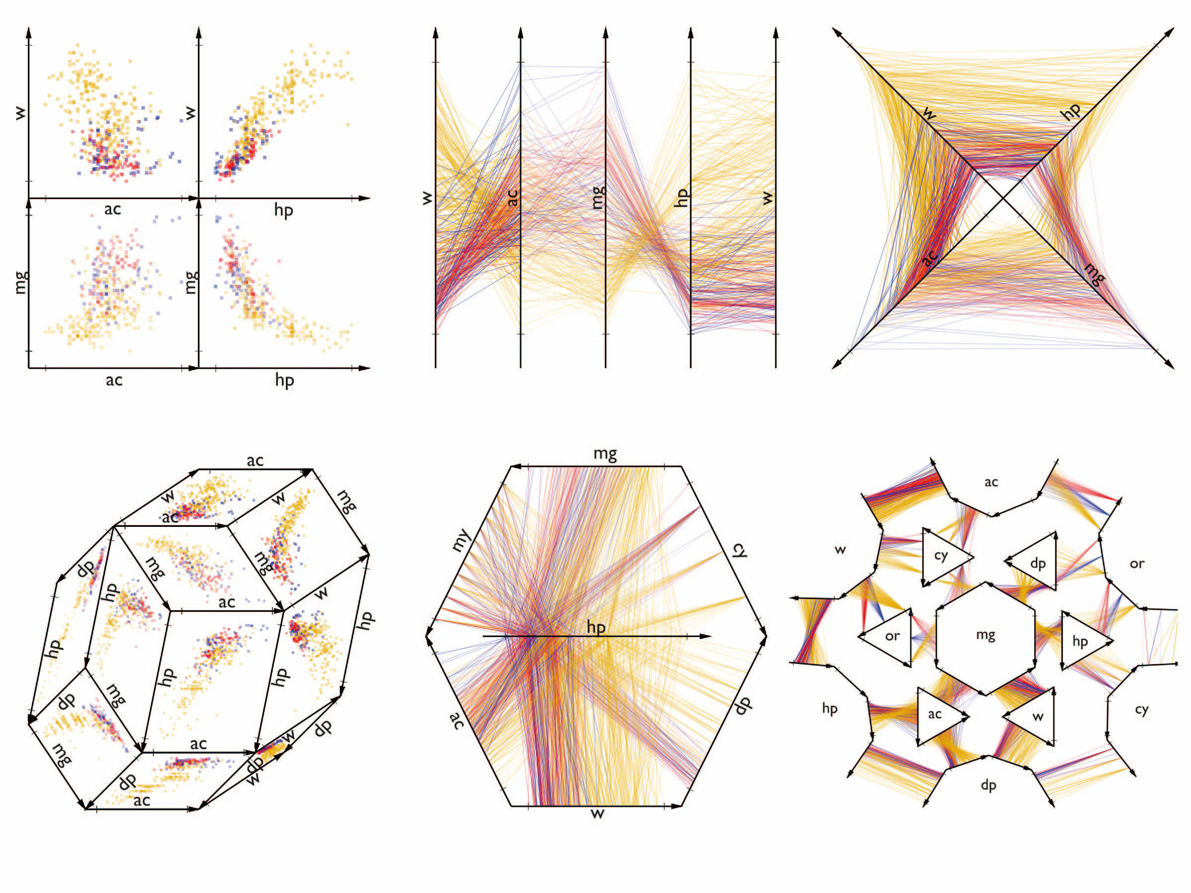
Example #1: ARGOIs
(Domain: Data, Elements: Attributes in Data Set, Cardinality: binary)
Generalization by Claessen+Wijk (2011):
A
B
C
D
A
A
B
C
B
D
Attribute Relation Graphs of Interest ARGOIs
A
D
C
G
E
F

Slide 47
Example #1: ARGOIs
(Domain: Data, Elements: Attributes in Data Set, Cardinality: binary)
Generalization by Claessen+Wijk (2011):
G
F
B
C
D
B
A
E
G
F
E
C
D
Straight-line planarity required!
Planarity required!

Slide 48
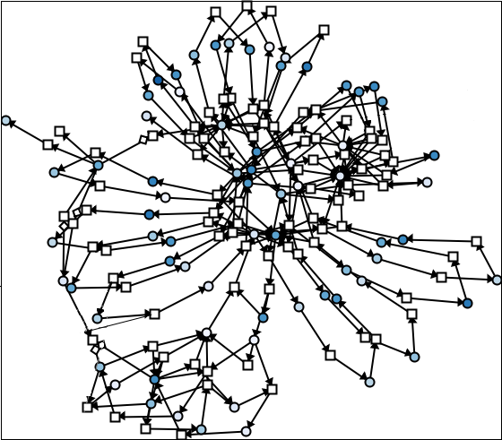
Example #2: Graphs
(Domain: Data, Elements: Items in Data Set, Cardinality: binary)
Relationship: two items are related, iff there exists an edge between them
Common visual representation: Node-Link-Diagram
Image taken from Hadlak, Schulz, Schumann (2011)

Slide 49
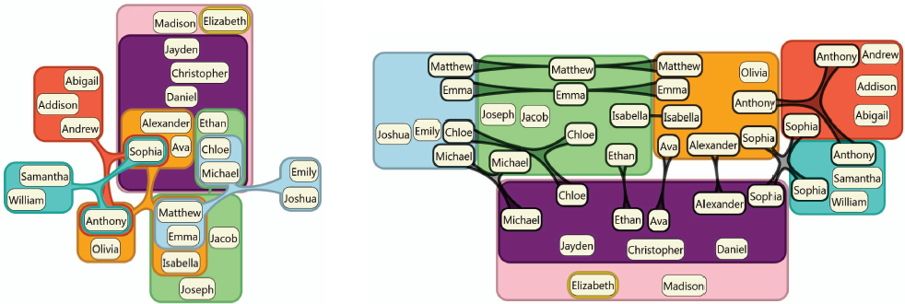
Example #3: Hypergraphs
(Domain: Data, Elements: Items in Data Set, Cardinality: n-ary)
Relationship: a number of items are related, iff there exists a hyperedge between them
Common visual representation: Euler-Diagram
Image taken from Riche+Dwyer (2010)

Slide 50
Example #3: Hypergraphs
(Domain: Data, Elements: Items in Data Set, Cardinality: n-ary)
Recall interrelationships
Hypergraphs can be transformed into regular graphs

Slide 51
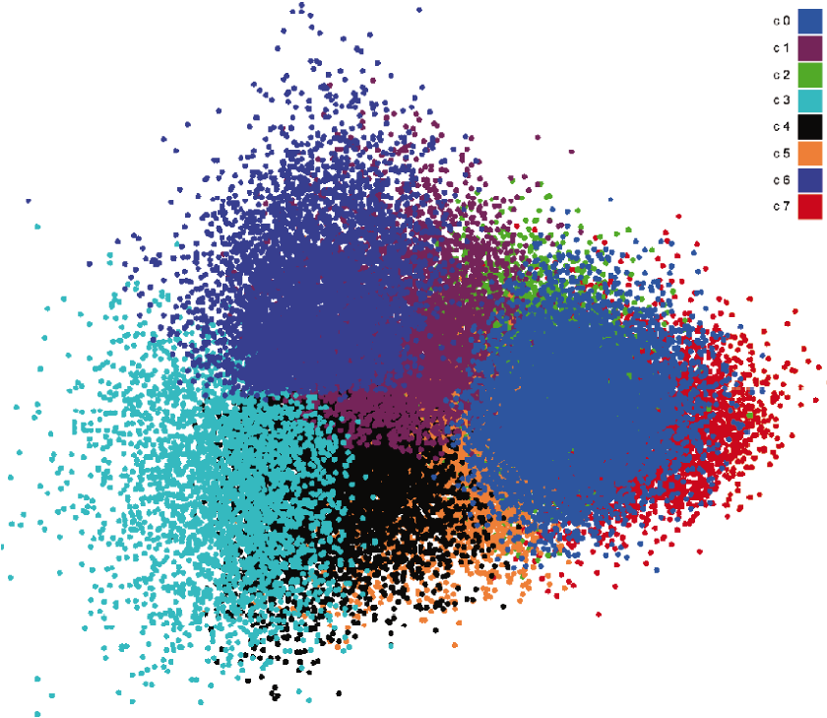
Example #4: Clustered Data
(Domain: Data, Elements: Items in Data Set, Cardinality: n-ary)
Relationship: a number of items are related, iff they belong to the same cluster
Common visual representation: Scatterplot
Image taken from Luboschik et al. (2010)

Slide 52
Example #4: Clustered Data
(Domain: Data, Elements: Items in Data Set, Cardinality: n-ary)
Clustering is the division of data into groups of similar objects.
given: a (dis-)similarity measure/matrix
n-dimensional, numerical data: Euclidean Distance
network data: Graph-theoretic Distance
strings of text: Edit Distance
sought: a grouping of the data w.r.t. that measure

Slide 53
Example #4: Clustered Data
(Domain: Data, Elements: Items in Data Set, Cardinality: n-ary)
What makes a good grouping?
Compact: elements in cluster are similar
Separated: clusters are different
Balanced: cluster membership is equally probable
Parsimonious: much fewer clusters than data objects
Source: Cosma Shalizi (2009)

Slide 54
Example #4: Clustered Data
(Domain: Data, Elements: Items in Data Set, Cardinality: n-ary)
Directionality of the clustering:
Top-down: divisive
Bottom-up: agglomerative
Linkage metrics:
Single Linkage: nearest neighbor
Complete Linkage: farthest neighbor
Average Linkage: all neighbors

Slide 55
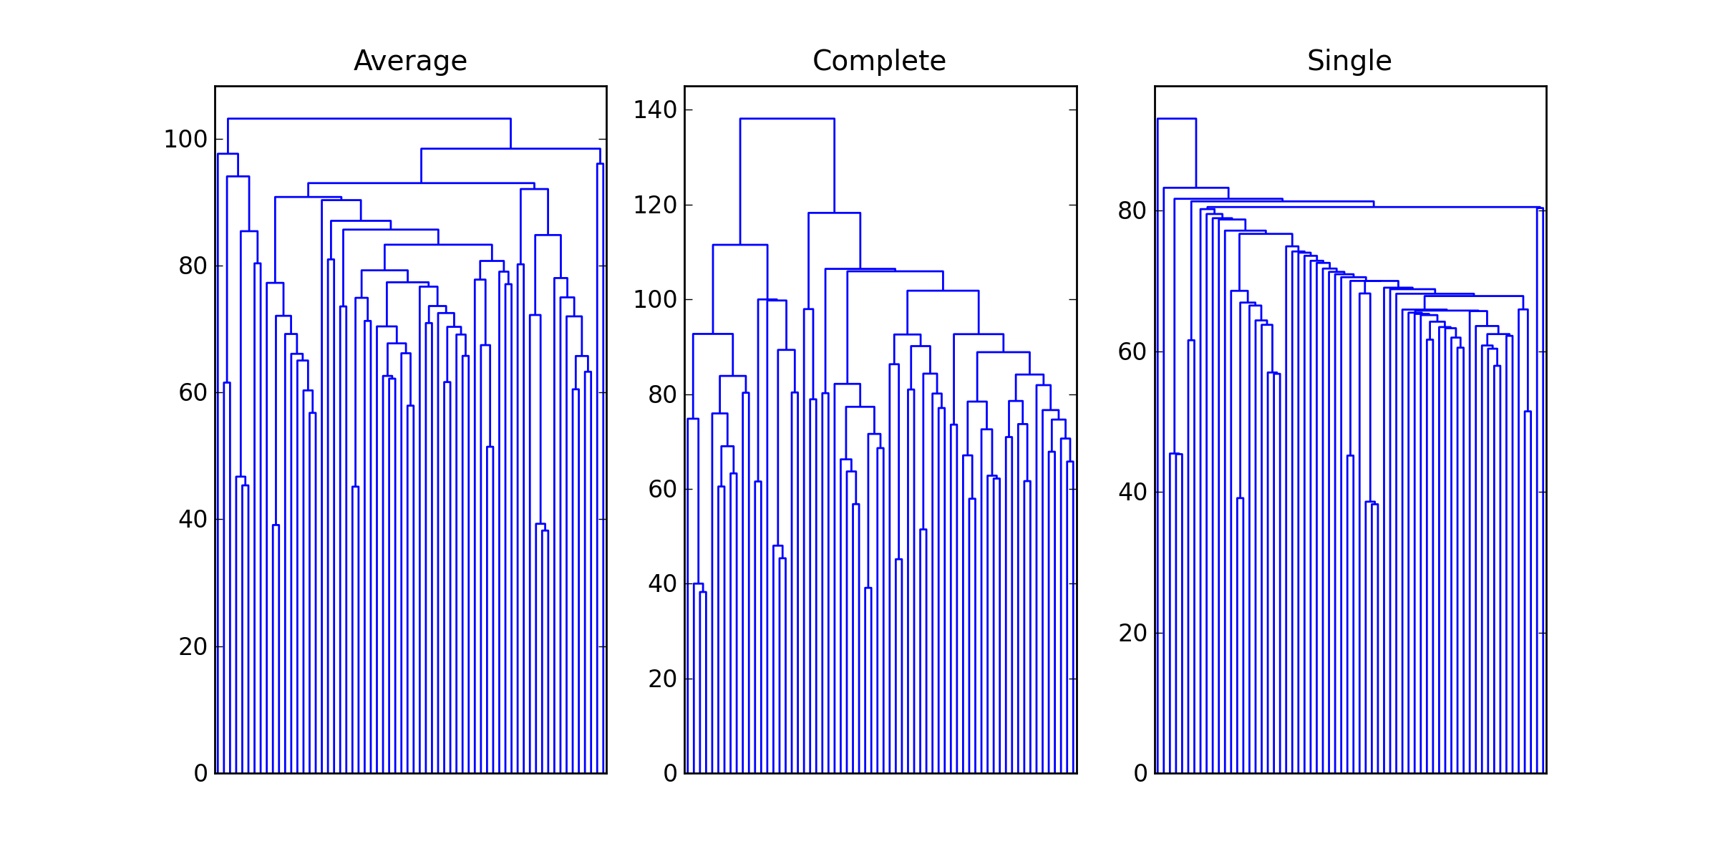
Example #4: Clustered Data
(Domain: Data, Elements: Items in Data Set, Cardinality: n-ary)
tends to construct small, evenly sized clusters
tends to construct chains of clusters
Images taken from Jonathan Taylor (2010)

Slide 56
Example #4: Clustered Data
(Domain: Data, Elements: Items in Data Set, Cardinality: n-ary)
Consensus Clustering
NP complete
Heuristics:
Quantitative/metric-based: CSPA Cluster-based Similarity Partitioning Algorithm
Structural/graph-based: HGPA Hyper-Graph Partitioning Algorithm

Slide 57
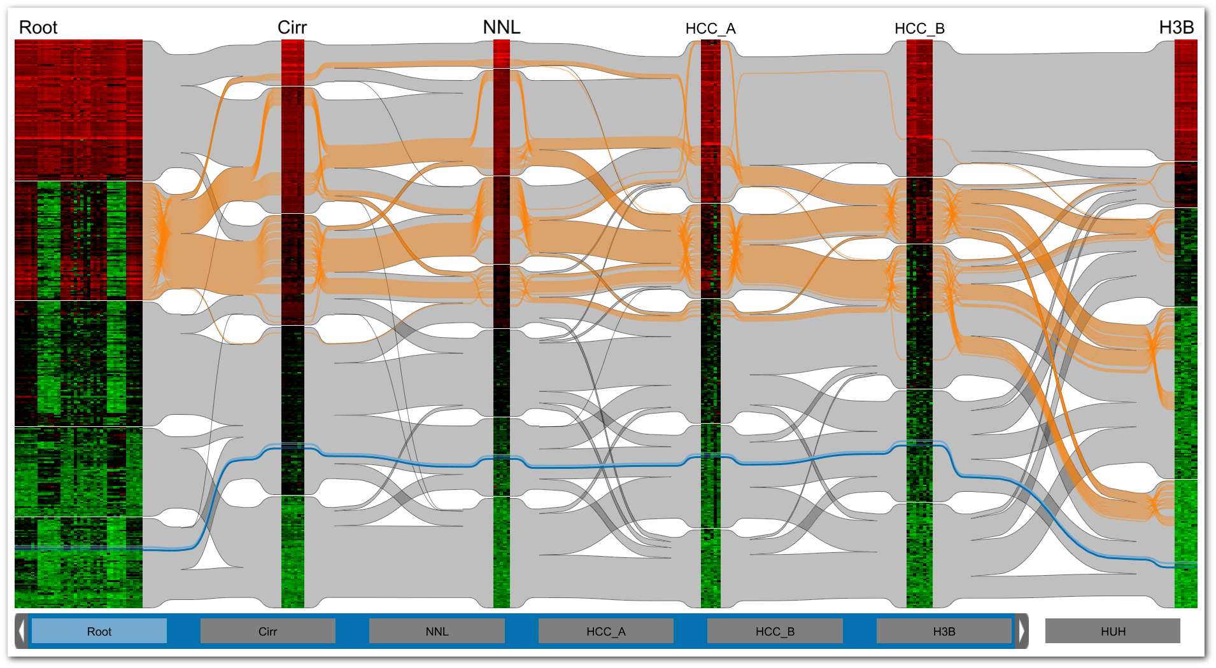
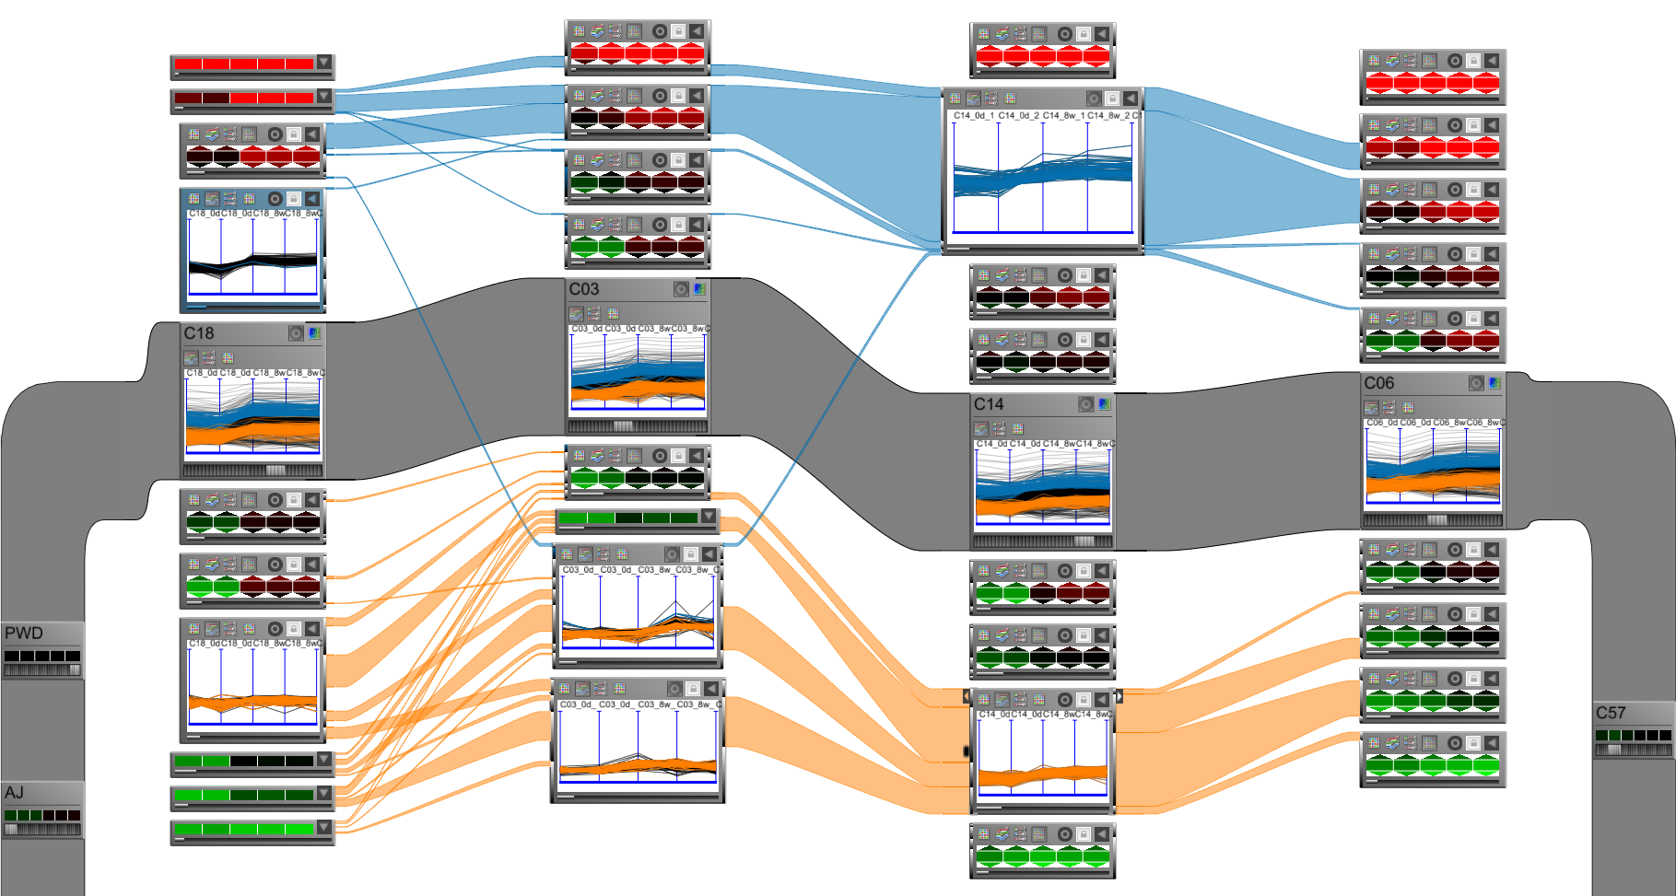
Example #5: Matchmaker/VisBricks
(Domain: Data, Elements: Clusters in Data Set, Cardinality: binary)
Relationship: two clusters are related, iff they share data items
Common visual representation: Ribbons
Image taken from Lex et al. (2010)
Image taken from Lex et al. (2011)

Slide 58
Example #5: Matchmaker/VisBricks
(Domain: Data, Elements: Clusters in Data Set, Cardinality: binary)
Matchmaker: Clusters of the whole data set
Image taken from Lex et al. (2010)

Slide 59
Example #5: Matchmaker/VisBricks
(Domain: Data, Elements: Clusters in Data Set, Cardinality: binary)
VisBricks: Clusters of dimensional subsets
Image taken from Lex et al. (2011)

Slide 60
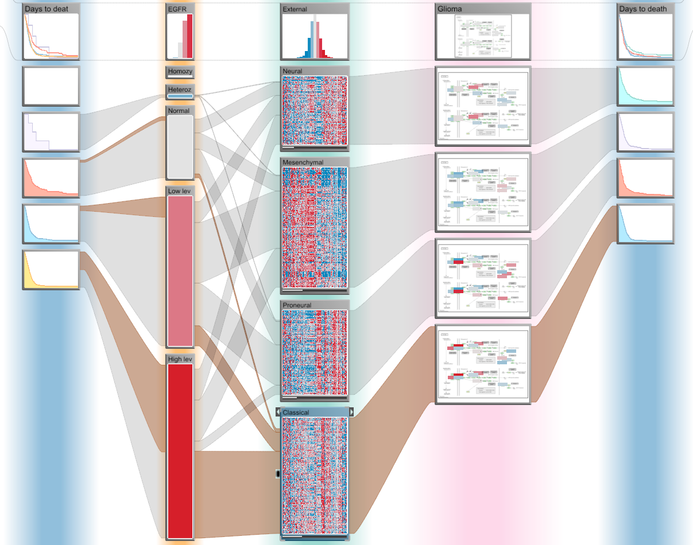
Example #6: StratomeX
(Domain: Data, Elements: Clusters in Landscape, Cardinality: binary)
Relationship: two clusters are related, iff they contain data with the same keys (IDs)
Common visual representation: Ribbons
Image taken from Lex et al. (2012)

Slide 61
Example #6: StratomeX
(Domain: Data, Elements: Clusters in Landscape, Cardinality: binary)
StratomeX: Clusters of different data sets
Image taken from Lex et al. (2012)

Slide 62
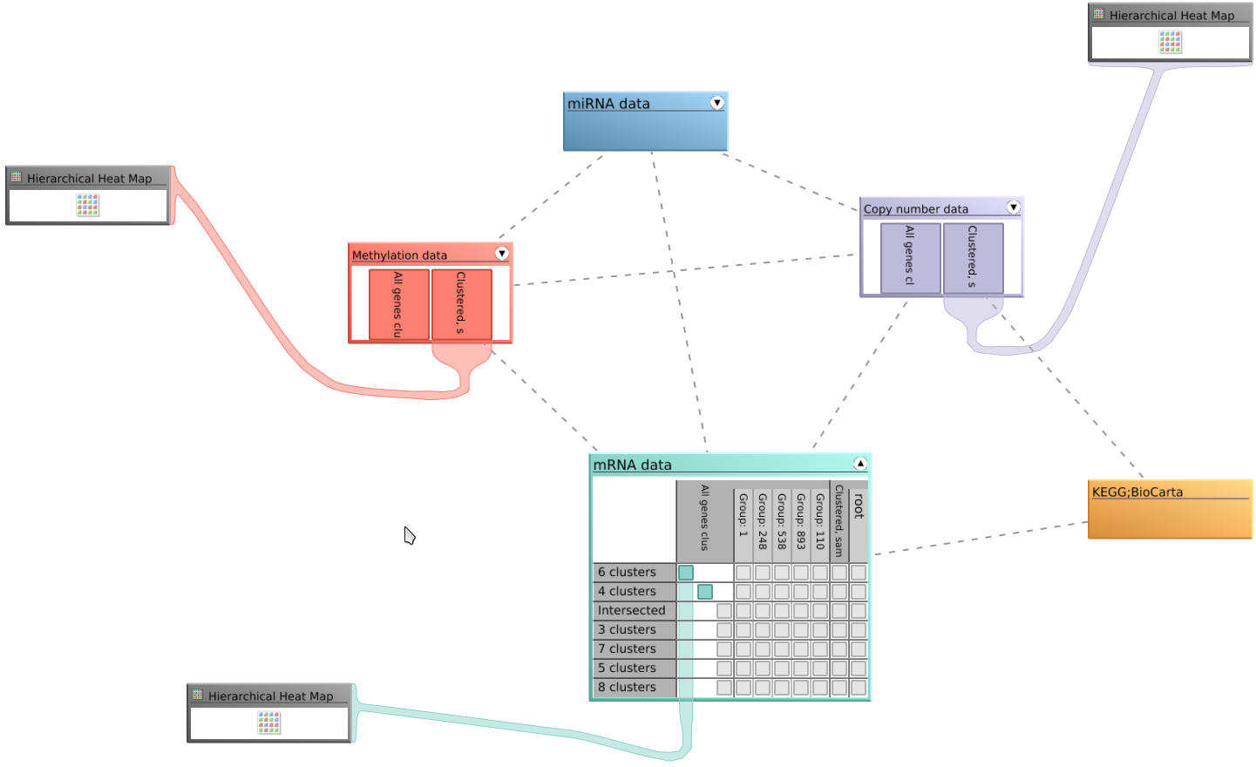
Example #7: StratomeX DVI
(Domain: Data, Elements: Data Sets in Landscape, Cardinality: binary)
Relationship: two data sets are related, iff they contain data with the same keys (IDs)
Common visual representation: Graph
Image taken from Lex et al. (2012)

Slide 63
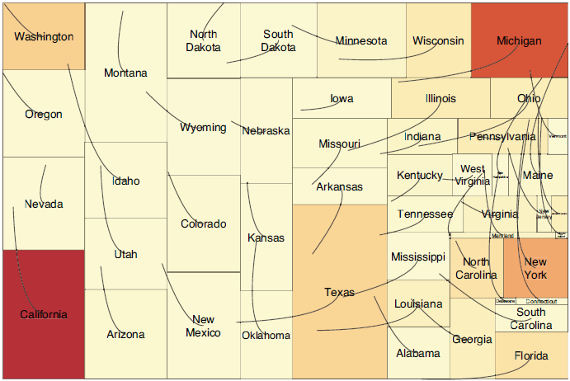
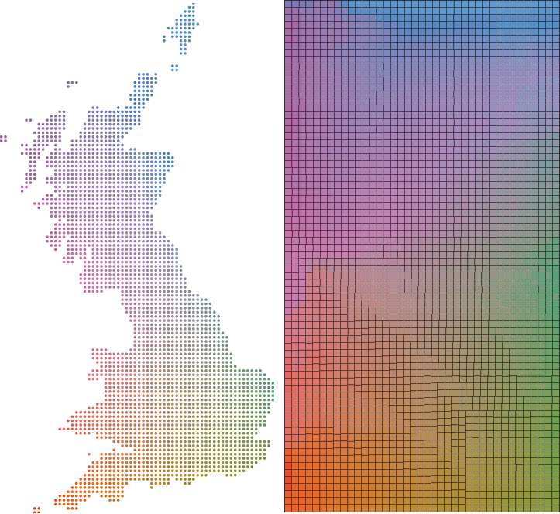

Example #8: Spatial Treemaps
(Domain: View, Elements: Attributes of Data Items, Cardinality: binary)
Relationship: two spatial positions are related, iff they both belong to the same data item
Common visual representation: Strokes and/or Color
Images taken from Wood+Dykes (2008)

Slide 64
Example #8: Spatial Treemaps
(Domain: View, Elements: Attributes of Data Items, Cardinality: binary)
Lines
Image taken from Wood+Dykes (2008)

Slide 65
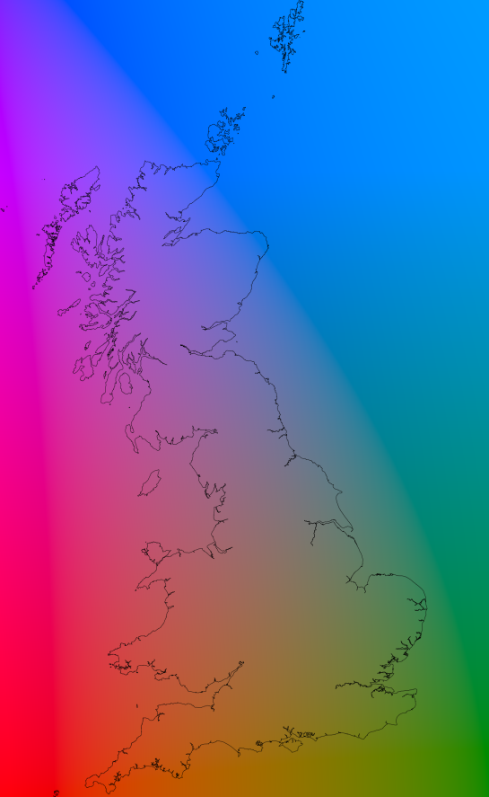
Example #8: Spatial Treemaps
(Domain: View, Elements: Attributes of Data Items, Cardinality: binary)
Color
Images taken from Wood+Dykes (2008)

Slide 66
Example #8: Spatial Treemaps
(Domain: View, Elements: Attributes of Data Items, Cardinality: binary)
Color+Lines
Images taken from Wood+Dykes (2008)

Slide 67
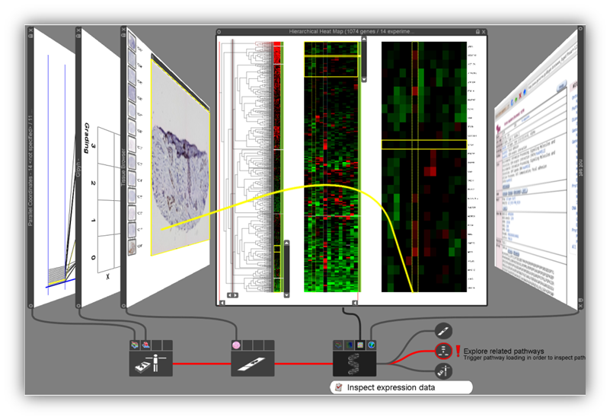
Example #9: Stack’n’Flip
(Domain: Interaction, Elements: Data Sets in Landscape, Cardinality: binary)
Relationship: two data sets are related, iff they are used in sequence
Common visual representation: Graph
Image taken from Streit et al. (2012)

Slide 68
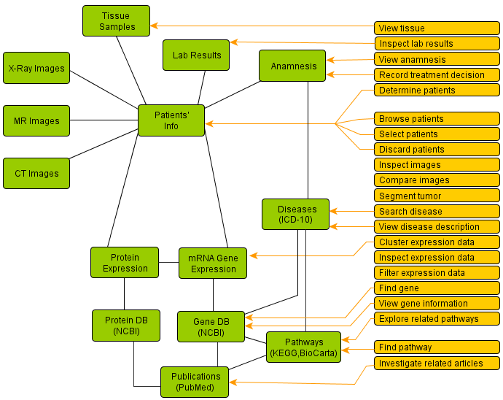
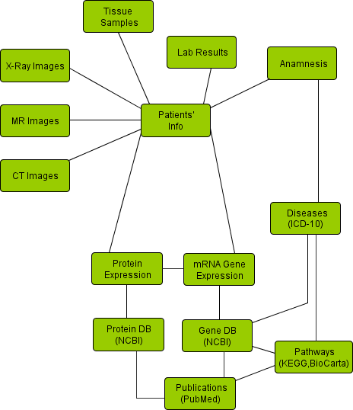
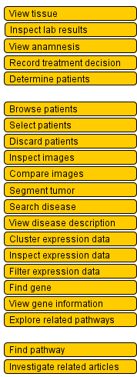
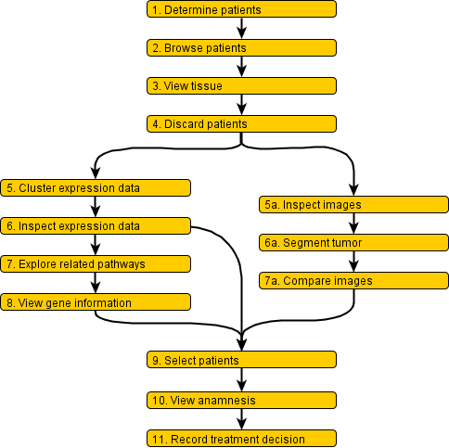
Example #9: Stack’n’Flip
(Domain: Interaction, Elements: Data Sets in Landscape, Cardinality: binary)
Images taken from Streit et al. (2012)

Slide 69
Example #9: Stack’n’Flip
(Domain: Interaction, Elements: Data Sets in Landscape, Cardinality: binary)
Image taken from Streit et al. (2012)

Slide 70
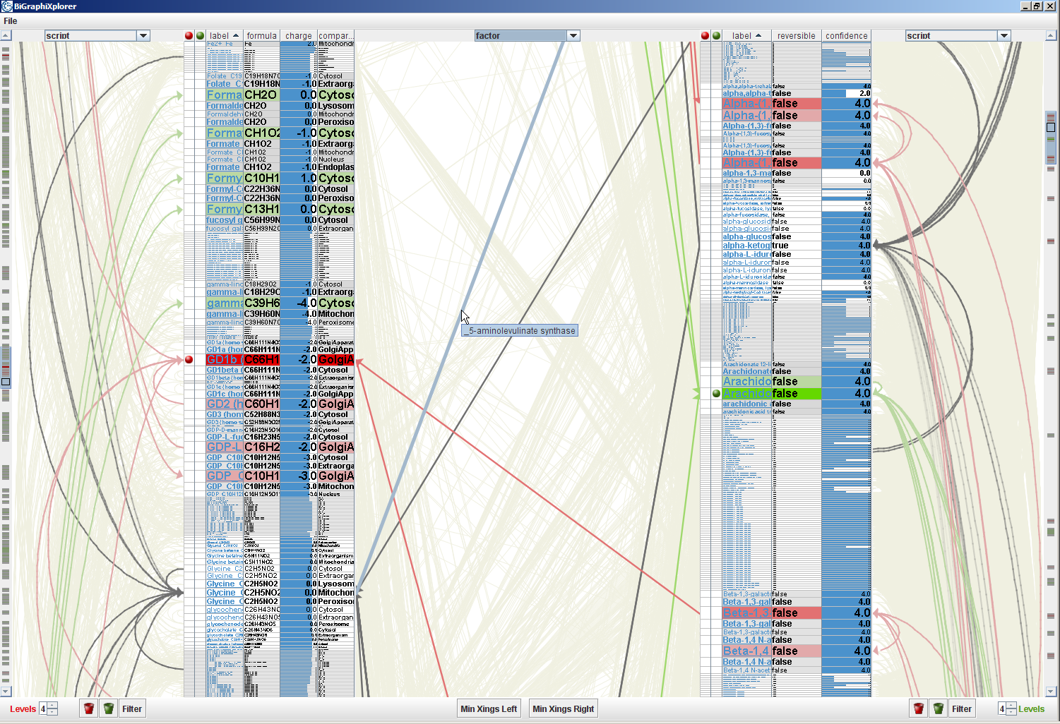
Edge-based Traveling
Using Relations for Interaction
Clicking an edge with one off-screen end leads automatically towards it
Tooltip indicates details about the off-screen node
Image taken from Schulz et al. (2008)

Slide 71
What to do with a relation?
Represent in data space: e.g., multidimensional data → graph → use standard graph visualization
Represent in view space:
This is what “Part 2: How to Link” is all about!

Slide 72
Part II: HOw To Link?
Speaker: Alexander Lex

Slide 73
Schedule
3:15 – 3:40 First half
3:40 – 4:15 Coffe break
4:15 – 4:50 Second half
4:50 – 5:50 When to link? By Marc Streit

Slide 74
Contents
1. Discussion of objectives, definitions
2. Establishing quality criteria
3. Brief introduction to most linking techniques
4. Detailed discussion of selected linking techniques
5. Details on techniques that employ connectedness

Slide 75
Linking Objective
Express a relationship between n entities, which is not obvious from the visual encoding.
Supplementary relationships, e.g., based on
brushing
clustering
derived relationship
Consequence:
must work in supplement to the primary visual encoding, the base representation (BR).

Slide 76
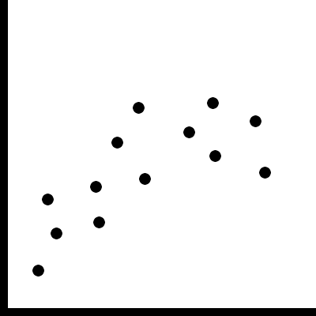
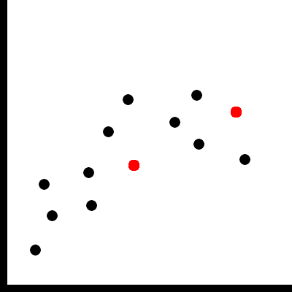
Base Representation (BR)…
… is a visualization or an image which is meaningful by itself
… may be adapted to enable linking
Base Representation
with supplemented links

Slide 77
How To Link?
Linking of information based on perceptual grouping principles.
Gestalt principles [Wertheimer, 1923] and recent extensions
Good resource for grouping principles and other issues of perception:
http://www.csc.ncsu.edu/faculty/healey/PP/index.html
By Christopher G. Healey

Slide 78
Quality Attributes for Links (1/2)
Scalability for # items
How many items can be linked for one relation?
Scalability for # relations
How many relationships can be shown at the same time?
Perception issues
Can the links be perceived easily or “preattentively”?
Can all entities belonging to a relationship be easily identified?

Slide 79
Quality Attributes for Links (2/2)
Occlusion issues
Is the base representation preserved?
Compatibility to base representation?
Is the choice of visual encoding for a link suitable for the encoding of the base representation?
Practical/Implementation issues?
Easy to implement?
Efficient to implement?
Notes:
It might be acceptable to (partially)
occlude
modify
the base representation
Not all forms of encoding visual links work with all encodings in a BR

Slide 80
Quality Attributes Online
http://connecting-the-dots.caleydo.org

Slide 81
Critique: Visual Encoding Conventions
Good, suitable, feature inherent!
Limiting, but good technique might address the problem.
Limiting, but may work under certain circumstances.
Severely limiting, no (known) solution.

Slide 82
Three Major Classes of Links
Proximity
Similarity
Connectedness

Slide 83
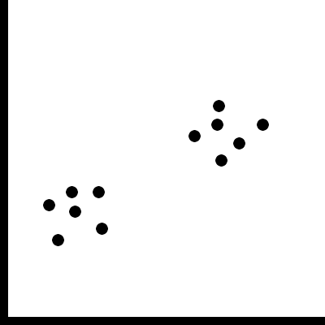
Proximity
Grouping/linking by placing entities in close proximity

Slide 84
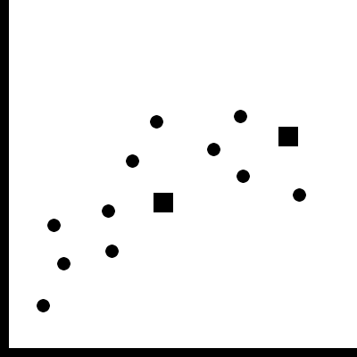
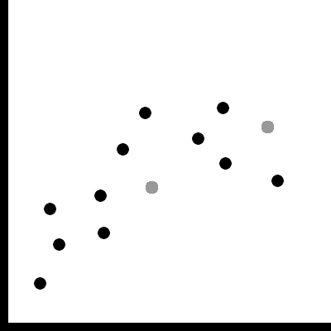
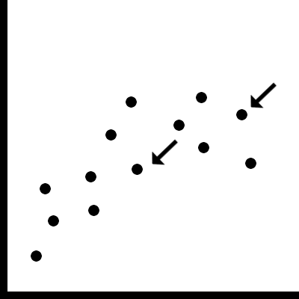
Similarity
Co-modulation of a visual-variable [Bertin 1974]
color, shape, size, value, orientation, texture, …
Adding a glyph, label, frame, background
Color
Shape
Value
Glyph

Slide 85
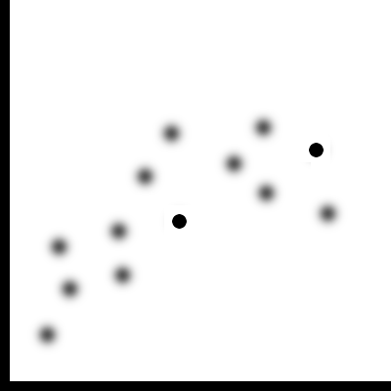
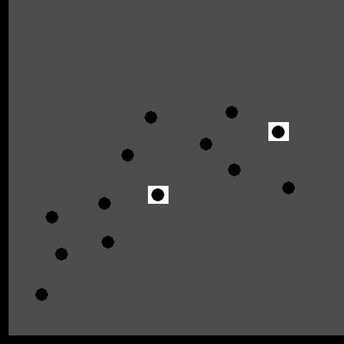
Similarity
Modulate everything else
Blurring, darkening, desaturating, etc.
Blur
Darkening

Slide 86
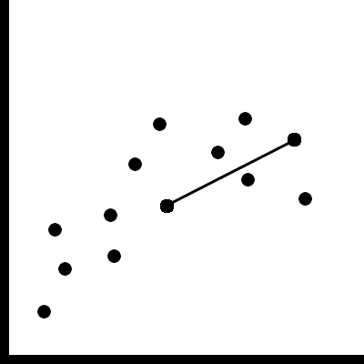
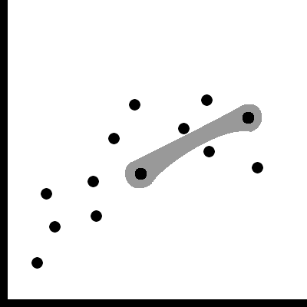
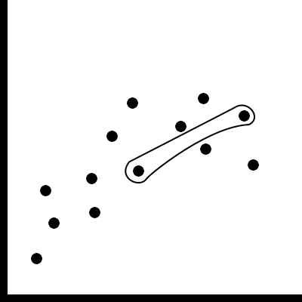
Connectedness and Common Region
Connected items with a line or curve
Surround items with a outline, surface, volume
Connectedness
Surface
Outline
Common Region

Slide 87
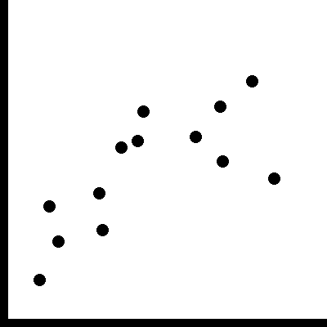
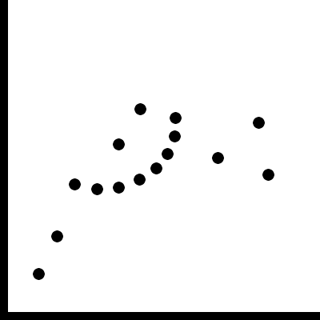
The “obscure” grouping principles
“Obscure” in terms of applicability for linking
Common fate
motion in the same direction
Good Continuation
arrange items on a line / curve
in consequences similar to position but more limited

Slide 88
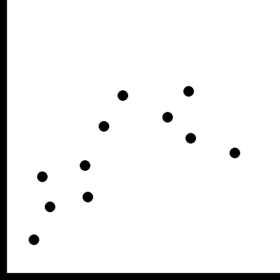
The “obscure” grouping principles
Flicker
Works well for a few items
Grabs your attention
Often perceived annoying

Slide 89
Proximity

Slide 90
Proximity
Scalability for # items: very good
Scalability for # relations: very good
Perception: very good
Occlusion issues: not really
Practical/implementation issues: not really
Notes:
Scalability:
very many items
Can become „tight“ if good grouping criteria is not fulfiled – as hansi explained
Compact: elements in cluster are similar
Separated: clusters are different
Balanced: cluster membership is equally probable
Parsimonious: much fewer clusters than data objects

Slide 91
Proximity: Compatibility to BR
Problematic because:
position is „the best“ visual variable → in very many cases used as a primary encoding
adding relationships (e.g. by brushing) triggers significant rearrangement
difficult to keep up mental map

Slide 92
Proximity Uses
Is used only when position is variable
e.g., in graphs using a node-link layout
e.g., when using projection/MDS methods: to emphasize individual dimensions
e.g., sorting in a table

Slide 93
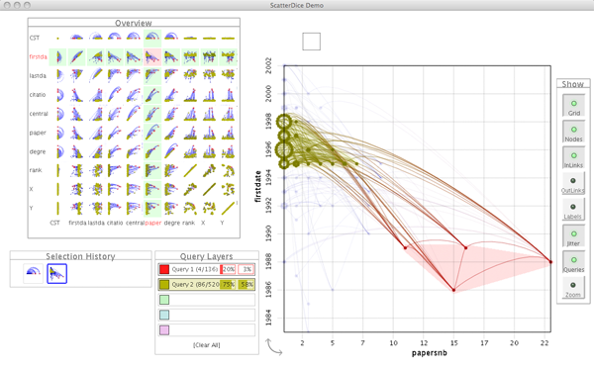
Proximity in Graphs
GraphDice
System to see relationships between large quantities of node attributes in graphs
[Brezerianos et al., 2010]
Notes:
Inria/Purdue @ EuroVis 2010

Slide 94
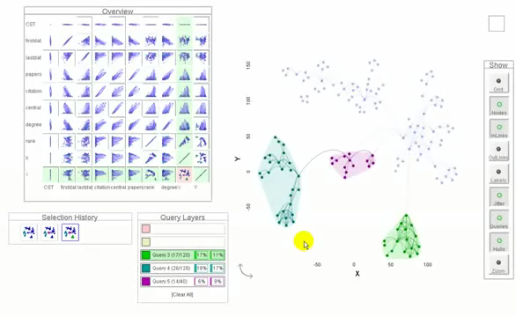
Proximity - Graph Dice
[Brezerianos et al., 2010]

Slide 95
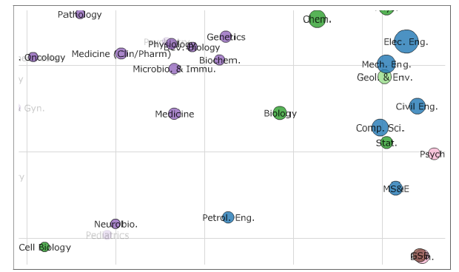

Proximity - MDS
Topical distances between depratments in a 2D projection
Topical distances between the selected Petroleum Engineering and the others.
[Chuang et al., 2012]
Notes:
Sandford group @ CHI 2012

Slide 96

Proximity - Sorting
Table-Lens sorted according to one dimension.
Bi-partite graph with tabular display for node attributes.
[Rao and Card, 1994]
[Schulz et al., 2008]
Notes:
Table Lens: CHI
Hansi: VCBM

Slide 97
Proximity Reccomendation
Use proximity if your primary visual encoding doesn‘t use position.
Proximity is also often combined with other visual encodings for links.
Notes:
dual encoding makes it more obvious, trustworthy
common example: observable clustering in scatterplot is enhanced by color

Slide 98
Similarity

Slide 99
Similarity - Color
Scalability for # items: very good
Scalability for # relations: limited (7-8 colors can be easily distinguished)
Occlusion issues: not really
Compatibility to BR: good if color is „free“
Practical/implementation issues: not really

Slide 100

Color – Perception Issues (1/2)
Preattentive properties: Very good for 1-2 simultaneous, serial search for more

Slide 101
Color – Perception Issues (2/2)
Slower in a cluttered environment
Size of colored object relevant.
Notes:
Point to hidden dot on picture

Slide 102
Color Reccomendation
Use color if
position is already used
you expect large numbers of elements
you expect a limited number of simultaneous relationships
Be careful if
the BR is cluttered
its important that no entity is overlooked

Slide 103
Value / Saturation / Transparency
Value / Saturation / Transparency
Similar to color
Lower # of relations
Influences visibility
Often used for binary selections/filters

Slide 104



Color/Value Modulation Examples
[Hauser et al., 2002]
[Doleisch , 2007]
[Johansson et al. , 2007]

Slide 105
Other Modulation-Based Similarity
Shape
Less easily perceived than color.
Better for larger # of relations, but doesn’t work preattentively.
Less flexible – requires a scatterplot-like setup
e.g.: exchange symbol used in a scatterplot
Requires a minimum size of a mark
Size
Problematic for larger # of relations.
May lead to occlusions.
e.g.: make line in PC plot thicker
Notes:
Shape:
e.g. you know a lot of shapes from symbols, traffic signs and
they are obvious to distinquish
Doesn‘t work for many encodings – e.g. Parallel coordinates plots, line charts, theme-river, etc
Size:
works for highlighting individual items

Slide 106
Other Modulation-Based Similarity
Orientation
Special requirements on the mark and on the BR
-> limitations of shape apply
Texture
Special requirements on the mark
Minimum size of mark
Notes:
Orientation:
you have to have marks that have a clear orientation. A dot, for example, does not
Texture:
Putting texture on a pc plot will be difficult – but could be done – i.e. stippling

Slide 107
Similarity based on Supplementation
Glyph, label
Same problems as for shape
Scalability for # relations: very good
Scalability for # items: bad, introduces additional clutter
Frame & background
Often combined with color to counter-balance small/thin features of mark otherwise binary only
Notes:
Only that instead of directly exchanging a mark an exiting mark is supplemented

Slide 108
Similarity based on Modulating Everything Else
Blurring, darkening the surrounding
Perception: good
Scalability # items: very good
Scalability # relations: practically only 1 possible
Compatibility to BR: BR may become hard/impossible to read
Practical issues: blur sometimes difficult to implement
Notes:
Perception:
depends also on the BR
works good with items with clear edges – glyphs, lines,
not so good with heat maps, etc

Slide 109


Modulating Everything Else: Reccomendation, Example
Don‘t use unless the sole objective is to guide attention toward one (set of) items
[Zhai et al., 1997]
[Kosara et al., 2002]

Slide 110
Connectedness and Common Region

Slide 111
Connectedness
Scalability for # items: ok, special measures for many
Scalability for # relations: difficult if # items is non-trivial
Occlusion issues: problematic if no special measures are taken
Notes:
@Occlusion – links add a lot of „ink“

Slide 112
A Little Experiment…
Proximity
Color
Size
Shape

Slide 113


Connectedness
Perception issues:
Connections can be perceived preattentively
Very strong grouping principle
Good at pointing at outliers
Practical Issues:
Basic implementation trivial & fast
Counter-balancing for the mentioned issues comes at a cost
Notes:
Perception:
Even works for elements outside of field of view

Slide 114
Common Region
Very similar to Connectedness
At what point is a line an area?
More „ink“ necessary
Reduces possible # items and # relations
Increases saliency
Alternative if edges already used
Can be used with transparency to preserve BR

Slide 115

Connectedness Varieties
Bubble Sets
Line Sets
Kelp Diagrams
Image by [Dinkla et al., 2011] Technique by [Collins et al.,2009]
[Alper et al., 2011]
[Dinkla et al., 2012]

Slide 116


Bubble Sets
[Collins et al., 2009]
[Partl et al., 2012]

Slide 117


Bubble Sets
How it works:
Approach: connect nodes through virtual edges (route around obstacles) and compute a contour from this initial polyline
[Collins et al., 2009]
Positive (red) and negative (blue) energy fields, which guide the construction of the contour

Slide 118

“Advanced” Euler Diagrams
Compact Rectangular
Euler Diagrams
Euler Diagrams
with Duplicates
[Riche & Dwyer, 2010]

Slide 119


Compact Rectangular Euler Diagrams
How it works:
start with an edge representation, use a force directed layout and transform from edges to shapes
[Riche & Dwyer, 2010]

Slide 120


Compact Rectangular Euler Diagrams
How it works:
[Riche & Dwyer, 2010]

Slide 121
Addressing Scalability, Occlusion Issues
Scalability:
Using abstraction
Bundling
Occlusion
Modifying the BR
Routing
Notes:
Only these two fullfill the „supplementing“ critereon for linking

Slide 122


Bundling - HEB
Hierarchical Edge Bundling (HEB)
Can be used for links within a tree.
[Holten, 2006]
Notes:
Example: Software System and Call Graph
Notice that the layout of the base representation is suitable to this type of linking

Slide 123

Bundling - HEB
How it works:
[Holten, 2006]

Slide 124

Bundling - HEB
The underlying structure
[Holten, 2006]

Slide 125


Bundling - FEB
Force-Directed Edge Bundling
[Holten & van Wijk, 2009]

Slide 126




Bundling - FEB
How it works:
Edge Comaptibility
Angle
Length
Position
Visibility
[Holten & van Wijk, 2009]

Slide 127


Other Bundling Approaches
Skeleton-based edge bundling
based on Clustering
Agglomerative bundling
minimizing ink (collapsing edges in proximity)
[Esroy et al., 2011]
[Gansner et al., 2011]
Notes:
Skeleton:
edges are clustered,
shapes for the clusters created,
skeleton for the cluster calcolated
edges attracted to skeleton

Slide 128
Routing
Case Study Context-Preserving Visual Links
Material based on InfoVis 2011 Talk by Markus Steinberger

Slide 129
Again a little experiment ;) …

Slide 130
Notes:
Base representation
various highlighting techniques around

Slide 135
What is the problem?
Notes:
Advantages sagen für großen screen (oder auch bei blinking)

Slide 136
Context-Preserving Visual Links

Slide 137










Design Goals: Optimal link routes…
minimal length
minimal occluded information
visually distinguishable
unnecessary link-segments are avoided (bundling)

Slide 138

Tradeoff

Slide 139
System Overview
Penalty Map Creation
Routing
Rendering

Slide 140

Important Content
Bottom-Up Visual Saliency [Itti 98]
Based on human visual system
What stands out in images
Ignores high-level cognitive system
Notes:
Base on contrast

Slide 141


Saliency for a complex scene

Slide 142


Color Similarity
Non-fixed link color: choose distinguishable color
Otherwise: compute color similarity for every region
Requires base representation as image

Slide 143



Highlight Regions
Avoid highlight regions and their surrounding
Realized by using blurred version of highlight regions

Slide 144




Other Link Sets
To support multiple linksets, we require a fixed priority among the linksets
Add high priority links as regions to avoid

Slide 145

Combined Penalties
+
=

Slide 146
System Overview
Penalty Map Creation
Routing
Rendering

Slide 147



Routing
Multiple source shortest path problem
Penalty map for crossing different regions
Discretized version
Modified version of Dijkstra‘s Algorithm
Notes:
Additional pic (rendered)

Slide 148

Technique applied to Caleydo

Slide 149
Evaluation: Hypothesis
Visual links lead to a better performance than conventional highlights.
Context-preserving visual links do not have a negative impact on performance.
Context-preserving visual links have a positive impact on user satisfaction.

Slide 150






Task: Visual Search
Count number of highlight regions (5 to 12)
Correctness and speed
Variety of visualizations
Eye-Tracker
Context information not required for task
Notes:
… pathways?

Slide 151



Three Techniques
Frame/color based highlighting
Straight Visual Links
Context-Preserving Visual Links

Slide 152

Results
Visual links lead to a better performance than conventional highlights.
Context-preserving visual links do not have a negative impact on performance.
Notes:
Check significance

Slide 153



Gaze Plots
Context-Preserving Visual Links
Straight Visual Links
Frame based highlighting
Notes:
Show highlight regions also

Slide 154

Results
Context-preserving visual links have a positive impact on user satisfaction.

Slide 155
Context-Preserving Visual Links Summary
Context-preserving visual links …
… avoid occlusion of important content in the BR
… can be adjusted to visually stand out from the BR
… do not harm performance when compared to non-routed visual links

Slide 156
Connectedness Reccomendation
Use connectedness if:
You need the additional ink to make the links stand out from the BR
You want to show many different relationships (e.g. as in a graph)
You can not easily modulate the visual rep of the items
You want to make sure that nothing is overlooked

Slide 157
Connectedness Reccomendation
Be careful if:
You only have a handful of classes but a high # items
You need a very fast implementation
Making connectedness run efficiently is often not trivial!
Notes:
eg. brushing in PCS, scatterplots

Slide 158
What‘s Next: When to Link? by Marc

Slide 159
Part III: WHEN to LINK?
Speaker: Marc Streit
Notes:
Scenarios when linking can be applied

Slide 160
Heterogeneity of Linking
Display 1
Display 2
Application 1
Application 2
Application 3
View 1
View 2
View 3
View 4
User 1
User 2
User 3

Slide 161
Clarification
Part III orthogonal to Part I and II
Could be linking on data/view/interaction level
Could be any linking technique

Slide 162
View vs. Visualization
Visualization
Visual representation that
is based on (non-visual) data
produces an image
is readable and recognizable
View
Physical display space (most often 2D) where a visual structure is rendered
[Kosara 2008]
[Card, Mackinlay and Shneiderman 1999]

Slide 163

Single Visualization
Showing a single relationship in the data
D3.js Line Chart Example
Notes:
D3 = Data Driven Documents
D3.js is a JavaScript library for manipulating documents based on data. D3 helps you bring data to life using HTML, SVG and CSS. D3’s emphasis on web standards gives you the full capabilities of modern browsers without tying yourself to a proprietary framework, combining powerful visualization components and a data-driven approach to DOM manipulation.
Tutorial today in the morning sessions

Slide 164
Composite Visualization Views (CVV)
[Javed and Elmqvist 2012]
Create new visualizations by combining different visualizations
Juxtaposition (Integrated Views)
Superimposition
Overloading
Nesting
Notes:
Design patterns

Slide 165

Composite Visualization Views (CVV)
[Javed and Elmqvist 2012]
Notes:
Bar chart + scatterplot

Slide 166
Linking WITHIN a Single View
Display 1
Display 2
Application 1
Application 2
Application 3
View 1
View 2
View 3
View 4
User 1
User 2
User 3

Slide 167
Composite Vis: Superimposition
Overlay of two or more visual spaces on top of each other
1:1 spatial linking

Slide 168

Superimposition Example
Superimposition
With several data series
D3.js Interactive Line Graph Example

Slide 169
Base Representation with Supplemented Links
Superimposition
Color
Shape
Value
Glyph

Slide 170




Example: Graphical Overlays
Superimposition
[Kong and Agrawala 2012]
2nd InfoVis Session on Wednesday
More examples: http://vis.berkeley.edu/papers/grover

Slide 171

Visual Comparison Inspired by Natural Behavior
Superimposition
1st InfoVis session on Thursday
FoldableVis [Tominski et al. 2012]
Notes:
interaction techniques that assist in con-
ducting comparison tasks for table-based and matrix-based visual
representations.
Temporarily fold layers away

Slide 172
Composite Vis: Overloading
One visualization rendered inside another visualization
Host / client visualization
Same spatial mapping
No 1:1 spatial linkling
Notes:
While previous design patterns have all operated on speciﬁc
views of component visualizations, overloaded views (and also the
next pattern, Nested Views) operate on the visual structure themselves. In other words, it is no longer possible to merely use visual layout operations to organize the views together, but the visual structures themselves must be modiﬁed to combine the components. We will see examples of this below

Slide 173



Overloading Examples
Overloading
Treemap Overlay [Fekete et al. 2003]
HEB [Holten et al. 2006]
[Collins et al. 2009]
Notes:
graph links are not just a separate
layer on top of the treemap, but they are embedded into the visual
structure of the treemap and use the node positions as anchors.

Slide 174
Linking Across Multiple Views
Display 1
Display 2
Application 1
Application 2
Application 3
View 1
View 2
View 3
View 4
User 1
User 2
User 3

Slide 175
Composite Vis: Juxtaposition
Show visualizations in a side-by-side fashion
Very prominent paradigm

Slide 176
Manual Comparison
Juxtaposition
Cognitive work

Slide 177


Multiple Coordinated Views
Juxtaposition
Actions in one view can be related to other view
Premise: View and interact with data through different representations
Coordination on diff. levels
[Colins and Carpendale 2007]
LinkWinds [Jacobson et al. 1994]

Slide 178



Linking & Brushing
Juxtaposition
Linking: Coordination between views
Brushing: Select groups of data points
Geometric functions such as:
Rectangles, angles, free-form, lassos, etc.
Can be composite (AND, OR)
Can be continuous (smooth brush)
[Doleisch et al. 2004]
[Hauser et al. 2002]

Slide 179

Coordination on Different Levels
Juxtaposition
Most Common Types
Brushing
Navigational slaving (transformation, rotation)
Instead: coordinate on all levels of Vis Pipeline
[Boukhelifa et al. 2003]

Slide 180

MCV Type 1
Juxtaposition
Different visualization techniques showing the same data
SimVis [Doleisch 2004]

Slide 181



MCV Type 2: Small Multiples
Juxtaposition
Same visualization technique showing different data
[Tufte 1993]
Cerebral [Barsky et al. 2008]
Rolling the Dice [Elmqvist et al. 2008]

Slide 182
Guidelines for Using MCV
Juxtaposition
Rules on how to use multiple views → see [Baldonado et al. 2000]
Cost-Benefit Tradeoffs
Cognitive aspect
The time and effort required to learn the system
The load on the user’s working memory
The effort required for comparison
The effort required for context switching
System aspect
Computational requirements
Display space requirements
Notes:
Rule of Diversity
Use multiple views when there is a diversity of
attributes, models, user profiles, levels of abstraction, or genres.
Rule of Complementarity
Use multiple views when different views bring
out correlations and/or disparities.
Rule of Decomposition
Partition complex data into multiple views to
create manageable chunks and to provide insight
into the interaction among different dimensions.
Rule of Parsimony
Use multiple views minimally.

Slide 183
Composite Vis: Integrated Views
Visual composition is the same as for juxtaposition
Adds explicit visual links

Slide 184

Semantic Substrates
Integrated Views
[Shneiderman and Aris, 2006]
Graph results in a too complex visualization to interpret
User-defined semantic subsets
Visual links connecting identical items across visualizations
Single visualization Single relationship

Slide 185


VisLink
Integrated Views
[Collins and Carpendale 2007]
Multiple relationships / datasets
Multiple visualizations
Inter-plane edges

Slide 186

Connected Charts
Integrated Views
[Viau and McGuffin 2012]
Notes:
Relationships between multiple charts
A ConnectedChart showing a text table, bar charts, parallel coordinate axes, and scatterplots.

Slide 187

Connected Charts
Integrated Views
[Viau and McGuffin 2012]
Notes:
A ConnectedChart with four barcharts, and a scatterplot, displaying 5 dependent variables that are functions of time.
In this case, GPU temperature is a smooth, slowly varying function of time, hence the connection between the scatterplot’s
horizontal axis and the barchart below it exhibits an interesting, continuous variation. (Synthetic data set.)

Slide 188



Further Integrated View Examples
[Risch et al. 1996]
Microsoft patent [Höllerer et al. 2007]
Interconnected Pathways [Streit et al. 2007]

Slide 189
Combined Vis: Nesting
Client visualizations nested inside host visualization
Single or multi view?
Depends on perspective
Notes:
Nested views, like overloaded views, are also based on the notion of
host and client visualizations. However, in this design pattern, one
or more client visualizations are nested inside the visual marks of
the host visualizations, based on the relational linking between the
points. Most often, the nesting is performed simply by replacing
the visual marks in the host visualization by nested instances of the
client visualization.

Slide 190

Example 1: Nodetrix
Nesting
[Henry et al. 2007]
Single or composite visualization?

Slide 191

Example 2: VisBricks
Nesting
[Lex et al. 2011]
Single or composite visualization?
Notes:
Handle more data

Slide 192

Example 3: Jigsaw List View
[Stasko et al. 2008]
Single or composite visualization?
Notes:
Distinction often not clear

Slide 193
Linking ACROSS Applications
Display 1
Display 2
Application 1
Application 2
Application 3
Visualization 1
Visualization 2
Visualization 3
Visualization 4
User 1
User 2
User 3

Slide 194


Domain specific specializations:
Banking, Consumer Packaged Goods, Education, Game Design, Government, Healthcare, Insurance, Manufacturing, Oil And Gas, Real Estate, Retail, Securities And Investments, Communications

Slide 195


Jigsaw
[Stasko et al. 2007]
Notes:
Examples from scientific community
List: relations between people, places,

Slide 196



Caleydo
[Partl et al. 2012]
[Streit et al. 2012]
[Lex et al. 2012]

Slide 197

Super Application?
Super Application that can visualize everything
Not Feasible! Solution: use existing applications
Downsides:
not integrated
no highlighting, linking, etc.
Can we solve this?
Notes:
Clinical scenarios
Design decision: should we really integrate a volume viewer in Caleydo? Answer: no, not our focus nor our expertise
Eierlegende wollmilchsau = swiss army knife

Slide 198

Snap-Together Visualizations
Juxtaposition
[North and Shneiderman 2000]
Linking & brushing across multiple applications
Notes:
Connected via a central database
Snap-together: API based on COM, database for synchronization across applications → load, select (synchronized highlighting), synchronized scrolling – our focus: visualizing the relationships between selected items on a crowded desktop
A coordinated visualization environment for exploring Census data of U.S. states and counties, dynamically
constructed using Snap-Together Visualization. Users can explore states from nominal, geographic, and numeric perspectives
using the outliner, map, and scatter plot. Selecting a state displays detailed county and industry information for that state in
the table and Treemap on the right. Selecting Maryland on the map reveals a fairly high ranking in Per Capita Income in the
plot, and immediately reveals in the Treemap that the Services industry in Montgomery County is responsible for a major
portion of that income.

Slide 199


Visual Linking Across Applications
[Waldner, GI 2010] – best paper award
Manuela Waldner

Slide 200

Motivation
Notes:
200
Large, high resolution displays: people usually do not maximize content (wasting display space)
This gets even more

Slide 201


Notes:
201
They rather „carefully coordinate“ their windows on the available screen space
Windows can be arranged so all relevant information is simultaneously visible → results in large amount of visible information
Example:
Planning a trip to a conference:
- web browser with conference website
- web browser with travel information on the country
- map to see where it is exactly located
- and other windows not contributing to this task, but still visible
Comparing information across application windows requires the user to manually search for relevant items, which is exhaustive and error-prone
Visual links:
- connection lines linking related data items across application windows
- strong visual cue to guide attention to relevant (peripheral) display regions and secondary windows contributing to primary task

Slide 202


Visual Links Across Applications
Notes:
202
How do visual links across applications work?
Consider a set of applications which may contribute to the information analysis task
The user registers all these applications to a central management process
The management process is based on the Tomcat Java Application Server.
Communication between the manager and the applications is accomplished HTTP-based → web-browser applications can directly communicate

Slide 203


Triggering Selections
Determined by individual application
Notes:
203
To trigger visual links, the user needs to select an item of interest
How this selection is triggered depends on the application
Examples:
- mouse-over or mouse click
- search boxes
- text selection

Slide 204

Visual Links Across Applications
Notes:
204

Slide 205

Visual Links Across Applications
Notes:
205
The application where the input has been registered sends the selection ID – in this case „Canada“, which the user has entered into a search box – to the management process.
It also reports:
- the application name
- the selection area(s) where occurrences of the search term have been found in application A
The management process then dristributes the selection ID („Canada“) to all remaining registered applications
Applications report selection regions
Then they report back the identified regions to the links manager

Slide 206


Selection Mapping
Applications evaluate incoming selection ID
Notes:
206
The applications now have to map the incoming term onto screen regions
Examples:
- where the string occurs in a text
- query for geospatial location and setting a location on the map window

Slide 207

Visual Links Across Applications
Notes:
207
The application where the input has been registered sends the selection ID – in this case „Canada“, which the user has entered into a search box – to the management process.
It also reports:
- the application name
- the selection area(s) where occurrences of the search term have been found in application A
The management process then dristributes the selection ID („Canada“) to all remaining registered applications
Applications report selection regions
Then they report back the identified regions to the links manager

Slide 208

Visual Links Across Applications
Selection regions are collected and sent to renderer
Notes:
208
As soon as every application has reported back, the collected regions are sent to the renderer application
Each reported region is assigned to a container, which corresponds to the window extents of the application window
Plugin for Linux compositing window manager „Compiz“

Slide 209







Design of Visual Links Across Apps
Notes:
209
Example:
- 4 windows, each containing some regions
- some „invisible“ region (e.g. Content which is currently not visible because it is scrolled away)
- mouse pointer indicates the region where the user has started the request
Step 1:
- all regions in the „source“ window (where user is currently interacting) are connected to the center of gravity of all regions
- this „bundling point“ is where links to all other windows will emerge
- we do this, because we assume the center of interest of the user is currently on this window
Step 2:
- from the center point in the source window, connection lines are calculated to the center points in the target windows
Step 3:
- these lines are intersected with the window boundaries → bundling points for target windows
Step 4:
- from target window bundling points, connections to target regions are calculated
Step 5:
- we avoid intersections with selection regions so valueable information is not hidden by links
- lines are curved around regions resulting in shortest non-intersecting route
- now we still need to treat the invisible regions
Step 6:
- we indicate the existence of hidden regions by drawing arrows at the window boundaries
- arrows show in 4 directions
- length of arrow codes the number of hidden elements

Slide 210

Design of Visual Links
Notes:
210

Slide 211


Design of Visual Links
Notes:
211
Visual links introduce some clutter on the desktop
It is unlikely that users want to see the full links at any time
After a user-defined period, links fade to a user-given alpha value – can be brought back by a keyboard shortcut at any time
Can be switched completely off (and on again) at any time

Slide 212
Application Integration
Application support
Direct support
Software extensions (plug-ins)
Mashup application
OCR‏
Notes:
212
Applications using visual links have to use the visual links software API
- they have to register and report the visible window region
- they have to provide a user interface to trigger selections
- process incoming selection IDs and map them to regions within the application window (and report these regions as a response to the requst)
- report changes in window content (e.g. If the content is scrolled) so visual links can be re-calculated
We created examples for all three support mechanisms
Application integration can either
- directly support the API (i.e. Integration into existing software)
- be used as mashup
- be extended through a plug-in
Direct support: full access to user interface and information → elaborate interaction techniques and sophisticated ID mapping
Mashup: re-using powerful APIs, integration of sophisticated user interface but ID mapping limited to existing API
Plug-ins: access to arbitrary data and high number of application scenarios – many tools can be extended this way (e.g. Web browser, office tools) but information access and user interface options are limited

Slide 213

Direct Application Support
Extending Caleydo visualization framework
Internal highlighting → coordinates are sent to manager
Notes:
213
3) Direct support: visualization framework
Extending the existing Caleydo visualization framework: multiple coordinated views originating from biomedical domain but can also treat arbitrary data
Brushing and linking; synchronized highlighting
Item selection by moving the mouse pointer over an element
Integrating selection mechanism in visual links API → incoming and outgoing selections

Slide 214

Software Extension
Mozilla Firefox web browser add-on
Access to DOM of HTML-document
Temporarily enclosing selection ID with <span>-tag
Notes:
214
Software Extension
Add-on for popular web browser Mozilla Firefox
Add-ons have full access to document object model of the displayed HTML-document
Processing incoming request: searching DOM for search string and finding region by temporarily enclosing string with <span> tag
Report selections: selecting word in browser and pressing a button integrated in toolbar

Slide 215

Mashup Application
HTML-page utilizing JavaScript and Google Maps API
Geographic location associated with selection ID
Reports bounding rectangle around screen coordinates
Notes:
215
2) Mashup
Google maps API integrated in simple HTML-page with JavaScript
Processing incoming request: search Google Maps API and retrieving geographic location associated with string (first hit); API provides method to convert geographic location to window position; small bounding rectangle around window position
User interface: search box to enter search string → sending to Google Maps API

Slide 216
Usage Scenario: Biomedical Analysis
Notes:
216
Usage scenario 1:
Information from external sources can be integrated in the visualization framework
Example: information of genes on the web are linked to gene expression data visualized in different visual representations of the framework

Slide 217

Usage Scenario: Economic Statistics
Notes:
Usage scenario 2:
Data from other domains can be handled in special-purpose visualization framework
External applications are used as supportive views
Example: economic statistics data linked to world map → geographic information without integrating a map view into visualization framework

Slide 218

Soon Available: Routed Visual Links Across Apps
Light-weight app that renders on top of desktop
Real-time, OS-independent

Slide 219
What’s missing: Linking beyond Strings
Data
Abstractions
Selections
Intermediate processing results
Meta-data
Groups (clusters)
Interaction
→ As discussed in Part I

Slide 220


Domain specific coordination project for systems biology
Broad Institute
http://www.genomespace.org
Allows to move data(sets) smoothly between applications

Slide 221

Domain specific coordination project for systems biology
Institute of Systems Biology
http://gaggle.systemsbiology.net/
Also integrates analytical tools such as R

Slide 222
Allows to exchange:
Name list
Clusters/groups
Tuple: a collection of name/value pairs
Matrix (rows and columns)
Network: a collection of nodes and edges

Slide 223

Firefox toolbar for the Gaggle

Slide 224
Obvious
[Fekete et al. 2011]
Meta-Toolkit to Encapsulate Information Visualization Toolkits
http://code.google.com/p/obvious
Deep integration between frameworks
Unifies Prefuse, the InfoVis Toolkit, partly Improvise, JUNG and other data management libraries

Slide 225
Linking ACROSS DISPLAYS / USERS
Display 1
Display 2
Application 1
Application 2
Application 3
Visualization 1
Visualization 2
Visualization 3
Visualization 4
User 1
User 2
User 3

Slide 226

Collaborative Information Analysis
Notes:
In nowadays computing systems, there are several deficites impeding collaborative information analysis:

Slide 227

Collaborative Information Analysis
Notes:
Input is usually restricted to a single collaborator
→ one user is taking control

Slide 228

Collaborative Information Analysis
Notes:
Experts from different domains may prefer different role-specific visual encodings or specialized applications

Slide 229

Collaborative Information Analysis
Notes:
Screen space limitations do not allow synchronous display of specialized information
Leads to input conflicts

Slide 230


Collaborative Information Analysis
Separation
Individual information extraction
Discussion of individual contributions
Notes:
As a result:
Information is individually extracted and later discussed as a team

Slide 231


Collaborative Visual Analysis
Interdisciplinary analysis problems
Single domain expert may not be enough → Need for collaboration
Pathologist
Geneticist
Biologist
[Streit et al. 2009]
[Waldner et al. 2009]
Notes:
Uses Deskotheque as infrastructure

Slide 232

Collaborative Brushing and Linking
[Isenberg and Fisher 2009]
Co-located Visual Analytics of Document Collections
Notes:
We present Cambiera, a tabletop visual analytics tool that supports individual and
collaborative information foraging activities in large text document collections. We define collaborative brushing
and linking as an awareness mechanism that enables analysts to follow their own hypotheses during collaborative
sessions while still remaining aware of the group’s activities. With Cambiera, users are able to collaboratively
search through documents, maintaining awareness of each others’ work and building on each others’ findings.

Slide 233


LARK: Coordinating Co-located Collaboration with InfoVis
[Tobiasz et al. 2009]
MCV on large multi-touch displays
Explicitly indicating coordination points on
data, representation, presentation, and view level
Notes:
Large multi-touch displays are expanding the possibilities of multiple-coordinated views by allowing multiple people to in
teract with data in concert or independently. We present Lark, a system that facilitates the coordination of interactions with information
visualizations on shared digital workspaces. We focus on supporting this coordination according to four main criteria: scoped interac-
tion, temporal flexibility, spatial flexibility, and changing collaboration styles. These are achieved by integrating a representation of the
information visualization pipeline into the shared workspace, thus explicitly indicating coordination points on data, representation, pre-
sentation, and view levels. This integrated meta-visualization supports both the awareness of how views are linked and the freedom
to work in concert or independently. Lark incorporates these four main criteria into a coherent visualization collaboration interaction
environment by providing direct visual and algorithmic support for the coordination of data analysis actions over shared large displays.

Slide 234

Collaborative Info Linking
[Waldner et al. 2011]
Notes:
Bridging Knowledge Gaps between Users by Linking across Applications

Slide 235

Collaborative Info-Linking Approach
Collaborative environment that provides:
Unmodified single-user application support
Sufficient screen space
Multi-pointer support
User-specific visual links across applications
Protecting workspaces
Storing and sharing
Notes:
We build upon a collaboration-transparent environment which provides:
Multi-user input support on windowing system level – this means: applications do not have to take care of multiple input streams for themselves
And
Providing tiled projected displays on window manager level – this means: we have multiple projectors, which are casually aligned and the window manager corrects the resulting desktop image transparently to the applications
This fulfills the requirements:
- single-user application support (application transparency)
- sufficient screen space → we can create very large displays from multiple projectors (limited to maximum number of output devices per machine – using VGA splitters can double / triple the amount)
- multi-user input
Collaborative information linking:
Modifies applications in a minimally invasive way:
User selections are visualized by user-specific visual links across applications
→ help to localize important information on the cluttered screen
→ provide awareness cues of other user‘s current investigations
Application windows can be protected from other users‘ links
A central selection storage tool allows to collect selections and to replay links later (by oneself or other persons)
We need sufficient screen space to arrange multiple application windows (should be side-by-side if multiple users are collaborating)
Also: users want to establish their personal territories (important for coordinating activities)
Multiple sources and a lot of screen space to arrange items side-by-side → a lot of visual information → we need visual cues to localize relevant information
(useful for individual information extraction but also for discussion → deictic referencing)
Cues should be personalized and consistent across the entire desktop
Concurrent input, visual coordination → interference when working individually
Known interferences from related work: changes in spatial window layout, cursor movements by other users
Providing protected spaces (e.g. Areas on a shared screen, private displays) for uninterrupted private work
providing possibility to lock or protect certain workspace artifacts (e.g. Application windows)
Users should be enabled to record their findings for later review and discussion
We are using multiple applications → storing tool should be centralized and unified
Findings should be saved in a generic form

Slide 236


Large displays
Casually aligned multi-projector displays
Compiz extension for tiled displays [Waldner et al., EDT/IPT 2008]
Warping and blending of overlapping projections in the window manager → application transparent
Notes:
Large, seamless, high-resolution displays are created from multiple overlapping projections
Using a Compiz extension which applies warping and blending on window manager level
Application transparent and interactive framerates
Six projectors, overlapping
Window manager applies warping of projected images...
And blending of overlap regions
Two cursors are concurrently interacting with two application windows
So in this setting, two users can work independently in different application windows and have enough space to establish their territories
Applications shown are unmodified

Slide 237







Linking Infrastructure
Notes:
Given multiple single-user applications
Applications need to minimally modified – they need to:
- provide interaction techniques for user selections
- (browse their content for an incoming selection and find out the bounding rectangles of the discovered selections)
All applications communicate with a central management application
Management application is implemented as Tomcat Java application server – communication with applications takes place in HTTP
Finally, the window manager:
Based on Compiz, extended via plugin infrastructure
multi-pointer plugin rendering multiple pointers and providing interface to query user identities
Links rendering plugin receives bounding rectangles for different application windows, then routes and renders the links
Warping and blending plugin takes care to undistort and blend multiple overlapping projections
Application 1 receives a selection
Looks for occurrences in its content
Reports selection string and corresponding bounding rectangles to management application
Management application consults multi-pointer plugin:
Plugin returns pointerID of latest active pointer within window boundaries
(simple, but works – never detected any problems, also in user study)
Management application detects access rights for this pointer (which applications are accessible? Which are locked by other users?)
Sends selection string to all accessible applications
(in this case app 3)
Application responds with bounding rectangles
Bounding rectangles and color associated with pointer is sent to rendering plugin
Plugin clears previous set of links and renders new one
String based - OCR possible as well
If one of application reports window change (e.g. A user has scrolled a page)
→ All link sets branching to this app need to be re-rendered

Slide 238

Collaborative Info Linking Video
Notes:
User left selects word in a browser and presses an embedded button to invoke linking
Links are rendered to all application windows containing instances of the selected string
Multiple sets of links are color-coded like their pointers
In this example: two different application examples:
Firefox extended by simple add-on (searches occurrences in text and image tags)
Google maps mash-up using Google maps API to search for geographic locations and to map these locations to screen positions

Slide 239



Collaborative Information Linking
Notes:
Example:
Shared overview map, very coarse
Seeing how selections relate to each other on the overview
Not required to change representation to search for occurrences (where is D-Clucuronate? → just select it for linking, no need to search in KEGG table)
Problem:
When other user makes a selection, link may unexpectedly intrude other user‘s current focus window
→ Users can lock their windows

Slide 240

Window Protection
Notes:
Just pressing a keyboard shortcut on focus window
If not already locked by another user, window is now locked for other users‘ links
Visualized by colored border in pointer color

Slide 241

Selection „Hijacking“
Notes:
Quickly check whether other user‘s selection is contained in own (locked) window:
Move cursor on top of another user‘s selection rectangle
Own links are temporarily exchanged
Move cursor away
Own links re-appear
For quick checks and comparisons of different user selections

Slide 242


Selection Storage and Management
Bookmark list as central storage and global search tool
Notes:
We provide a simple bookmark list which can be used as central storage tool, but also as global search tool
Shows current selection strings by all users and also provides an empty field where user can enter any string and look for occurrences in other windows
Clicking on „bookmark“ creates a labeld button
User clicks on button → links emerge
VIDEO:
Left user: selecting bookmarks from list
Later: selecting item in web browser text → sees that other user has bookmarked this item before → start discussion
In this example: bookmark lists for two users – yellow link shows that one item has been bookmarked by both users → probably interesting

Slide 243

One-Shot Linking
Light-weight linking from unmodified applications
Text selection → keyboard shortcut → selection buffer
Notes:
Other way for storing selections:
Arbitrary, unmodified applications (e.g. Spreadsheet applications, text editors etc.)
User selects a word and presses a keyboard shortcut
Manager consults OS selection buffer → selection string
Sends selection string to all accessible applications
Restrictions:
We cannot access content of applications
- we can only link FROM these apps, but not into
- we cannot visualize other instances in this application when linking from it
- we don‘t know where the string is actually located → rendering from mouse pointer location
We cannot detect changes in these apps
→ links are only shown temporarily

Slide 244


Observational Experiment
18 participants (16 males, 2 females) - pairs
Analysis of migration from Africa to Europe
Observations, video / audio recording, questionnaires, interview
Notes:
Observational experiment in a collaborative information analysis task
Goal: initial assessment of collaborative information linking and our infrastructure
18 participants, working in pairs
Each user had own mouse and keyboard pair and color-coded pointer (yellow and red)
Task: analysis of migration from Africa to Europe
Available material: map and data from the web (migration table, newspaper articles); slightly shortened
More information in the paper
Maximum of 30 minutes (some were finished earlier)
Windows:
Shared migration table and map, one bookmark list of the left, simple, unmodified editor on the right, on each side a browser window containing the articles (the same) – windows protected
There was also pen and paper on the desk, but nobody used it
Warm-up period:
Intruction how to invoke linking, how to switch off / fade links, how to bookmark, how to protect / unprotect windows
Collected data: field notes, video recording with audio, questionnaires, semi-structured interview in the end

Slide 245


Results
Usage of information linking depends on work style
Individual information retrieval → links to locate info
Joint discussion → one set of links only
Mixed-focus collaboration: most frequently
Notes:
Observation:
User of collaborative information linking depends on work style:
Most groups: mixed-focus collaboration: switching between individual work and tightly coupled collaboration (e.g. Discussions, task division, clarification etc.)
Others: working individually on different questions, tightly collaborating (no individual work), single active user and passive observer
Linking used most when working in mixed-focus style:
Usually individual information retrieval period after discussing task division and clarifying questions:
Linking used to locate countries on map and to find associated numbers in table
Tight collaboration (discussing individual findings):
One set of links faded or switched off
One user taking control to summarize findings, clarify etc.
Linking to visualize location or to clarify on unknown items → support in deictic referencing (no problems resolving deictic references observed)

Slide 246
Results
Distractions and conflicts
In general distraction was assessed as low
Input conflicts on shared windows, changes to window layout
Could be resolved by social protocols, but subjectively annoying
Territoriality
Window ownership based on initial window layout
Movement of shared windows rare
Notes:
Surprising: distraction was assessed as low
(There was distraction, but mainly caused by occasional input conflicts on shared windows or if the window layout was changed)
Sometimes: one user silently watching other user‘s links
We observed input conflicts on shared windows (e.g. One user drags the map, other enters with pointer → map starts flickering) and
Users reported that they were annoyed by other user‘s window layout changes
Observed that these issues could be resolved by social protocols (was immediately resolved: „ups, sorry!“) but
Users reported that they were very annoyed
As observed by many other researchers, we also saw a strong sense of territoriality based on initial window layout
(users were instructed that they could change the window layout but except for the group working in a tightly coupled fashion, this was rare)
Example: bookmark window was on the left, text editor on the right, initially:
shown is the average number of linking invoked from the bookmark list and editor, respectively → corresponds to the closest user
Movement of shared windows was rare and if, users always discussed that before-hand

Slide 247
Open Issues
What about visual clutter when more users are interacting?
How to handle discontinuous multi-display/projector setups?

Slide 248

Virtual Reality
Visual links in immersive environments
Biological Network Analysis in VR [Dickerson et al 2002]
Notes:
Early examples of using explicit linking from the VR community

Slide 249
Tutorial Summary
Connecting the Dots

Slide 250
Summary Part I – What to Link
Relations differ in their:
Cardinality
Elements (Granularity + Scope)
Domain
Relations can be derived or inherent
Examples given show what‘s already been done
– and what’s still left to explore!

Slide 251
Summary Part II – How to Link

Slide 252
Summary Part III – When to Link
Display 1
Display 2
Application 1
Application 2
Application 3
View 1
View 2
View 3
View 4
User 1
User 2
User 3

Slide 253



Connecting The Dots Showing Relationships in Data and Beyond
connecting-the-dots.caleydo.org
?
Marc Streit
Hans-Jörg Schulz
Alexander Lex
marc.streit@jku.at
contact@hjschulz.net
alex@seas.harvard.edu

