Slide 1



Cancer Data Analysis with Caleydo StratomeX and enRoute
Marc Streit Johannes Kepler University Linz, Austria
Alexander Lex Harvard University, Cambridge, USA

Slide 2
What is Caleydo?
Software for visualizing biomolecular data
tabular data
numerical & categorical
e.g., mRNA, microRNA, copy number variation, methylation, mutation status, etc.
clinical data
pathways
KEGG, WikiPathways

Slide 3
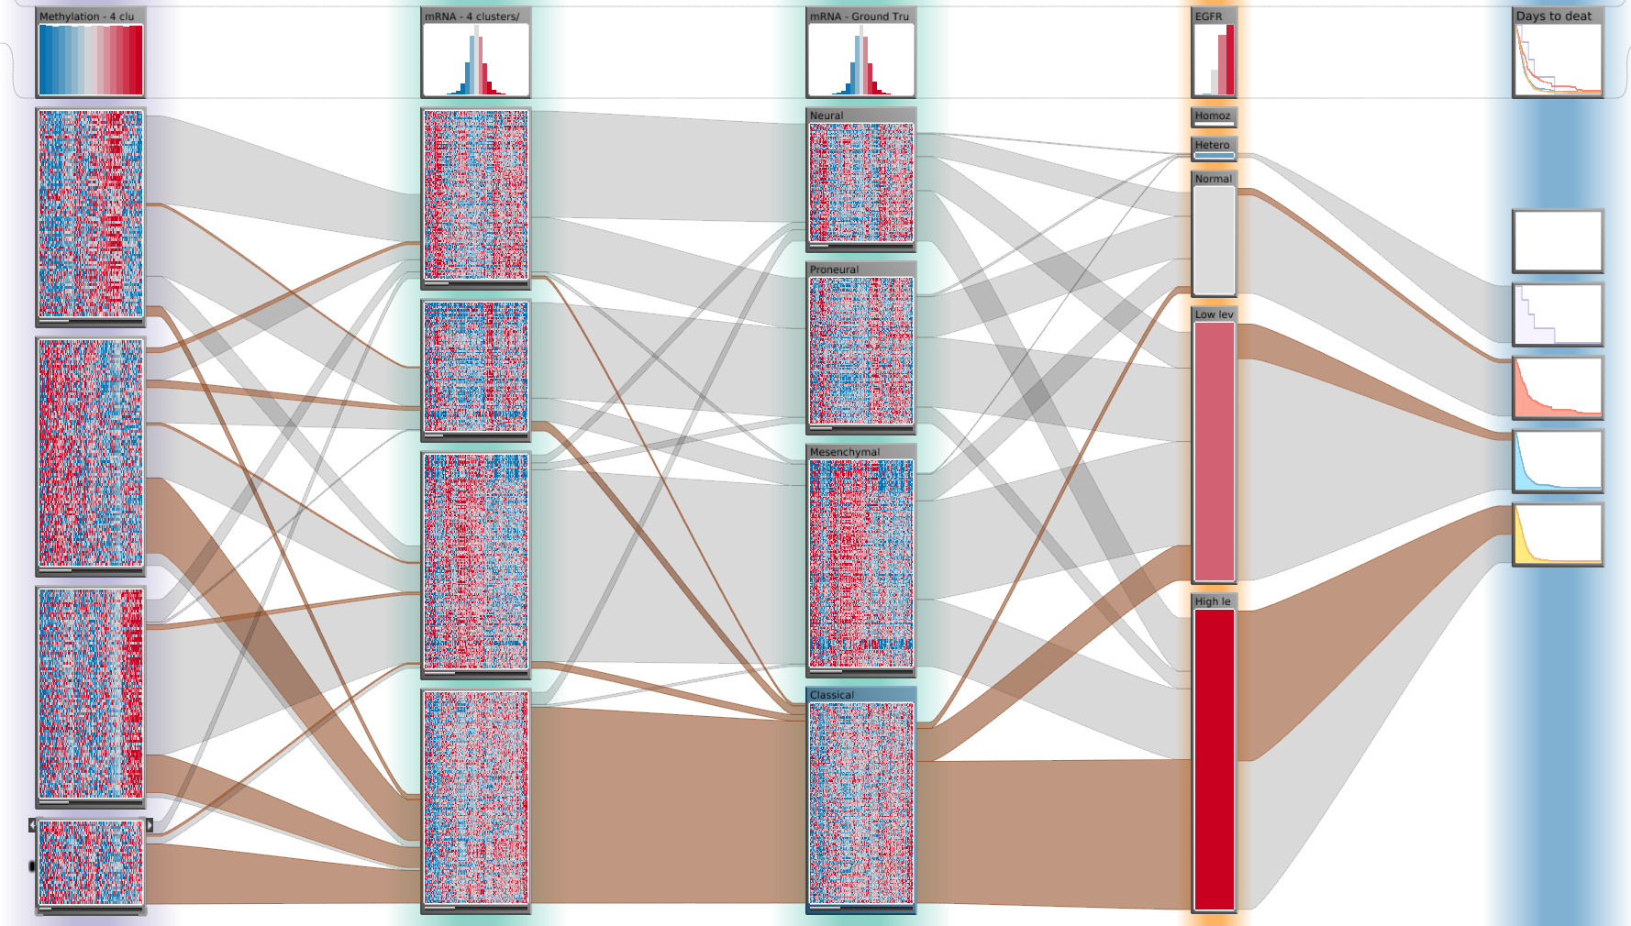
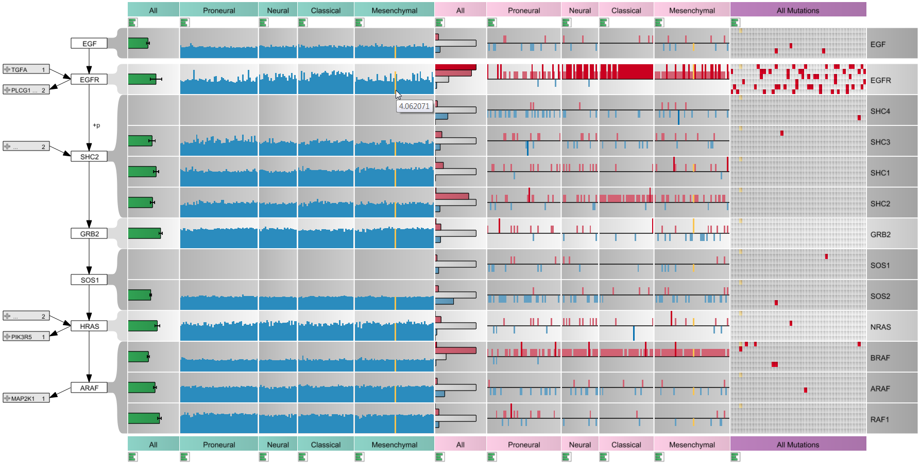
Caleydo Core Features
Multi-Dataset Analysis. Want to see….
…relationships between multiple datasets?
…relationships between tabular and graph data?

Slide 4
What is Caleydo?
Software for doing research in visualization
developed in academic setting
platform for trying out radically new visualization ideas
Quest for compromise between academic prototyping and ready-to-use software

Slide 5
What is Caleydo?
Open source platform for developing visualization and data analysis techniques
easily extendible due to plug-in architecture
you can create your own views
you can plug-in your own algorithms

Slide 6
Who is Caleydo?
Marc Streit Johannes Kepler University Linz, AT
Alexander Lex Harvard University, Cambridge, USA
Christian Partl Graz University of Technology, AT
Samuel Gratzl Johannes Kepler University Linz, AT
Nils Gehlenborg Harvard Medical School, Boston, USA
Dieter Schmalstieg Graz University of Technology, AT

Slide 7
Outline
14:00 - 15:15 Intro Data Format & Loading Data Assignment, Clustering Tabular Data & Subtype Visualization I
15:15 - 15:30 Break
15:30 - 16:30 Tabular Data & Subtype Visualization II Pathway Visualization
Marc
Alex

Slide 8
Data Format & Loading

Slide 9
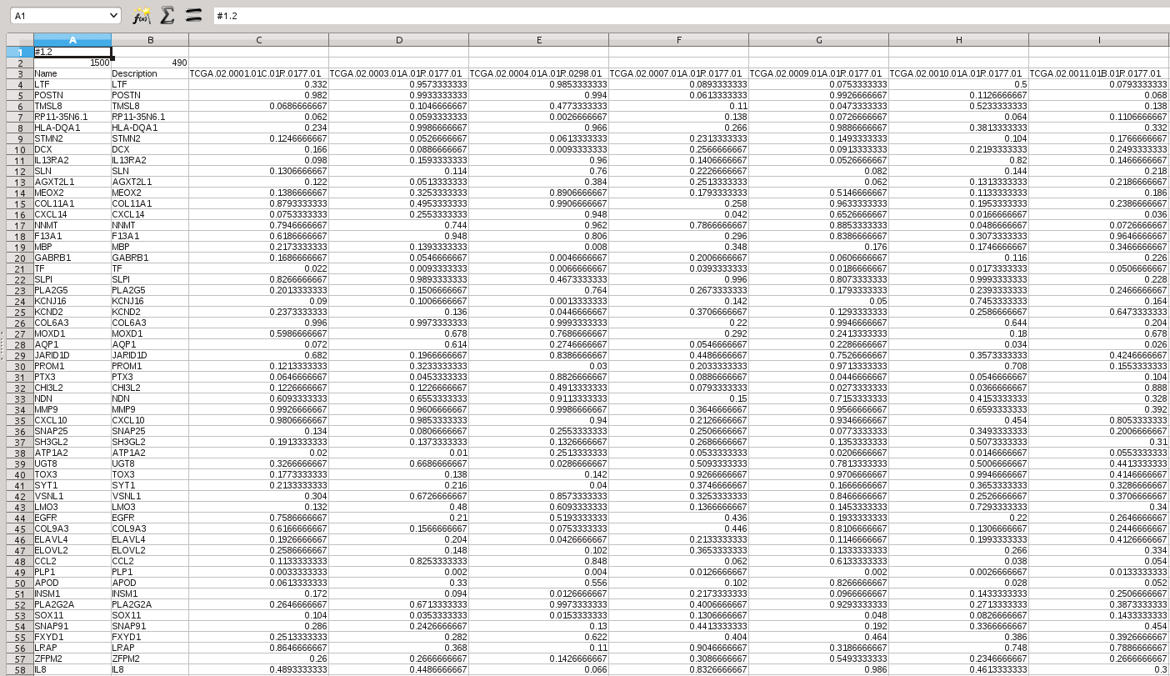
Data Example
Comma-separated text files
various types of separators
Column Identifiers (Samples)
Header
Row Identifiers (Genes)
Irrelevant Column
Data

Slide 10
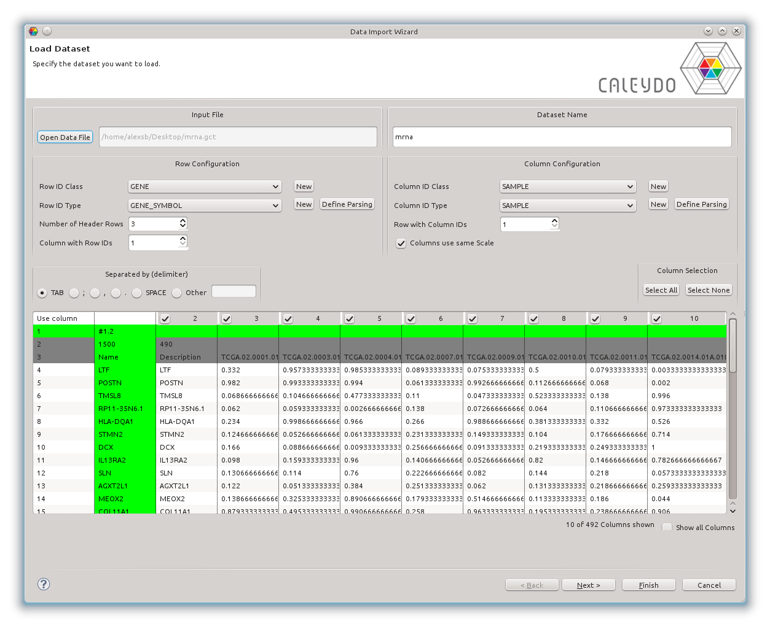
Data Format
Comma-separated text files
various types of separators

Slide 11
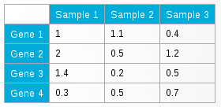
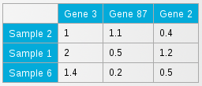
Data Format
Multiple heterogeneous tables
Matching based on IDs

Slide 12
Data Format
Caleydo has many genetic identifiers built-in
ID Classes group ID types
ID types in a class are different but can be mapped
e.g., RefSeq ID maps to gene short name

Slide 13
Data Format

Slide 14
Transformations
How to transform your data to make sense for visualization?

Slide 15
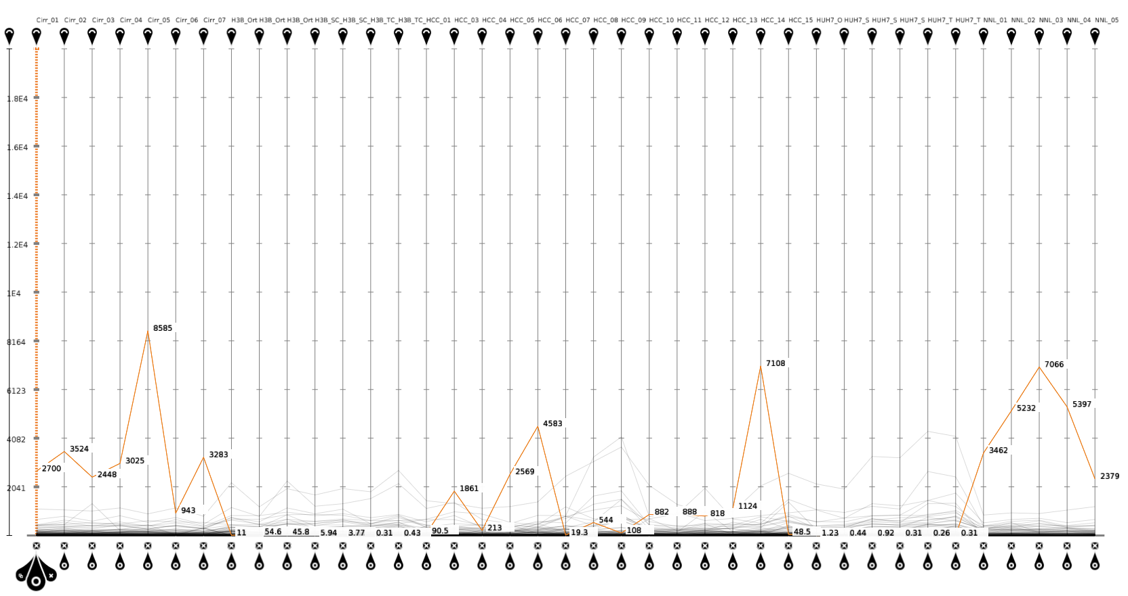
Scale Transformation

Slide 16
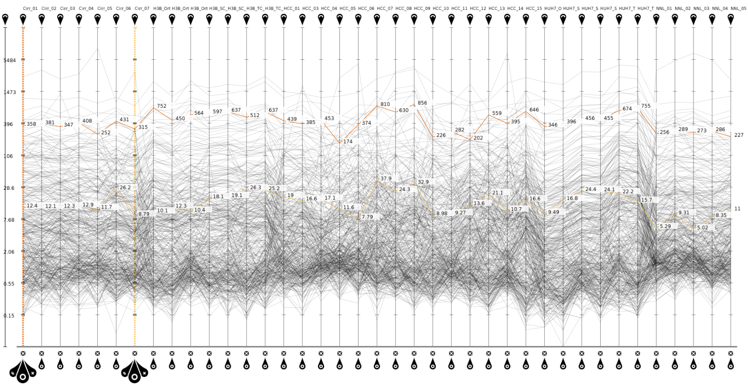
Scale Transformation - LOG
No transformation vs. log transformation

Slide 17
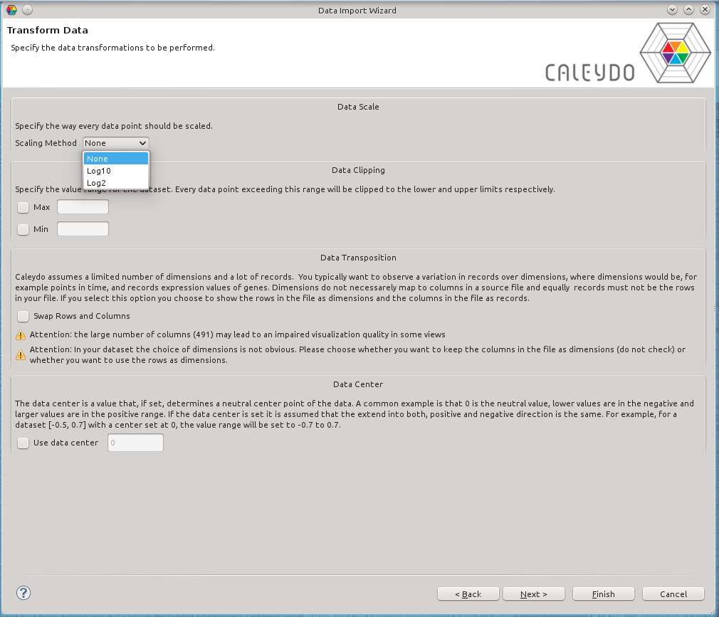
Scale Transformation

Slide 18
Switch Columns with Rows
Transpose data

Slide 19
Columns & Rows as in Source
No transformation vs. log transformation

Slide 20
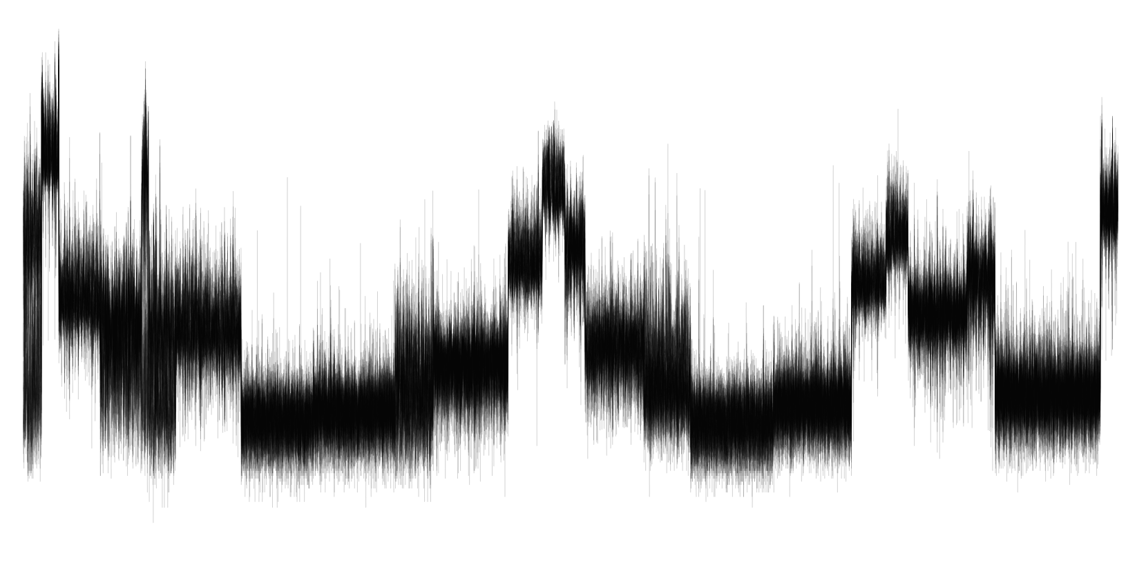
Columns & Rows Switched

Slide 21
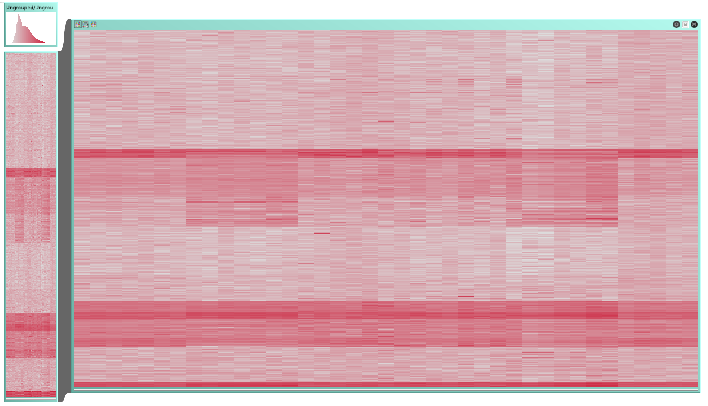
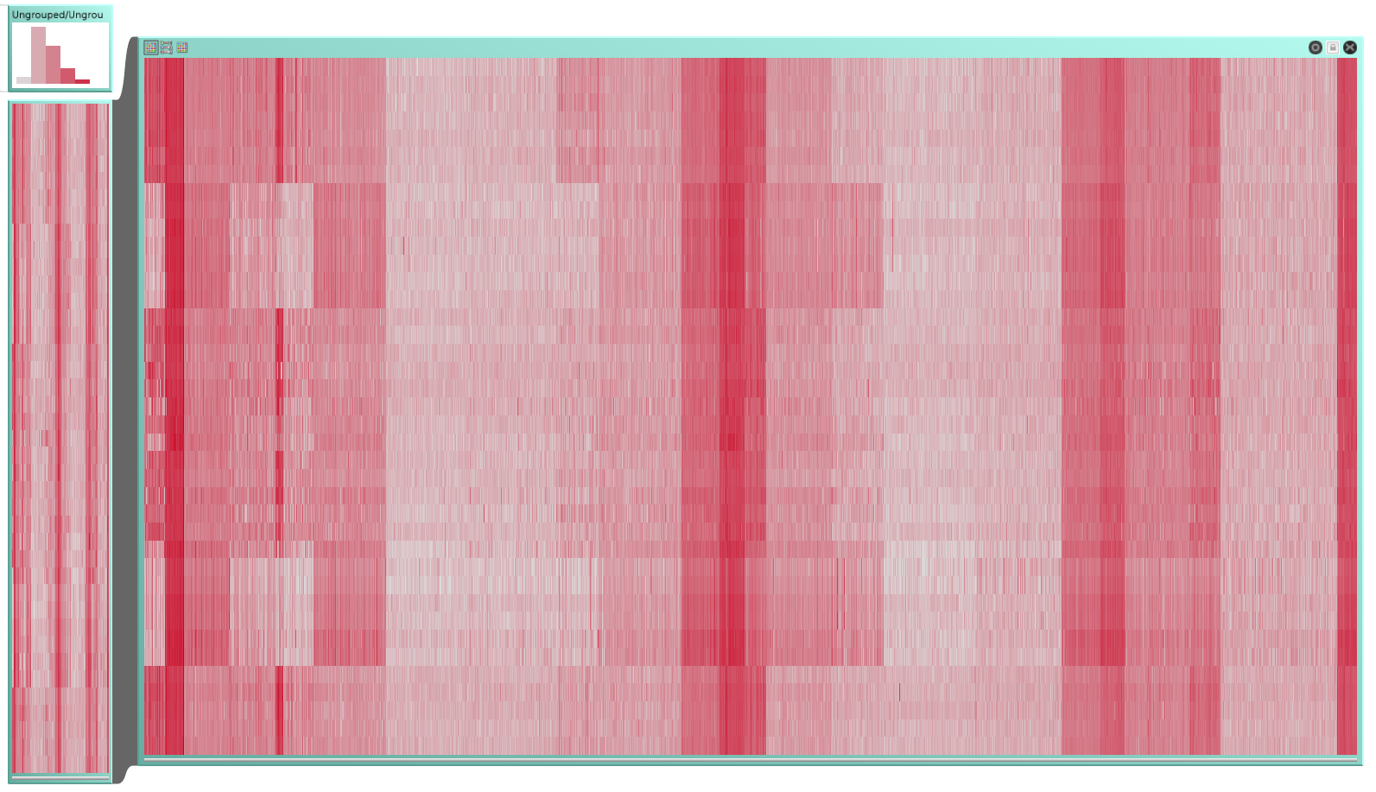
Switch Columns with Rows
Genes = Rows Samples = Columns
Genes = Columns Samples = Rows

Slide 22
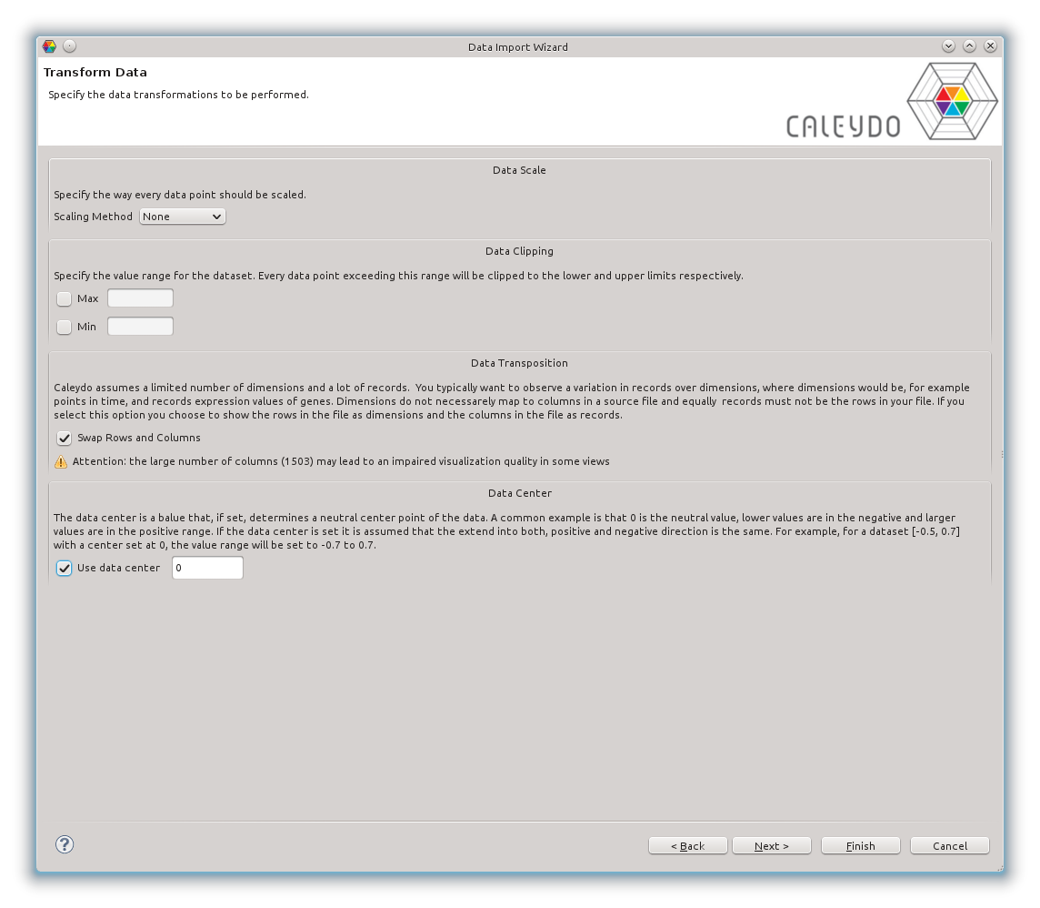
Switch Columns with Rows

Slide 23
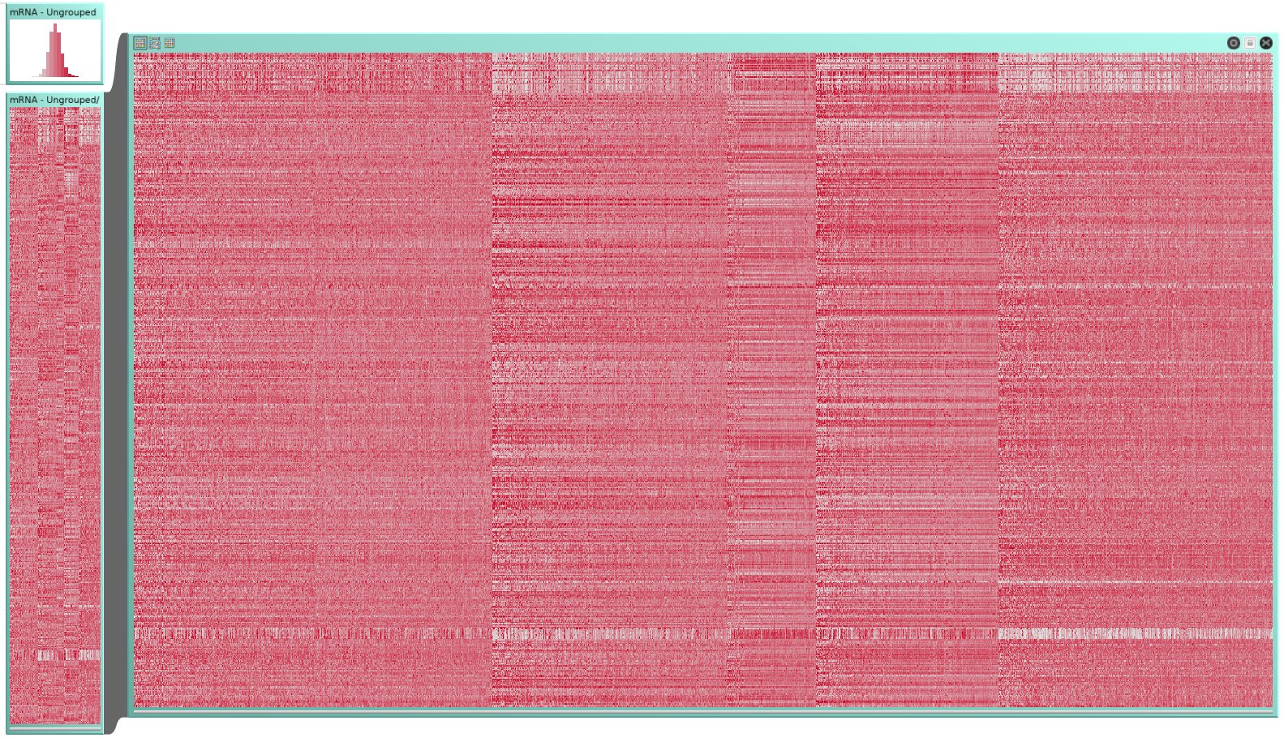
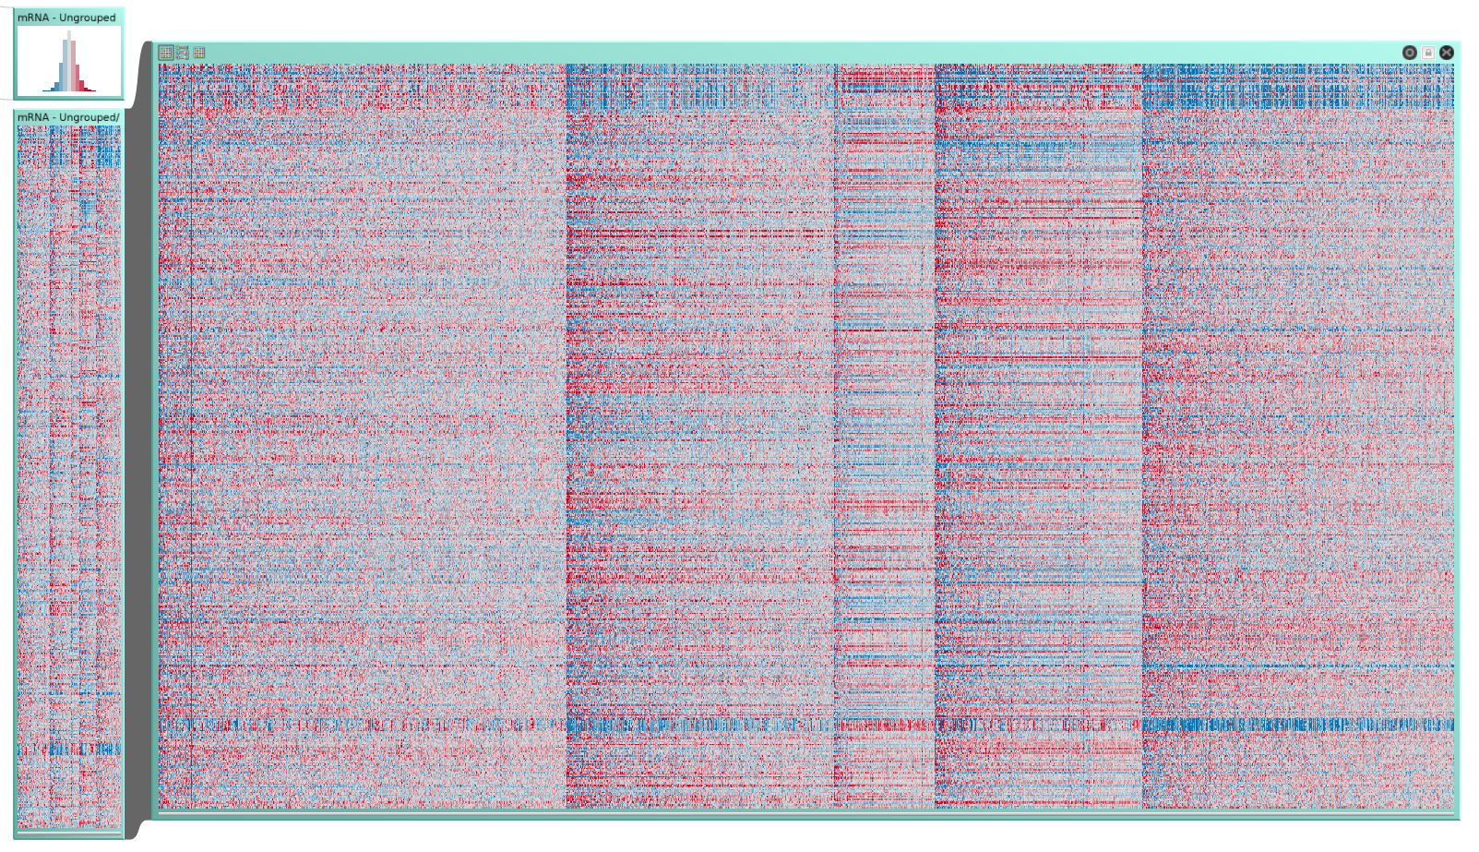
Data Center
Data not centered
White-red color map
Data centered (at 0)
Blue-white-red color map

Slide 24
Switch Columns with Rows

Slide 25
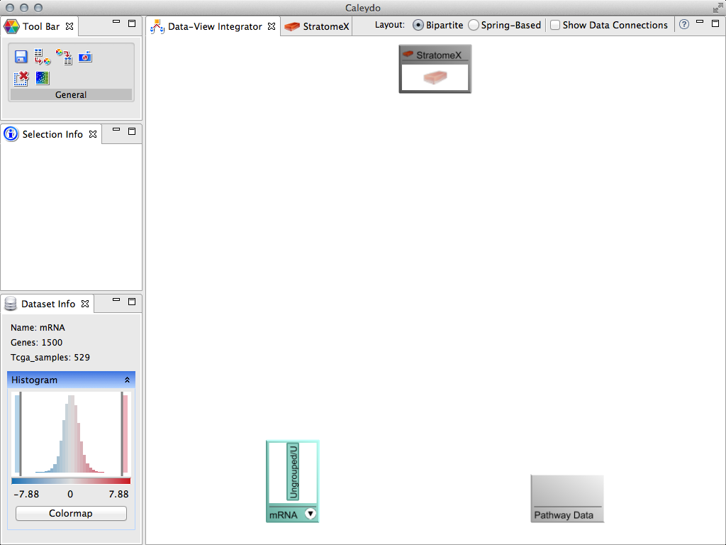
Data Successfully loaded

Slide 26
What‘s next?
Start exploring your data
Load another dataset
Save as project

Slide 27
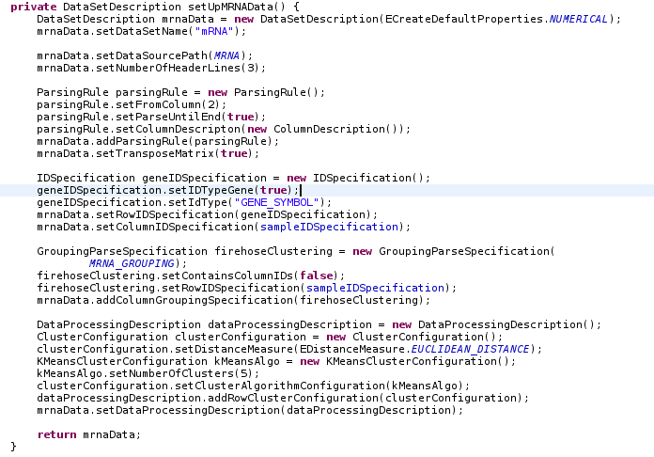
Scripted Data Loading
GUI-based data loading process can be tedious
Currently limited to numerical data
Alternative
use XML format or simple Java code to set up many datasets all at once

Slide 28
Projects contain
the data you loaded
the views you opened
your clustering results and filters
your color codes
etc.,
Stored in .cal files

Slide 29
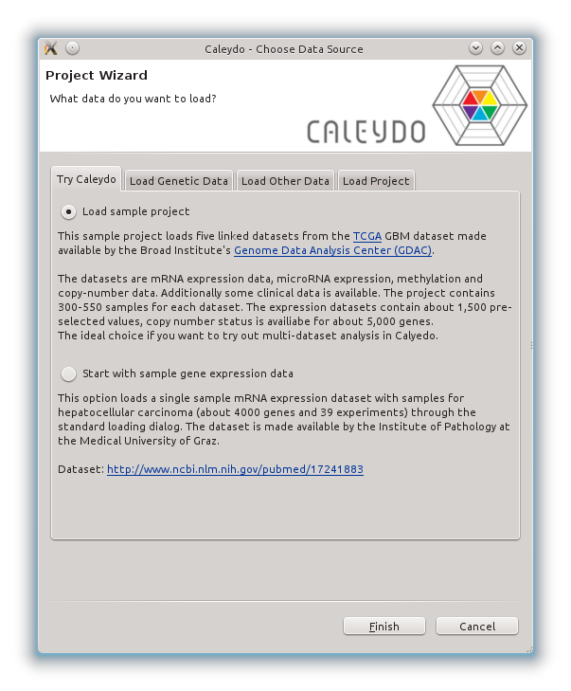
Sample Data
2 sample datasets included
complex glioblastoma multiforme dataset with many datasets and clusterings
simple mRNA dataset for hepatocellular carcinoma and other conditions

Slide 30
Handing Over to Marc

Slide 31
Data Assignment, Clustering

Slide 32
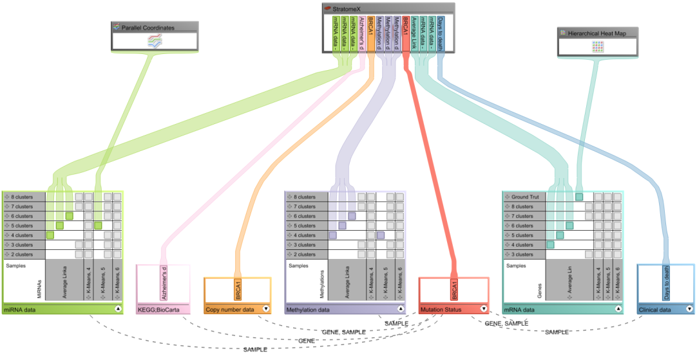
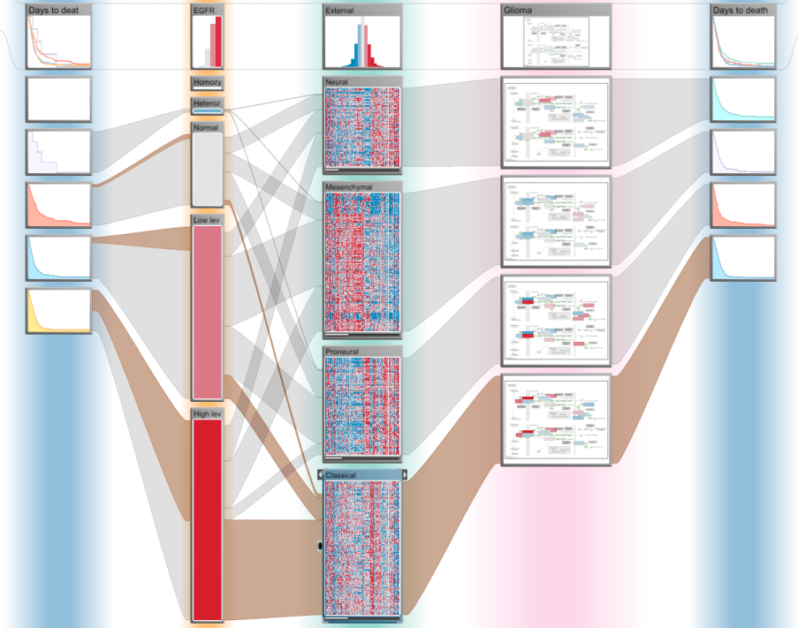
Data-View Integrator
Challenge 1
Manage complex setup of multiple datasets, multiple stratifications & multiple views
Challenge 2
Visualize complex interdependencies between multiple, heterogeneous, large datasets
StratomeX

Slide 33
Getting Started
mRNA Dataset: Data assignment + heatmap + color mapping

Slide 34
Loaded data at the bottom – available views on the top

Slide 35
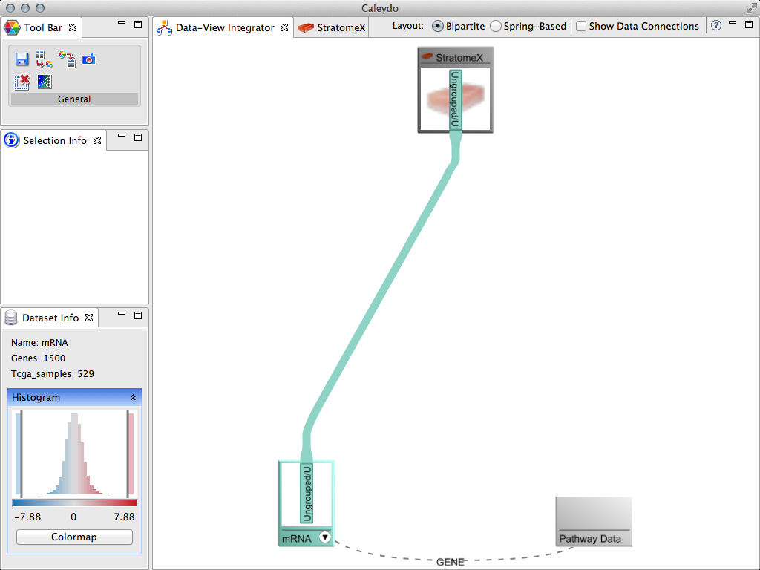
Use drag-and-drop to add data to StratomeX view

Slide 36
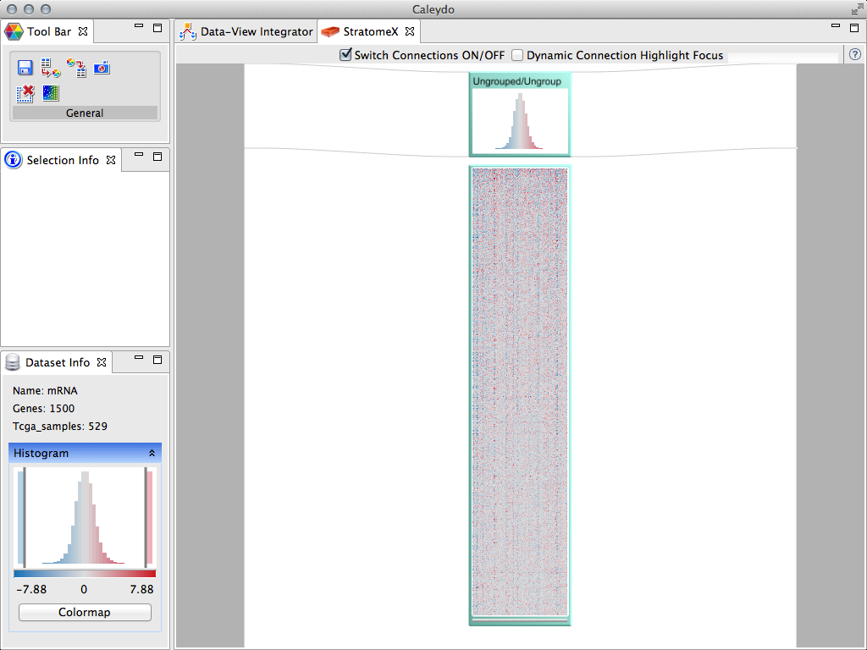
Switch to StratomeX view: heatmap rows = samples, columns = genes

Slide 37
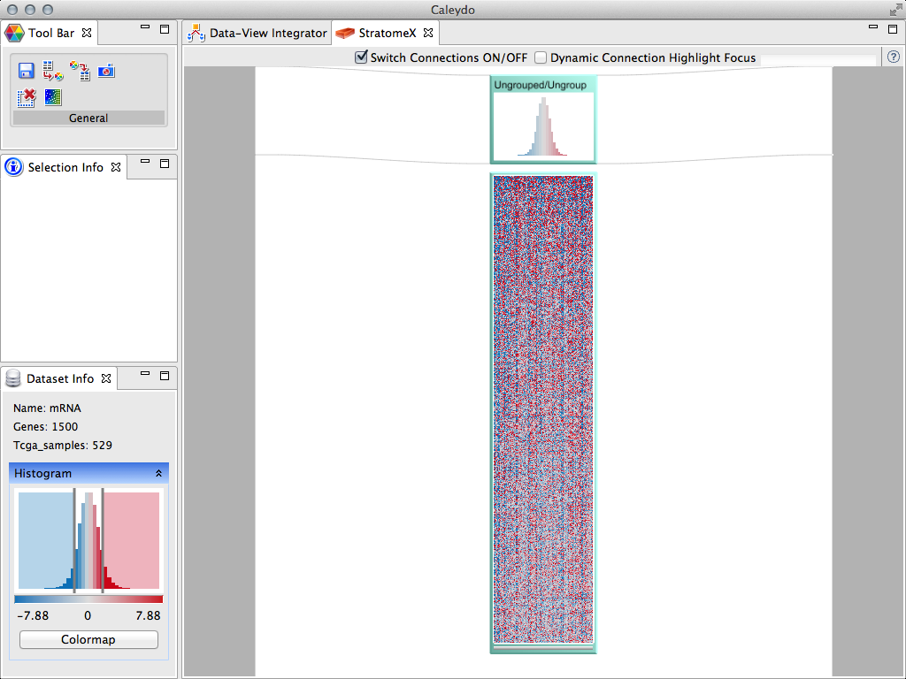
Use interactive histogram to update color mapping

Slide 38




Cancer
Cancer types are not homogeneous
They are divided into Subtypes
different histology
different molecular alterations
Subtypes have serious implications
different treatment for subtypes
prognosis varies between subtypes

Slide 39
Cancer Subtype Analysis
Done using many different types of data,
for large numbers of patients.
Notes:
Goal: improved patient outcome
Usually you have to deal with lots of different tables that you have stored in a DB or files

Slide 40

Large-scale project to catalogue genetic mutations responsible for cancer
20 tumor types
500 patient samples each
Extensive molecular profiling for each patient
Notes:
“The Cancer Genome Atlas is a comprehensive and coordinated effort to
accelerate our understanding of the molecular basis of cancer through the
application of genome analysis technologies, including large-scale genome
sequencing.”

Slide 41
TCGA Data
sequencing data
microRNA expression
clinical parameters
mRNA expression
pathways
methylation levels
mutation status
copy number status
Notes:
Every one of them is a huge table

Slide 42
Our goal is to support tumor subtype characterization through integrative
visual analysis of cancer genomics data sets.

Slide 43
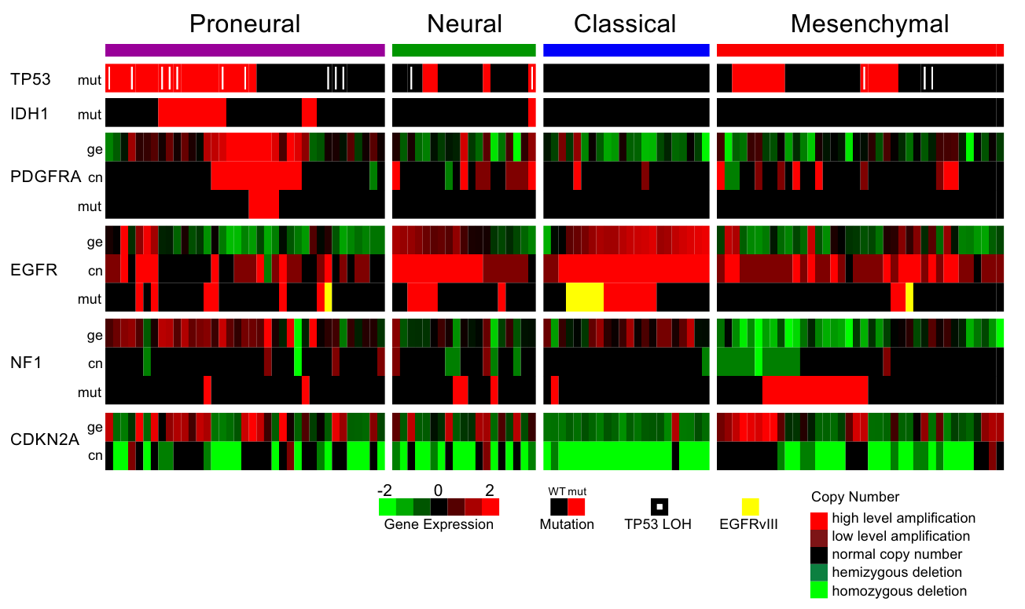
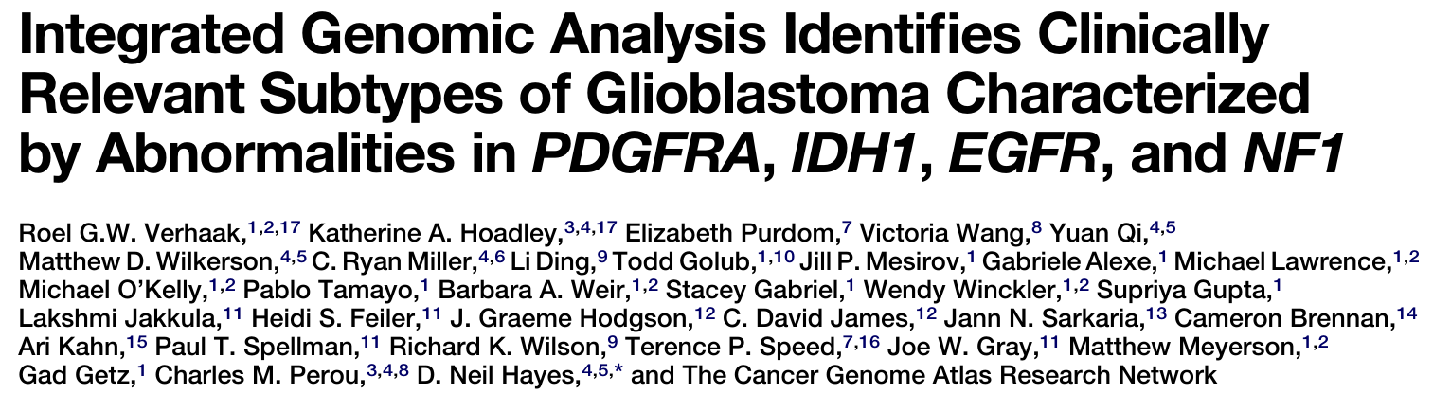
Subtype Identification
Patients
Notes:
Can only be used to present the found subtypes in a paper
Not to identify them in the first place

Slide 44
Subtype Identification Process
Step 1: Determine candidate subtypes
Step 2: Find supporting evidence

Slide 45
Stratification
Tabular Data
Patients
Candidate Subtypes
Genes, Proteins, etc.

Slide 46
Stratification of a Single Dataset
Cluster A1
Cluster A2
Cluster A3

Slide 47
Subtype Identification Process
Step 1: Determine candidate subtypes
Step 2: Find supporting evidence

Slide 48
Stratification of Multiple Datasets
Cluster A1
B1
B2
Cluster A2
Evaluate whether stratifications support each other
Cluster A3
Tabular e.g., mRNA
Categorical,
e.g., mutation status

Slide 49
Stratification of Multiple Datasets
Cluster A1
B1
B2
Cluster A2
Cluster A3
Tabular e.g., mRNA
Categorical,
e.g., mutation status

Slide 50
Stratification of Multiple Datasets
Cluster A1
B1
Dep. C1
B2
Cluster A2
Dep. C2
Review effect of stratification
Cluster A3
Tabular e.g., mRNA
Categorical,
e.g., mutation status
Dependent Data, e.g. clinical data

Slide 51

Cate-
gorical
Depen-
dent
Table
Show expression patterns in subtypes

Slide 52
Patients stratified by Copy Number
Patients stratified by Clustering

Slide 53
Columns = Genes
Band = Subset of Patients
Rows = Patients
Notes:
Works also for clustered genes

Slide 54
Survival
Survival
mRNA Levels
Glioma Pathway
EGFR Copy Number Status

Slide 55
Live Demo
mRNA Dataset: Stratification loading / clustering / heatmap comparison

Slide 56
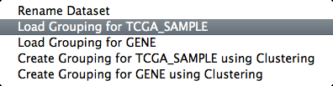
Right-click on data set box to load a stratification

Slide 57
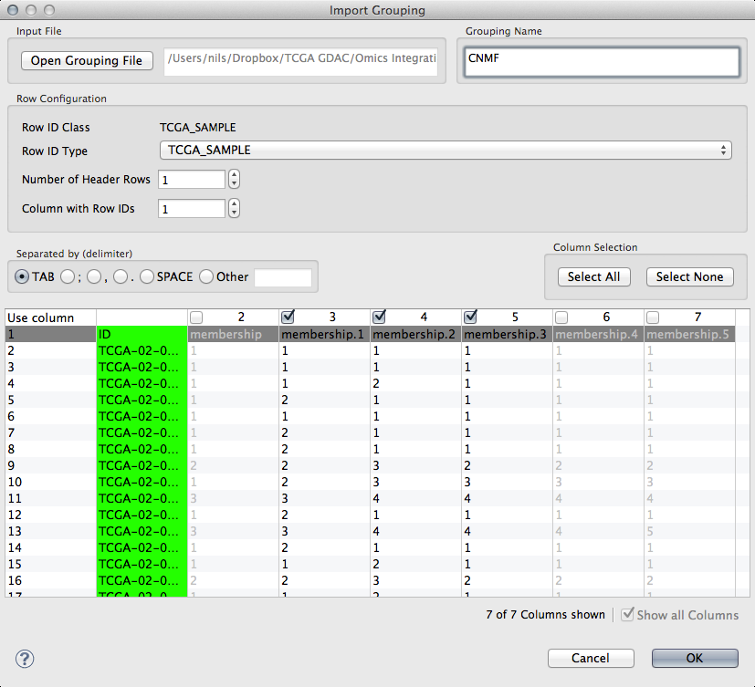
Choose one or more stratifications

Slide 58
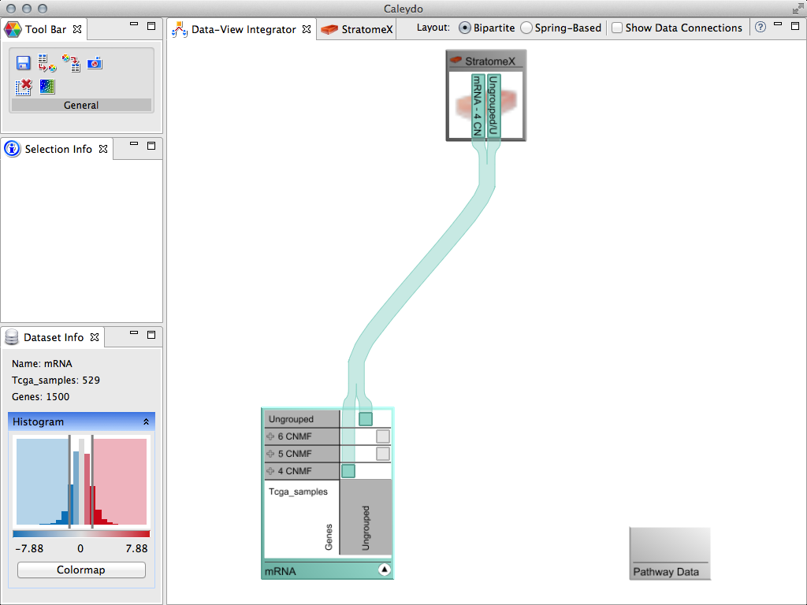
Click arrow on data set box to see new stratifications and drag onto StratomeX view

Slide 59
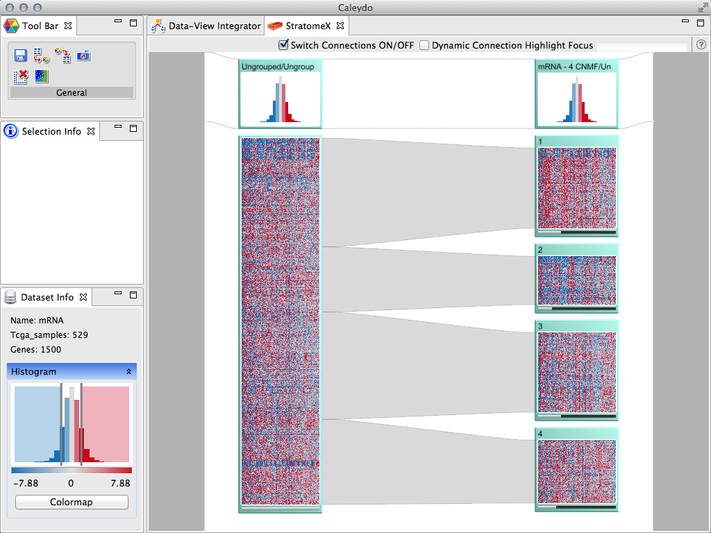
Switch to StratomeX view

Slide 60
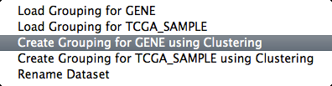
Right-click on data set box to cluster genes

Slide 61
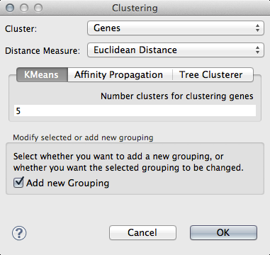
Run with defaults

Slide 62
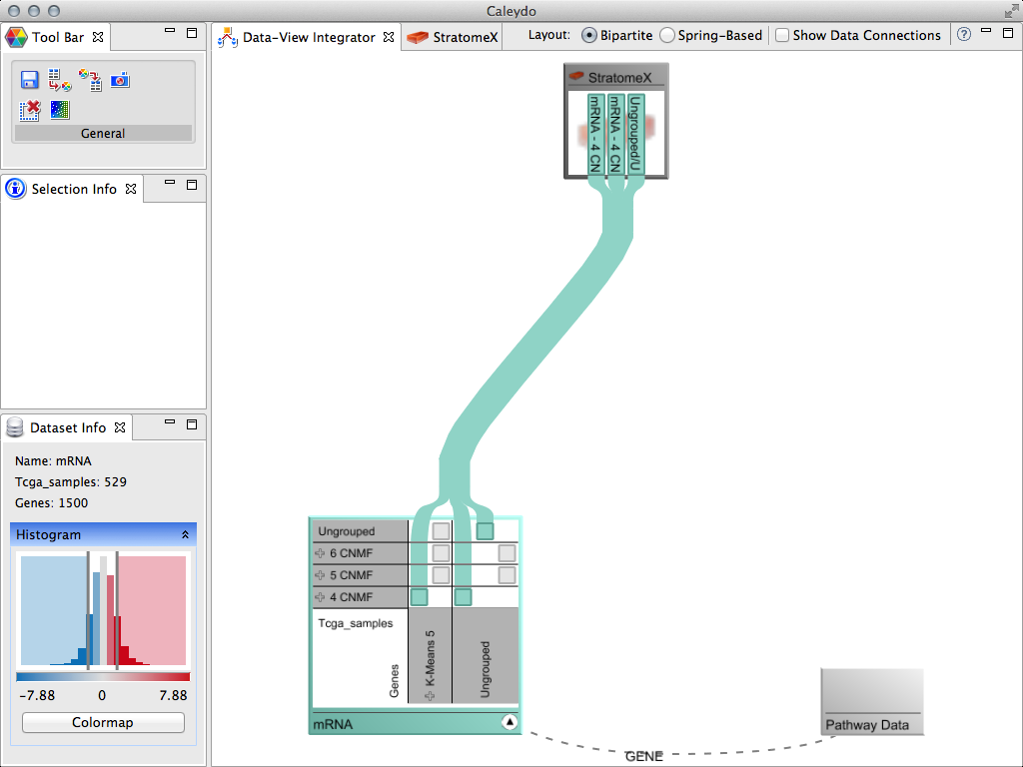
A new column “K-Means 5” appears in the gene dimension
Drag stratification with 4 clusters to view

Slide 63
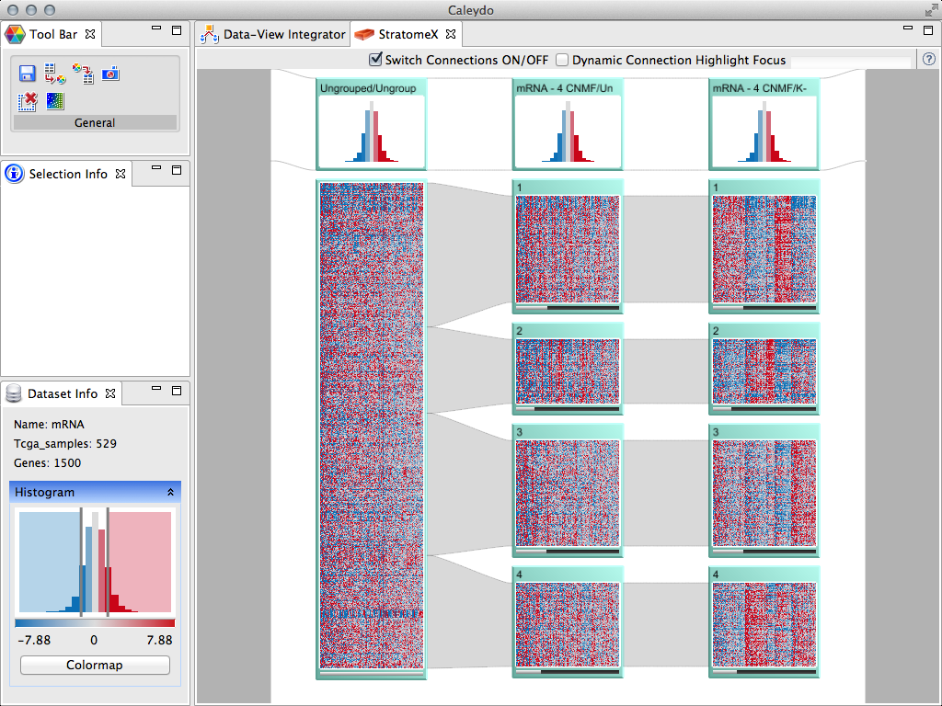
Compare heatmaps

Slide 64
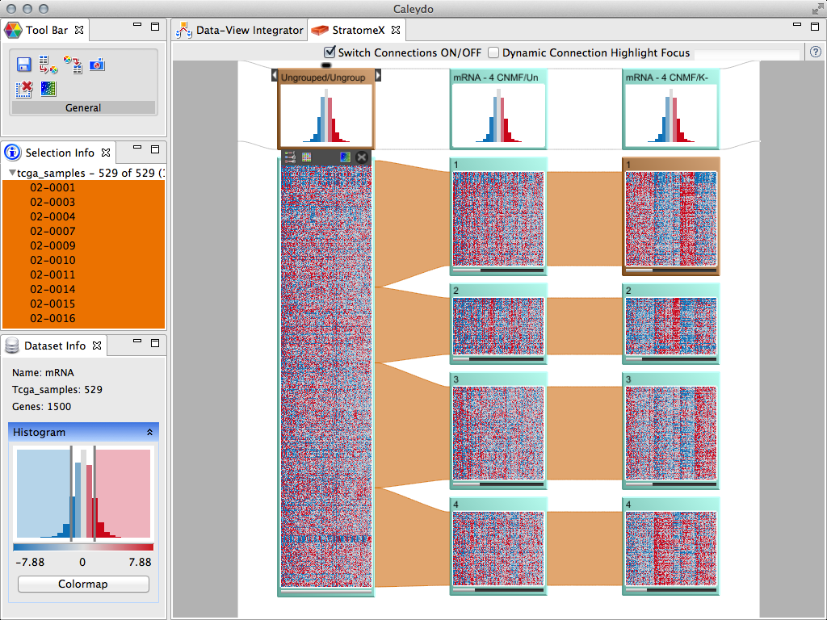
Hover over header brick and click on “X” in menu bar below to remove the column

Slide 65
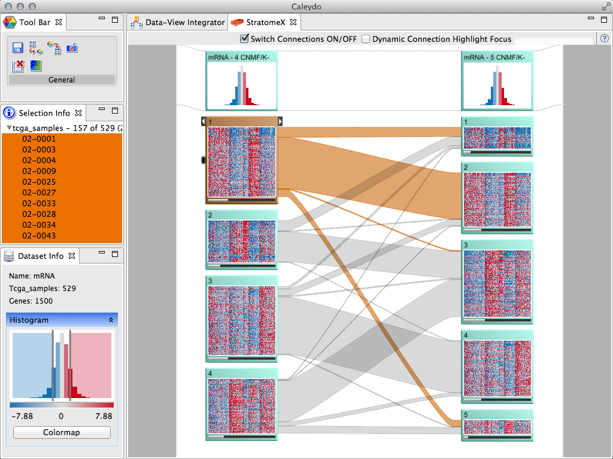
Compare clusterings with 4 and 5 clusters
Click on brick to highlight all patients in this set

Slide 66
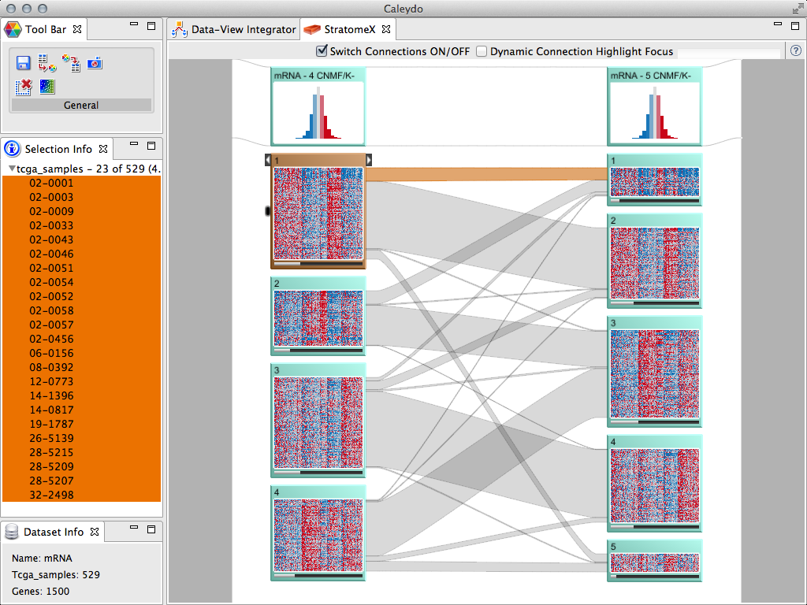
Click on band to highlight all patients in the intersection of two sets
Use “Selection Info” view to see the list of patient ids

Slide 67
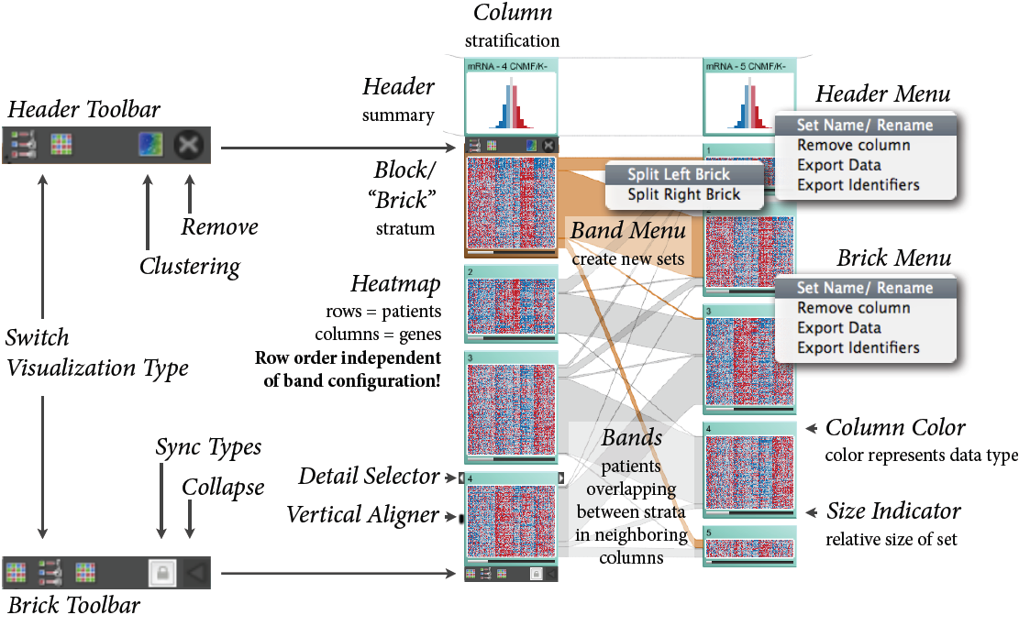
Components of the StratomeX view

Slide 68
Getting more data

Slide 69
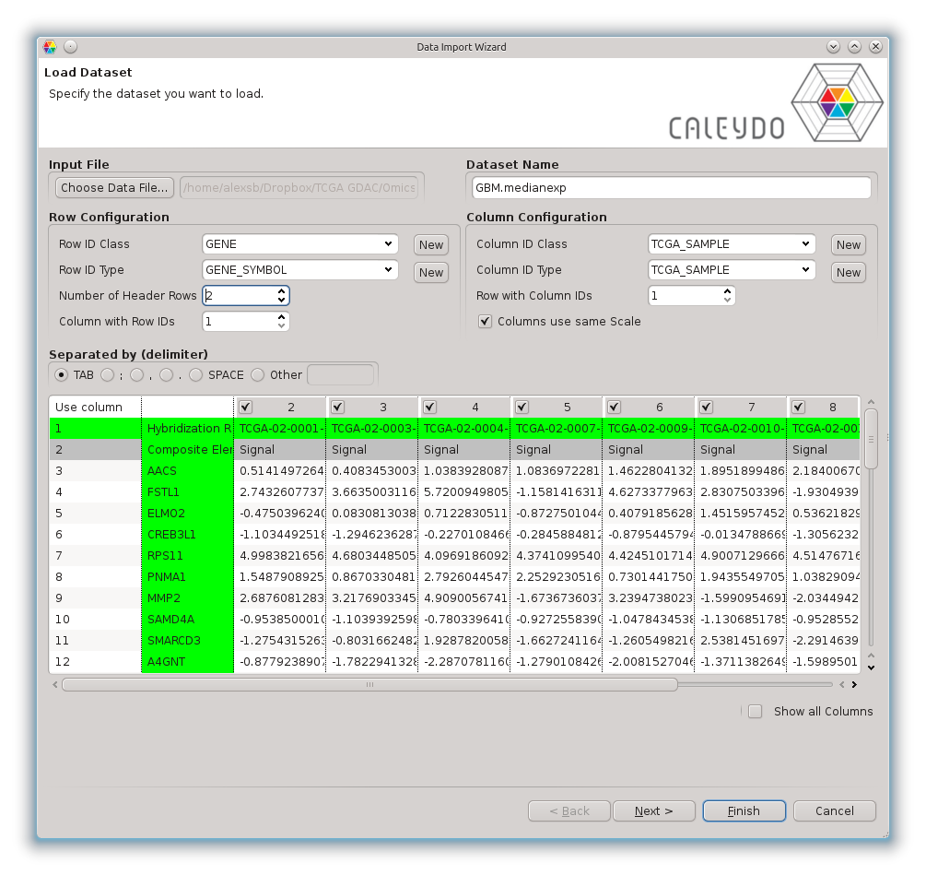
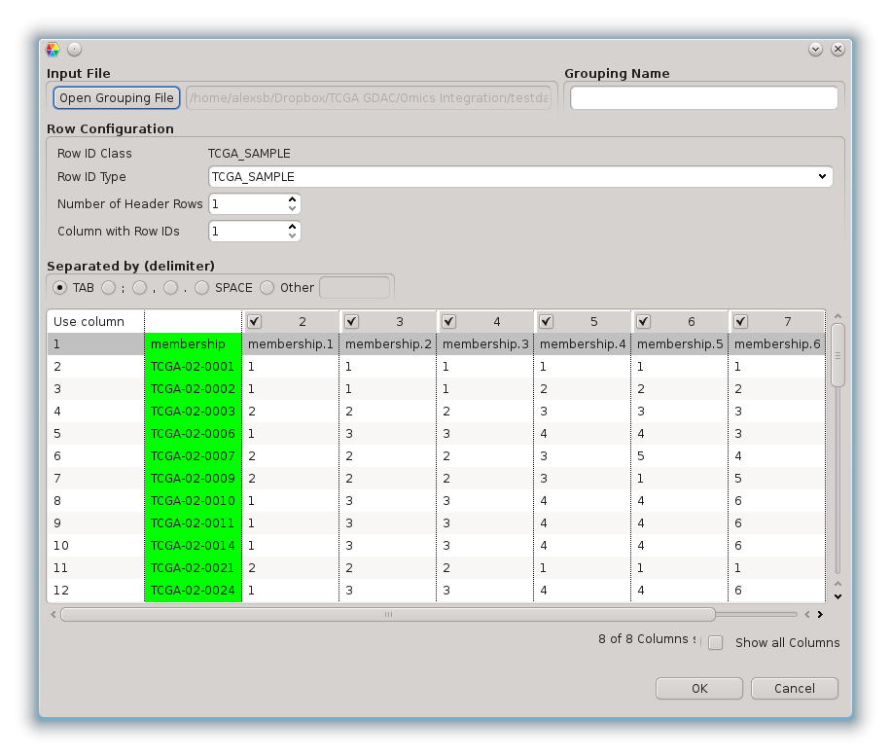
Import your own data
Import stratifications
Import data matrices

Slide 70
TCGA Data
20 tumor types
500 patient samples each
microRNA expression
clinical parameters
mRNA expression
methylation levels
mutation status
copy number status
Notes:
Every one of them is a huge table

Slide 71
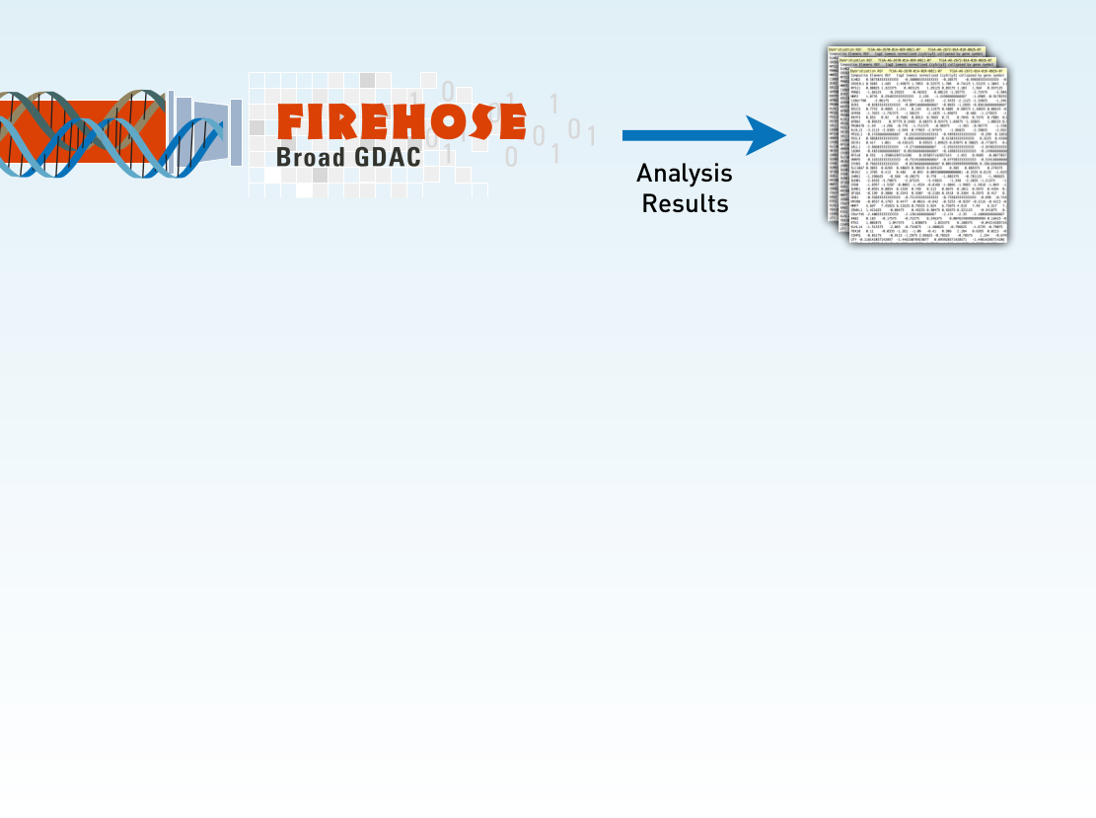
Analysis Workflow

Slide 72
Analysis Workflow
Cluster A1
Cluster A2
Cluster A3
mRNA (array & sequencing)
microRNA (array & sequencing)
methylation
reverse phase protein array
clinical parameters
clustering (CNMF & hierarchical)
gene mutation status (binary)
gene copy number status (5 class)

Slide 73
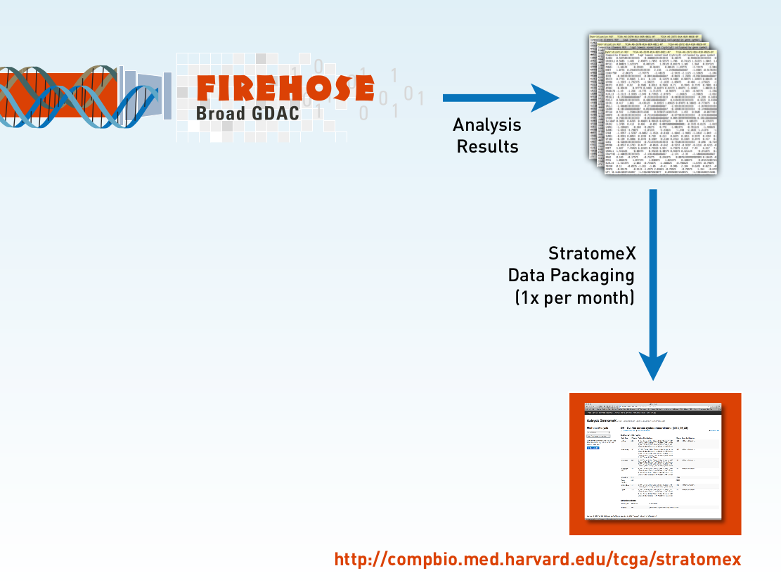
http://tcga.caleydo.org

Slide 74
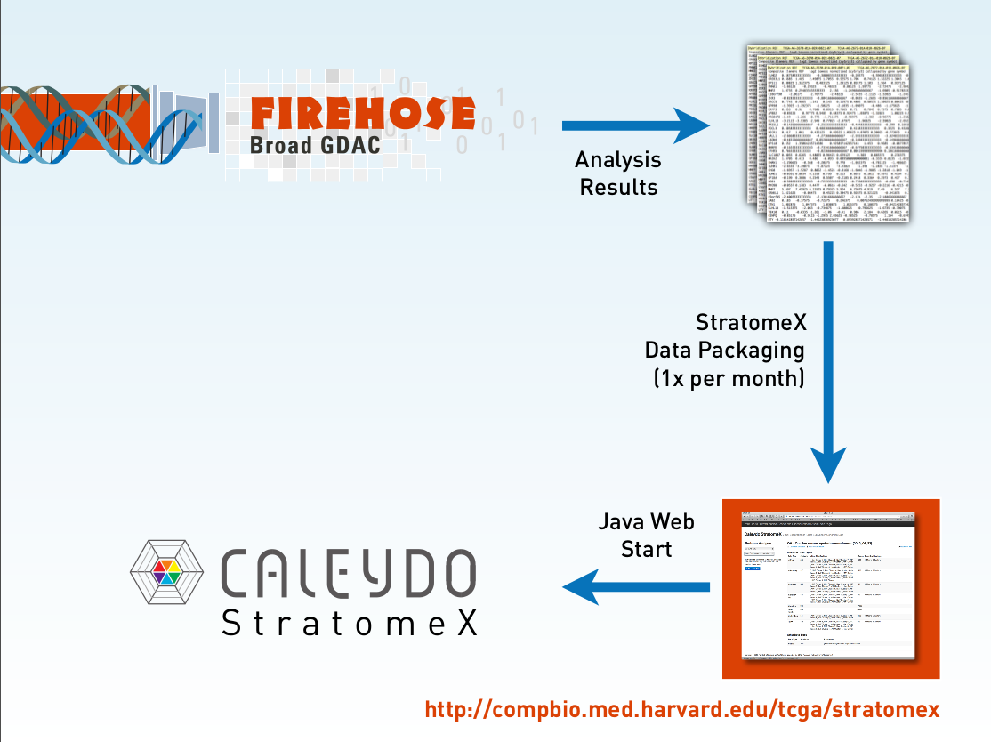
http://tcga.caleydo.org

Slide 75
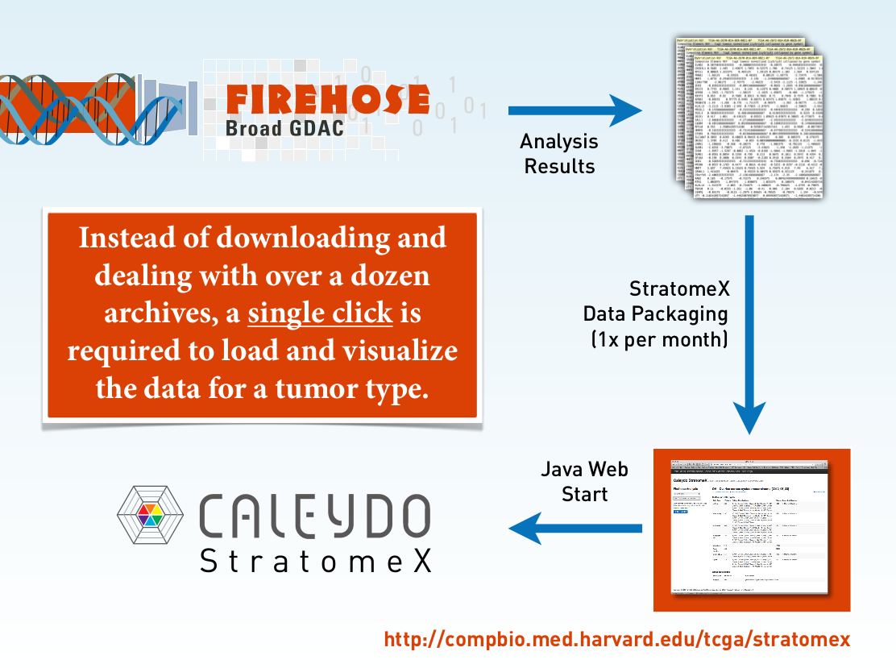
http://tcga.caleydo.org

Slide 76
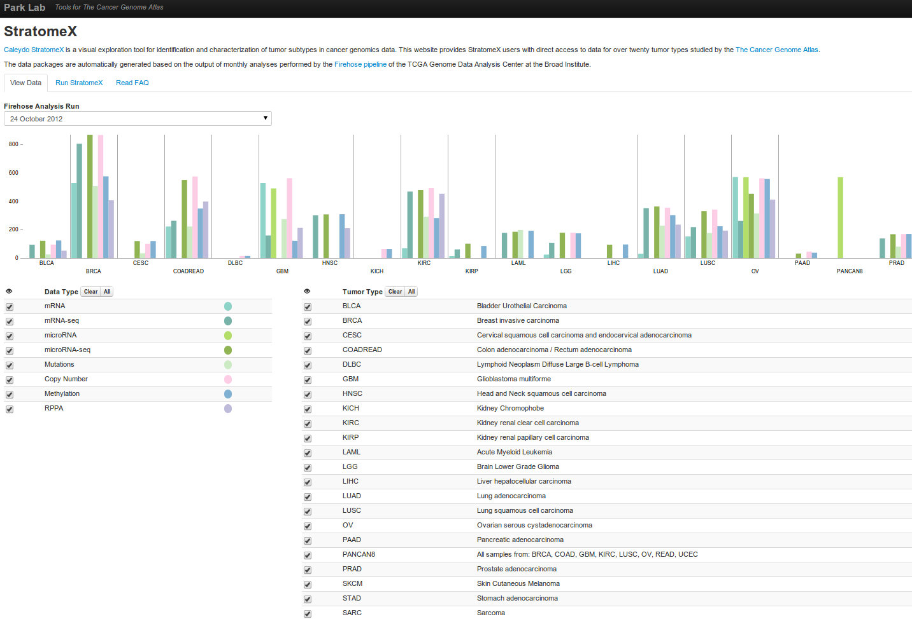
http://tcga.caleydo.org

Slide 77
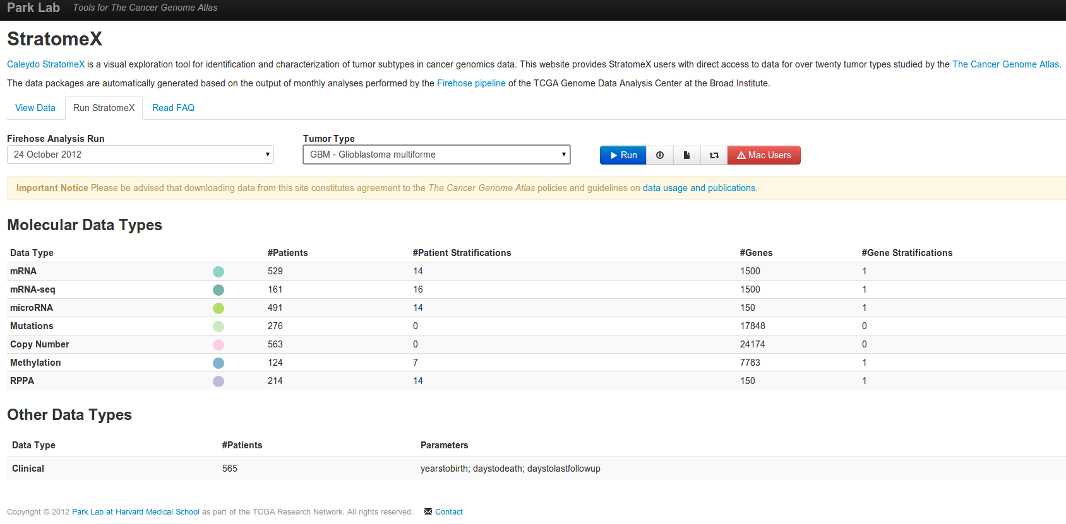
http://tcga.caleydo.org

Slide 78

Use case / Live Demo
Using TCGA Glioblastoma Multiforme

Slide 79
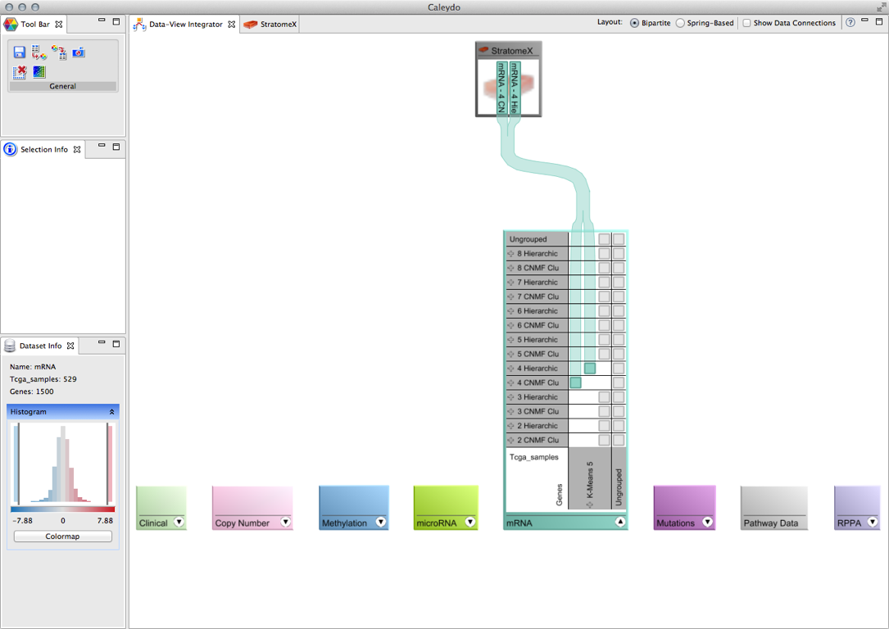
Glioblastoma Multiforme
mRNA clustering CNMF and hierarchical with 4 clusters

Slide 80
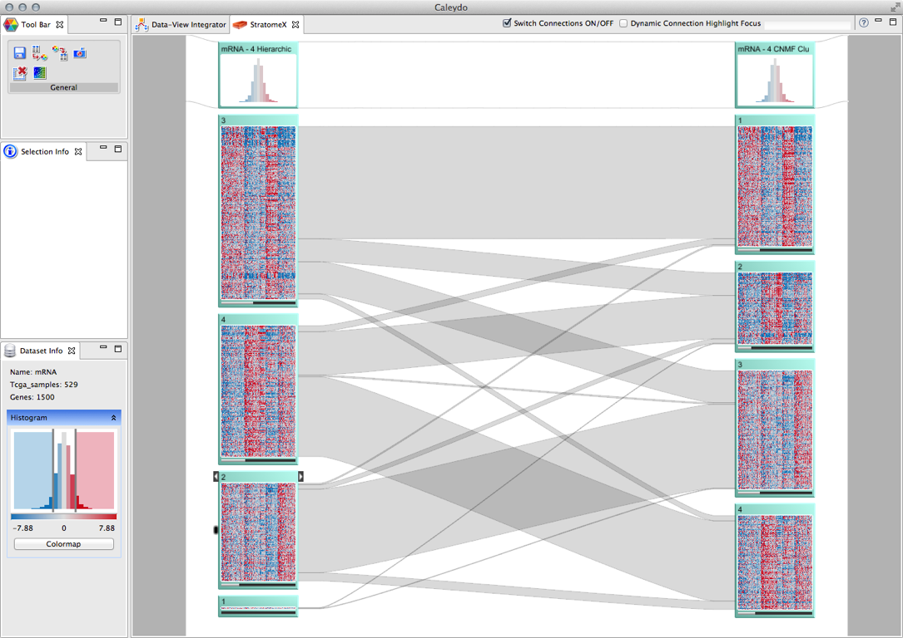
Glioblastoma Multiforme
mRNA clustering CNMF and hierarchical with 4 clusters

Slide 81
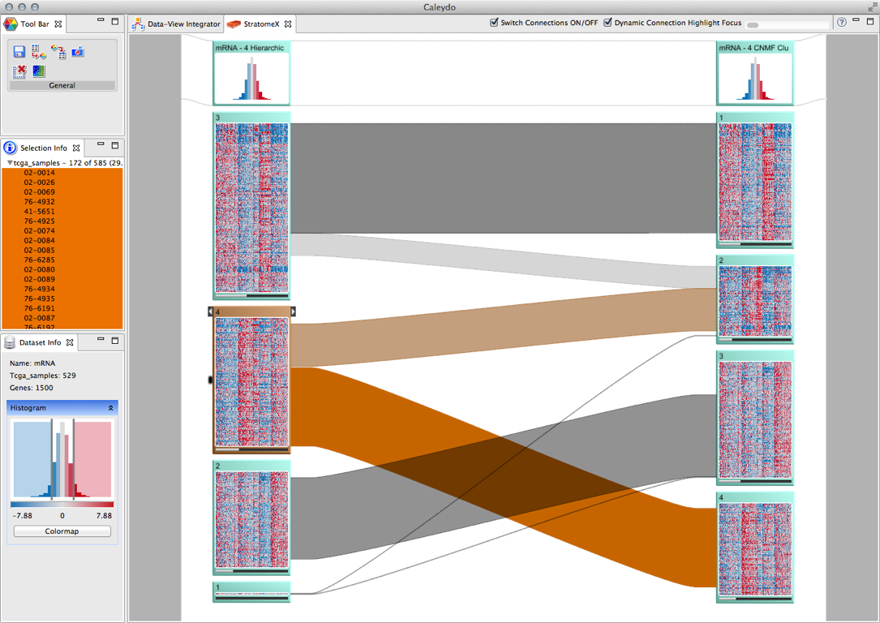
Glioblastoma Multiforme
Use “Dynamic Connection Highlight Focus”

Slide 82
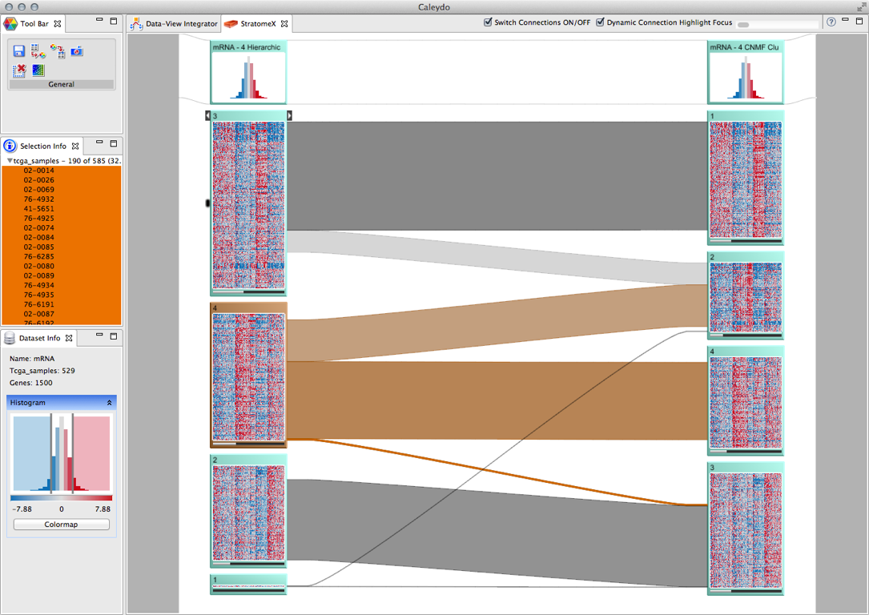
Glioblastoma Multiforme
Reorder bricks within column to detangle bands

Slide 83
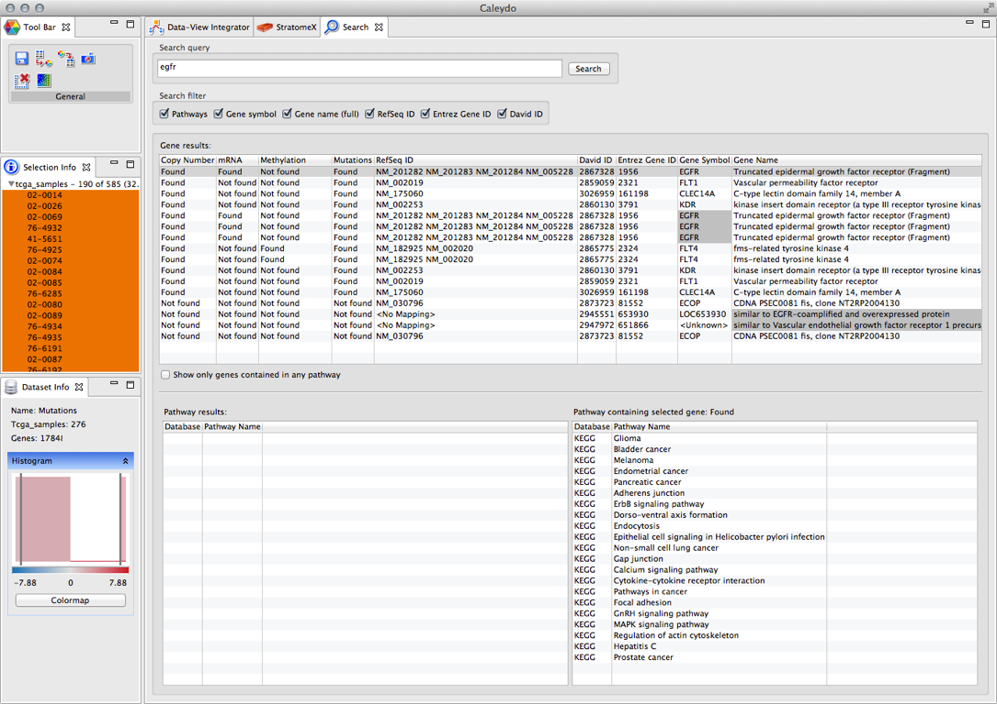
Glioblastoma Multiforme
Add EGFR copy number and mutation status

Slide 84

Glioblastoma Multiforme
Add EGFR copy number and mutation status

Slide 85

Glioblastoma Multiforme
Mutated EGFR almost always means amplified EGFR

Slide 86

Glioblastoma Multiforme
Richt-click on mRNA header brick and add glioma pathway

Slide 87

Glioblastoma Multiforme
mRNA mapped to glioma pathway - even distribution of EGFR mutations

Slide 88

Glioblastoma Multiforme
mRNA mapped to glioma pathway - high amplification frequent in 3rd cluster

Slide 89

Glioblastoma Multiforme
View pathway map for glioma and 3rd cluster in detail

Slide 90

Glioblastoma Multiforme
View pathway map for glioma and 3rd cluster in detail - zoomed into map

Slide 91

Glioblastoma Multiforme
View pathway map for glioma and 1st cluster in detail - EGFR down regulated

Slide 92


Glioblastoma Multiforme
Add clinical variable: survival

Slide 93

Glioblastoma Multiforme
Add clinical variable: survival

Slide 94

Glioblastoma Multiforme
Add clinical variable: survival - EGFR amplification is worse

Slide 95

Glioblastoma Multiforme
Add IDH1 mutation status - IDH1 mutation is strongly associated with Cluster 4

Slide 96

Glioblastoma Multiforme
Add unclustered methylation data

Slide 97


Glioblastoma Multiforme
Create methylation cluster based on IDH1 status

Slide 98

Glioblastoma Multiforme
Create methylation cluster based on IDH1 status: striking pattern emerges

Slide 99

Glioblastoma Multiforme
Add CNMF methylation clustering with 3 clusters

Slide 100

Glioblastoma Multiforme
Add CNMF methylation clustering with 8 clusters

Slide 101

Glioblastoma Multiforme
Add survival data

Slide 102

Glioblastoma Multiforme
Export data

Slide 103

Glioblastoma Multiforme
Export data

Slide 104

Glioblastoma Multiforme
Downstream analysis on exported matrix

Slide 105
Please cite the StratomeX paper
A Lex, M Streit, H-J Schulz, C Partl, D Schmalstieg, PJ Park and N Gehlenborg, "StratomeX: Visual Analysis of Large-Scale Heterogeneous Genomics Data for Cancer Subtype Characterization", Computer Graphics Forum (EuroVis '12), 31:3, 1175-1184 (2012)

Slide 106
CURRENT DEVELOPMENTS

Slide 107
StratomeX strong for hypothesis validation

Slide 108
TCGA Data
#Subtype Candidates
#Subtype Candidates
microRNA expression
clinical parameters
#Subtype Candidates
mRNA expression
pathways
methylation levels
mutation status
>100
copy number status
>500
>25000
>25000

Slide 109

Millions of possible combinations to try out
Notes:
StratomeX strong for validation of hypothesis

Slide 110

Guided Exploration
Visually guide analyst through analysis
Pinpoint to possibly interesting patterns and correlations
Tour Guide

Slide 111
Tour Guide Approach
Q: Which stratifications are most similar to this mRNA clustering?
Q: Which stratifications contain a subset with the same patients who also have a homozygous deletion of this gene?
Q: What are the top pathways containing genes with copy number alteration or mutations?
Notes:
Fairly complex questions -> but no hypothesis required

Slide 112

StratomeX Tour Guide
Notes:
Ranking of scored entities

Slide 113

Combine Complex Queries

Slide 114
Back to Alex…

Slide 115
Pathway Visualization

Slide 116
Experimental Data and Pathways
Pathways represent consensus knowledge for a healthy organism or specific disease
Cannot account for variation found in real-world data
Branches can be (in)activated due to
mutation,
changed gene expression,
modulation due to drug treatment,
etc.

Slide 117
Why use Visualization?
Efficient communication of information
A -3.4
B 2.8
C 3.1
D -3
E 0.5
F 0.3
B
A
C
D
E
F

Slide 118



Experimental Data and Pathways
[KEGG]
[Lindroos2002]

Slide 119






Visualization Approaches
[Lindroos 2002]
On-Node Mapping
Separate Linked Views
Small Multiples
[Junker 2006]
[Meyer 2010]
Layout Adaption
Linearization
Path-Extraction

Slide 120
Requirements For Visualizing Pathways and Experimental Data

Slide 121
What to Consider when Visualizing Experimental Data and Pathways
Conflicting Goals
Preserving topology of pathways
Showing lots of experimental data
Five Requirements
Ideal visualization technique addresses all

Slide 122
R I: Data Scale
Large number of experiments
Large datasets have more than 500 experiments
Multiple groups/conditions

Slide 123
R II: Data Heterogeneity
Different types of data, e.g.,
mRNA expression numerical
mutation status categorical
copy number variation ordered categorical
metabolite concentration numerical
Require different visualization techniques

Slide 124
R III: Multi-Mapping
Pathways nodes are biomolecules
Proteins, nucleic acids, lipids, metabolites
Experimental data often on a „gene“ level
Multiple genes can produce protein
Multiple genes encode one protein
Result: many „gene“ values map to one pathway node
CA3
C
KJ2
RAF
E1
E2
E
E3
E4

Slide 125
R IV: Preserving the Layout
Pathways are available in carefully designed layouts
e.g., KEGG, WikiPathways, Biocarta
Users are familiar with layouts
Goal: preserve layouts as much as possible
Two approaches:
Emulate drawing conventions
Use original layouts

Slide 126
R V: Supporting Multiple Tasks
B
Two central tasks:
Explore topology of pathway
Explore the attributes of the nodes (experimental data)
Need to support both!
A
C
D
E
F

Slide 127
Visualization Approaches
[Lindroos 2002]
On-Node Mapping
Separate Linked Views
Small Multiples
[Junker 2006]
[Meyer 2010]
Layout Adaption
Linearization
Path-Extraction

Slide 128

Caleydo EnRoute

Slide 129
Concept
Pathway View
Pathway View
enRoute View
B
B
B
A
A
A
C
C
C
D
D
D
E
E
E
F
F
F
Group 1
Dataset 1
Group 2
Dataset 1
Group 1
Dataset 2

Slide 130





Pathway View
low
high
IGF-1
On-Node Mapping
Path highlighting with Bubble Sets [Collins2009]
Selection
Start- and end node
Iterative adding of nodes

Slide 131



enRoute View – Path Representation
Design of KEGG [Kanehisa2008]
Abstract branch nodes
Additional topological information
Incoming vs. outgoing branches
Expandable
Branch switching

Slide 132






Experimental Data Representation
Gene Expression Data (Numerical)
Copy Number Data (Ordered Categorical)
Mutation Data

Slide 133
enRoute View – Putting All Together

Slide 134
Live Demonstration!
Demo Video: http://enroute.caleydo.org

Slide 135

Glioblastoma Multiforme Example

Slide 136

Glioblastoma Multiforme Example

Slide 137
Please cite the enRoute paper
C. Partl, A. Lex, M. Streit, D. Kalkofen, K. Kashofer, and D. Schmalstieg, enRoute: Dynamic Path Extraction from Biological Pathway Maps for In-Depth Experimental Data Analysis, in Proceedings of the IEEE Symposium on Biological Data Visualization (BioVis ’12), 2012, pp. 107–114.

Slide 138
Conclusion

Slide 139
Caleydo – Multi-Dataset Analysis
For relationships of
multiple datasets and tabular and graph data
Free to use for all
Feedback and help welcome anytime!

Slide 140
Resources
Project website http://caleydo.org
Caleydo help http://help.caleydo.org
Pre-packaged TCGA data http://tcga.caleydo.org
Contact caleydo@icg.tugraz.at

Slide 141

Cancer Data Analysis with Caleydo StratomeX and enRoute
?
Alexander Lex, Harvard University
alex@seas.harvard.edu
http://alexander-lex.com
Christian Partl
Samuel Gratzl
Nils Gehlenborg
Dieter Schmalstieg
Peter J. Park
Hans-Jörg Schulz
Marc Streit, JKU Linz
marc.streit@jku.at
http://marc.streit.com

