Slide 1
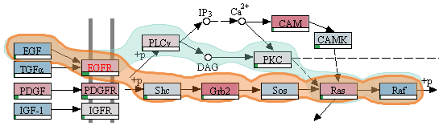


Data Visualization in Molecular Biology
Alexander Lex
July 29, 2013

Slide 2
research requires understanding data
but there is so much of it…

Slide 3
What is important?
Where are the connections?

Slide 4

protein expression
publications
microRNA expression
clinical parameters
mRNA expression
pathways
methylation levels
mutation status
copy number status
sequencing data
Notes:
Every one of them is a huge table

Slide 5
Data Visualization
… makes the data accessible
… combines strengths of humans and computers
… enables insight
… communicates

Slide 6
Three Topics

Slide 7
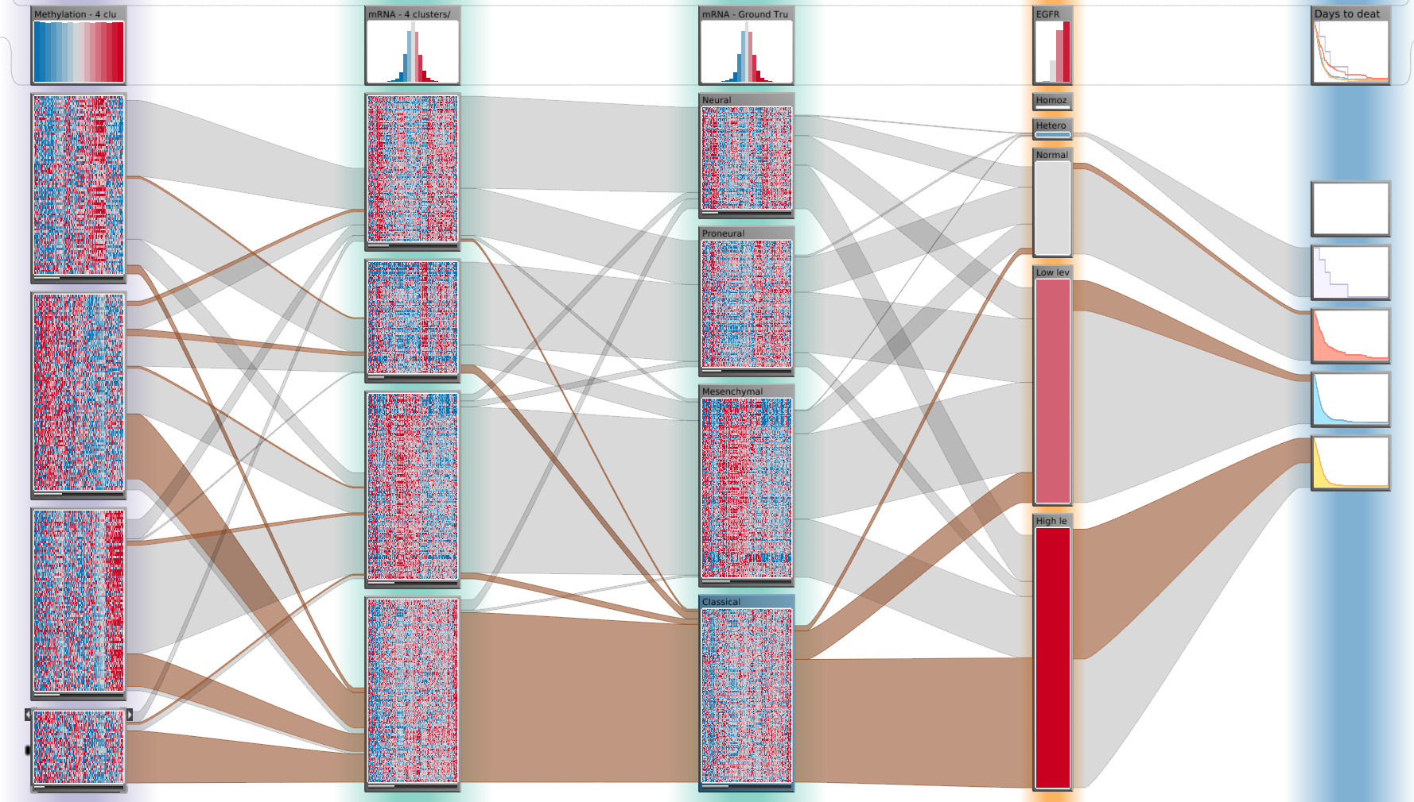
Cancer Subtype Analysis

Slide 8
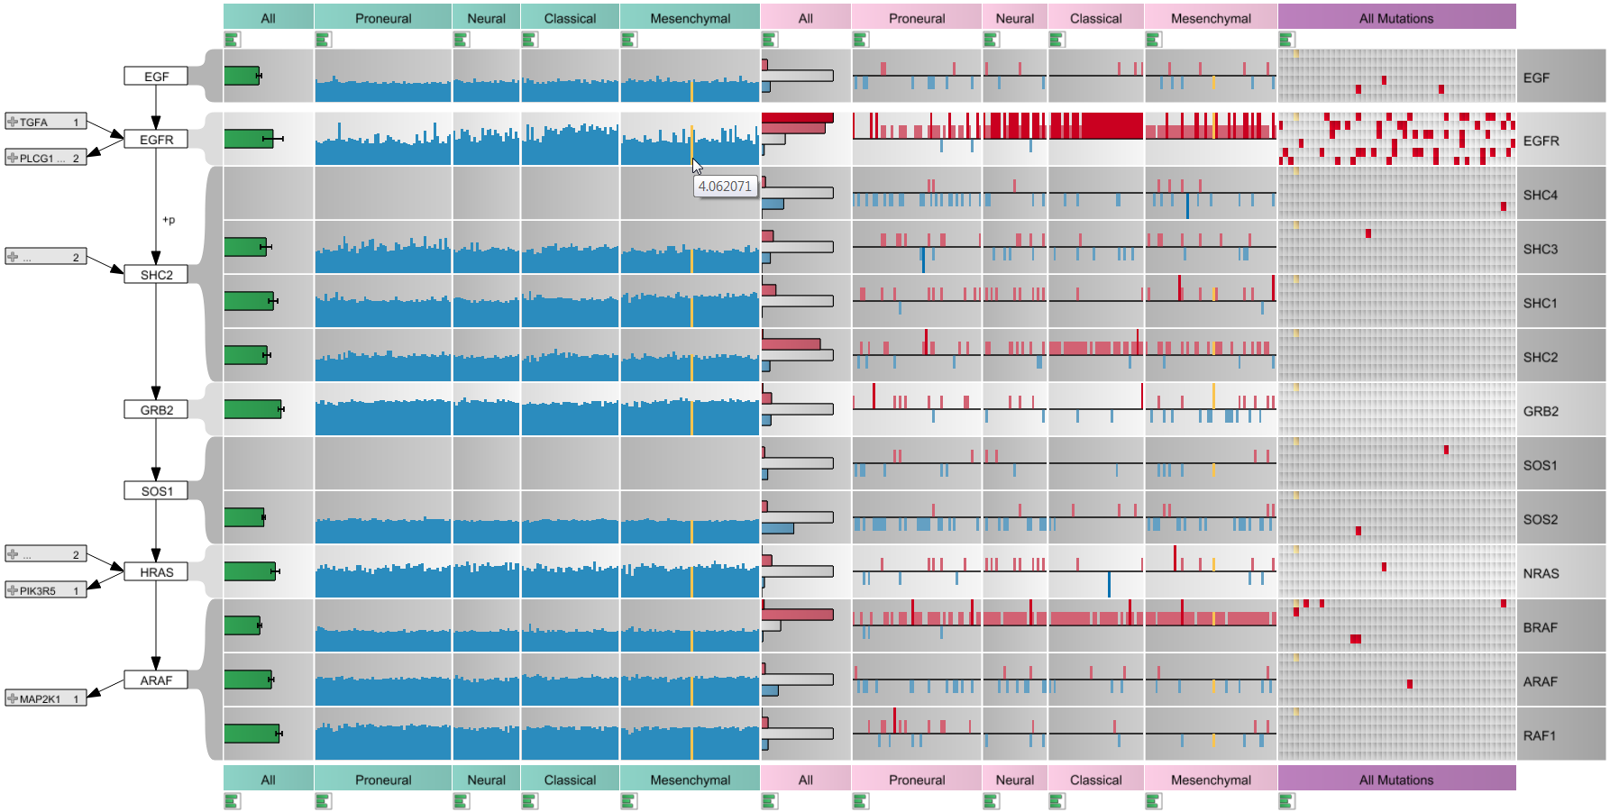
Pathways & Experimental Data

Slide 9
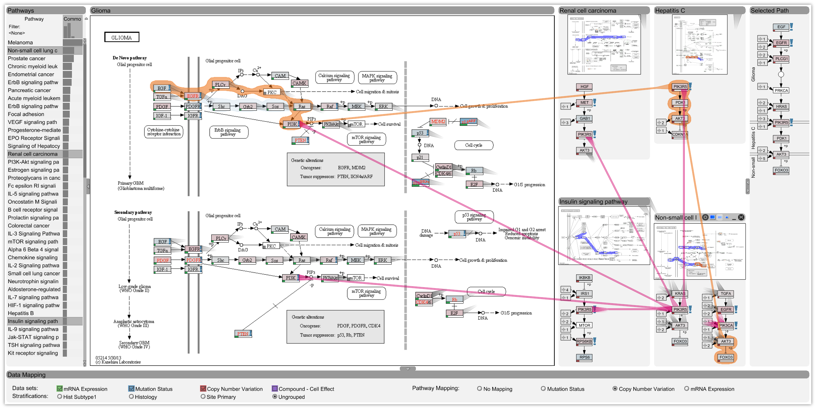
Managing Pathways & Cross-Pathway Analysis

Slide 10

Who am I?
PostDoc @ Harvard, Hanspeter Pfister’s Group
PhD from TU Graz, Austria
Co-leader of Caleydo Project

Slide 11
What is Caleydo?
Software analyzing molecular biology data
Software for doing research in visualization
developed in academic setting
platform for trying out radically new visualization ideas
Quest for compromise between academic prototyping and ready-to-use software

Slide 12
What is Caleydo?
Open source platform for developing visualization and data analysis techniques
easily extendible due to plug-in architecture
you can create your own views
you can plug-in your own algorithms

Slide 13



The Team
Marc Streit Johannes Kepler University Linz, AT
Christian Partl Graz University of Technology, AT
Samuel Gratzl Johannes Kepler University Linz, AT
Nils Gehlenborg Harvard Medical School, Boston, USA
Dieter Schmalstieg Graz University of Technology, AT
Hanspeter Pfister Harvard University, Cambridge, USA

Slide 14
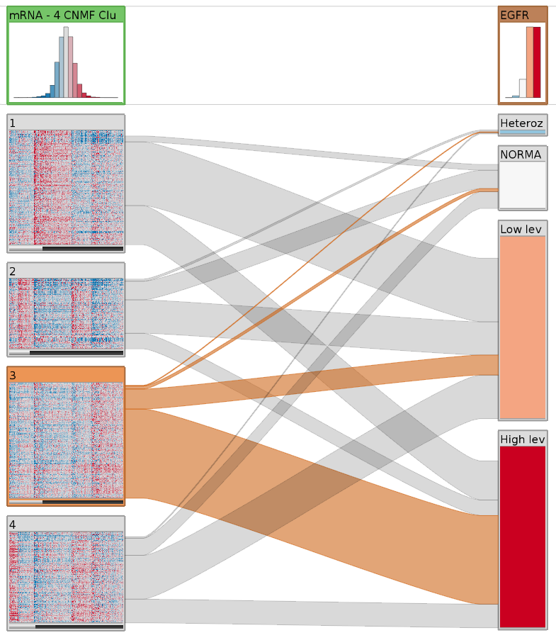
Cancer Subtype Visualization
Caleydo StratomeX

Slide 15




Cancer Subtypes
Cancer types are not homogeneous
They are divided into Subtypes
different histology
different molecular alterations
Subtypes have serious implications
different treatment for subtypes
prognosis varies between subtypes

Slide 16
Cancer Subtype Analysis
Done using many different types of data,
for large numbers of patients.
Notes:
Goal: improved patient outcome
Usually you have to deal with lots of different tables that you have stored in a DB or files

Slide 17
Large-scale project to catalogue genetic mutations responsible for cancer
20 tumor types
500 patient samples each
Extensive molecular profiling for each patient
Notes:
“The Cancer Genome Atlas is a comprehensive and coordinated effort to
accelerate our understanding of the molecular basis of cancer through the
application of genome analysis technologies, including large-scale genome
sequencing.”

Slide 18
Goal:
Support tumor subtype characterization through
Integrative visual analysis of cancer genomics data sets.

Slide 19
Stratification
Tabular Data
Patients
Candidate Subtypes
Genes, Proteins, etc.

Slide 20
Stratification of a Single Dataset
Cluster A1
Subtypes are identified by stratifying datasets, e.g.,
based on an expression pattern
a mutation status
a copy number alteration
a combination of these
Cluster A2
Cluster A3

Slide 21
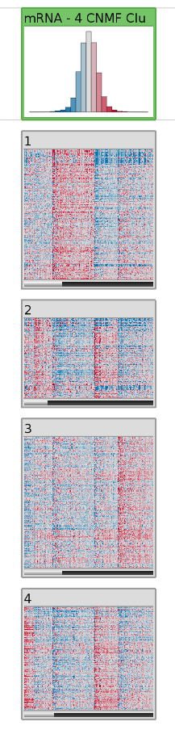
Header / Summary of
whole Stratification
Patients
Candidate Subtype /
Heat Map
Genes

Slide 22
Stratification of Multiple Datasets
Cluster A1
B1
B2
Cluster A2
Cluster A3
Tabular e.g., mRNA
Categorical,
e.g., mutation status

Slide 23
Stratification of Multiple Datasets
Cluster A1
B1
B2
Cluster A2
Cluster A3
Tabular e.g., mRNA
Categorical,
e.g., mutation status

Slide 24
Many shared Patients
Clustering of mRNA Data
Stratification on Copy Number Status

Slide 25
Stratification of Multiple Datasets
Cluster A1
B1
B2
Cluster A2
Cluster A3
Tabular e.g., mRNA
Categorical,
e.g., mutation status

Slide 26
Stratification of Multiple Datasets
Cluster A1
B1
Dep. C1
B2
Cluster A2
Dep. C2
Cluster A3
Tabular e.g., mRNA
Categorical,
e.g., mutation status
Dependent Data, e.g. clinical data

Slide 27
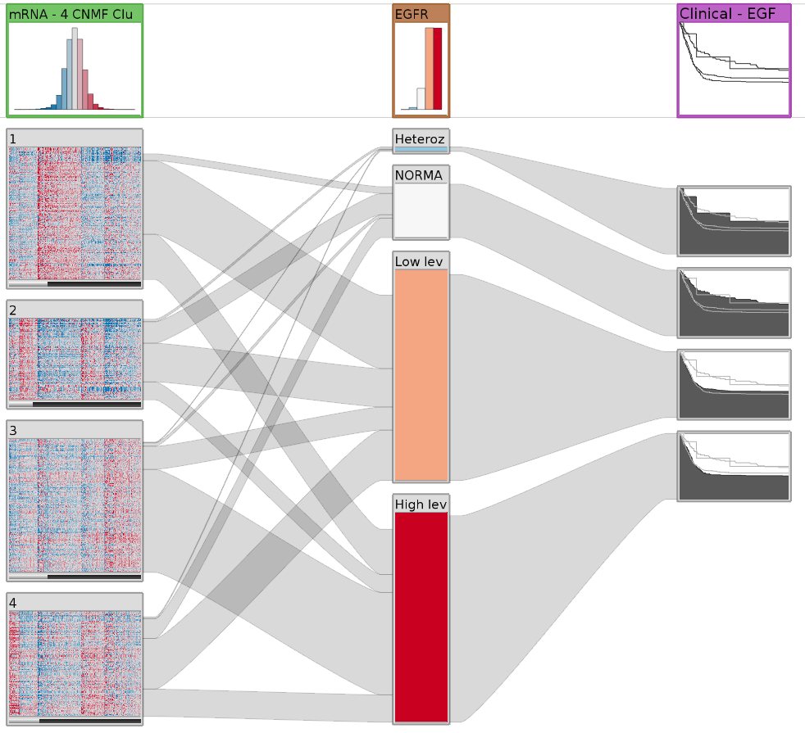
Survival data in Kaplan Meier plots

Slide 28
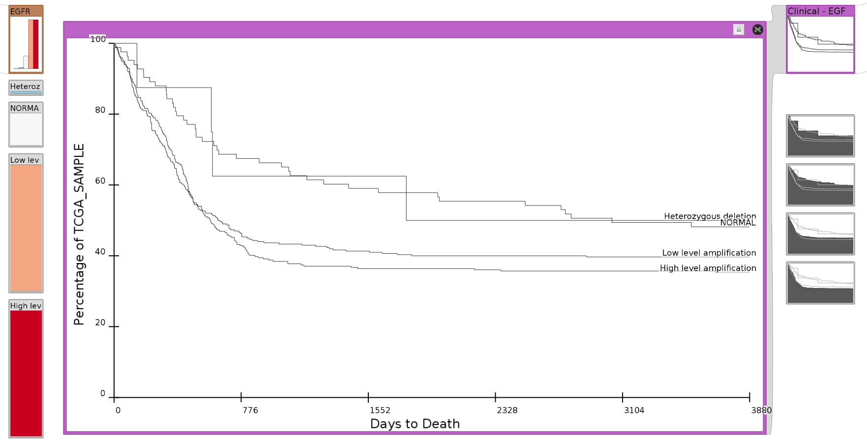
Detail View

Slide 29
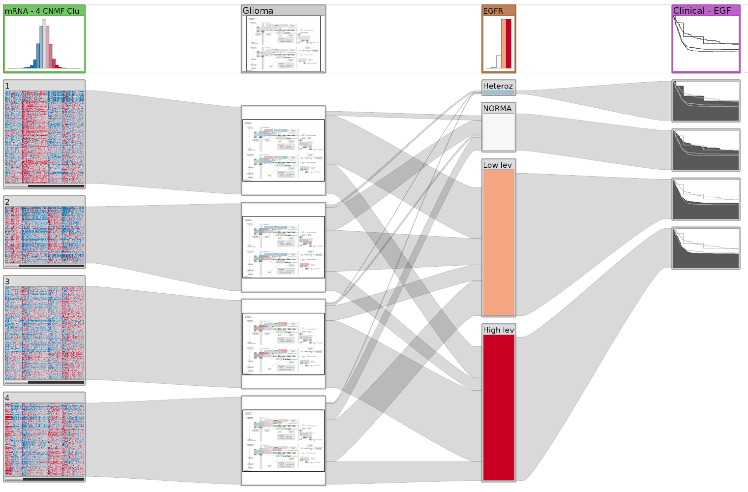
Dependent Pathway

Slide 30
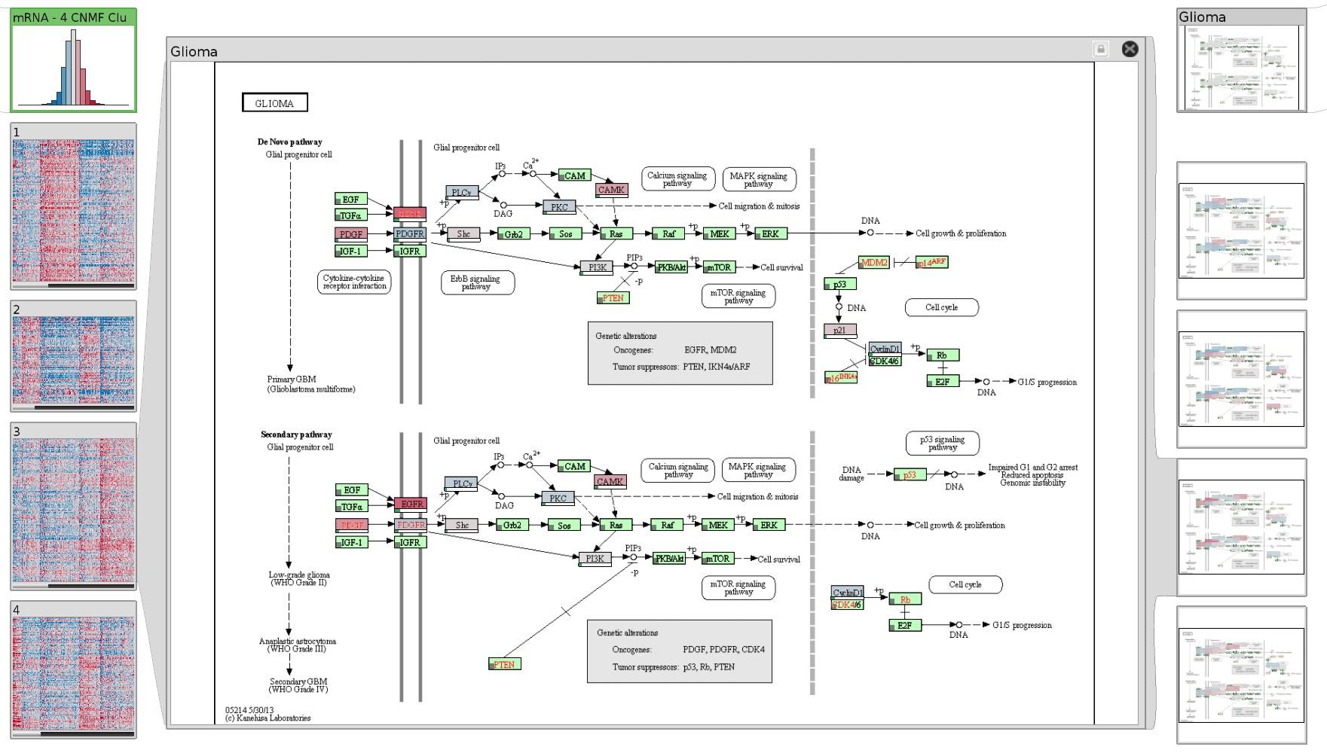

Slide 31
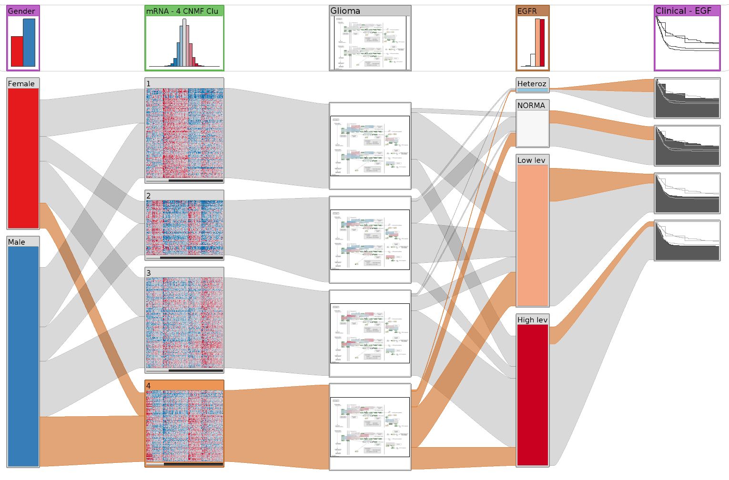
Stratification based on clinical variable (gender)

Slide 32
How to Choose Stratifications?
~ 15 clusterings per matrix
~ 15,000 stratifications for copy number & mutations
~ 500 pathways
~ 20 clinical variables
Calculating scores for matches
Ranking the results

Slide 33
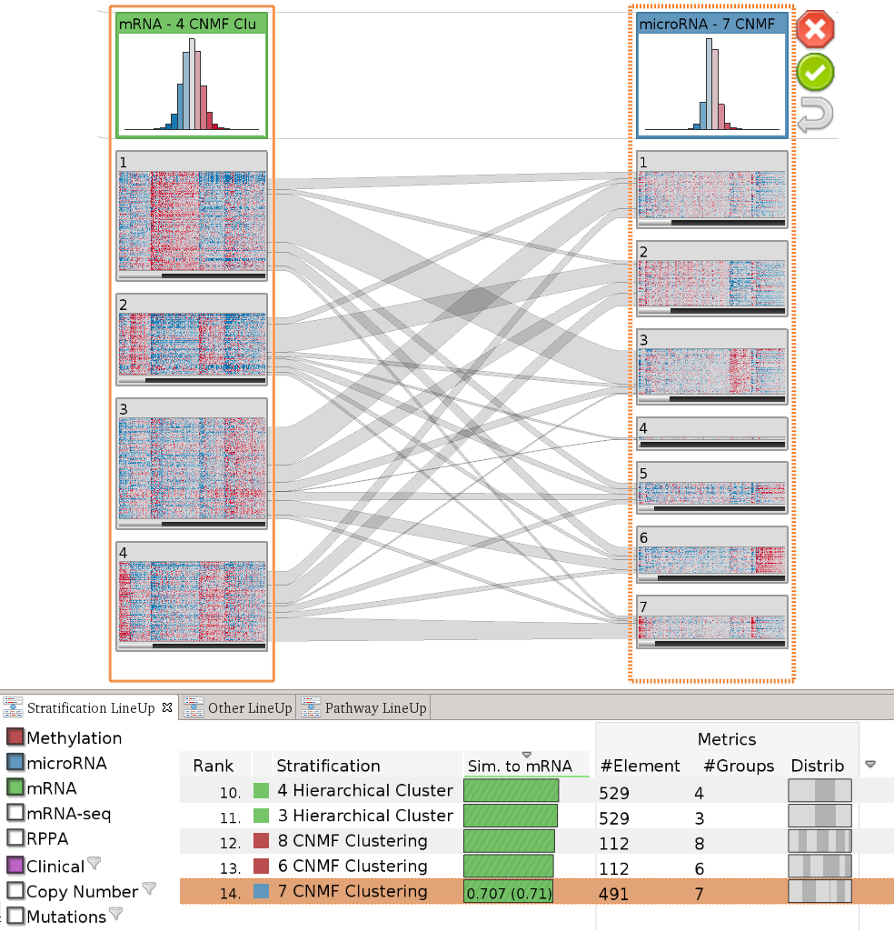
Query column
Result column
Considered Datasets
Ranked Stratifications

Slide 34
Algorithms for finding..
… matching stratification
… matching subtype
… mutual exclusivity
… relevant pathway
… stratification with significant effect in survival
… high/low structural variation

Slide 35
Live-Demo!
http://stratomex.caleydo.org

Slide 36
Pathways & Experimental Data
Caleydo enRoute

Slide 37
Experimental Data and Pathways
Cannot account for variation found in real-world data
Branches can be (in)activated due to
mutation,
changed gene expression,
modulation due to drug treatment,
etc.

Slide 38
Why use Visualization?
Efficient communication of information
A -3.4
B 2.8
C 3.1
D -3
E 0.5
F 0.3
B
A
C
D
E
F

Slide 39
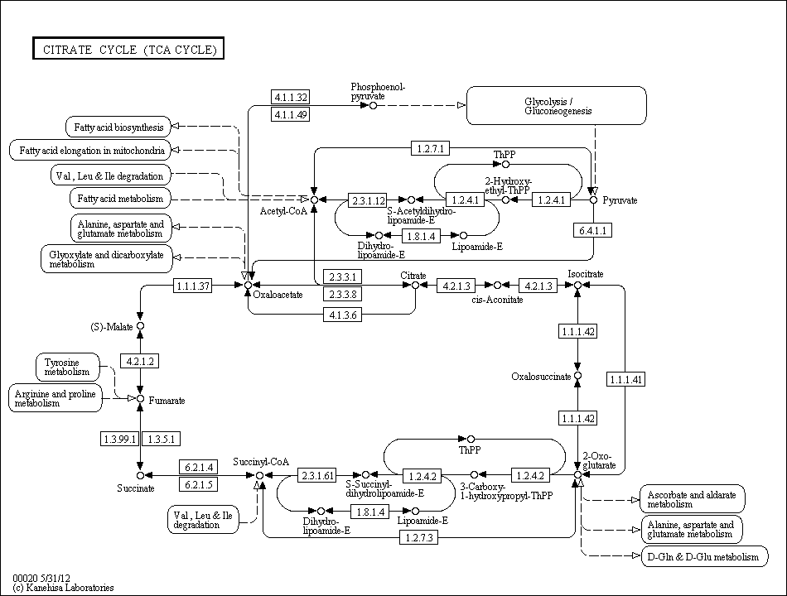
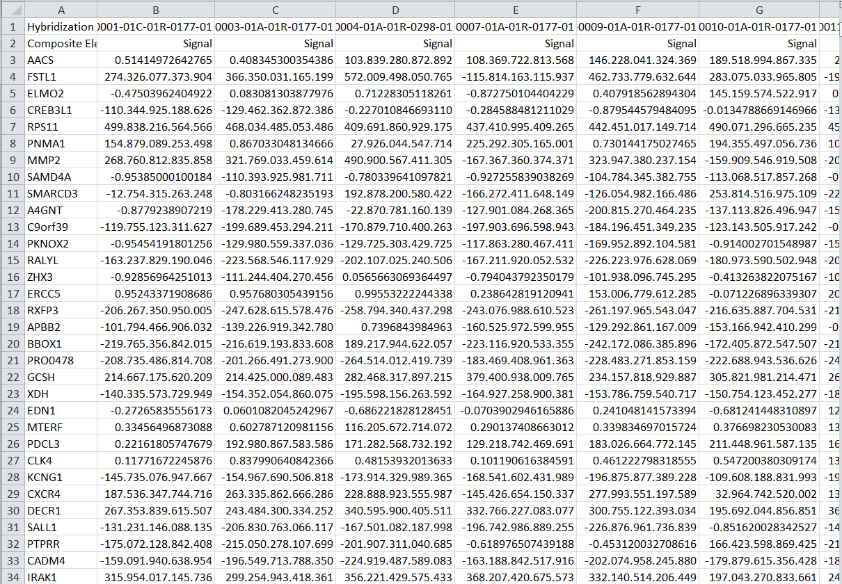

Experimental Data and Pathways
[KEGG]
[Lindroos2002]

Slide 40
Five Requirements
Ideal visualization technique addresses all
Talking about 3 today

Slide 41
R I: Data Scale
Large number of experiments
Large datasets have more than 500 experiments
Multiple groups/conditions

Slide 42
R II: Data Heterogeneity
Different types of data, e.g.,
mRNA expression numerical
mutation status categorical
copy number variation ordered categorical
metabolite concentration numerical
Require different visualization techniques

Slide 43
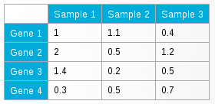
R V: Supporting Multiple Tasks
B
Two central tasks:
Explore topology of pathway
Explore the attributes of the nodes (experimental data)
Need to support both!
A
C
D
E
F

Slide 44
Concept
Pathway View
Pathway View
enRoute View
B
B
B
A
A
A
C
C
C
D
D
D
E
E
E
F
F
F
Group 1
Dataset 1
Group 2
Dataset 1
Group 1
Dataset 2

Slide 45
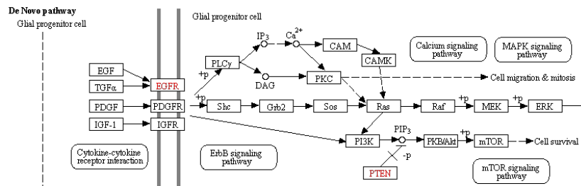
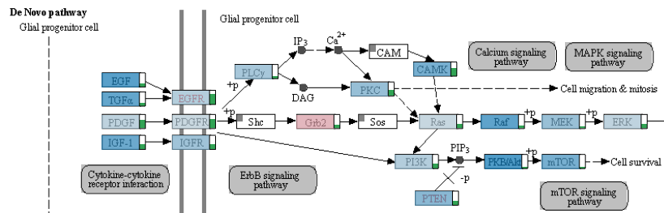
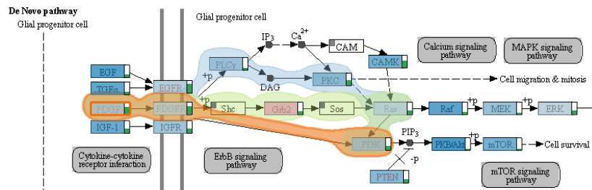
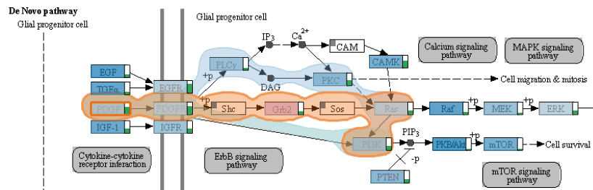
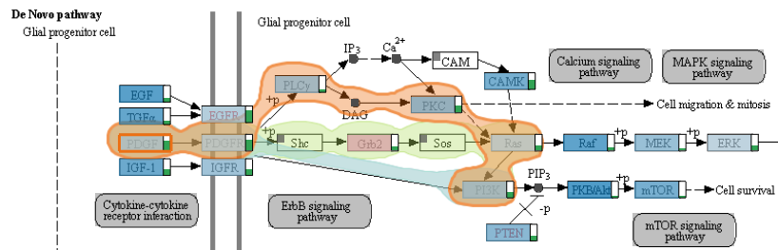
Pathway View
low
high
IGF-1
On-Node Mapping
Path highlighting with Bubble Sets [Collins2009]

Slide 46
enRoute View
B
A
C
D
E
F
Group 1
Dataset 1
Group 2
Dataset 1
Group 1
Dataset 2
Path Representation

Slide 47
enRoute View
B
A
C
D
E
F
Group 1
Dataset 1
Group 2
Dataset 1
Group 1
Dataset 2
Experimental Data Representation

Slide 48






Experimental Data Representation
Gene Expression Data (Numerical)
Copy Number Data (Ordered Categorical)
Mutation Data

Slide 49
enRoute View – Putting All Together

Slide 50
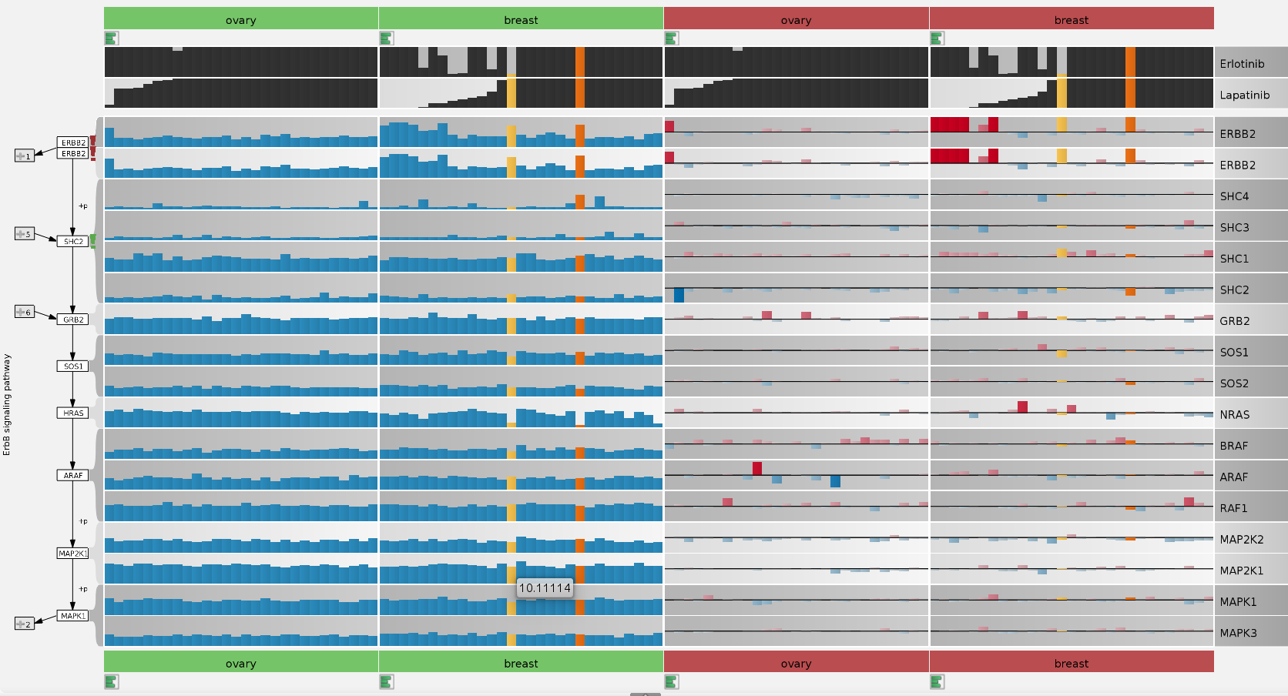
CCLE Cell lines & Cancer Drugs
Analysis by Anne Mai Wasserman

Slide 51
Managing Pathways & Cross-Pathway Analysis
Collaboration with AM Wassermann, M Borowsky, M Glick @NIBR

Slide 52
Pathways
Partitioning in pathways is artificial
Purpose: reduce complexity
“Relevant” subset of nodes and edge
Makes it hard to
understand cross-talk
identify role of nodes in other pathways

Slide 53
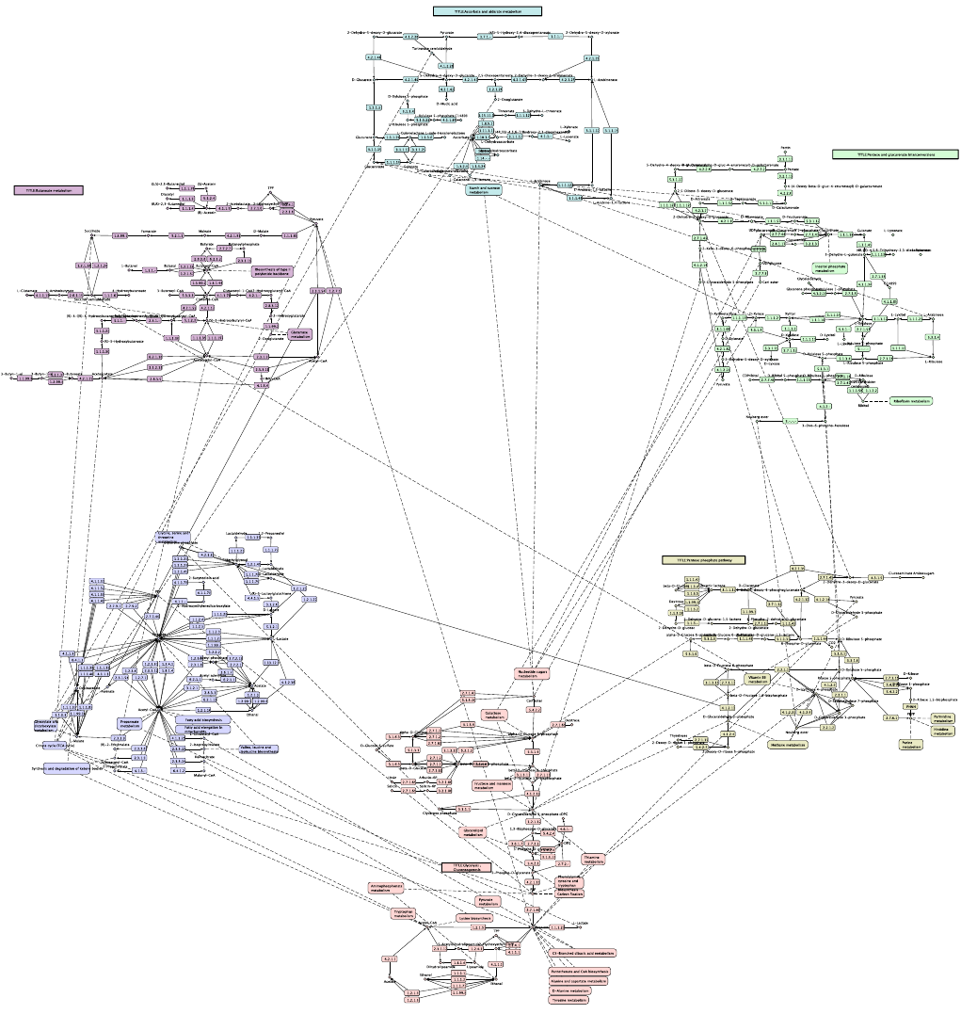
[Klukas & Schreiber 2006]

Slide 54
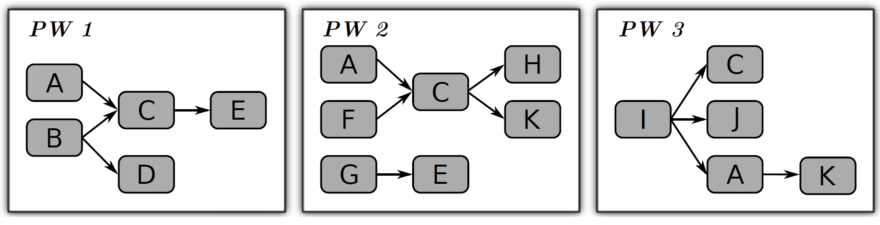
Solution: Contextual Subsets

Slide 55
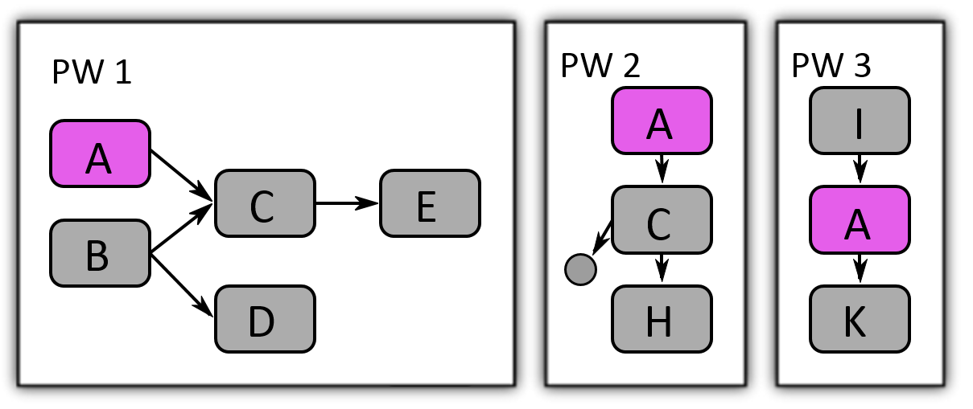
Solution: Contextual Subsets

Slide 56
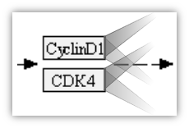
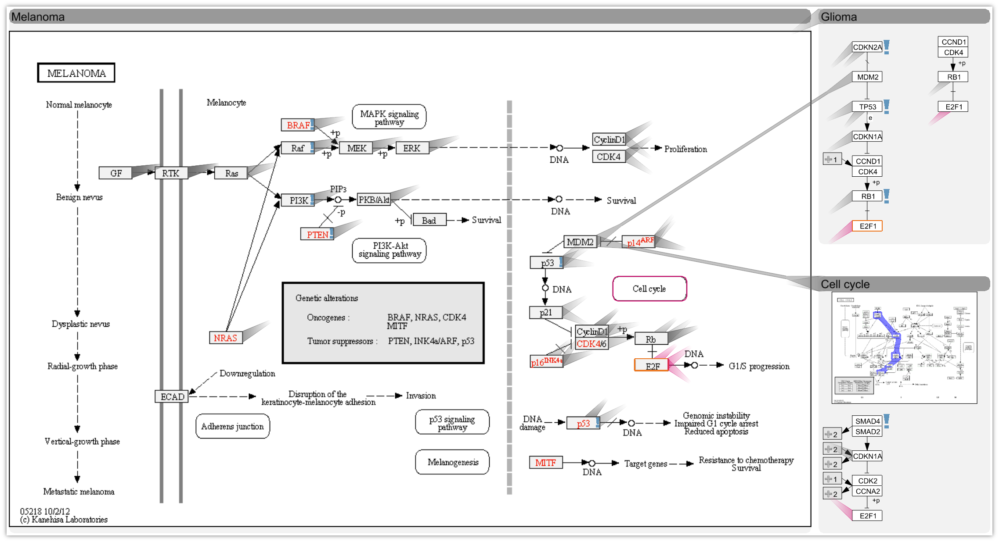

Slide 57
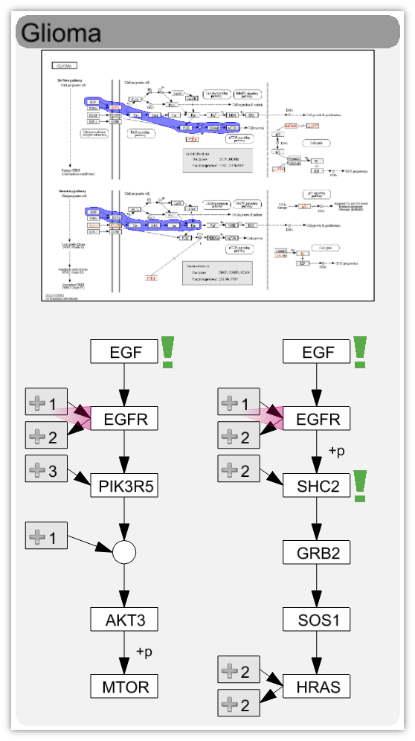
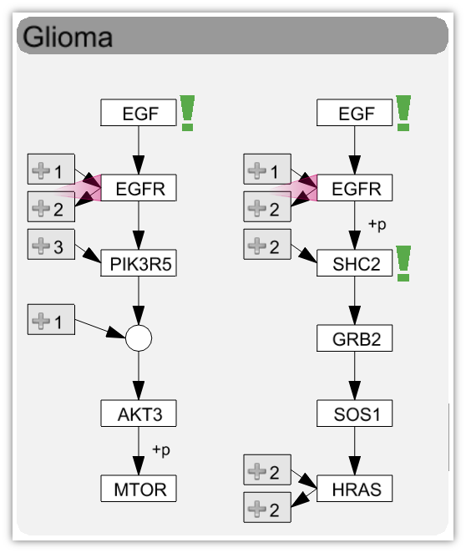
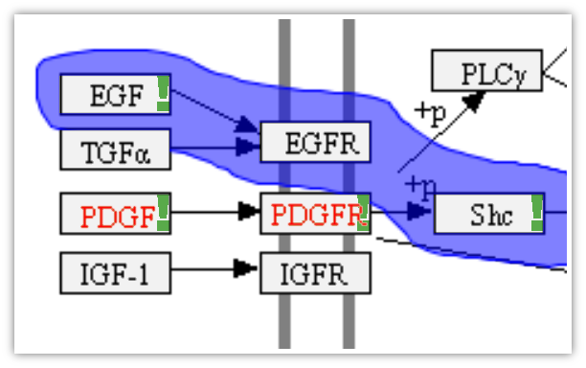

Levels of Detail
Thumbnail
showing paths
Experimental data highlights

Slide 58
How to Select Pathways?
Search Pathway
Find pathways that contain focus node
Find pathway that is similar to another one

Slide 59
Ranked
pathway list
Selected Path
Datasets

Slide 60
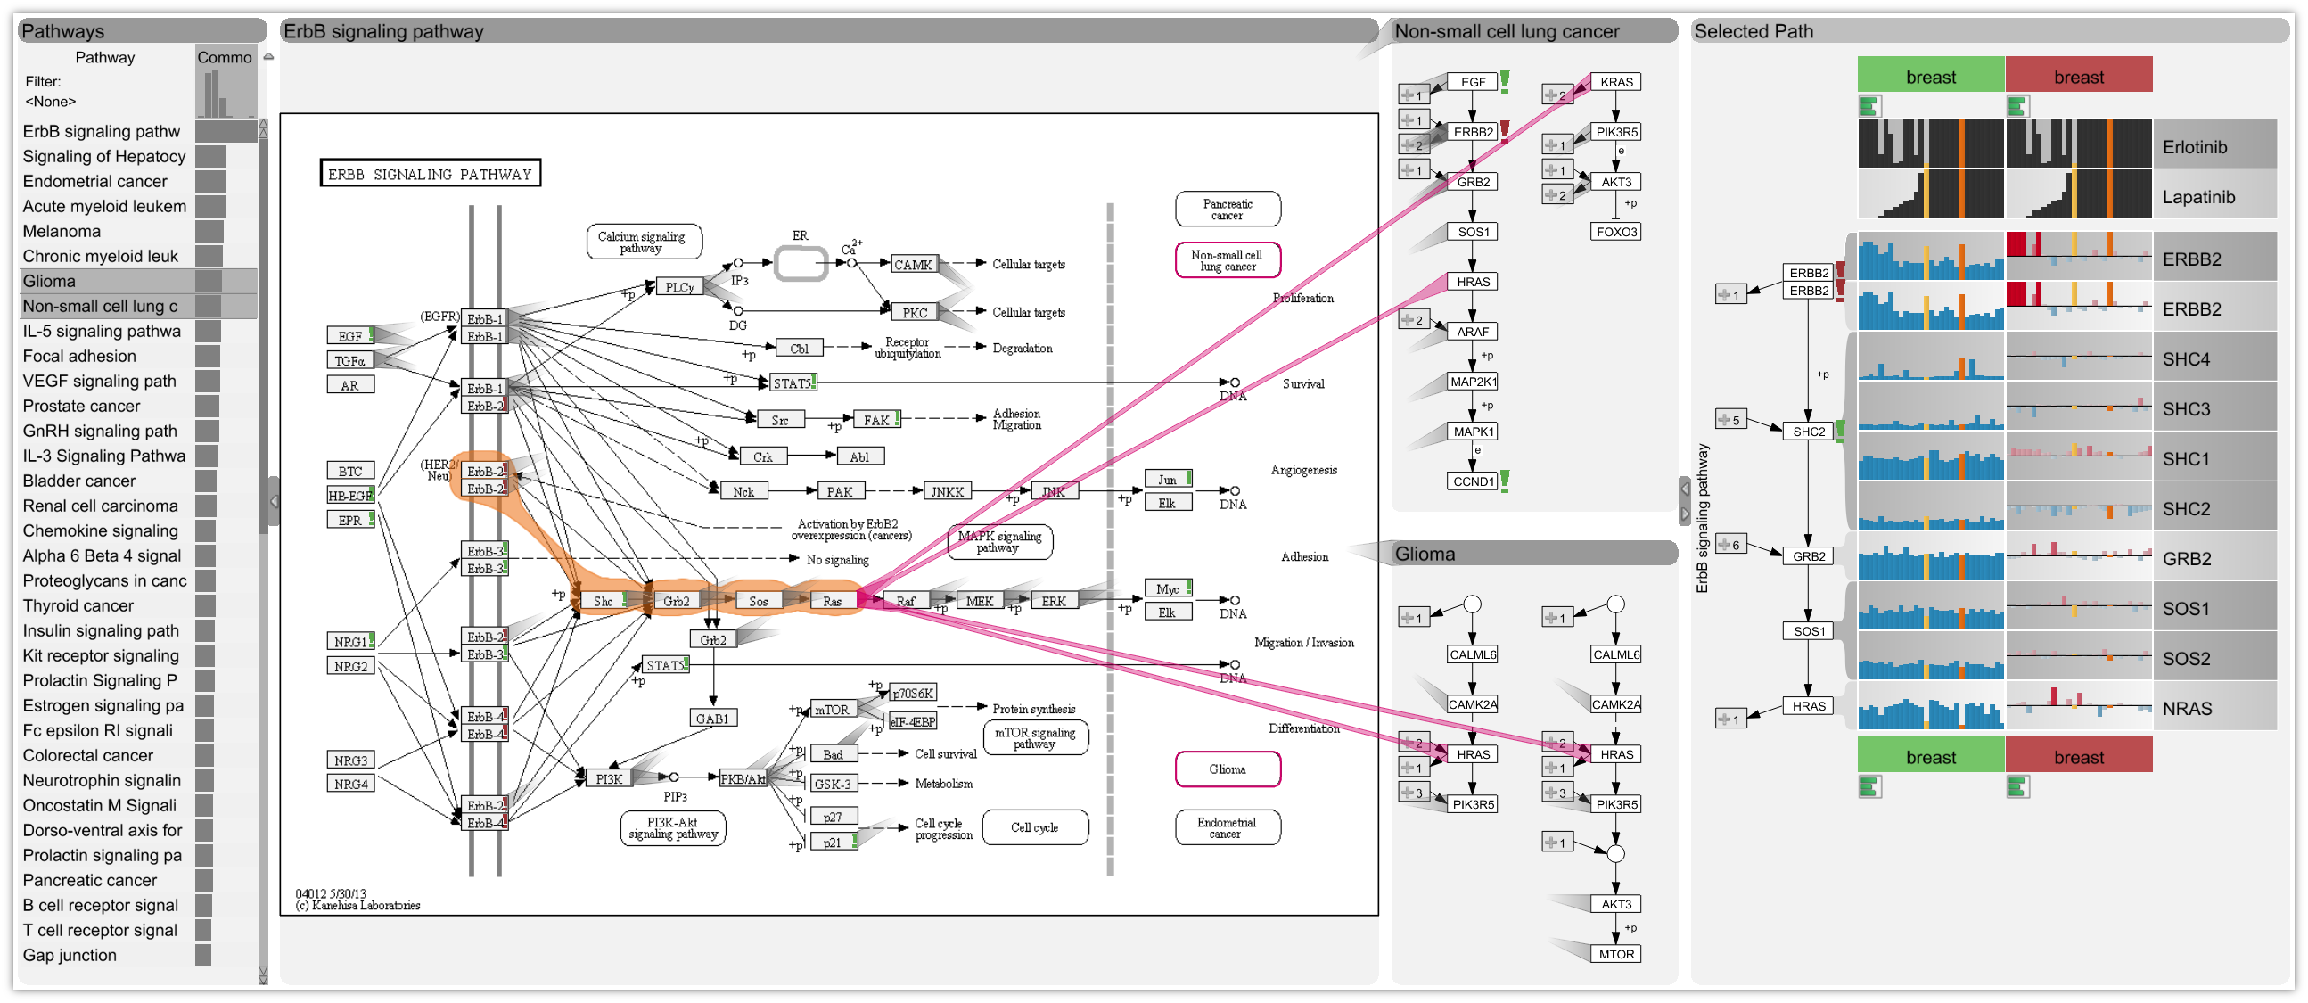
Integrating enRoute

Slide 61
Video!
http://enroute.caleydo.org

Slide 62
More Information
http://caleydo.org
Software, Help, Project Information, Publications, Videos

Slide 63

Data Visualization In Molecular Biology
?
Alexander Lex, Harvard University
alex@seas.harvard.edu
http://alexander-lex.com
Credits:
Marc Streit, Nils Gehlenborg, Hanspeter Pfister, Anne Mai Wasserman, Mark Borowsky,, Christian Partl, Denis Kalkofen, Samuel Gratzl, Dieter Schmalstieg

