Slide 1
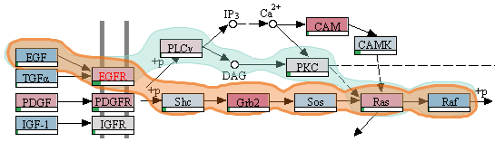


A Very Short Visualization Introduction Visualizing Multi-Attribute Rankings
Alexander Lex
Strategic Data Project
Harvard Graduate School of Education
March 07, 2014
Notes:
Shorten
Talk about some key points that are not in the slide
Cancer first , then university ranking, then context
Start with who am I, move cancer stuff to later, or find transition to ranking
Pause in LineUp slides
Not visible in slides – pathway klukas
Other research, maybe in beginning
Conclusion connecting projects, project to future points
Filtered to US and UK
Anne – drop Anne?
Team, don’t mention names verbally
Define Visualization, personal?

Slide 2

Who am I? alexander-lex.com
PostDoc @ Harvard, Hanspeter Pfister’s Group
PhD from TU Graz, Austria
Co-leader of Caleydo Project

Slide 3



Core Collaborators
Marc Streit Johannes Kepler University Linz, AT
Christian Partl Graz University of Technology, AT
Samuel Gratzl Johannes Kepler University Linz, AT
Nils Gehlenborg Harvard Medical School, Boston, USA
Dieter Schmalstieg Graz University of Technology, AT
Hanspeter Pfister Harvard University, Cambridge, USA

Slide 4
Historical Quotes
Imagination or visualization, and in particular the use of diagrams, has a crucial part to play in scientific investigation. - René Descartes, 1637
The purpose of computing is insight, not numbers.
- Richard Wesley Hamming(Founder of the ACM), 1962
Graphics is the visual means of resolving logical problems. - Jacques Bertin, 1977

Slide 5
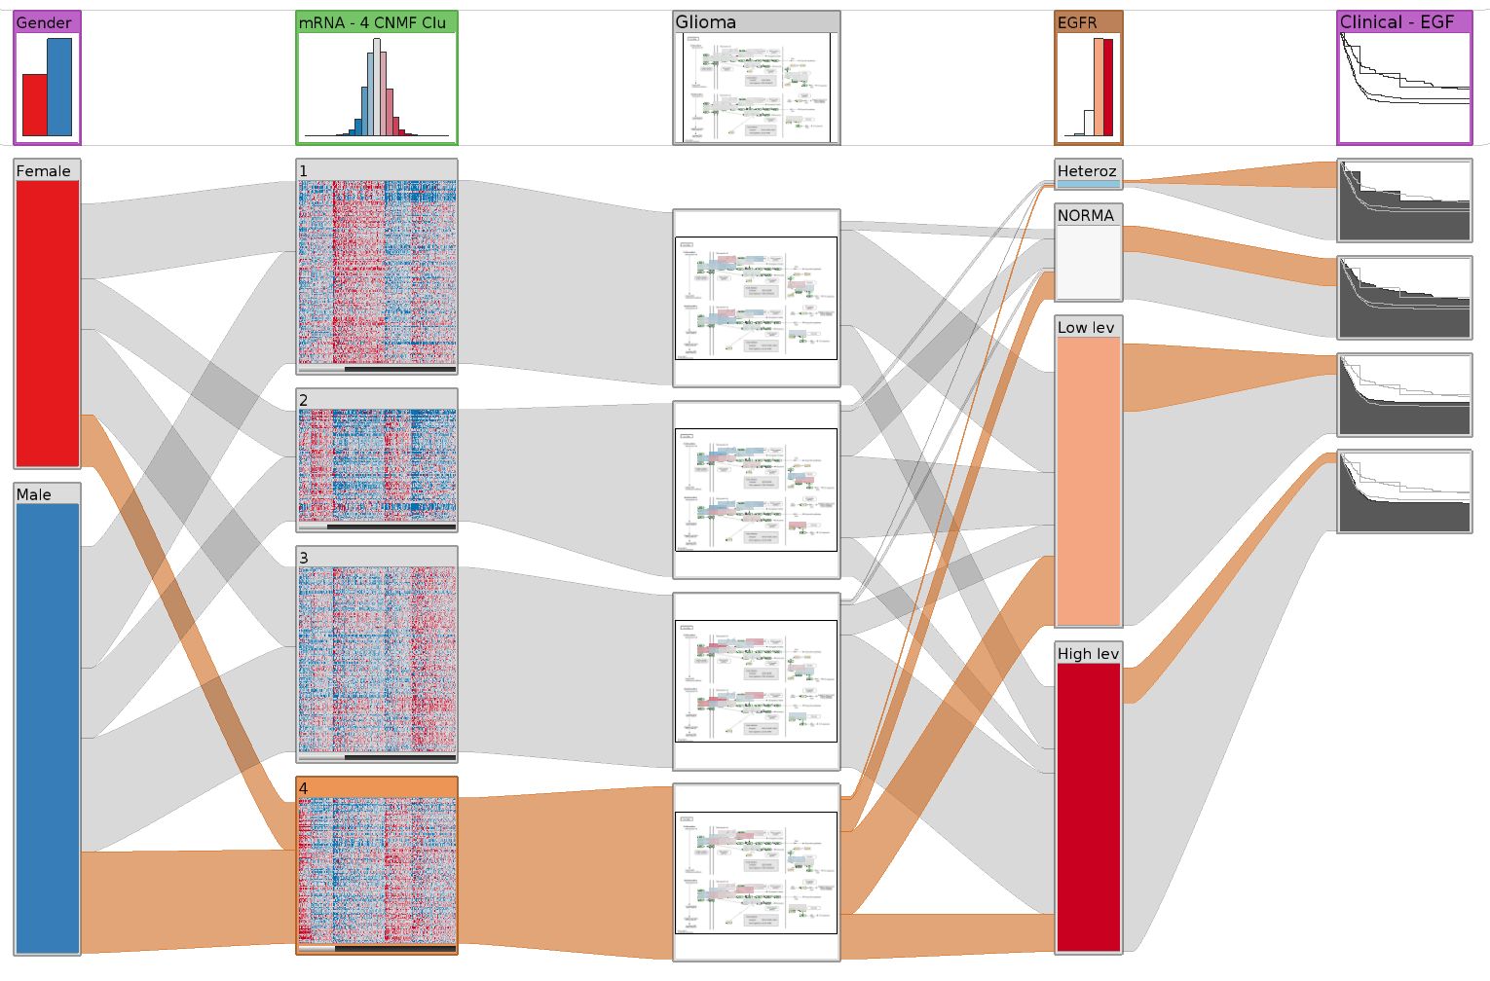
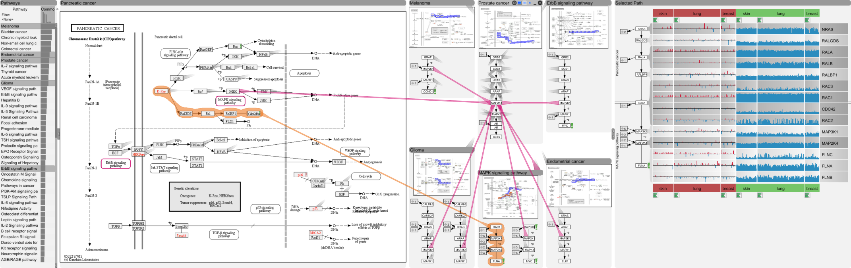
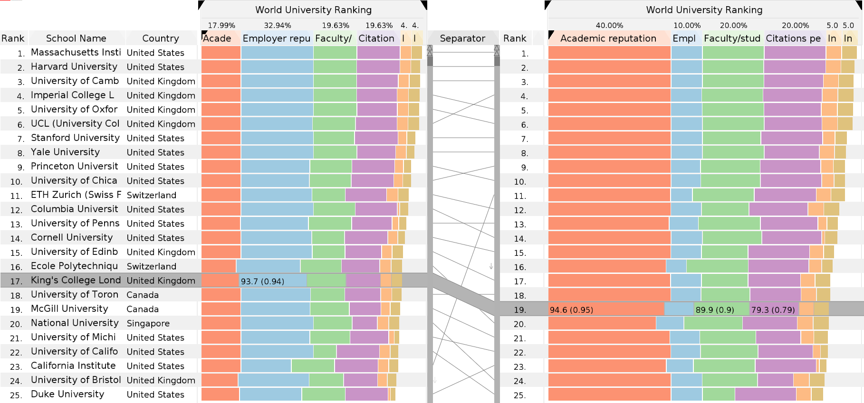
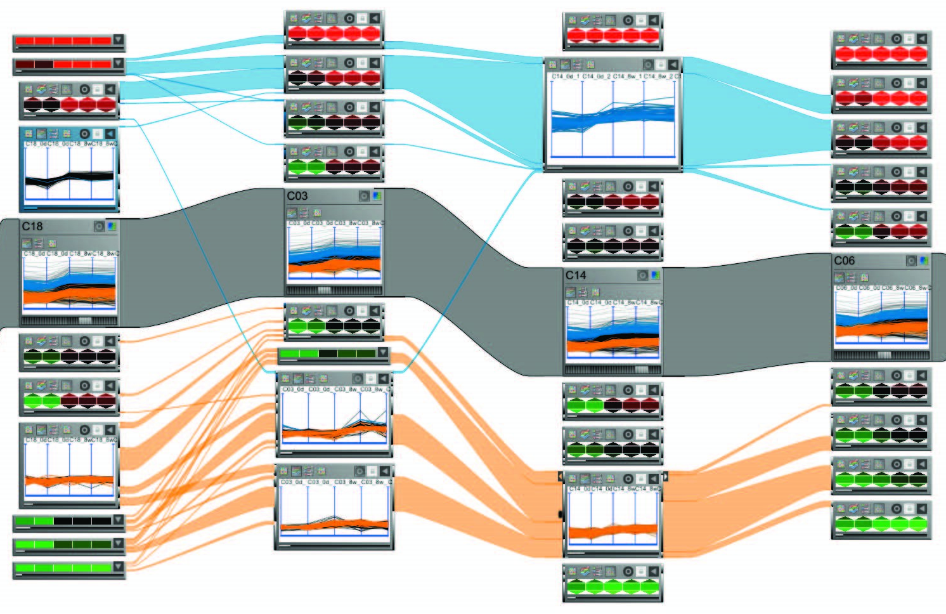
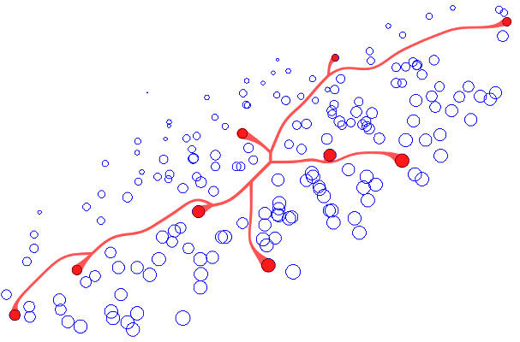
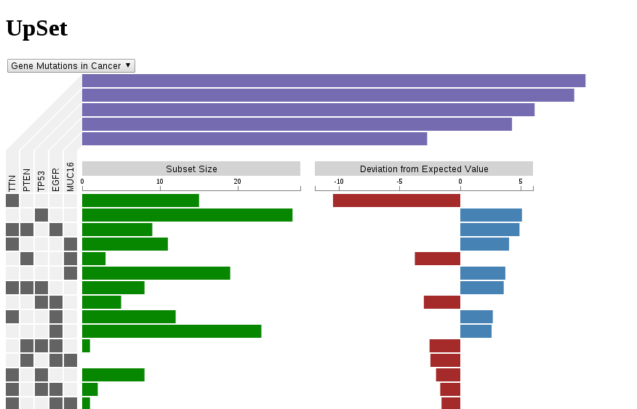
Heterogeneous Datasets
Multi-variate Graphs
Multi-attribute Rankings
Multi-dim. Datasets
Visual Linking
Set Visualization

Slide 6
Heterogeneous Data
Cancer Subtypes
[Lex, EuroVis ‘12]
3rd Best Paper Award

Slide 7
Pathways
[Partl, BioVis ‘12]
Best Paper Award

Slide 8
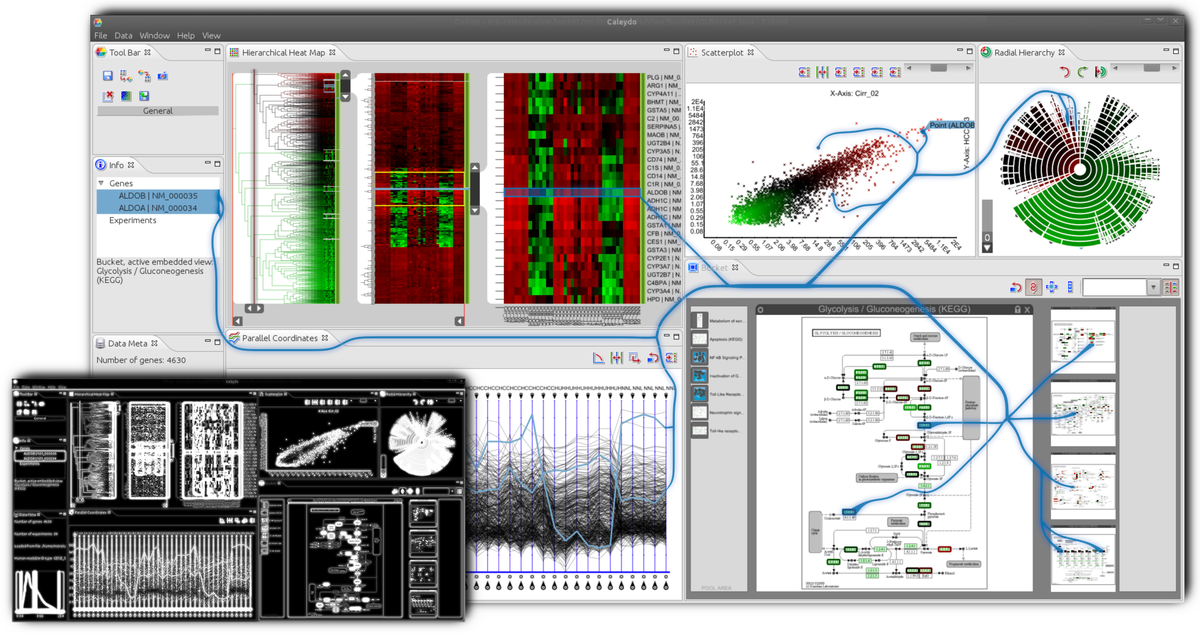
Visual Links
[Steinberger InfoVis’11]
Best Paper Award
[Steinberger InfoVis’11]
Best Paper Award

Slide 9
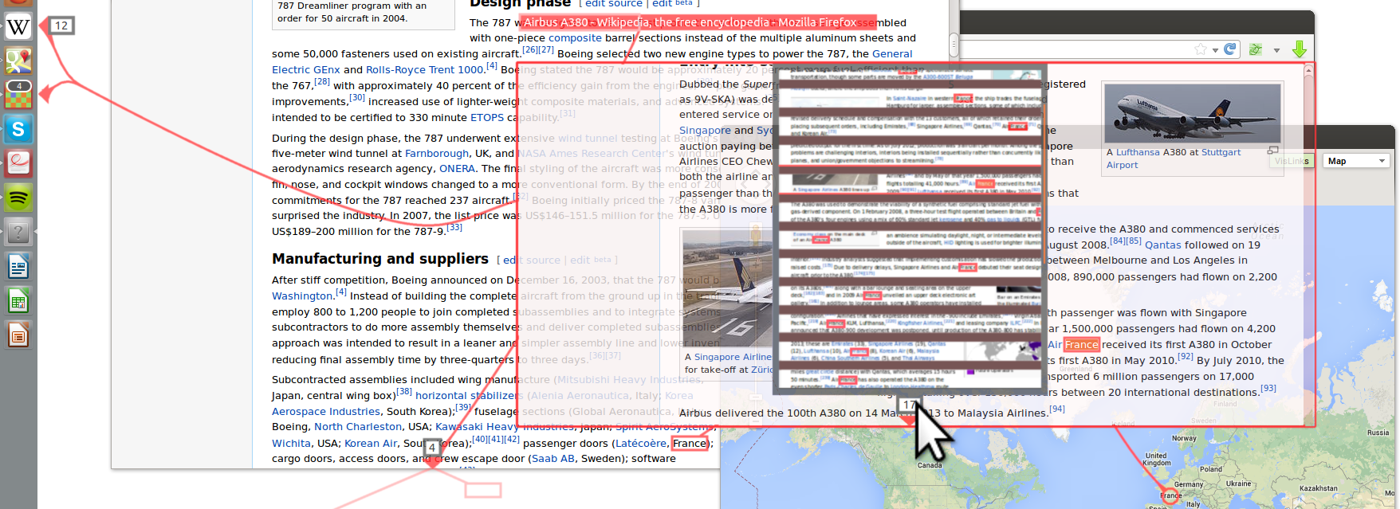
Visualizing Hidden Content
[Geymayer CHI’14]
Honorable Mention Award

Slide 11
Rankings
[Gratzl, InfoVis ‘13]
Best Paper Award

Slide 12
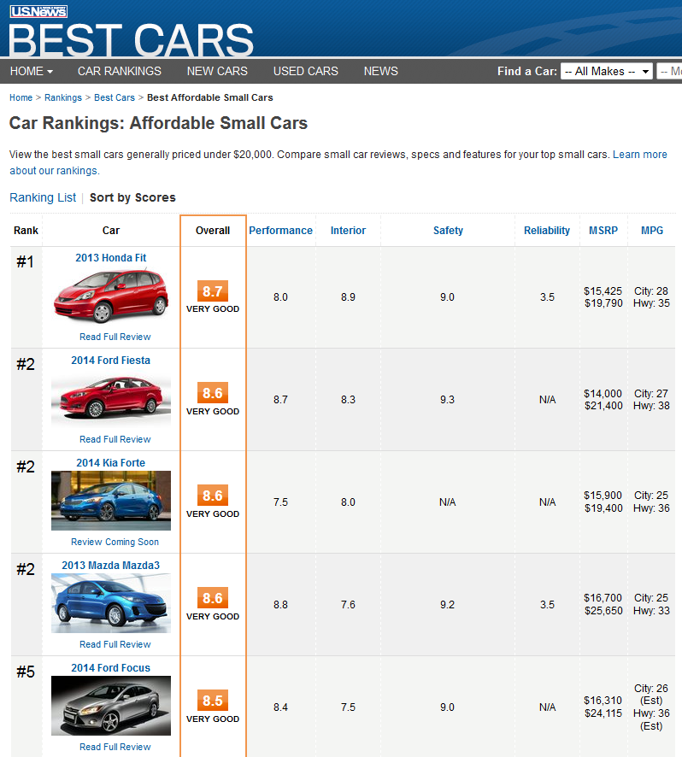
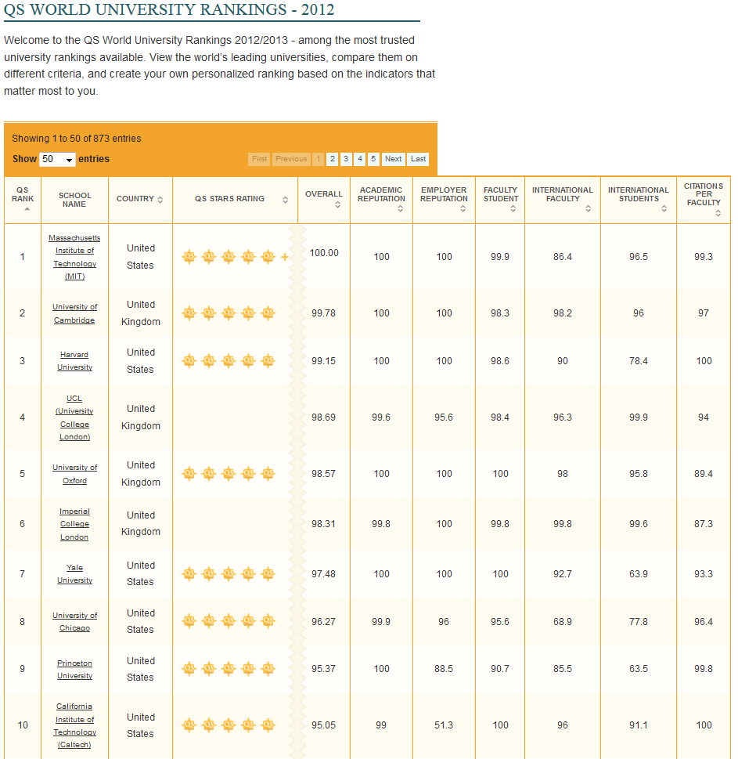
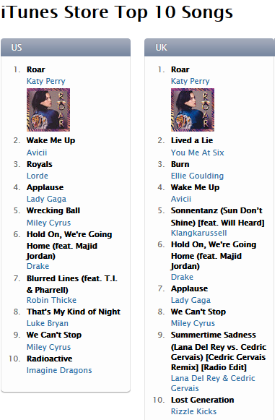
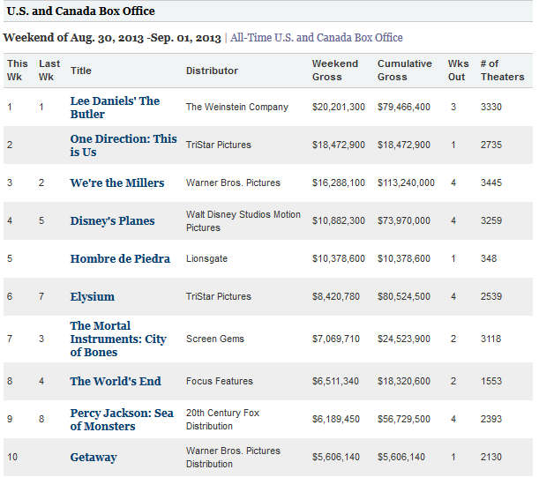
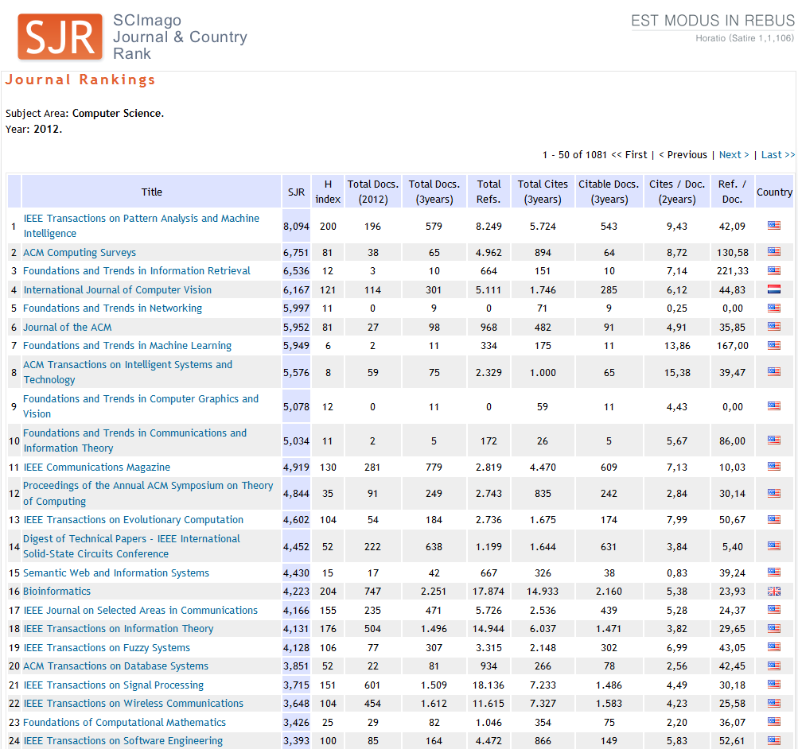
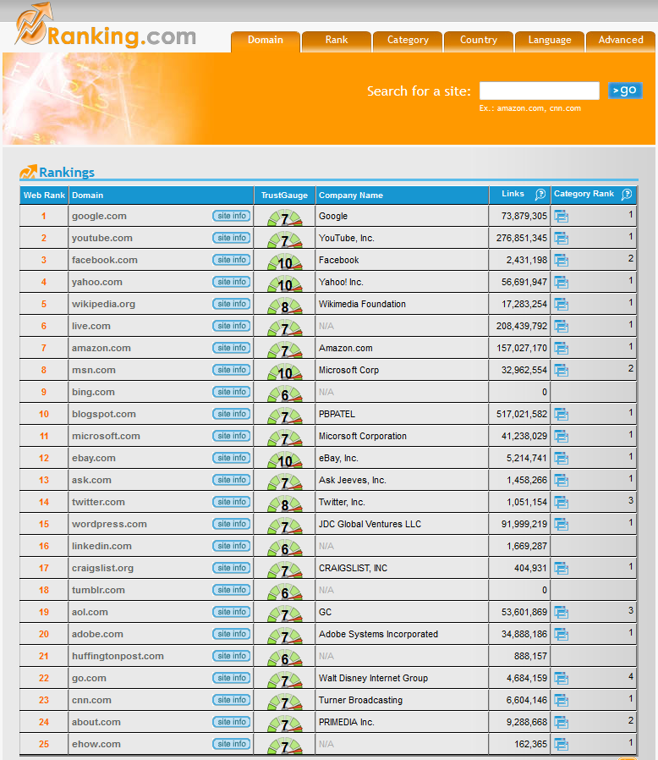
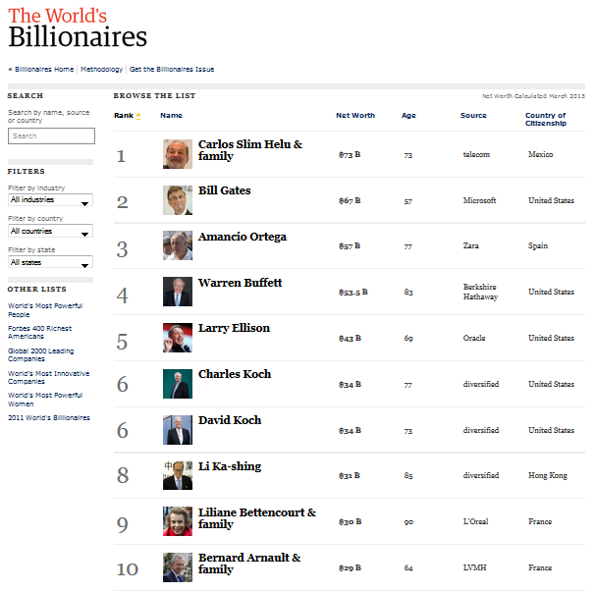
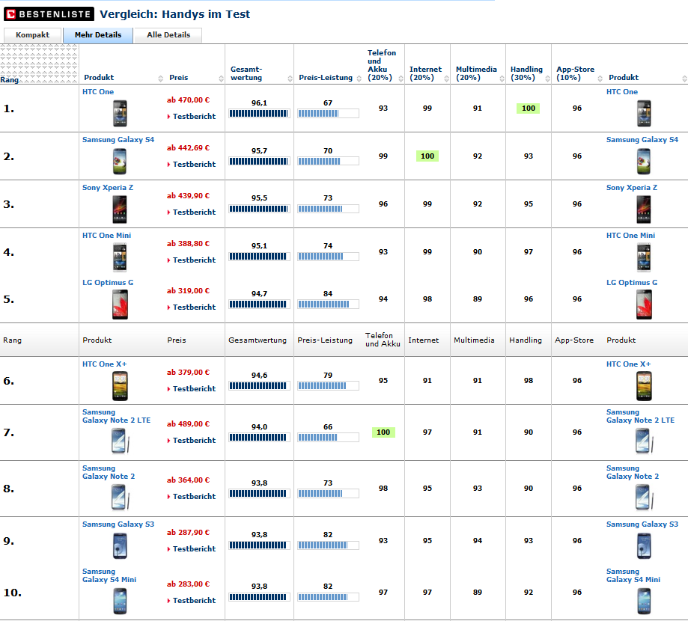
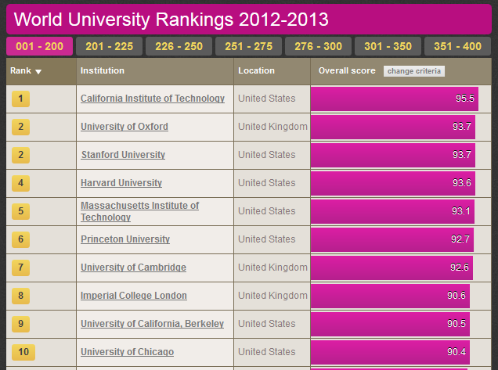

Rankings are omnipresent
Notes:
Rankings are omnipresent. They tell us what is the best, who has the most money and are helping us managing the vast amount of data.
There are simple rankings based on a single attribute like the iTunes top 10 there are range of rankings, which are based on multiple attributes, like Journal Rankings, Unviersity rankings or what is an energy efficient car.
While for the former one you don‘t need sophisticated tools, the later one are more complex to handle.
We therefore defined

Slide 13
Goal
Intuitive
Interactive
Multi-Attribute
Ranking Visualization
To Create
Refine
Explore

Slide 14
10 Requirements

Slide 15
University
MIT, USA
Harvard, USA
Princeton, USA
Cambridge, UK
Oxford, UK
Notes:
Start with a simple ordered university list
Problem: want is the rank of item X → have to count → so
Therefore the first requirement is to encode the rank
This is simple to solve, just add a column showing the rank of the item

Slide 16
10 Requirements
Encode Rank
University
Encode Rank
MIT, USA
Harvard, USA
Princeton, USA
Cambridge, UK
Oxford, UK
Notes:
Start with a simple ordered university list
Problem: want is the rank of item X → have to count → so
Therefore the first requirement is to encode the rank
This is simple to solve, just add a column showing the rank of the item

Slide 17
10 Requirements
Encode Rank
University
Encode Rank
MIT, USA
Harvard, USA
Princeton, USA
Cambridge, UK
Oxford, UK
Notes:
Start with a simple ordered university list
Problem: want is the rank of item X → have to count → so
Therefore the first requirement is to encode the rank
This is simple to solve, just add a column showing the rank of the item

Slide 18
Rank
University
1.
MIT, USA
2.
Harvard, USA
3.
Princeton, USA
4.
Cambridge, UK
5.
Oxford, UK
Notes:
No we directly spot the rank of item item.
However we can‘t see, why MIT is at the first place and whether it is by far the best or not
So the second requirement is to encode the cause of the rank
Assuming that our ranking is based on a score, we just add another column.

Slide 19
10 Requirements
Encode Rank
Encode Cause of Rank
Rank
University
Encode Cause of Rank
1.
MIT, USA
2.
Harvard, USA
3.
Princeton, USA
4.
Cambridge, UK
5.
Oxford, UK
Notes:
No we directly spot the rank of item item.
However we can‘t see, why MIT is at the first place and whether it is by far the best or not
So the second requirement is to encode the cause of the rank
Assuming that our ranking is based on a score, we just add another column.

Slide 20
10 Requirements
Encode Rank
Encode Cause of Rank
Rank
University
Encode Cause of Rank
1.
MIT, USA
2.
Harvard, USA
3.
Princeton, USA
4.
Cambridge, UK
5.
Oxford, UK
Notes:
No we directly spot the rank of item item.
However we can‘t see, why MIT is at the first place and whether it is by far the best or not
So the second requirement is to encode the cause of the rank
Assuming that our ranking is based on a score, we just add another column.

Slide 21
Rank
University
Score
Score
1.
MIT, USA
89.4
2.
Harvard, USA
84.2
3.
Princeton, USA
73.8
4.
Cambridge, UK
64.3
5.
Oxford, UK
44.0
Notes:
For simpler interpretation, we can also use bars for the scores.
Now we can easy see that MIT and Harvard are quite close together. … it is a close call
That more or less everything you can do about single attribute rankings. But since we are talking the more complex multiple attribute rankings. The next logical requirement is to support multiple attributes.

Slide 22
10 Requirements
Encode Rank
Encode Cause of Rank
Support Multiple Attributes
Rank
University
Score
Support Multiple Attributes
1.
MIT, USA
2.
Harvard, USA
3.
Princeton, USA
4.
Cambridge, UK
5.
Oxford, UK
Notes:
For simpler interpretation, we can also use bars for the scores.
Now we can easy see that MIT and Harvard are quite close together.
That more or less everything you can do about single attribute rankings. But since we are talking the more complex multiple attribute rankings. The next logical requirement is to support multiple attributes.

Slide 23
10 Requirements
Encode Rank
Encode Cause of Rank
Support Multiple Attributes
Rank
University
Score
Support Multiple Attributes
1.
MIT, USA
2.
Harvard, USA
3.
Princeton, USA
4.
Cambridge, UK
5.
Oxford, UK
Notes:
For simpler interpretation, we can also use bars for the scores.
Now we can easy see that MIT and Harvard are quite close together.
That more or less everything you can do about single attribute rankings. But since we are talking the more complex multiple attribute rankings. The next logical requirement is to support multiple attributes.

Slide 24
Score = f(A, B, C)
Rank
University
A
Score
B
C
1.
MIT, USA
2.
Harvard, USA
3.
Princeton, USA
4.
Cambridge, UK
5.
Oxford, UK
Notes:
In our case we assume that the final score is combination of multiple other attributes. In our example A,B, and C.
Depending on the combiner function, there are various existing ways to encode and show the attributes.

Slide 25
Combiner functions: f(A,B,C)
(Weighted) sum Score = w_{a} A + w_{b} B + w_{c} C
Maximum Score = max(A, B, C)
Product
Nesting
…
Serial
Parallel
Complex Combiners
Notes:
A combiner functions can be anything.
The simplest one is a weighted sum. It means that an item has a high score if all combined attributes has a high value.
In constrast to that the maximum operation can be interpreted as that an item has a high score if any attribute is high
But there are plenty of other combiner functions out there. Like Product Nesting and so on
In LineUp we are calling the weightet sum the serial combiner and the maximum a parallel combiner.
In addition, LineUp supports all the others by providing a generic javascript editor, in which you can type in the formula similar to Excel.
While we have special visual encodings for the first two ones, the formula based is simply represented by its result.

Slide 26
Serial Combiner
(as Stacked Bar)
w_{a} A + w_{b} B + w_{c} C
Rank
University
A
B
C
1.
MIT, USA
2.
Harvard, USA
3.
Princeton, USA
4.
Cambridge, UK
5.
Oxford, UK
Notes:
We make use of stacked bars

Slide 27
Serial Combiner
(as Stacked Bar)
w_{b} B
w_{c} C
w_{c} C
w_{a} A + w_{b} B + w_{c} C
w_{a} A
w_{a} A
+
w_{b} B
+
+
+
Rank
University
A
B
C
1.
MIT, USA
2.
Harvard, USA
3.
Princeton, USA
4.
Cambridge, UK
5.
Oxford, UK
Notes:
Start with the simple multi attribute table and animate to a stacked version,
Tell something about stacked pros & cons
Animated to a diverged stacked layout

Slide 28
Serial Combiner
(as Stacked Bar)
w_{b} B
w_{c} C
w_{a} A
+
+
Rank
University
A
B
C
1.
MIT, USA
2.
Harvard, USA
3.
Princeton, USA
4.
Cambridge, UK
5.
Oxford, UK
Notes:
Start with the simple multi attribute table and animate to a stacked version,
Tell something about stacked pros & cons

Slide 29
Parallel Combiner
10 Requirements
Encode Rank
Encode Cause of Rank
Support Multiple Attributes
Interactive Refinement and Feedback
Rank
University
MAX(A,B,C)
Interactive Refinement and Visual Feedback
1.
Oxford, UK
2.
Harvard, US
3.
MIT, US
4.
Princeton, US
5.
Cambridge, UK

Slide 30
Parallel Combiner
10 Requirements
Encode Rank
Encode Cause of Rank
Support Multiple Attributes
Interactive Refinement and Visual Feedback
Rank
University
MAX(A,B,C)
Interactive Refinement and Visual Feedback
1.
Oxford, UK
2.
Harvard, US
3.
MIT, US
4.
Princeton, US
5.
Cambridge, UK

Slide 31
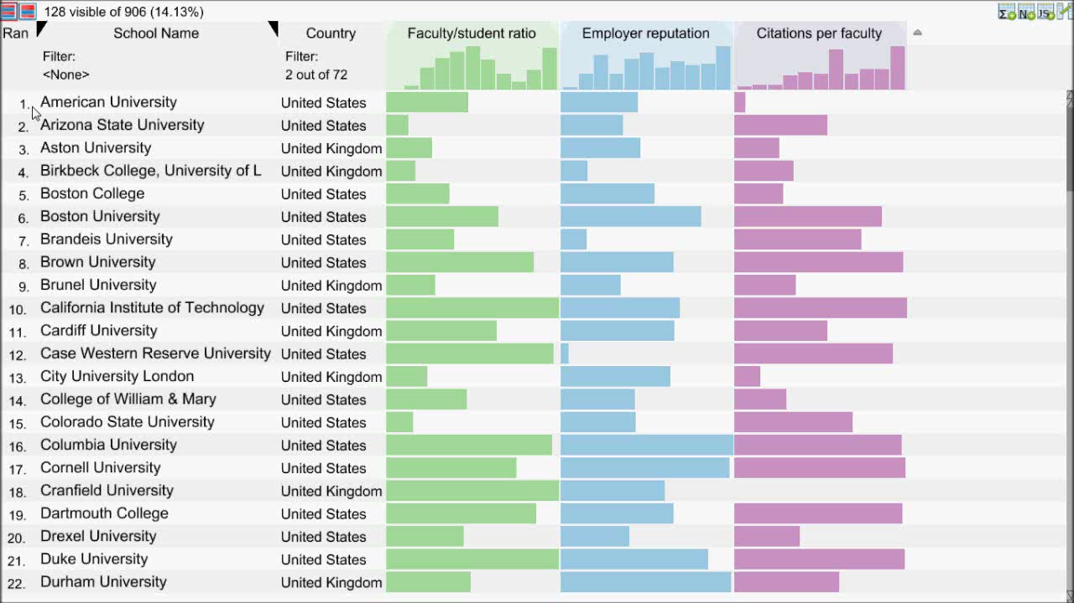
Video showing
Creating combined score
Sort by that
Change weights
Focus on animation: color & style
Notes:
Start with a LineUp video, showing: * creation of combined score
* changing weights
* animations (movement + color)

Slide 32
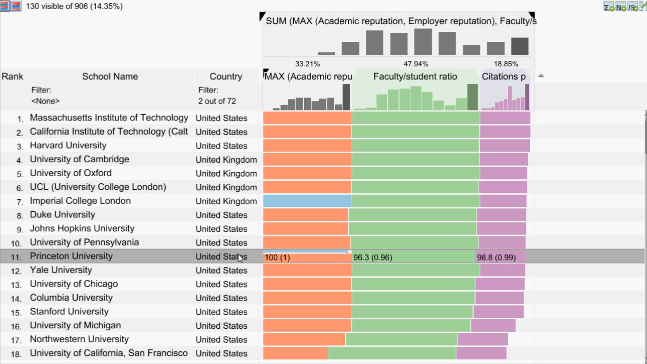
10 Requirements
Video showing
Creating combined score
Sort by that
Change weights
Focus on animation: color & style
Encode Rank
Encode Cause of Rank
Support Multiple Attributes
Interactive Refinement and Visual Feedback
Flexible Mapping of Attributes to Scores
Flexible Mapping of Attributes to Scores
Notes:
Start with a LineUp video, showing: * creation of combined score
* changing weights
* animations (movement + color)

Slide 33
10 Requirements
Video showing
Creating combined score
Sort by that
Change weights
Focus on animation: color & style
Flexible Mapping of Attributes to Scores
Encode Rank
Encode Cause of Rank
Support Multiple Attributes
Interactive Refinement and Visual Feedback
Flexible Mapping of Attributes to Scores
Notes:
Start with a LineUp video, showing: * creation of combined score
* changing weights
* animations (movement + color)

Slide 34
0
1
Max
Min
100
0

Slide 35
0
1
0
100

Slide 36
0
1
0
100
Notes:
Evaluation has show -> more difficult to interpret

Slide 37
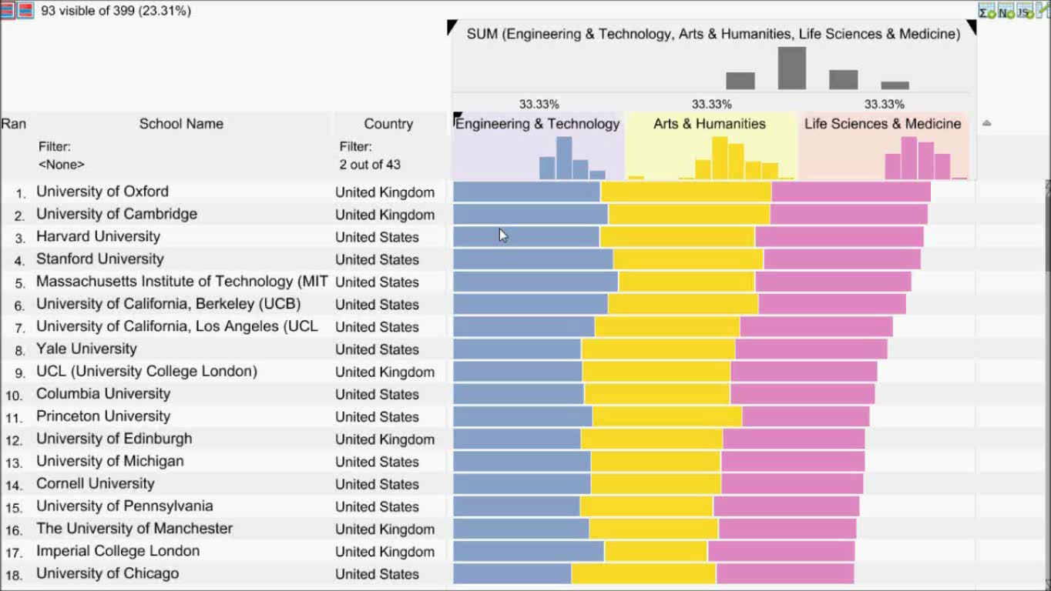
Video showing:
Scenario, manpulate mapping of attribute
Switch between two mode: hor / par
Add move points
Show java script editor
Apply A default one -> argument for compare

Slide 38
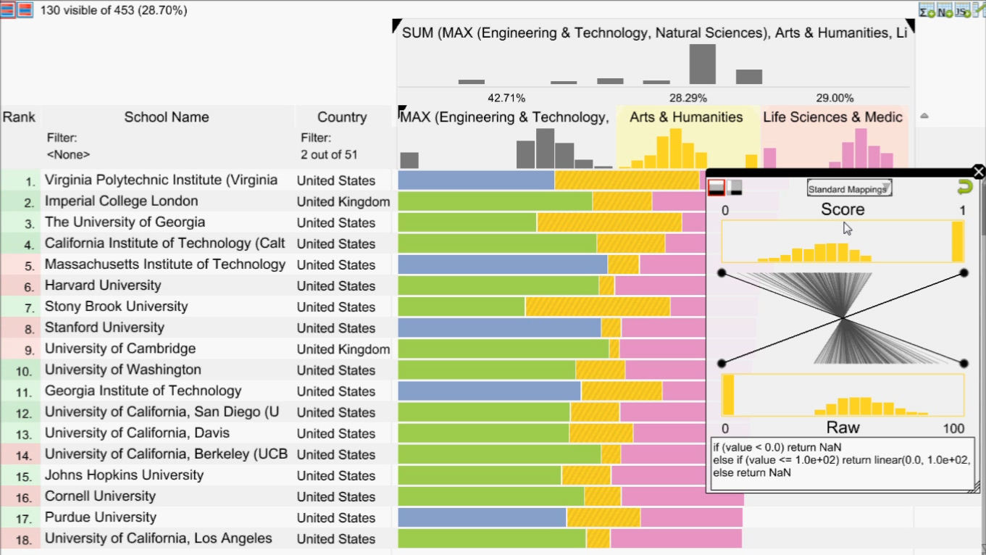
10 Requirements
Video showing
Creating combined score
Sort by that
Change weights
Focus on animation: color & style
Encode Rank
Encode Cause of Rank
Support Multiple Attributes
Interactive Refinement and Visual Feedback
Flexible Mapping of Attributes to Scores
Compare Rankings
Compare Rankings
Notes:
Start with a LineUp video, showing: * creation of combined score
* changing weights
* animations (movement + color)

Slide 39
10 Requirements
Video showing
Creating combined score
Sort by that
Change weights
Focus on animation: color & style
Encode Rank
Encode Cause of Rank
Support Multiple Attributes
Interactive Refinement and Visual Feedback
Flexible Mapping of Attributes to Scores
Compare Rankings
Compare Rankings
Notes:
Start with a LineUp video, showing: * creation of combined score
* changing weights
* animations (movement + color)

Slide 40
Bump Charts
Rank
University
Score
Rank
Score
Score
1.
MIT, USA
1.
2.
Harvard, USA
2.
(+1)
3.
Princeton, USA
3.
(+1)
4.
Cambridge, UK
4.
(-2)
5.
Oxford, UK
5.
Notes:
Same table from before, but with slopegraphs in it.
+ interpretation + arrows

Slide 41
Bump Charts
Rank
University
Score
Rank
Score
Score
1.
MIT, USA
1.
2.
Harvard, USA
2.
2.
Harvard, USA
(+1)
3.
Princeton, USA
3.
(+1)
4.
Cambridge, UK
4.
4.
(-2)
(-2)
5.
Oxford, UK
5.
Notes:
Same table from before, but with slopegraphs in it.
+ interpretation + arrows

Slide 42
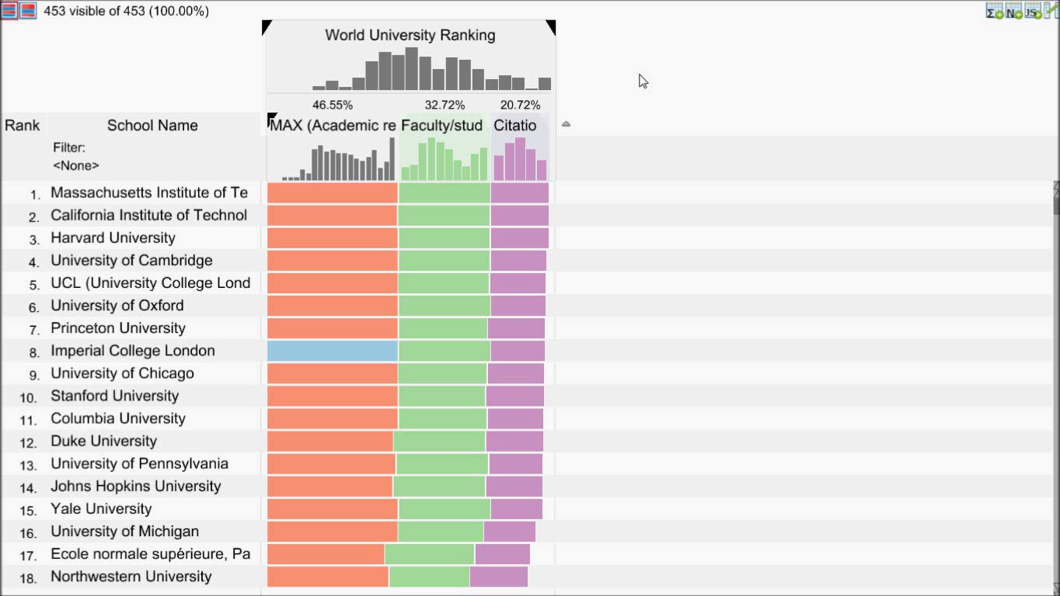
Video showing:
Creating snapshot for comparison
Play with weights
Show delta
Select by clicking on slopegraph
Notes:
Video of LineUp with snapshot and interactive changing of weights.

Slide 43
10 Requirements
Encode Rank
Encode Cause of Rank
Support Multiple Attributes
Interactive Refinement and Visual Feedback
Flexible Mapping of Attributes to Scores
Compare Rankings
Scalability
Filtering
Handle Missing Values
Optimization

Slide 44
Demos, Videos & More: http://lineup.caleydo.org

Slide 46
A Very Short Visualization INtroduction

Slide 47
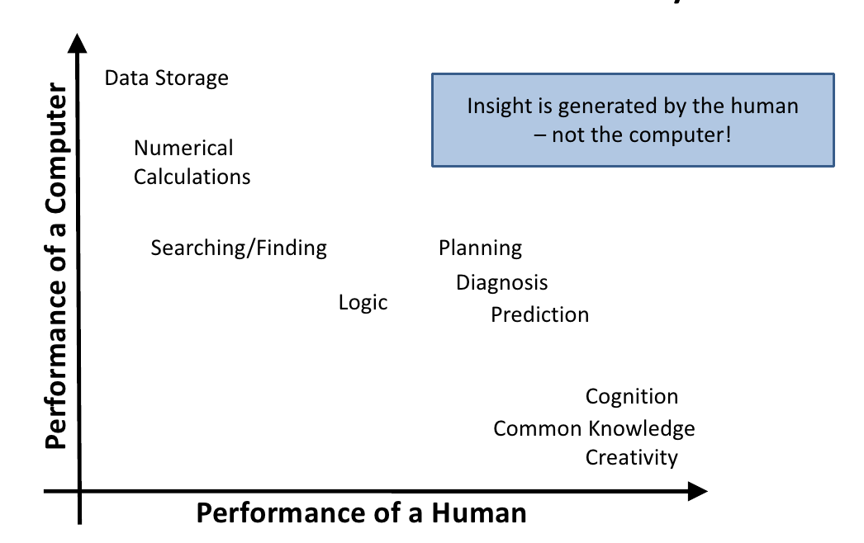
The Ability Matrix

Slide 48
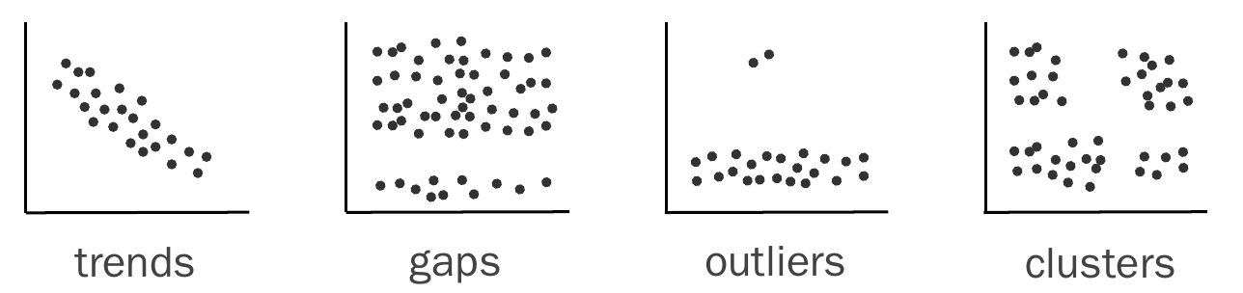
Pattern Discovery
Notes:
Can Statistics do this for us?

Slide 49
Can We Always Trust Statistics?
I
x | y
10 | 8.04
8 | 6.95
13 | 7.58
9 | 8.81
11 | 8.33
14 | 9.96
6 | 7.24
4 | 4.26
12 | 10.84
7 | 4.82
5 | 5.68
II
x | y
10 | 9.14
8 | 8.14
13 | 8.74
9 | 8.77
11 | 9.26
14 | 8.1
6 | 6.13
4 | 3.1
12 | 9.13
7 | 7.26
5 | 4.74
III
x | y
10 | 7.46
8 | 6.77
13 | 12.74
9 | 7.11
11 | 7.81
14 | 8.84
6 | 6.08
4 | 5.39
12 | 8.15
7 | 6.42
5 | 5.73
IV
x | y
8 | 6.58
8 | 5.76
8 | 7.71
8 | 8.84
8 | 8.47
8 | 7.04
8 | 5.25
19 | 12.5
8 | 5.56
8 | 7.91
8 | 6.89
Mean x: 9 y: 7.50
Variance x: 11 y: 4.122
Correlation x – y: 0.816
Linear regression: y = 3.00 + 0.500x

Slide 50
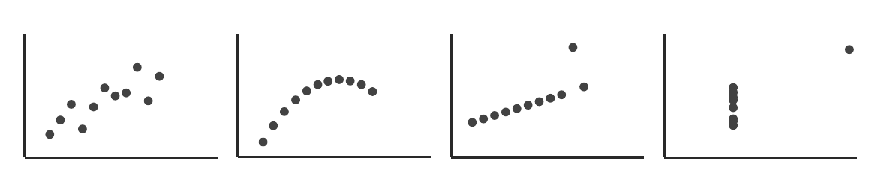
Anscombe’s Quartett
Mean x: 9 y: 7.50
Variance x: 11 y: 4.122
Correlation x – y: 0.816
Linear regression: y = 3.00 + 0.500x

Slide 51
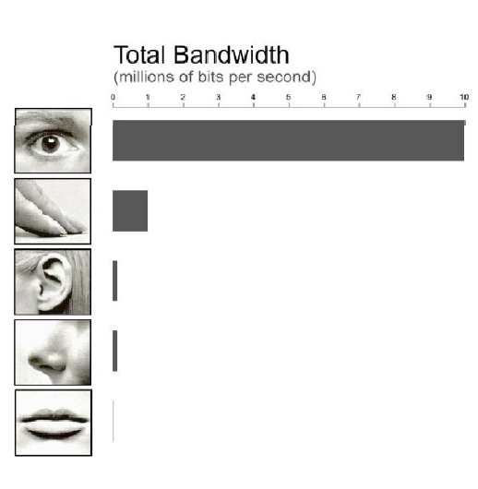
Why Graphics?
Figures are richer; provide more information with less clutter and in less space.
Figures provide the gestalt effect: they give an overview; make structure more visible.
Figures are more accessible, easier to understand, faster to grasp, more comprehensible, more memorable, more fun, and less formal.
list adapted from: [Stasko et al. 1998]

Slide 52
Visualization Definition
Visualization is the process that transforms (abstract) data into interactive graphical representations for the purpose of exploration, confirmation, or presentation.

Slide 53
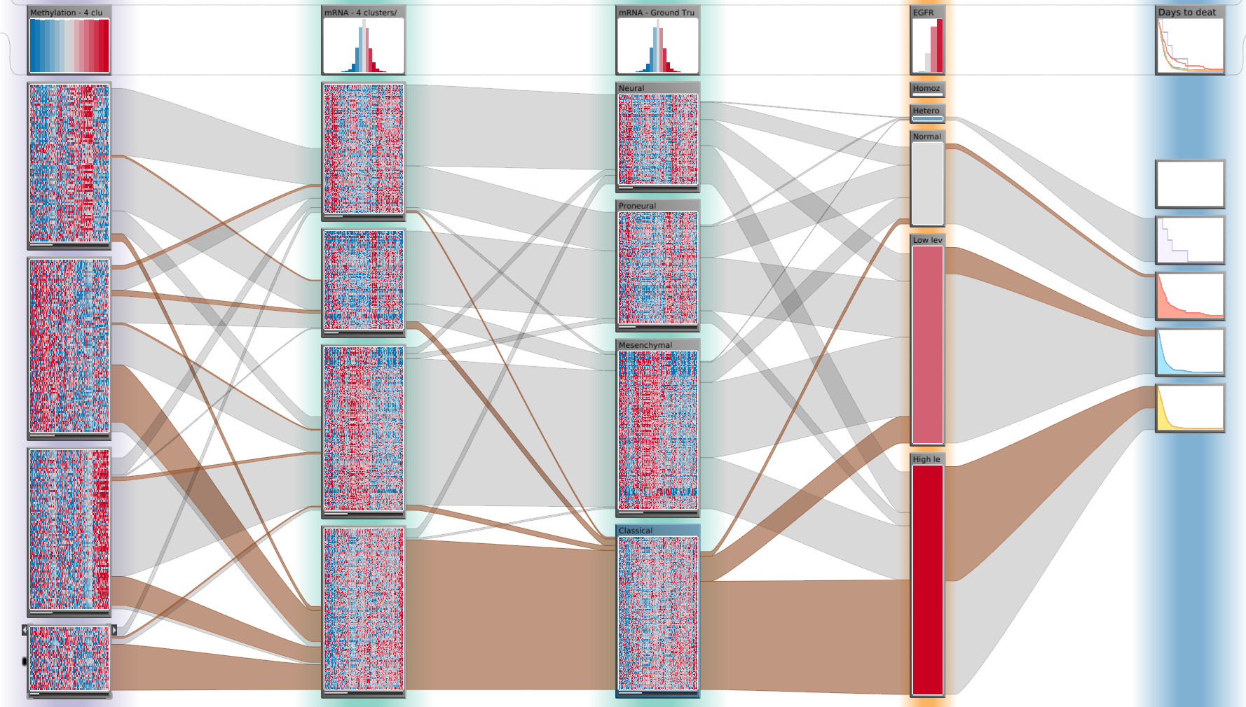
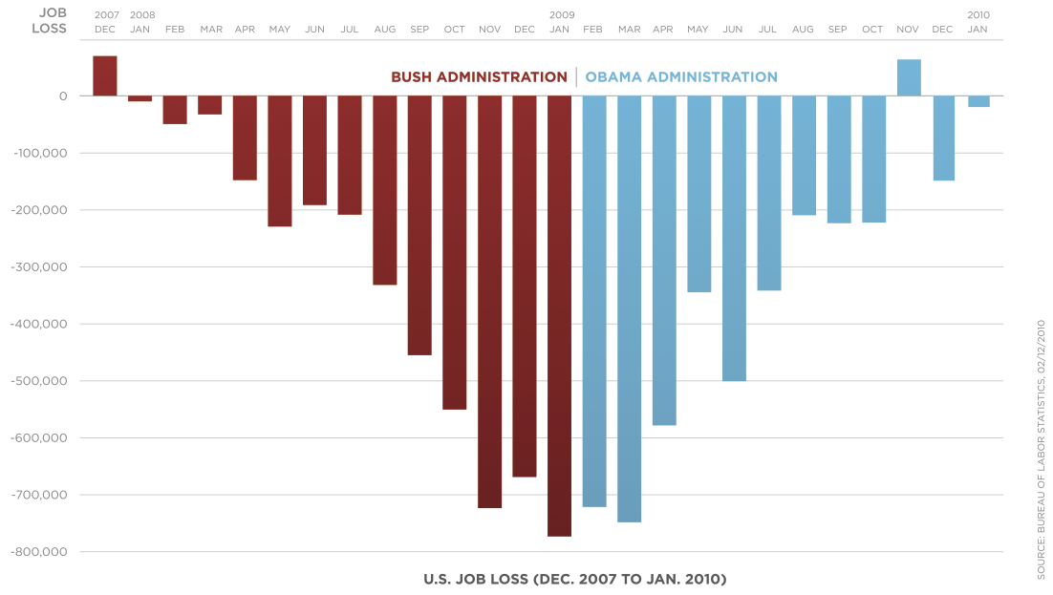
Applications of Visualization
Open Exploration
Illustration
Notes:
Exploration:
result not known
not even question
Illustration:
Know about the data
Communicate to others

Slide 54
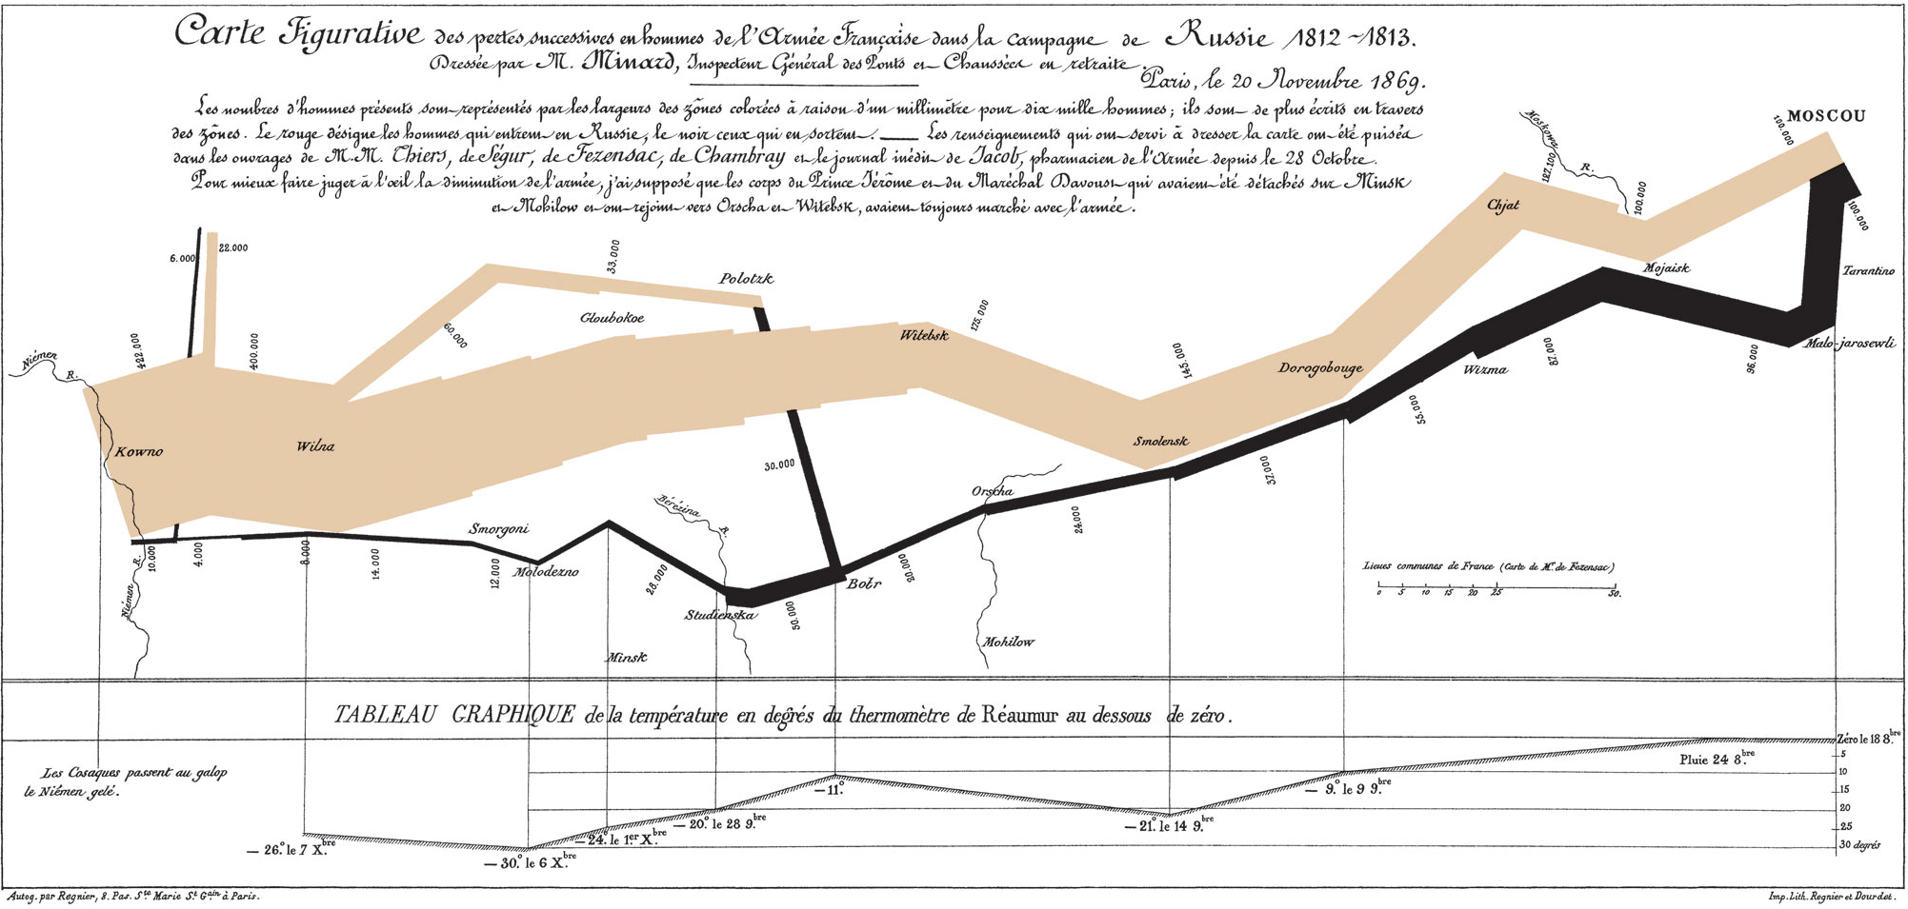

Slide 55
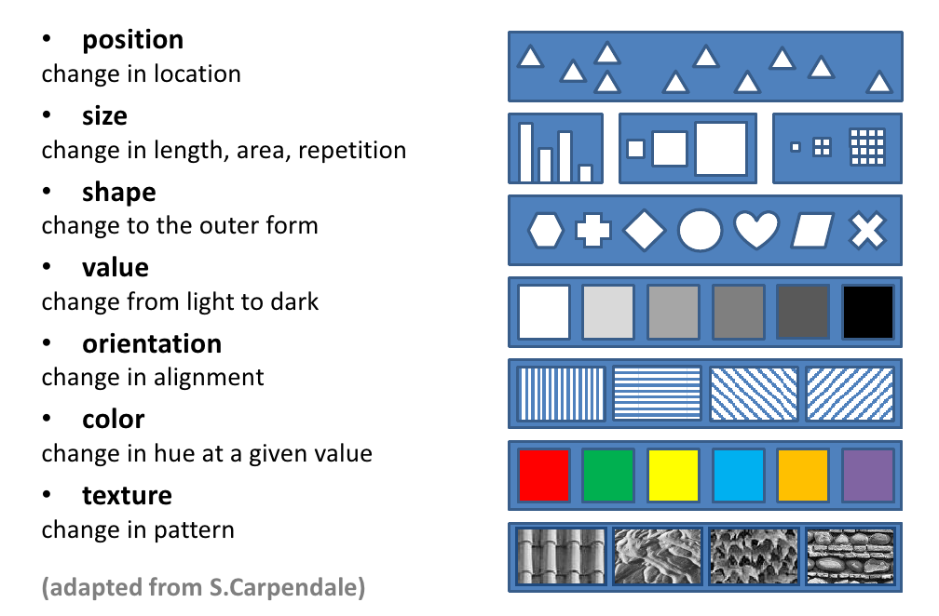
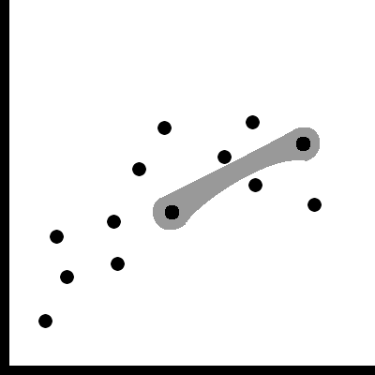
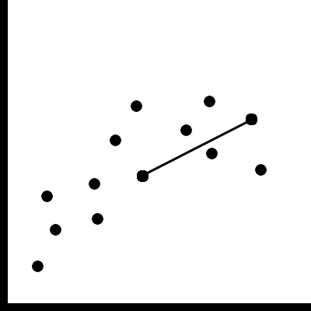
Visual Variables
For Relationships:
Containment
Connection

Slide 56
Position
Strongest visual variable
Suitable for all data types
Notes:
Cluttering due to many coinciding marks.

Slide 57
Size & Length
Good visual variable
Easy to see whether one is bigger
Grouping works
Judging differences
Good for aligned bars (position)
OK for changes in length
Bad for changes in area

Slide 58
Shape
Great to recognize many classes.
No grouping, ordering.

Slide 59
Value
Good for quantitative data when length & size are used.
Not very many shades recognizable
Supports grouping
Is preattentive (stands out) if sufficiently different

Slide 60
Color
Good for qualitative data
Limited number of classes!
Not good for quantitative data!
Is preattentive if sufficiently different.
Lots of pitfalls! Be careful!

Slide 61
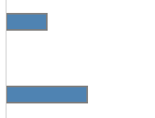
How much longer?
A
B
Notes:
2x

Slide 62
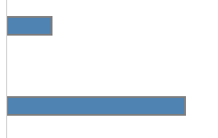
How much longer?
A
B
Notes:
4x

Slide 63

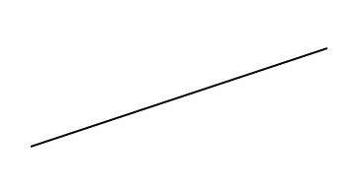
How much steeper?
A
B
4x
Notes:
A: slope 4:1 => theta = 76
B: slope 1:3 => theta = 18.4
So A is roughly 4 times steeper than B

Slide 64

How much larger?
A
B
2x (diameter)
Notes:
2x

Slide 65
How much larger?
A
B
2x Area
Notes:
2x

Slide 66

How much larger?
A
B
3x
Notes:
3x

Slide 67

How much darker?
A
B
Opacity: A = 0.2 / B = 0.4 ->
But: non-linearities of the human visual system
Notes:
Opacity: A = 0.2 / B = 0.4
So B is roughly 2x darker (of course this is not true due to non-linearities of the human visual system)

Slide 68
Visualization Guidelines & Pitfalls

Slide 69
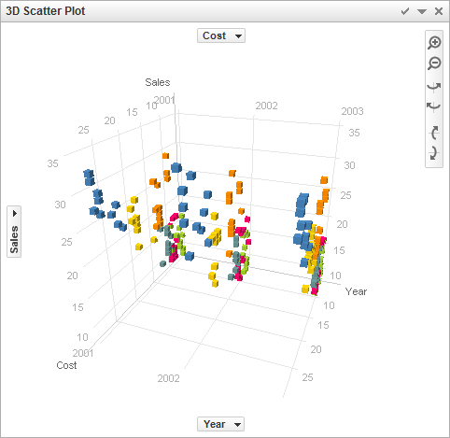
3D!
[Spotfire]

Slide 70
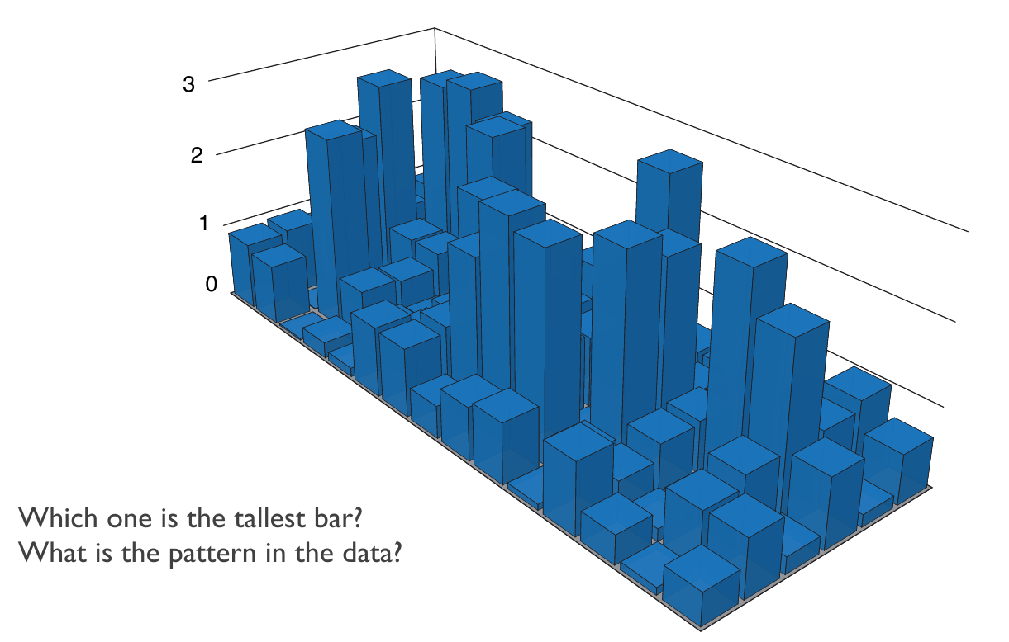
3D Pitfall: Occlusion & Perspective
[Gehlenborg and Wong, Nature Methods, 2012]

Slide 71
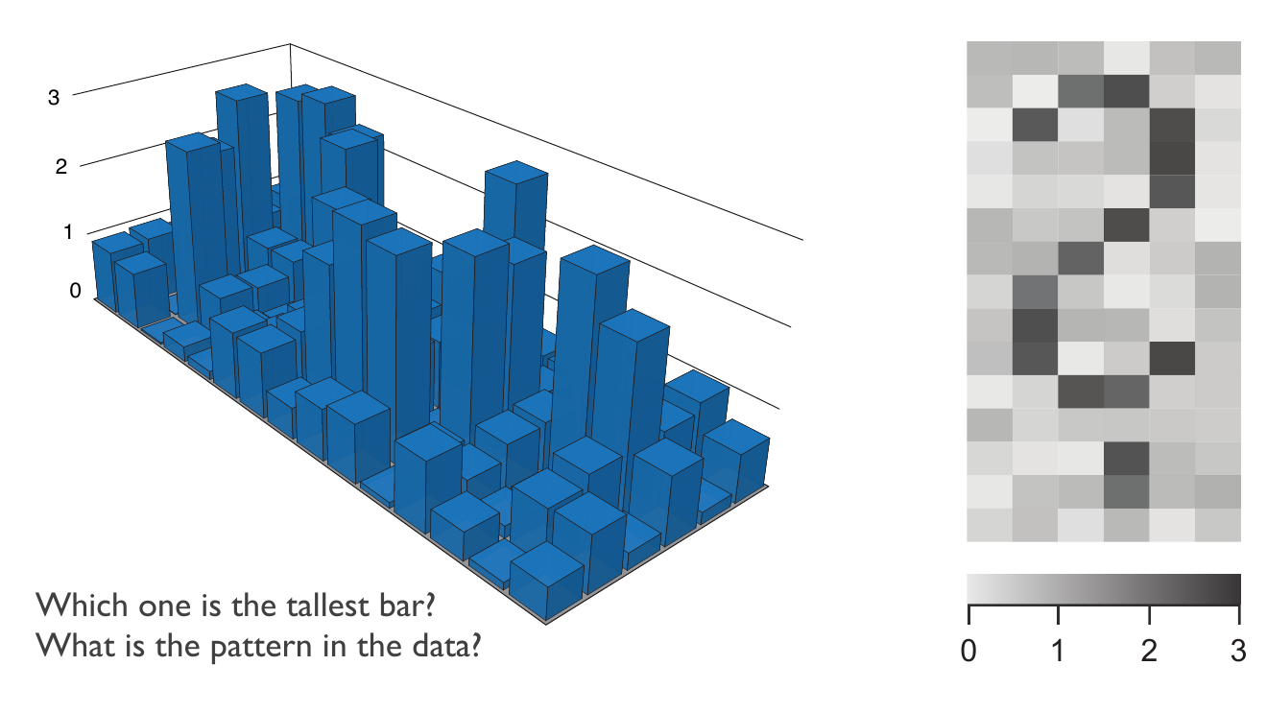
3D Pitfall: Occlusion & Perspective
[Gehlenborg and Wong, Nature Methods, 2012]
Notes:
Legibility of labels

Slide 72
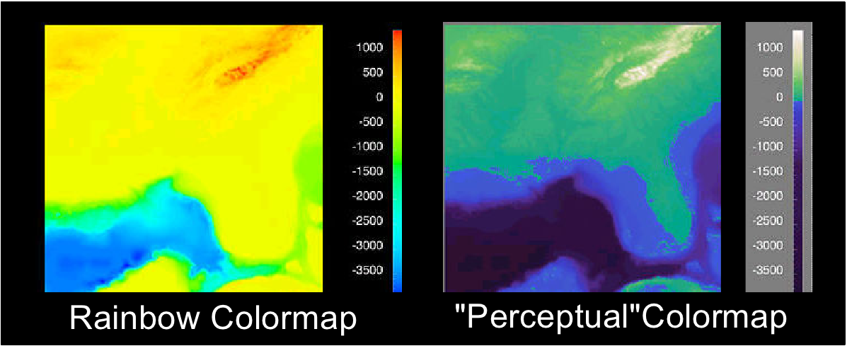
Color Scales
Don‘t! Ever! use multiple hues for (continous) quantitative data
Use multiple hues for meaningful intervals

Slide 73
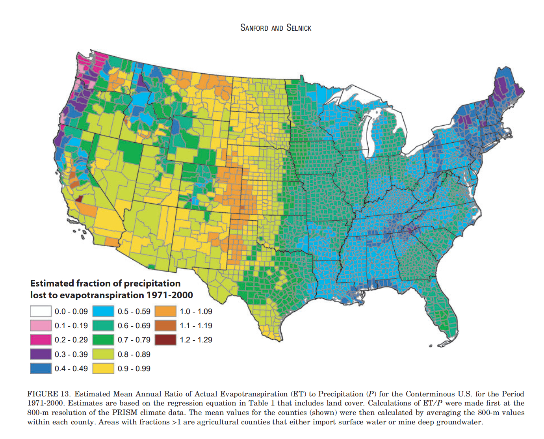

Slide 74
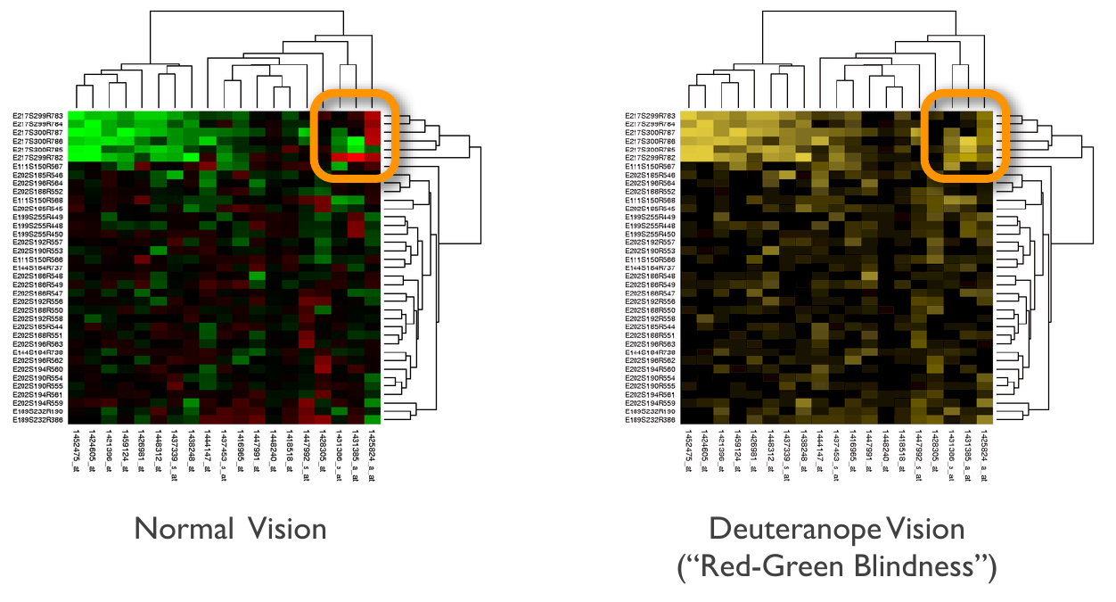
Bad Color Mapping

Slide 75
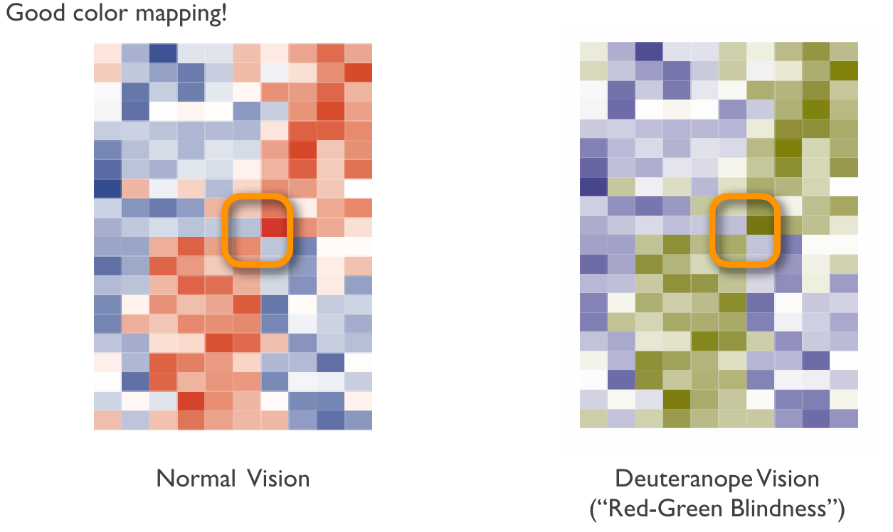
Good Color Mapping

Slide 76
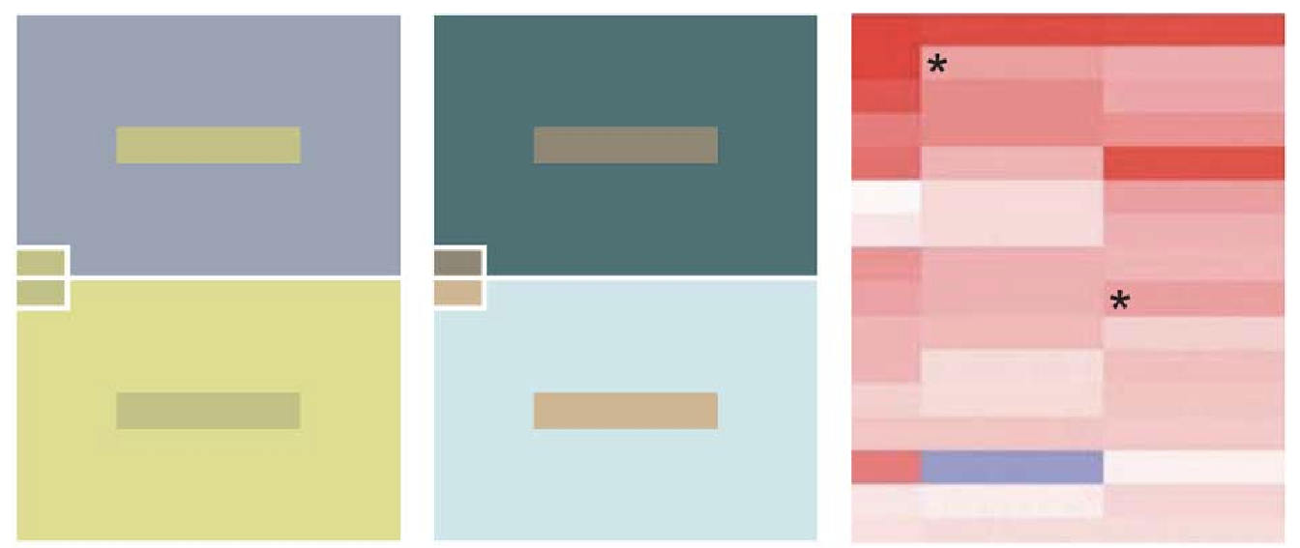
Color is relative!

Slide 77
Creating Color Scales
Quantitative range: go for one color
0
1
Quantitative range with “neutral” value: use two colors (diverging)
-1
0
1

Slide 78
Creating Color Scales
For Ordinal Data: same principles
Continuous
Diverging
For Categorical (nominal) Data: use unique hue
Helpful Tool: http://colorbrewer.org

Slide 79
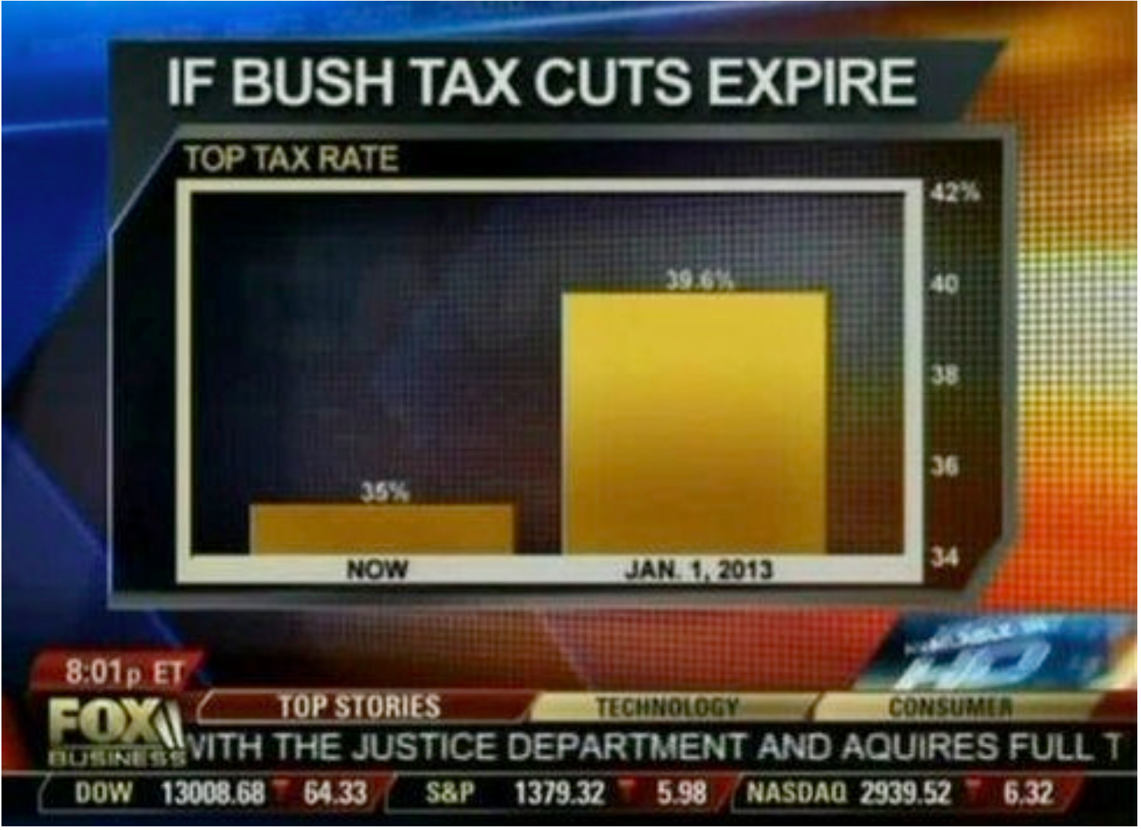
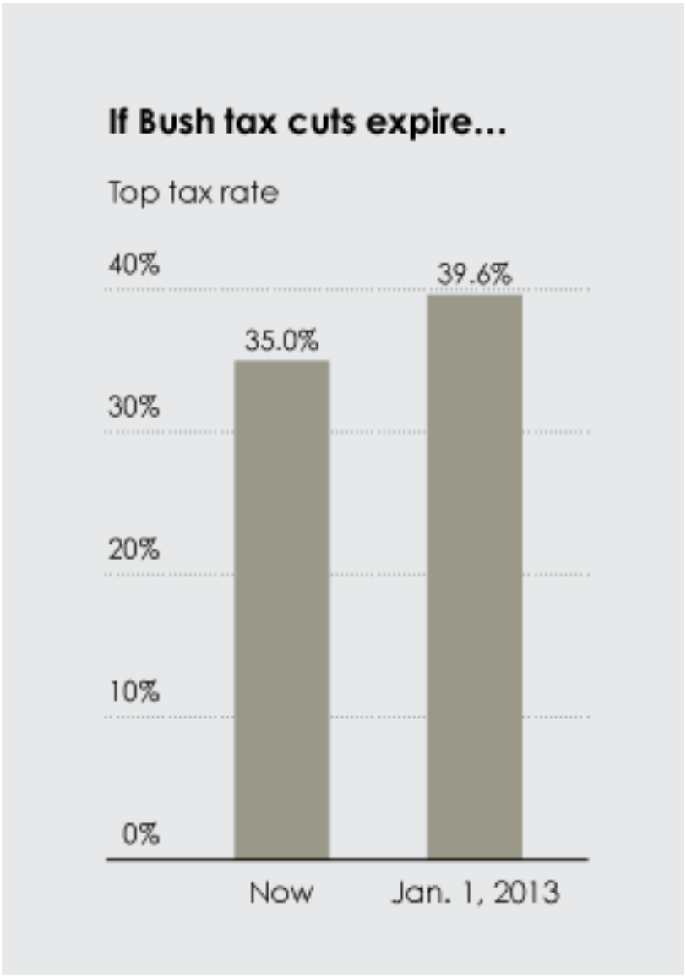
Scales

Slide 80
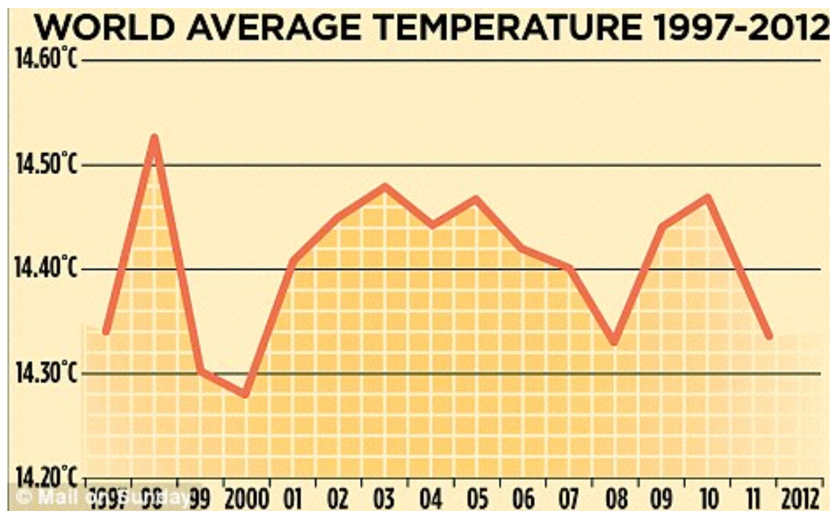
Context

Slide 81
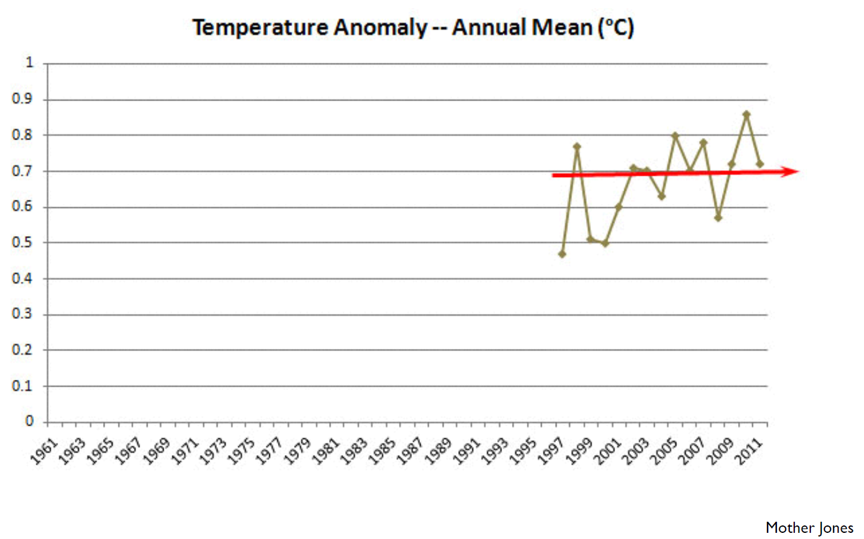
Context

Slide 82
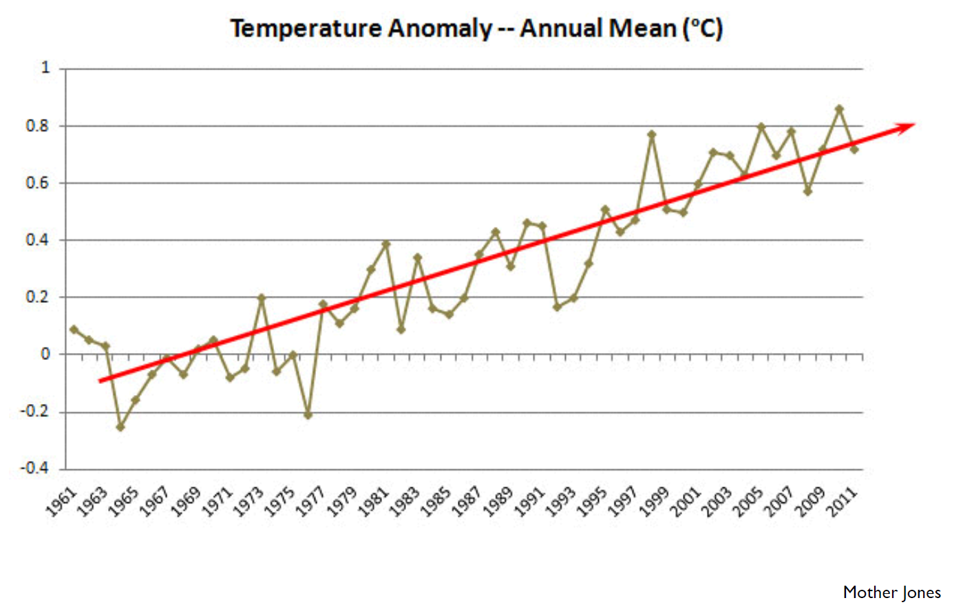
Context

Slide 83
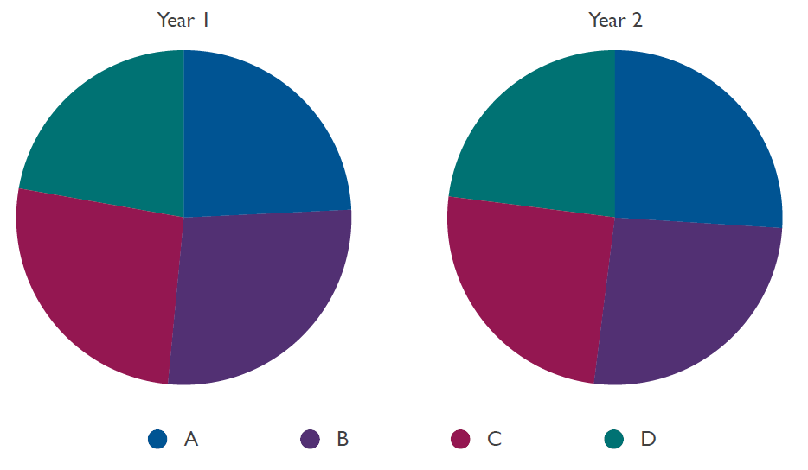
Wrong Visual Encoding

Slide 84

Wrong Visual Encoding

Slide 85

Resources
Hanspeter Pfister’s Visualization Class
http://www.cs171.org/
Visualization on the Web:
http://d3js.org/
Isabel Meirelles

Slide 86
Visualizing Multi-Attribute Rankings A Very Short Visualization Introduction
?
Alexander Lex, Harvard University
alex@seas.harvard.edu
http://alexander-lex.com
@alexander_lex
Credits:
Marc Streit, Nils Gehlenborg, Hanspeter Pfister, Anne Mai Wasserman, Mark Borowsky, Christian Partl, Denis Kalkofen, Samuel Gratzl, Dieter Schmalstieg

