Slide 1
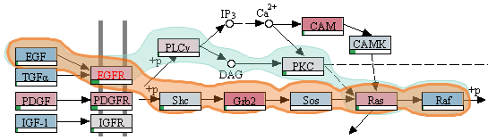


Visualization Approaches for Biomolecular Data
Alexander Lex
School of Interactive Computing Georgia Tech
April 8, 2014

Slide 2

Who am I? alexander-lex.com
PostDoc @ Harvard, Hanspeter Pfister’s Group
PhD from TU Graz, Austria
Co-leader of Caleydo Project

Slide 3
What is ?
Software for analyzing molecular biology data
Software for doing research in visualization
Quest for compromise between academic prototyping and ready-to-use software
http://caleydo.org

Slide 4



The Team
Marc Streit Johannes Kepler University Linz, AT
Christian Partl Graz University of Technology, AT
Samuel Gratzl Johannes Kepler University Linz, AT
Nils Gehlenborg Harvard Medical School, Boston, USA
Dieter Schmalstieg Graz University of Technology, AT
Hanspeter Pfister Harvard University, Cambridge, USA

Slide 5
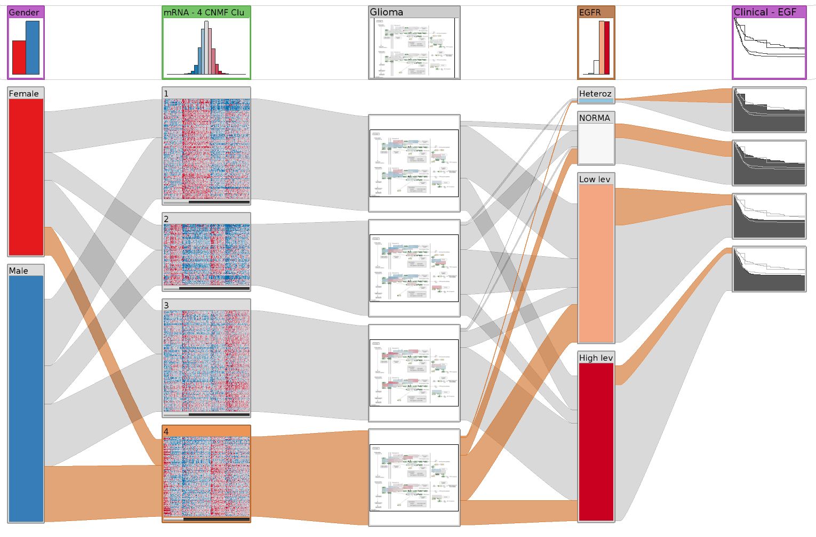
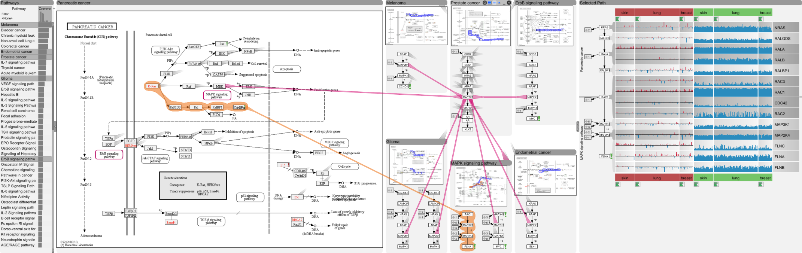
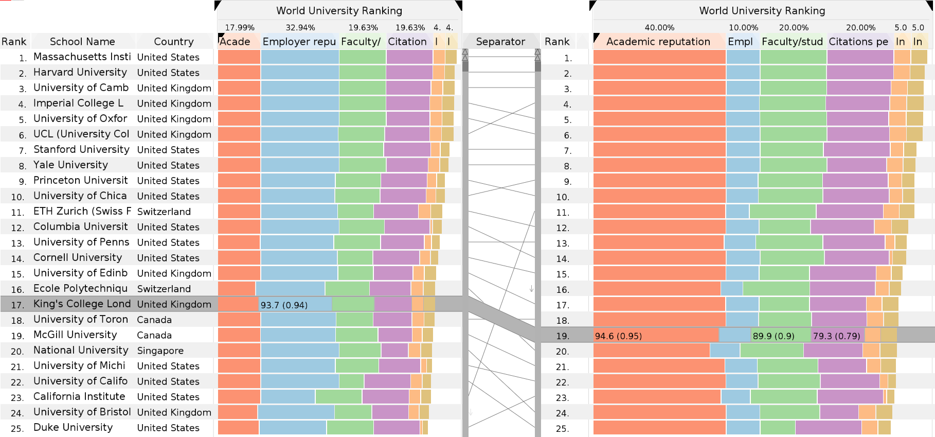
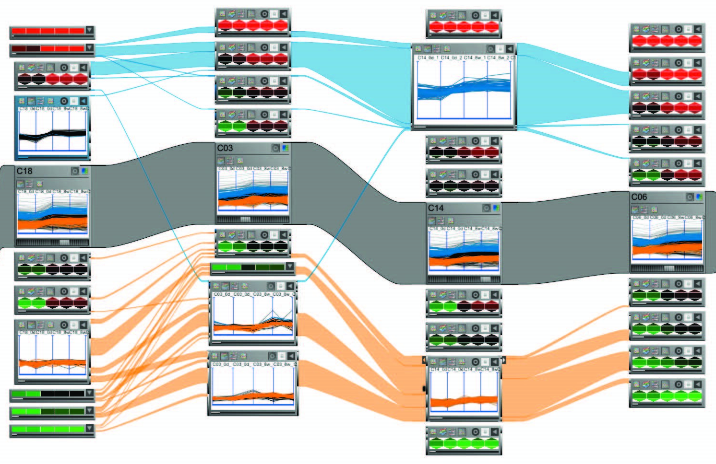
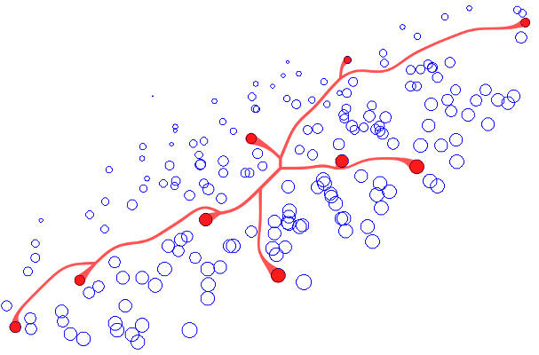
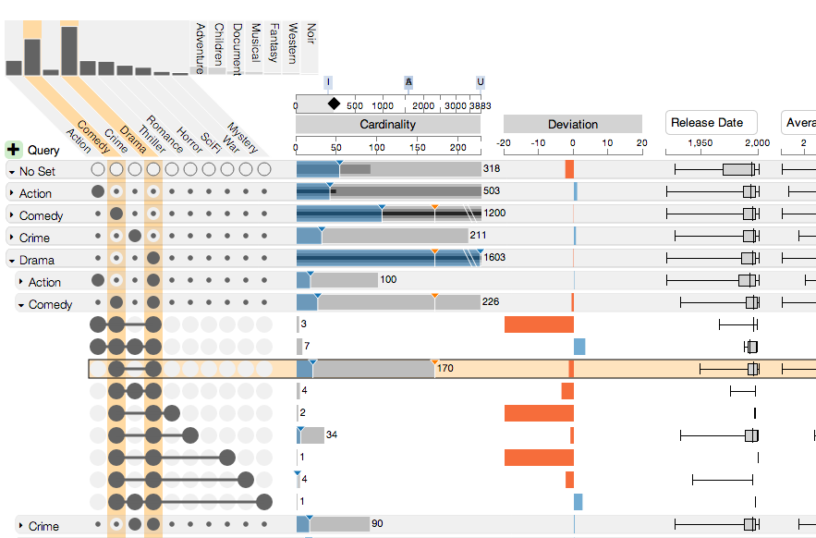
Heterogeneous Datasets
Multi-Variate Graphs
Multi-Attribute Rankings
Multi-Dim. Datasets
Visual Linking
Set Visualization

Slide 6
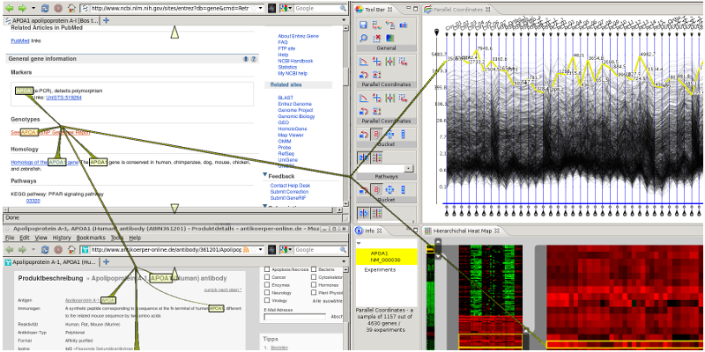
Visual Linking Across Applications
[Waldner GI’10]
Best Paper Award

Slide 7
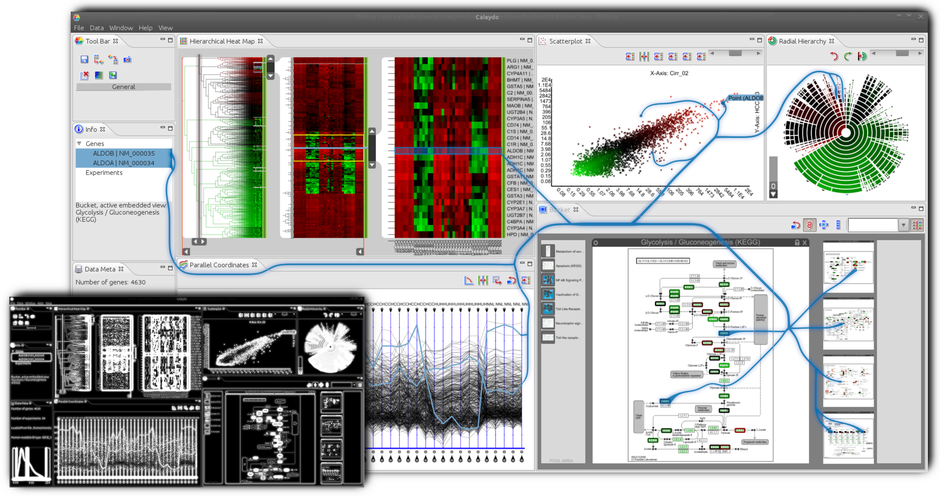
Context Preserving Visual Links
[Steinberger InfoVis’11]
Best Paper Award

Slide 8
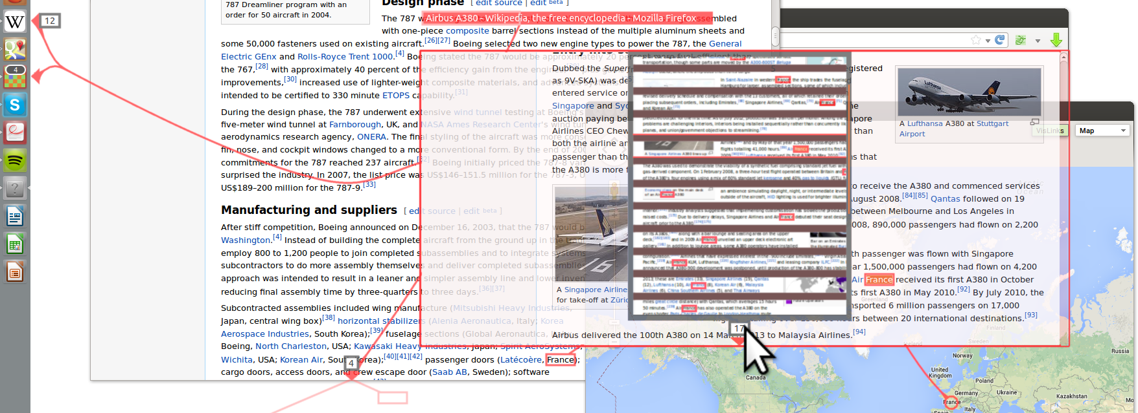
Visualizing Hidden Content
[Geymayer CHI’14] Honorable Mention Award

Slide 10
Heterogeneous Data
Cancer Subtypes
[Lex, EuroVis ‘12]
3rd Best Paper Award

Slide 11
biology research requires understanding data
but there is so much of it…

Slide 12
Data Visualization
… makes data accessible
… combines strengths of humans and computers
… enables insight
… communicates

Slide 13
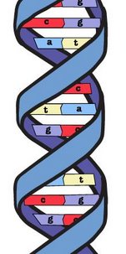
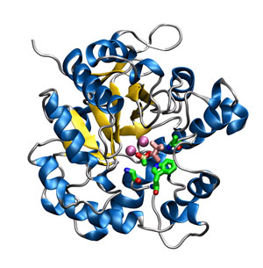

expression
Gene
Protein
microRNA expression
clinical parameters
mRNA expression
pathways
methylation levels
mutation status
copy number status
Notes:
Add datasets later, introduce protein functions

Slide 14
Cancer Subtypes
Cancer is not homogeneous
different histology
different molecular alterations
Subtypes have serious implications
different treatment for subtypes
prognosis varies between subtypes

Slide 15
Cancer Subtype Analysis
many different types of data
for
large numbers of patients.
Notes:
Goal: improved patient outcome
Usually you have to deal with lots of different tables that you have stored in a DB or files

Slide 16
… the relationships between multiple heterogeneous datasets
… the data within the datasets
… alternative clusterings & groupings
… the effect of groupings on clinical parameters & biological processes
StratomeX
visualizes…

Slide 17
Stratifying Patients
Cluster A1
Subtypes are identified by stratifying datasets, e.g.,
based on an expression pattern
a mutation status
a copy number alteration
a combination of these
Cluster A2
Cluster A3

Slide 18
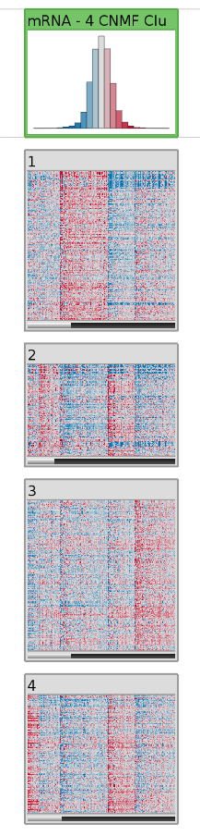
Header / Summary of
whole Stratification
Patients
Candidate Subtype /
Heat Map
Genes

Slide 19
Comparing Stratifications
Cluster A1
B1
B2
Cluster A2
Cluster A3
Tabular e.g., mRNA
Categorical,
e.g., mutation status

Slide 20
Comparing Stratifications
Cluster A1
B1
B2
Cluster A2
Cluster A3
Tabular e.g., mRNA
Categorical,
e.g., mutation status
[Parallel Sets, Kosara]

Slide 21
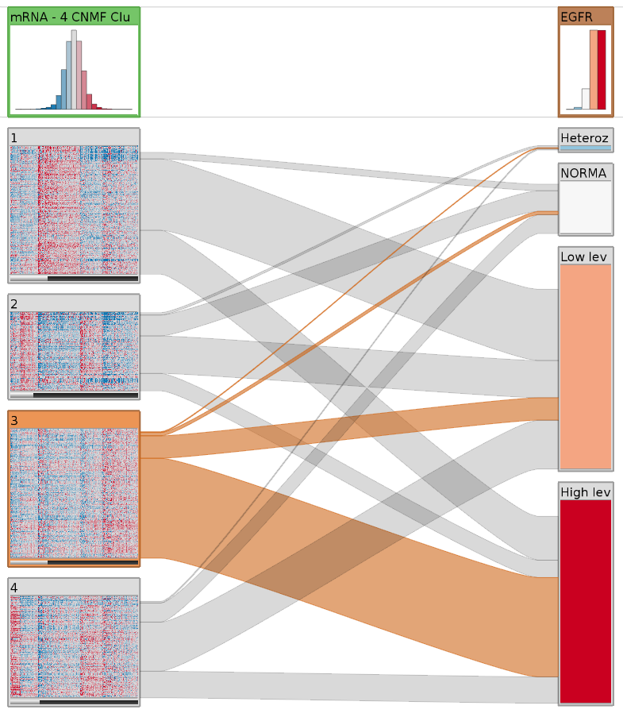
Many shared Patients
Clustering of mRNA Data
Stratification on Copy Number Status

Slide 22
Other Data – Same Stratification
Cluster A1
B1
B2
Cluster A2
Cluster A3
Tabular e.g., mRNA
Categorical,
e.g., mutation status

Slide 23
Other Data – Same Stratification
Cluster A1
B1
Dep. C1
B2
Cluster A2
Dep. C2
Cluster A3
Tabular e.g., mRNA
Categorical,
e.g., mutation status
Dependent Data, e.g. clinical data

Slide 24
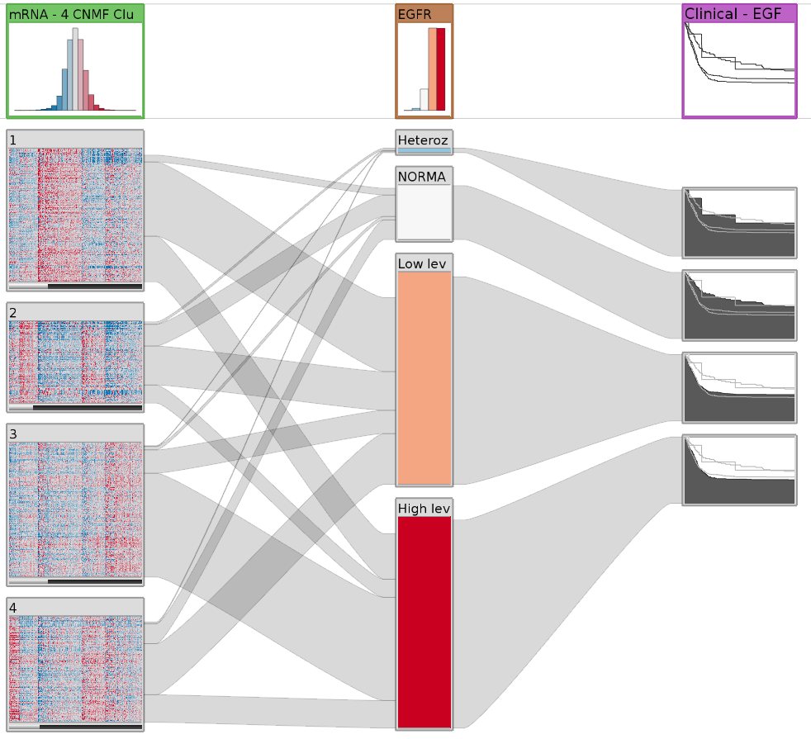
Survival data in Kaplan Meier plots

Slide 25
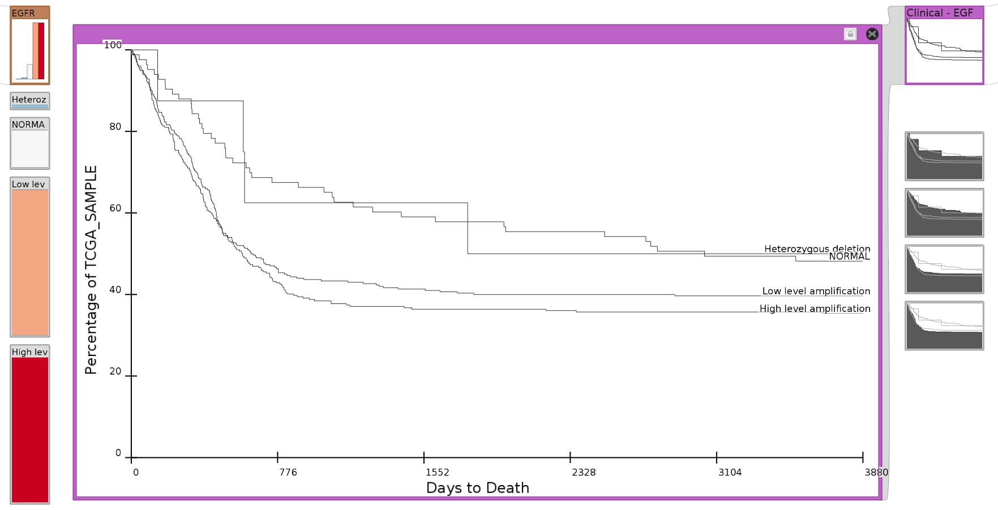
Detail View

Slide 26
Stratification based on clinical variable (gender)

Slide 27
Knowledge Driven Approach
Data Driven Approach

Slide 28
Finding Relevant Stratifications
~ 10 datasets
~ 15 clusterings per matrix
~ 15,000 stratifications for copy number & mutations
~ 500 pathways
~ 20 clinical variables
Calculate scores for matches
Rank the results

Slide 29
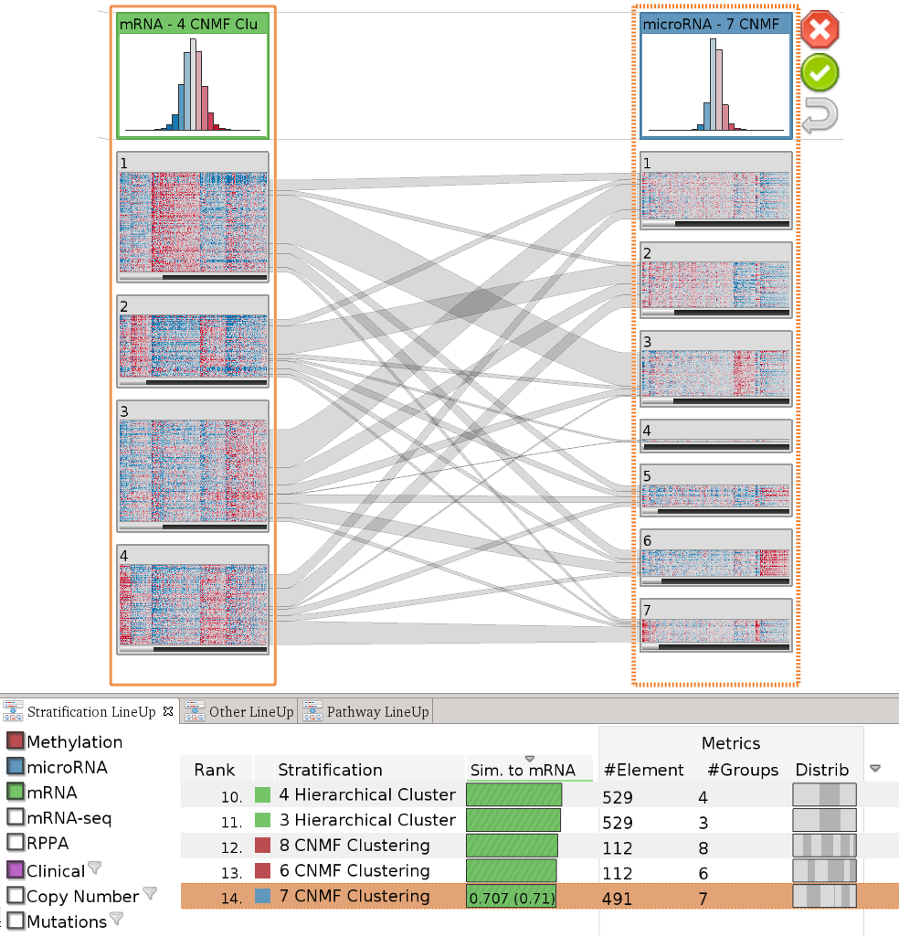
Query column
Result column
Considered Datasets
Ranked Stratifications
[Under Review at Nature Methods]

Slide 30
Algorithms for finding..
… matching stratification
… matching subtype
… mutual exclusivity
… relevant pathway
… stratification with effect in survival
… high/low structural variation

Slide 31
Live-Demo!
http://stratomex.caleydo.org

Slide 32
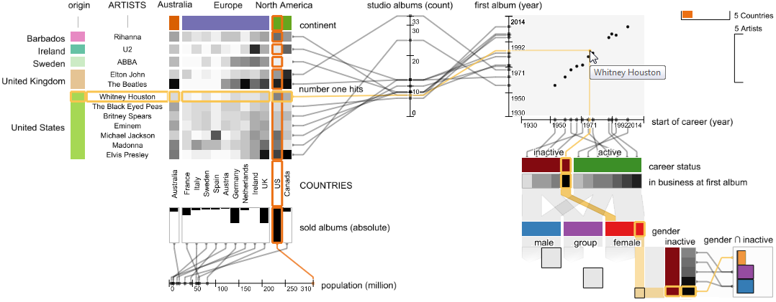
Current Developments: Generalization
[Under Review at IEEE TVCG (InfoVis)]

Slide 34
Pathways

Slide 35
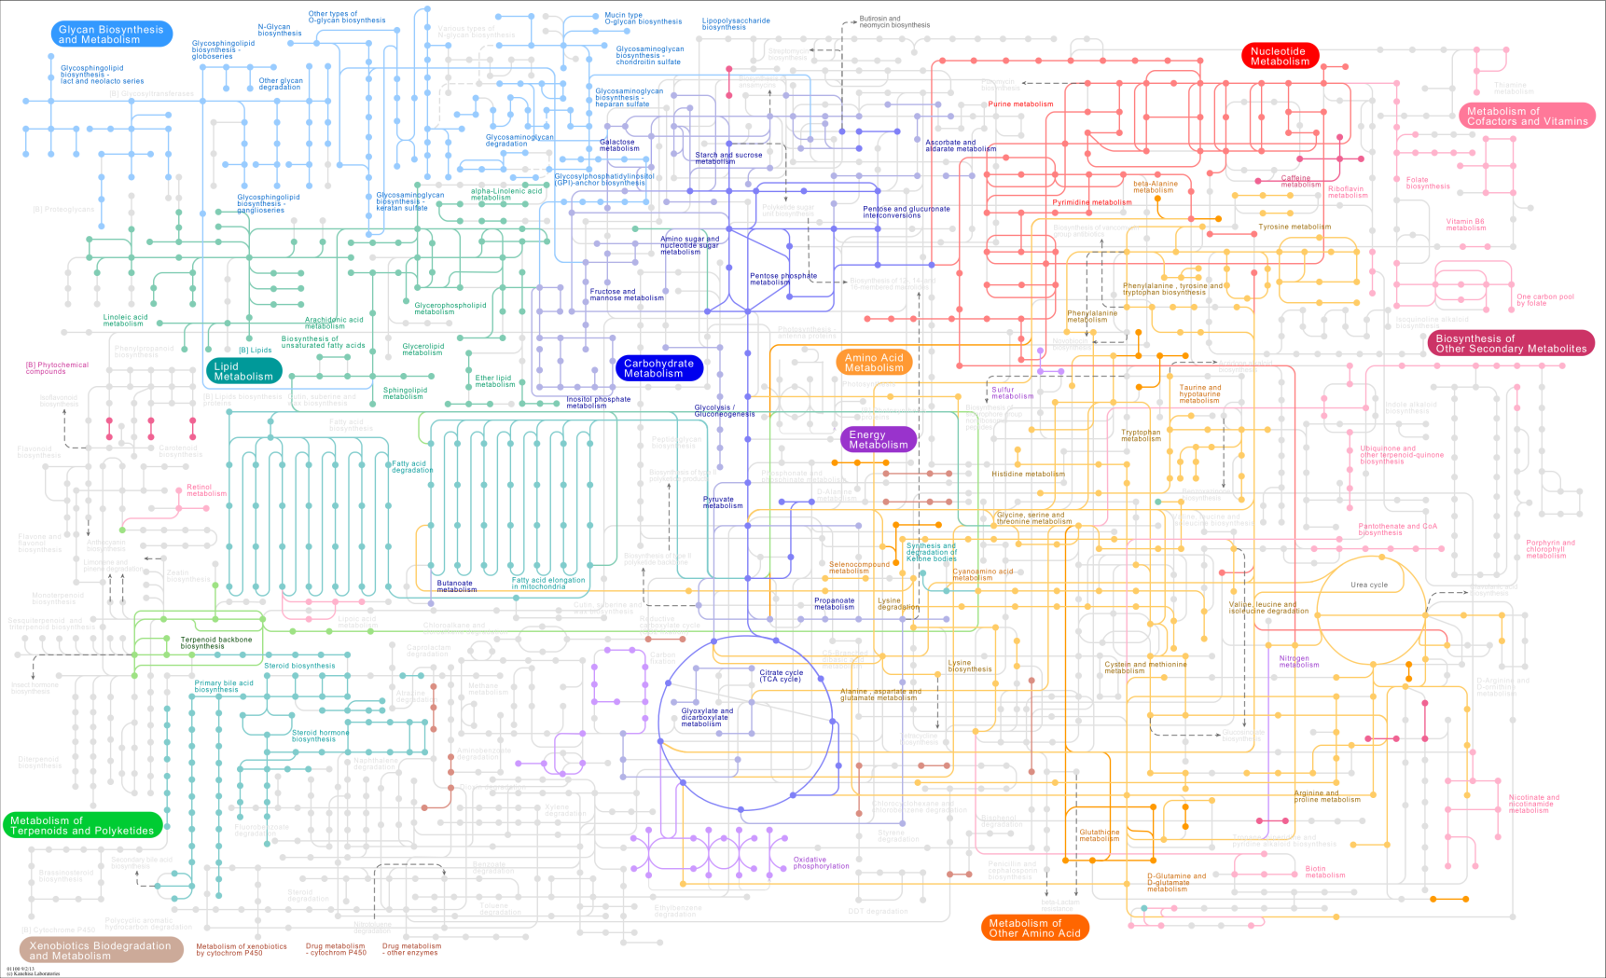
Background
Notes:
Alle prozesse im menschen im netzwerk, zuerst komplex, analyze -> understand

Slide 36
Background
Whole Network
Pathway A
B
Pathway B
Pathway C
D
I
A
E
C
C
H
J
G
L
F
G
L
P
N
K
Q
M
O

Slide 37
Entourage
many pathways
pathway cross-connections
(large graphs)
experimental data on pathways
(multi-variate graphs)
[Lex, InfoVis ‘13]
enRoute
[Partl, BioVis ‘12]
Best Paper Award
[Partl, BMC Bioinformatics ‘13]

Slide 38

Challenges
Pathway A
Pathway B
B
D
G
G
L
Drug side-effects
A
E
C
P
N
Drug repositioning
M
O
G
F
G
Notes:
-> add bio goals

Slide 39
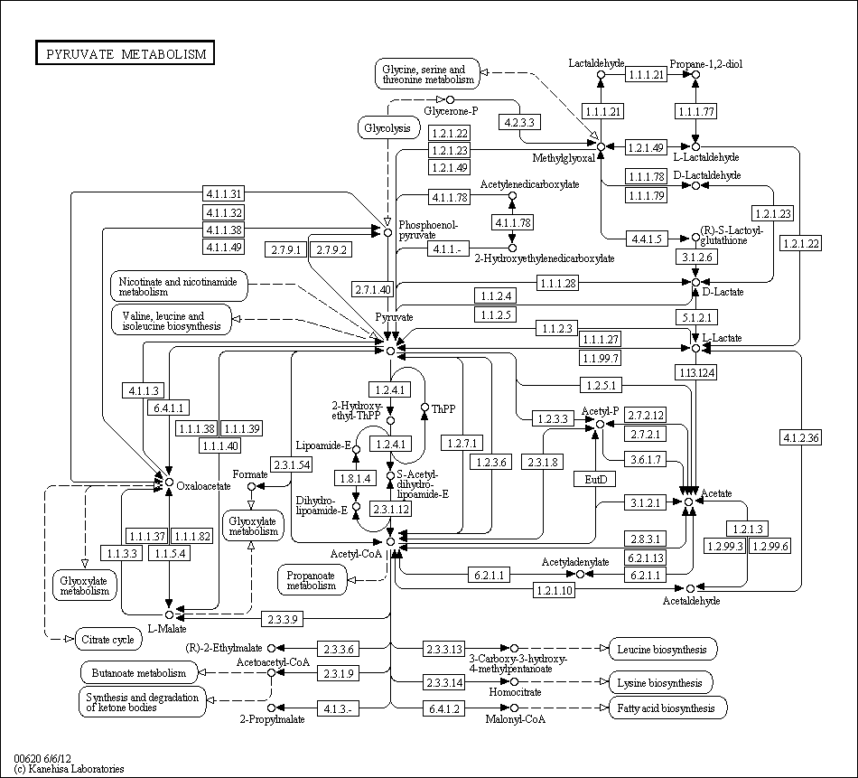
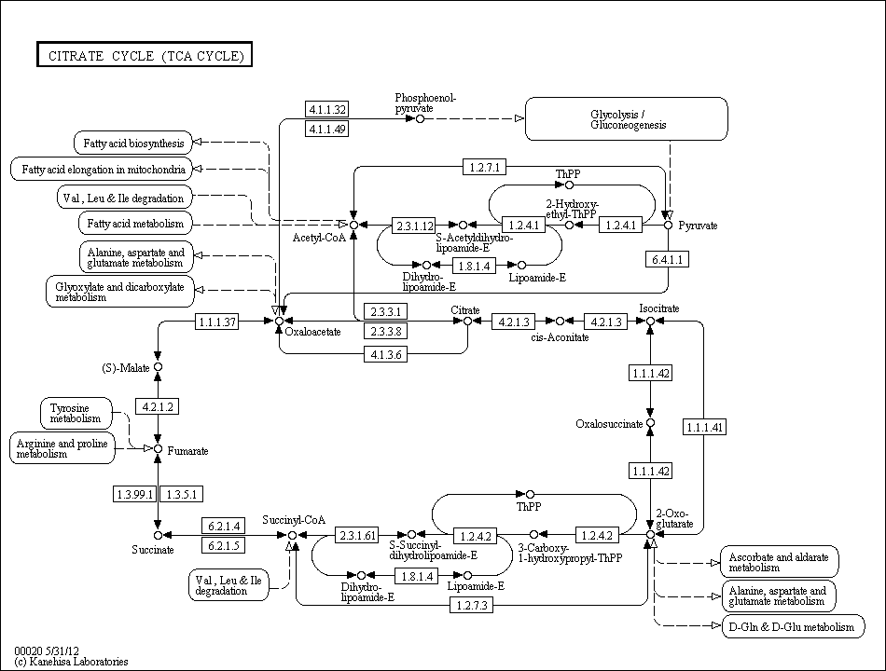
Challenges
How to visualize multiple pathways at the same time?
How to visualize
pathway relationships?

Slide 40
Challenges
Pathway A
Node
Sample 1
Sample 2
Sample 3
…
How to visualize
experimental data on pathways?
A
0.55
0.95
0.83
…
B
D
B
0.12
0.42
0.16
…
C
0.33
0.65
0.38
…
A
…
…
…
…
E
C
C
Node
Sample 1
Sample 2
Sample 3
…
A
low
low
very high
…
F
G
B
normal
low
high
…
C
high
very low
normal
…
…
…
…
…
Experimental data analysis
Notes:
… data in context of pathways, which basically means to associate multiple heterogeneous attributes…

Slide 41
How to visualize multiple pathways
at the same time?
How to visualize multiple pathways
at the same time?
How to visualize
pathway relationships?
How to visualize
experimental data on pathways?

Slide 42
Contextual Subsets
Pathway A
Pathway B
A
G
A
G
A
PW B
B
A
G
A
C
A
E
H
A
R
D
H
I
J
I
F
I
Contextual Subset
Focus Pathway
Context Pathway
Notes:
Wo kann ich shared nodes statt portals sagen -> introduce later, vermeide „in our case“; also show branches -> look at paper for detail

Slide 43
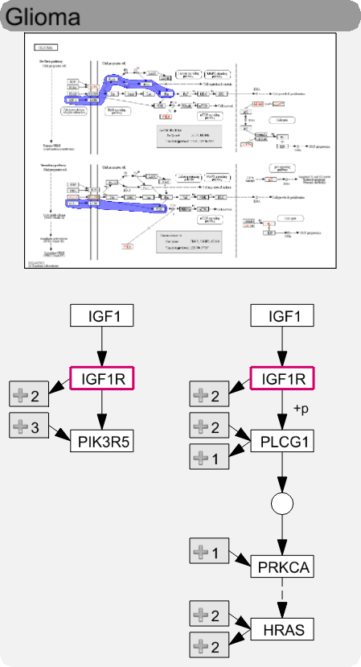
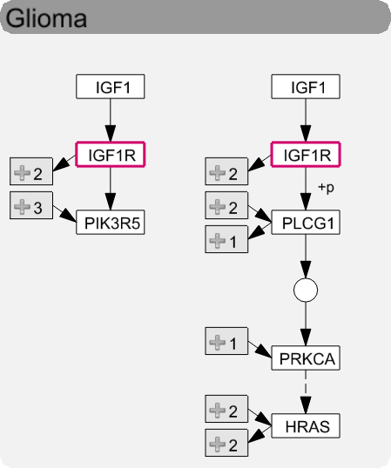
Levels of Detail
High
Medium
Low
Notes:
Kiss thumbnail, how actually looks like

Slide 44
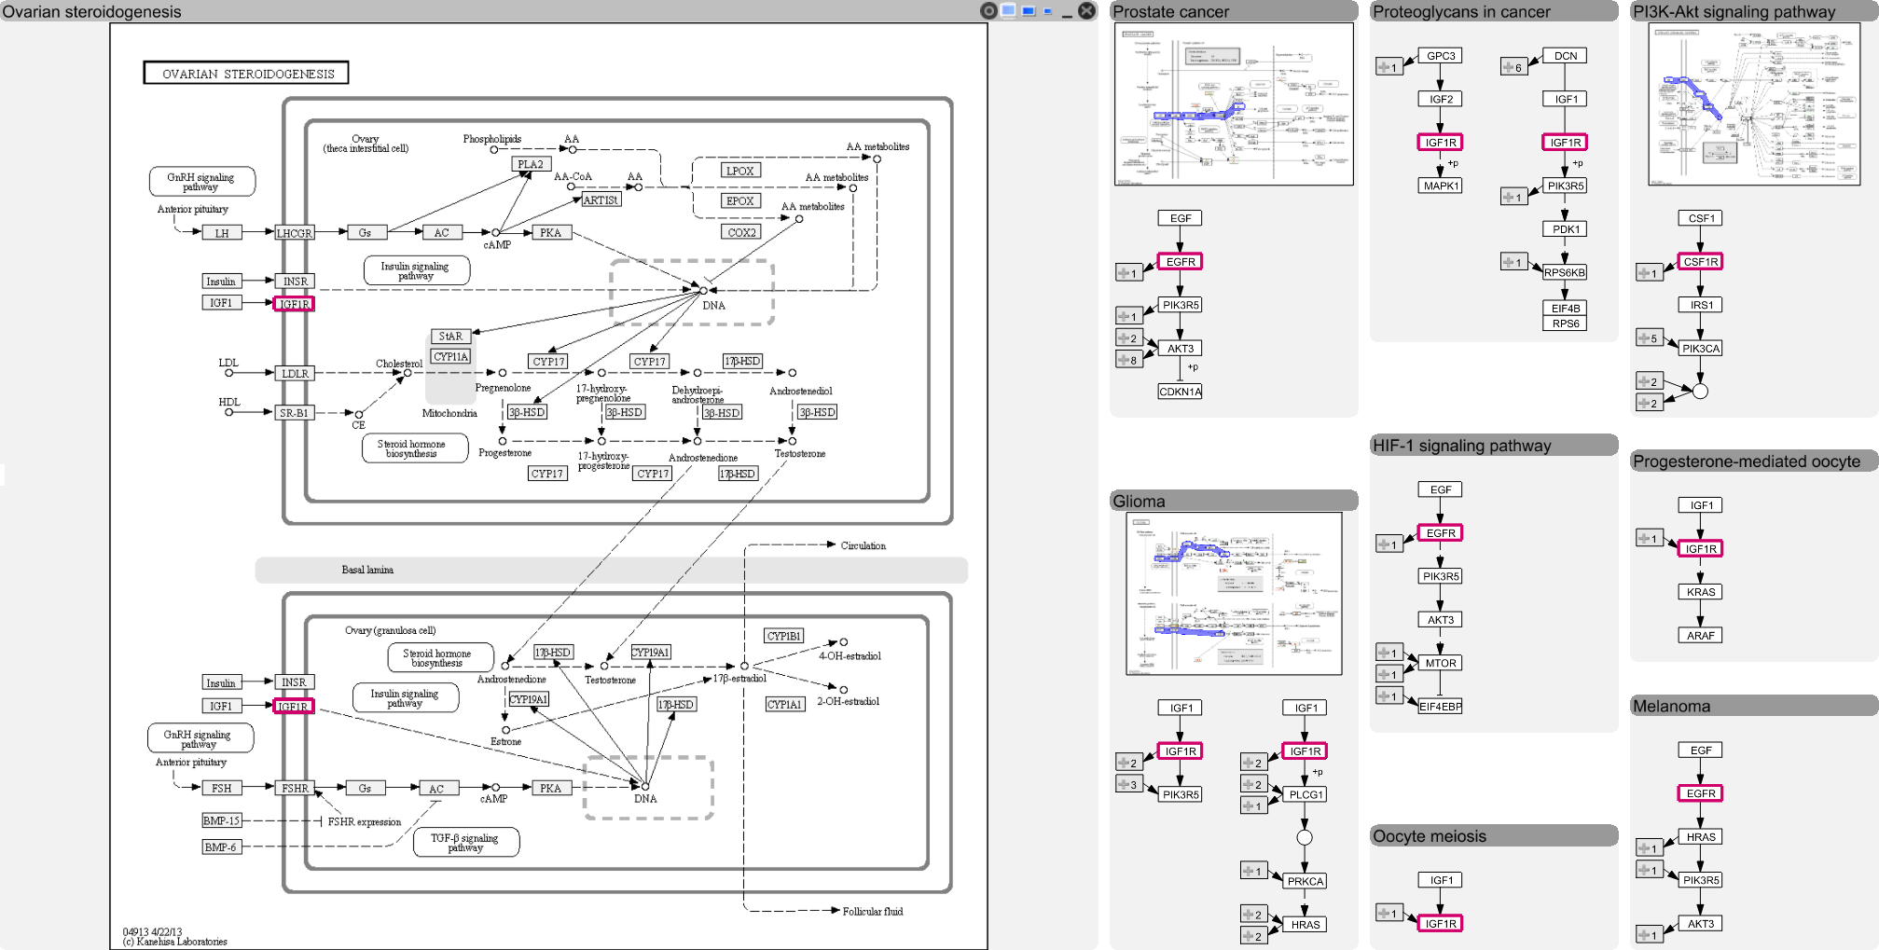
Layout

Slide 45
How to visualize multiple pathways at the same time?
How to visualize
pathway relationships?
How to visualize
experimental data on pathways?

Slide 46
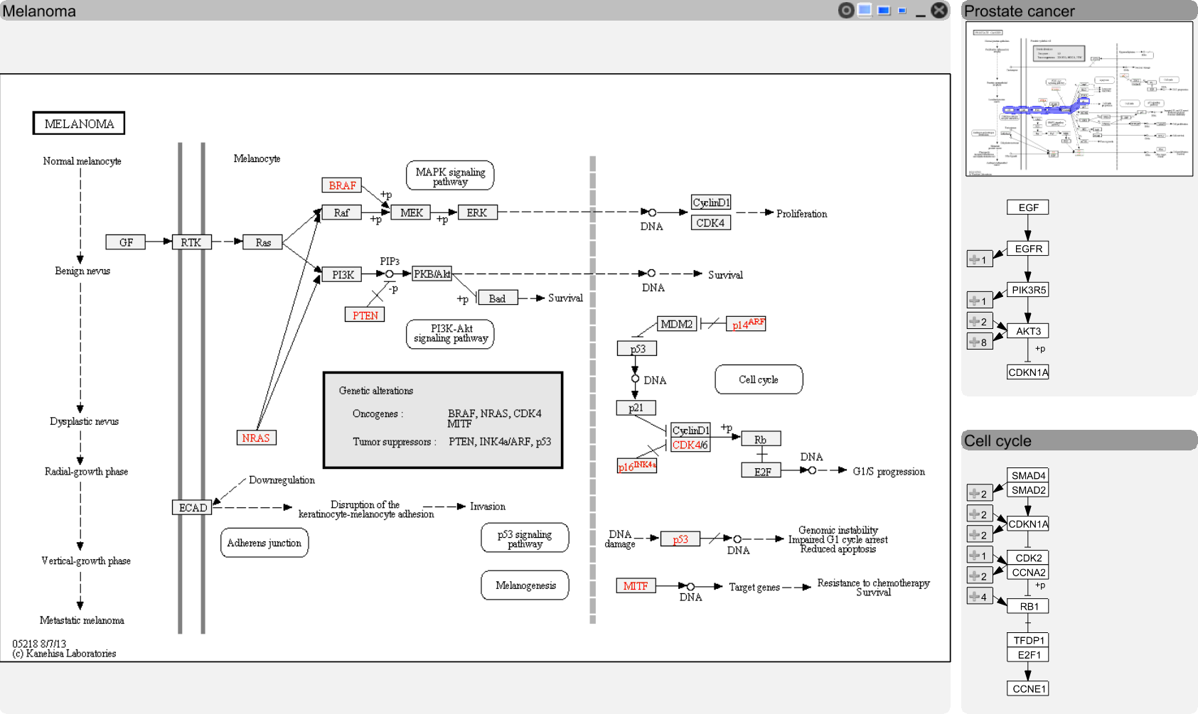
Visualizing Relationships
Notes:
Link to header gleich am anfang, overlay collins ref, stubs in detail

Slide 47
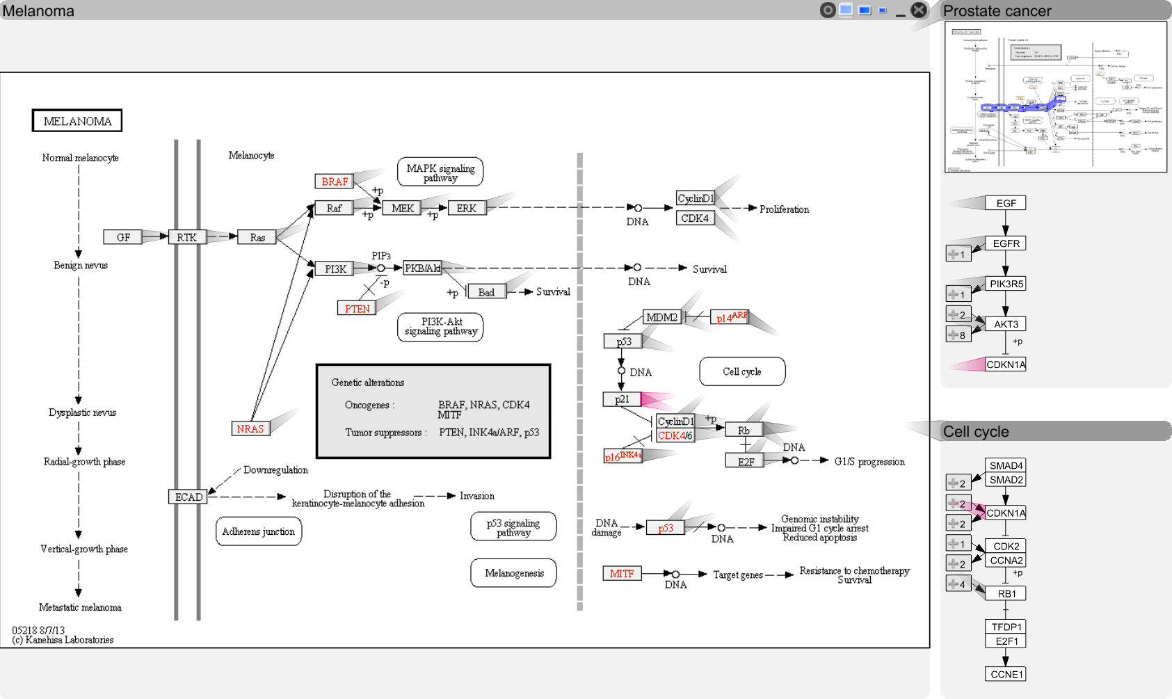
Visualizing Relationships

Slide 48
Visualizing Relationships

Slide 49
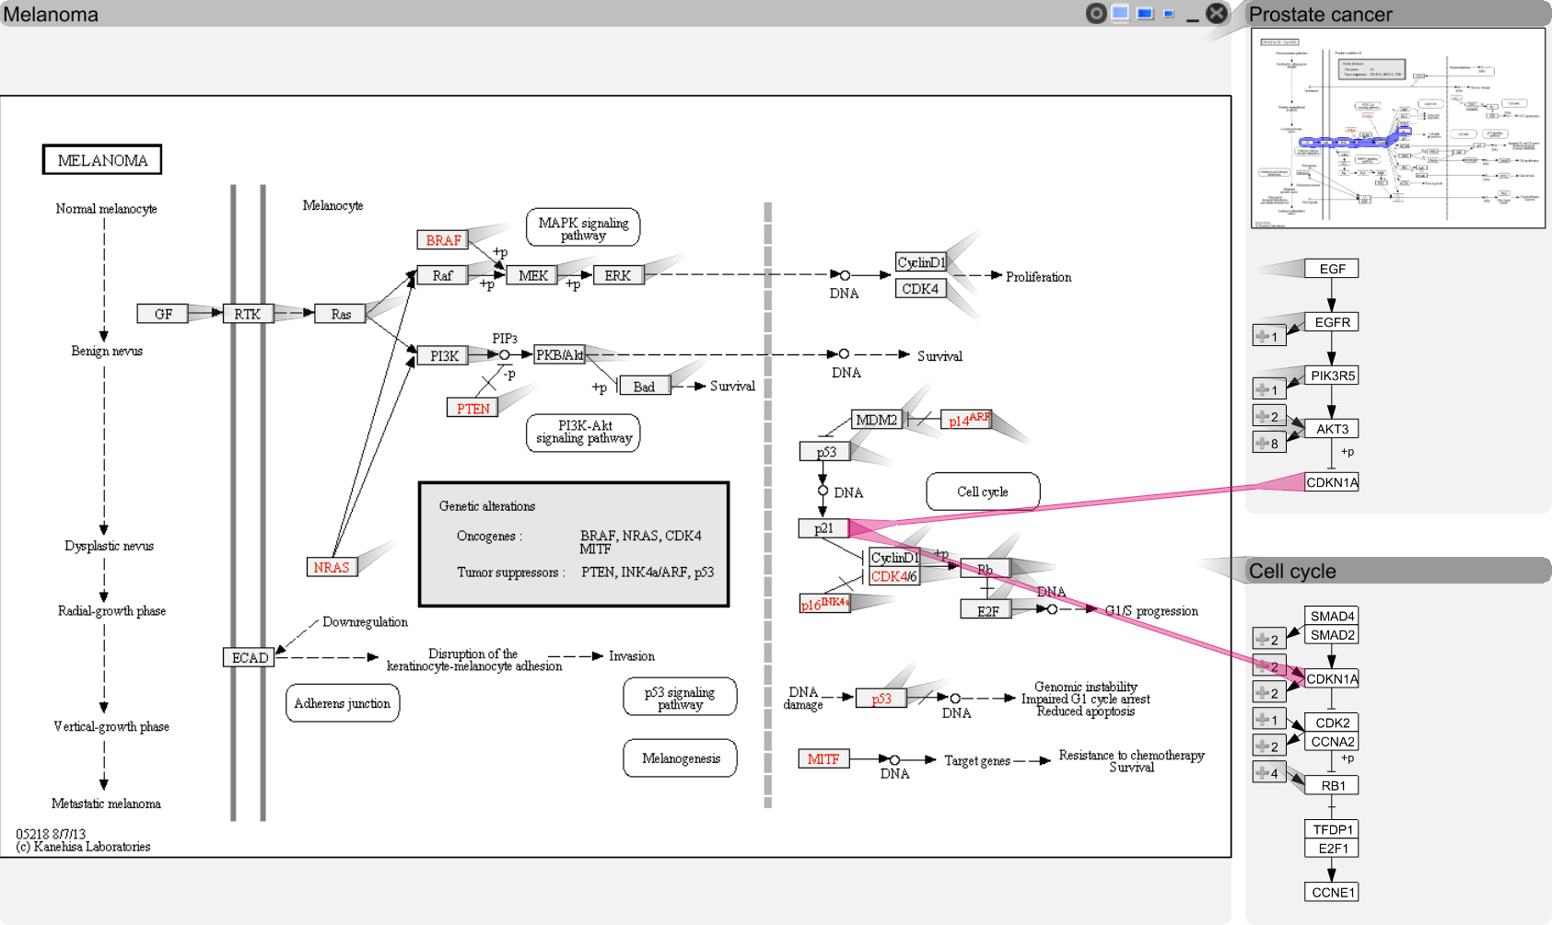
Visualizing Relationships

Slide 50

Visualizing Relationships

Slide 51
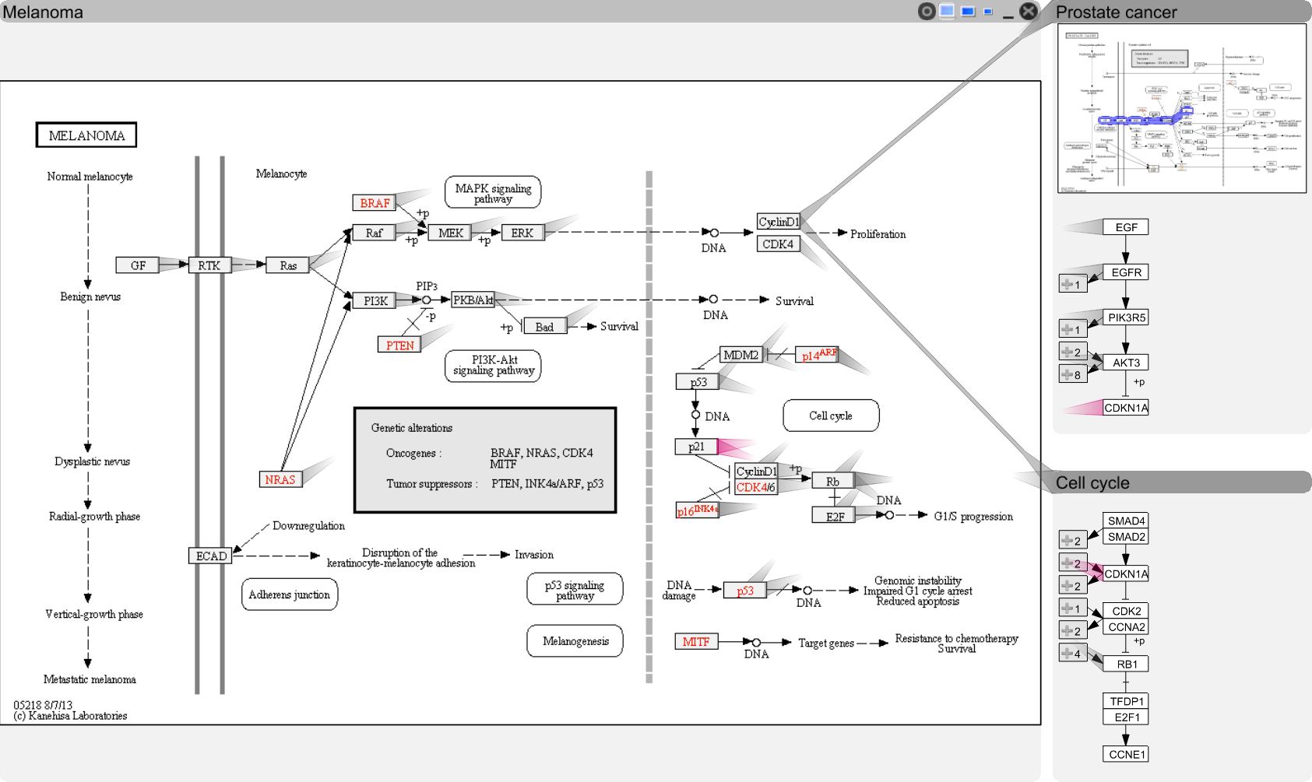
Visualizing Relationships
Notes:
hawer

Slide 52
How to visualize multiple pathways at the same time?
How to visualize
pathway relationships?
How to visualize
experimental data on pathways?

Slide 53
Experi-mental Data and Pathways enRoute
Cannot account for variation found in real-world data
Branches can be (in)activated due to
mutation,
changed gene expression,
modulation due to drug treatment,
etc.
[Partl, BioVis ‘12]

Slide 54
Good Old Color Coding
A -3.4
B 2.8
C 3.1
D -3
E 0.5
F 0.3
B
A
C
D
E
F

Slide 55
Challenge: Data Scale & Heterogeneity
Large number of experiments
Large datasets have more than 500 experiments
Multiple groups/conditions
Different types of data, require different visualization techniques

Slide 56
Concept
Pathway View
enRoute View
B
Non-Genetic Dataset
A
A
B
C
A
C
D
D
D
E
E
E
F
F
Group 1
Dataset 1
Group 2
Dataset 1
Group 1
Dataset 2

Slide 57





Experimental Data Representation
Individual Dimensions
Summary Representations

Slide 58
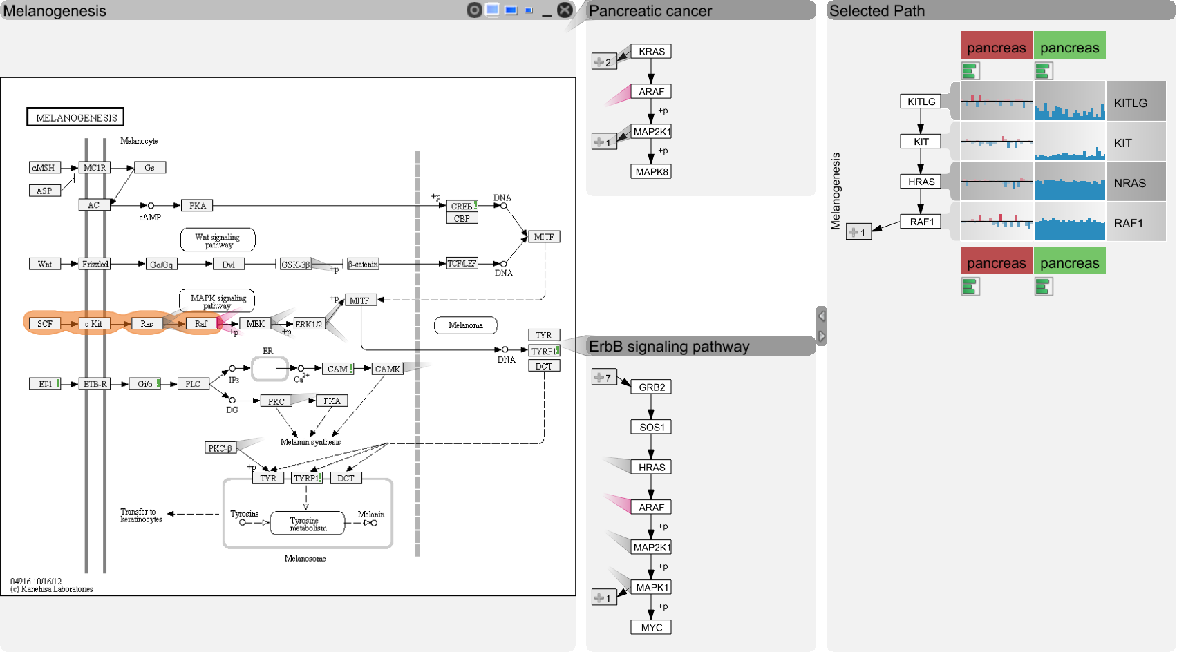
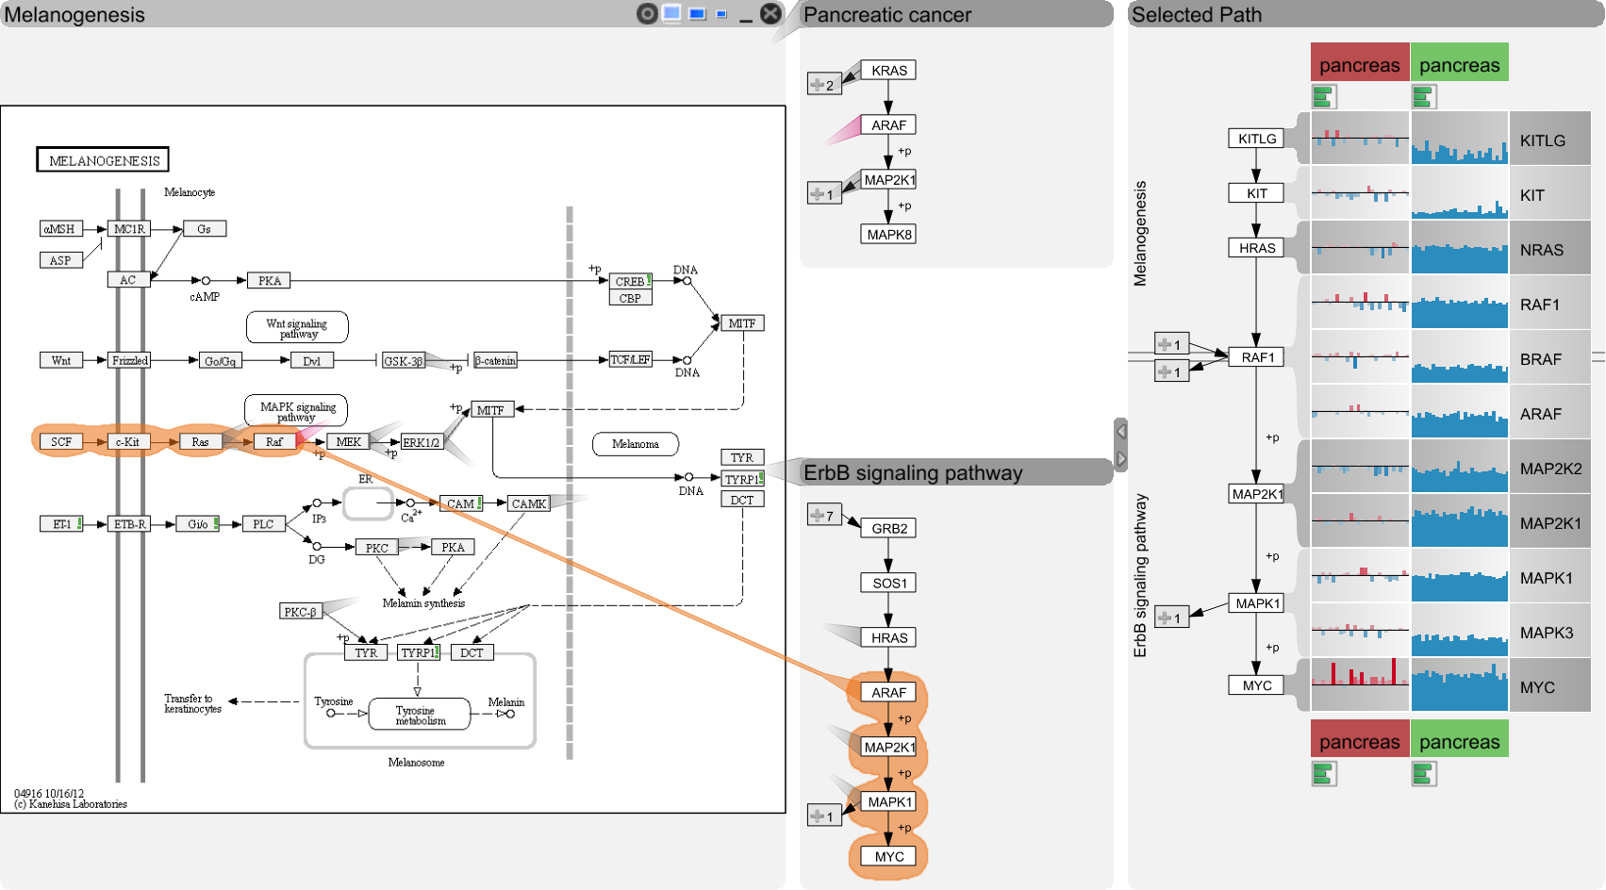
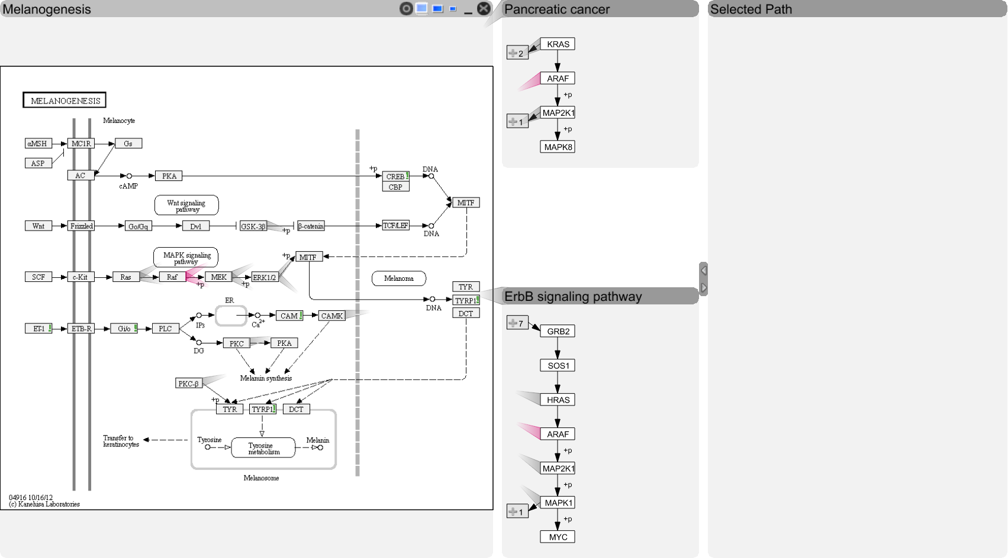
enRoute

Slide 59
Live-Demo!
http://entourage.caleydo.org
http://enroute.caleydo.org

Slide 60
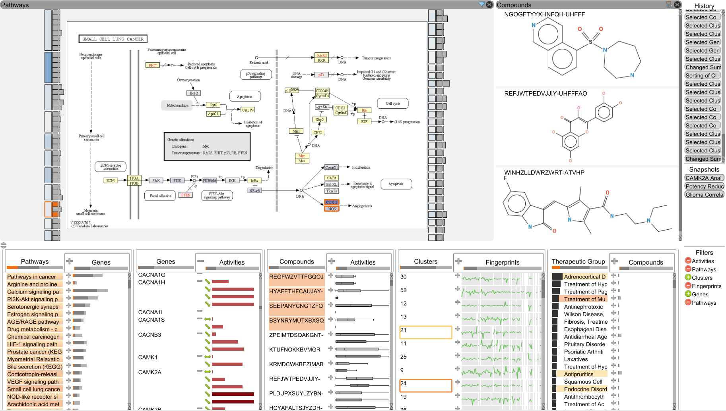
Current Developments: Drug Discovery
[Under Review at IEEE TVCG (VAST)]

Slide 62
Rankings
[Gratzl, InfoVis ‘13]
Best Paper Award

Slide 63
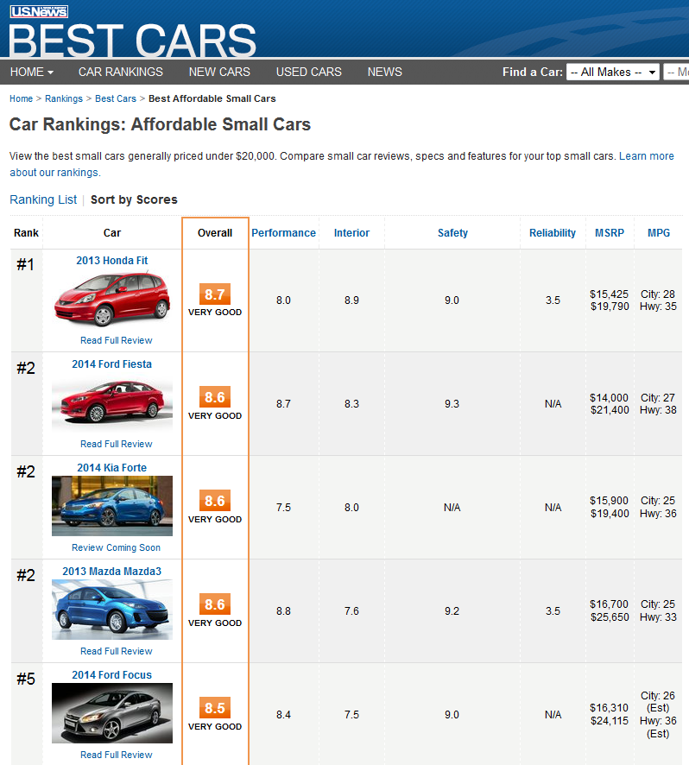
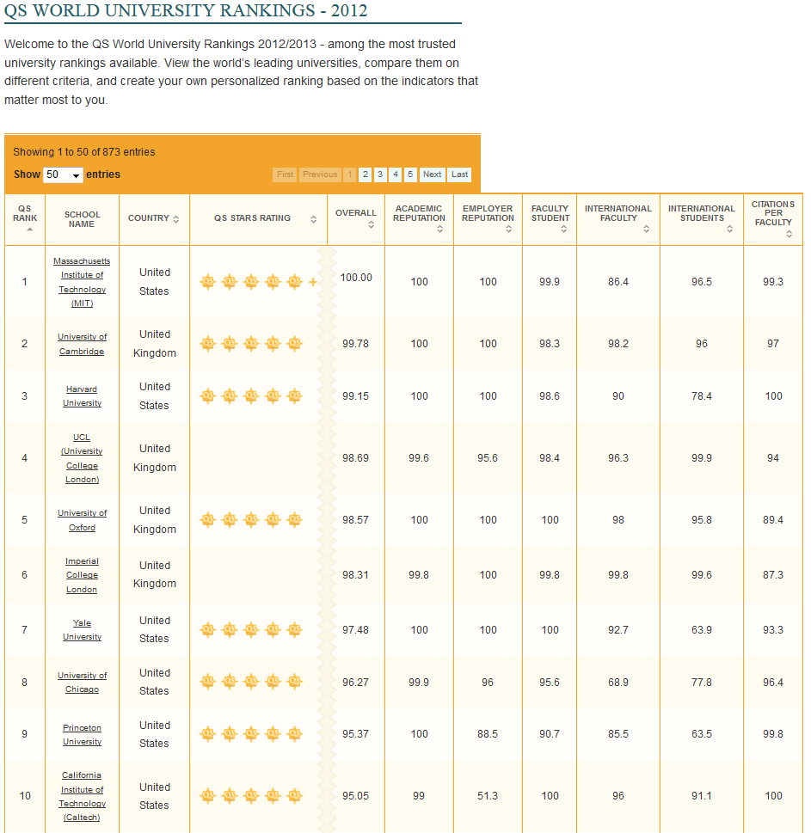
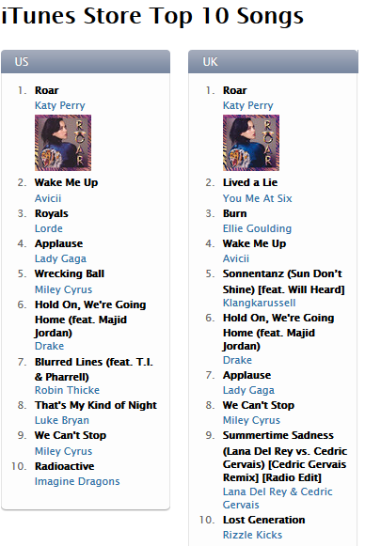
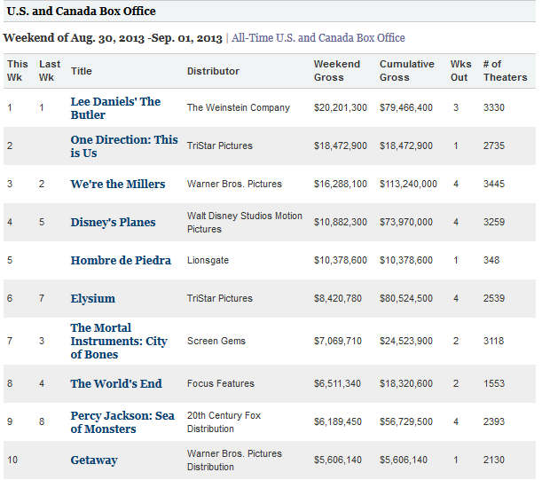
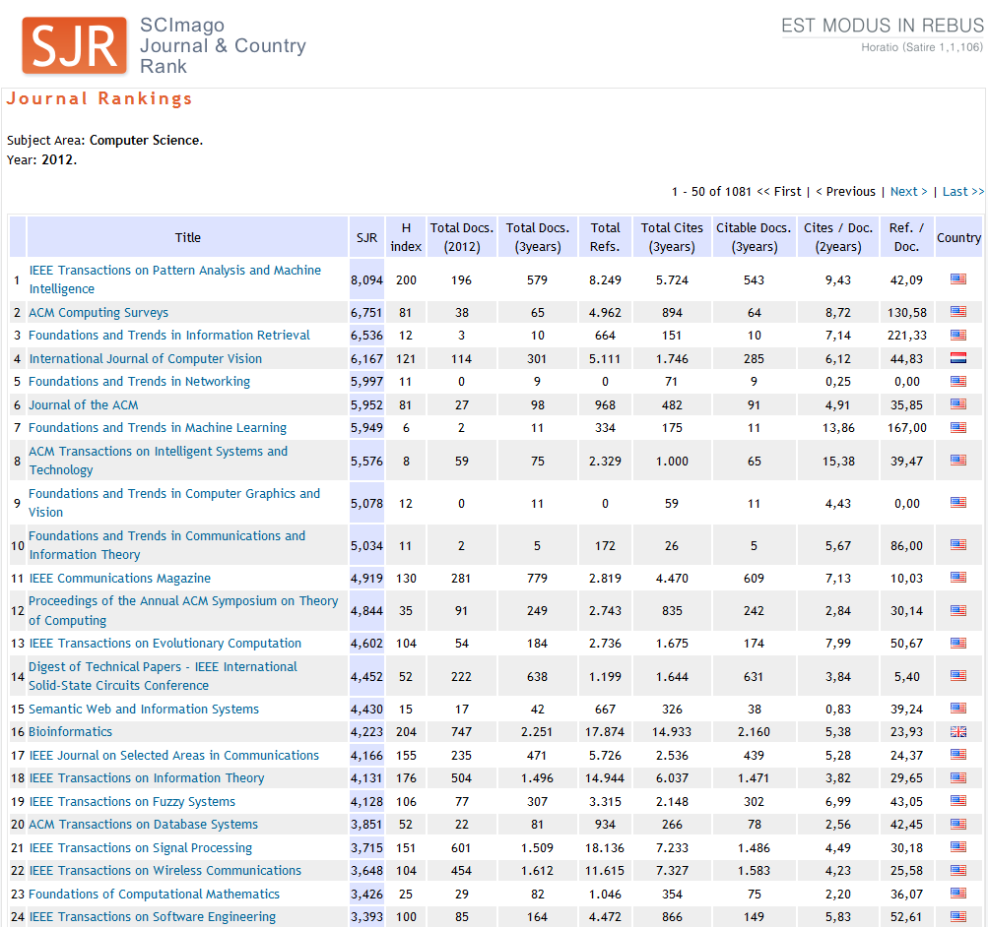
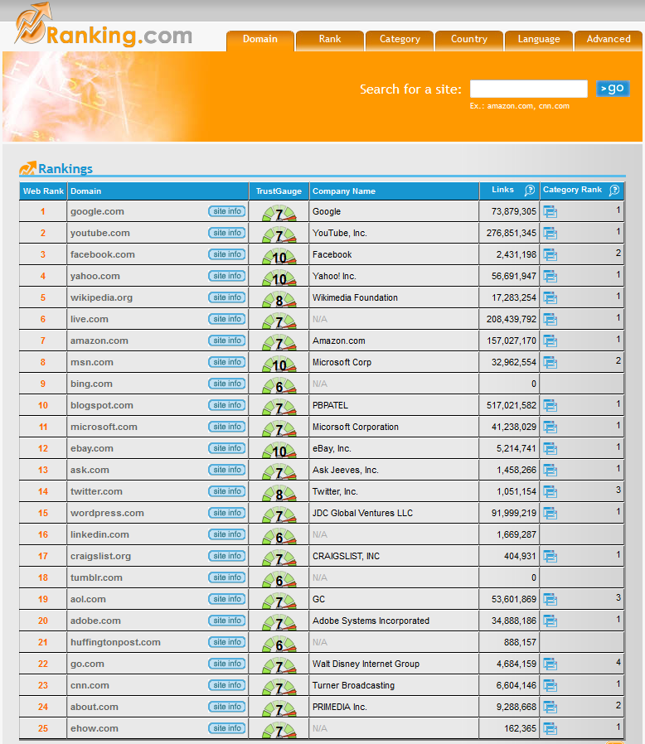
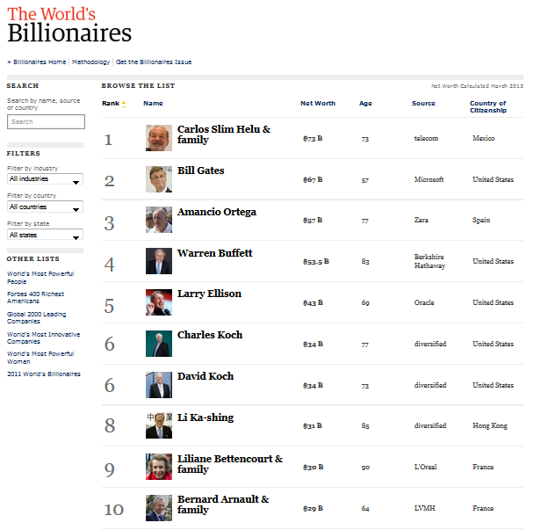
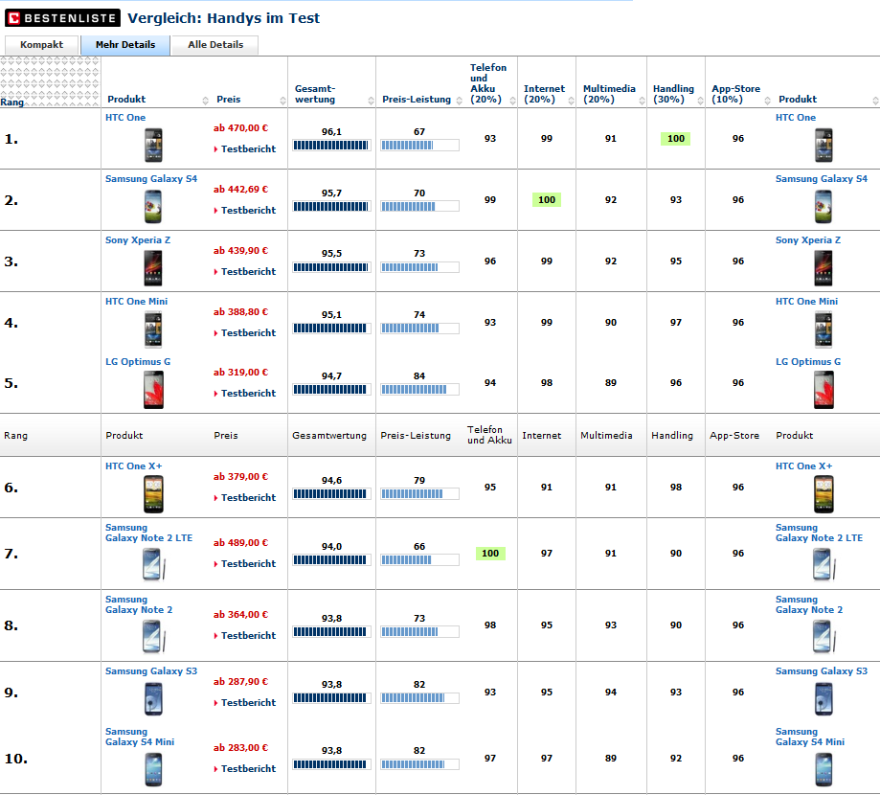
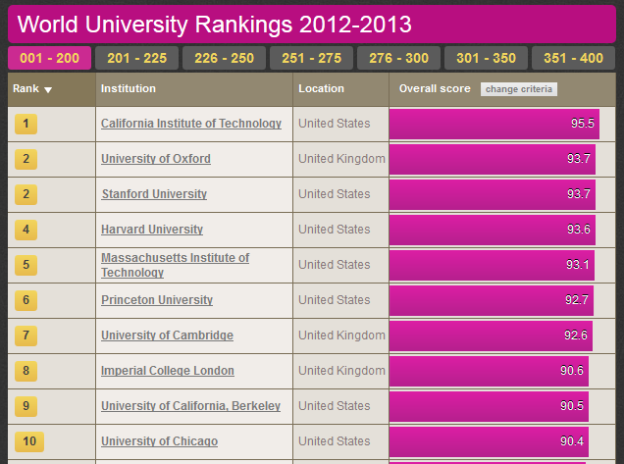

Rankings are omnipresent
Notes:
Rankings are omnipresent. They tell us what is the best, who has the most money and are helping us managing the vast amount of data.
There are simple rankings based on a single attribute like the iTunes top 10 there are range of rankings, which are based on multiple attributes, like Journal Rankings, Unviersity rankings or what is an energy efficient car.
While for the former one you don‘t need sophisticated tools, the later one are more complex to handle.
We therefore defined

Slide 64
Goal
Intuitive
Interactive
Multi-Attribute
Ranking Visualization
To Create
Refine
Explore

Slide 65
10 Requirements

Slide 66
University
MIT, USA
Harvard, USA
Princeton, USA
Cambridge, UK
Oxford, UK
Notes:
Start with a simple ordered university list
Problem: want is the rank of item X → have to count → so
Therefore the first requirement is to encode the rank
This is simple to solve, just add a column showing the rank of the item

Slide 67
10 Requirements
Encode Rank
University
Encode Rank
MIT, USA
Harvard, USA
Princeton, USA
Cambridge, UK
Oxford, UK
Notes:
Start with a simple ordered university list
Problem: want is the rank of item X → have to count → so
Therefore the first requirement is to encode the rank
This is simple to solve, just add a column showing the rank of the item

Slide 68
10 Requirements
Encode Rank
University
Encode Rank
MIT, USA
Harvard, USA
Princeton, USA
Cambridge, UK
Oxford, UK
Notes:
Start with a simple ordered university list
Problem: want is the rank of item X → have to count → so
Therefore the first requirement is to encode the rank
This is simple to solve, just add a column showing the rank of the item

Slide 69
Rank
University
1.
MIT, USA
2.
Harvard, USA
3.
Princeton, USA
4.
Cambridge, UK
5.
Oxford, UK
Notes:
No we directly spot the rank of item item.
However we can‘t see, why MIT is at the first place and whether it is by far the best or not
So the second requirement is to encode the cause of the rank
Assuming that our ranking is based on a score, we just add another column.

Slide 70
10 Requirements
Encode Rank
Encode Cause of Rank
Rank
University
Encode Cause of Rank
1.
MIT, USA
2.
Harvard, USA
3.
Princeton, USA
4.
Cambridge, UK
5.
Oxford, UK
Notes:
No we directly spot the rank of item item.
However we can‘t see, why MIT is at the first place and whether it is by far the best or not
So the second requirement is to encode the cause of the rank
Assuming that our ranking is based on a score, we just add another column.

Slide 71
10 Requirements
Encode Rank
Encode Cause of Rank
Rank
University
Encode Cause of Rank
1.
MIT, USA
2.
Harvard, USA
3.
Princeton, USA
4.
Cambridge, UK
5.
Oxford, UK
Notes:
No we directly spot the rank of item item.
However we can‘t see, why MIT is at the first place and whether it is by far the best or not
So the second requirement is to encode the cause of the rank
Assuming that our ranking is based on a score, we just add another column.

Slide 72
Rank
University
Score
Score
1.
MIT, USA
89.4
2.
Harvard, USA
84.2
3.
Princeton, USA
73.8
4.
Cambridge, UK
64.3
5.
Oxford, UK
44.0
Notes:
For simpler interpretation, we can also use bars for the scores.
Now we can easy see that MIT and Harvard are quite close together. … it is a close call
That more or less everything you can do about single attribute rankings. But since we are talking the more complex multiple attribute rankings. The next logical requirement is to support multiple attributes.

Slide 73
10 Requirements
Encode Rank
Encode Cause of Rank
Support Multiple Attributes
Rank
University
Score
Support Multiple Attributes
1.
MIT, USA
2.
Harvard, USA
3.
Princeton, USA
4.
Cambridge, UK
5.
Oxford, UK
Notes:
For simpler interpretation, we can also use bars for the scores.
Now we can easy see that MIT and Harvard are quite close together.
That more or less everything you can do about single attribute rankings. But since we are talking the more complex multiple attribute rankings. The next logical requirement is to support multiple attributes.

Slide 74
10 Requirements
Encode Rank
Encode Cause of Rank
Support Multiple Attributes
Rank
University
Score
Support Multiple Attributes
1.
MIT, USA
2.
Harvard, USA
3.
Princeton, USA
4.
Cambridge, UK
5.
Oxford, UK
Notes:
For simpler interpretation, we can also use bars for the scores.
Now we can easy see that MIT and Harvard are quite close together.
That more or less everything you can do about single attribute rankings. But since we are talking the more complex multiple attribute rankings. The next logical requirement is to support multiple attributes.

Slide 75
Score = f(A, B, C)
Rank
University
A
Score
B
C
1.
MIT, USA
2.
Harvard, USA
3.
Princeton, USA
4.
Cambridge, UK
5.
Oxford, UK
Notes:
In our case we assume that the final score is combination of multiple other attributes. In our example A,B, and C.
Depending on the combiner function, there are various existing ways to encode and show the attributes.

Slide 76
Combiner functions: f(A,B,C)
(Weighted) sum Score = w_{a} A + w_{b} B + w_{c} C
Maximum Score = max(A, B, C)
Product
Nesting
…
Serial
Parallel
Complex Combiners
Notes:
A combiner functions can be anything.
The simplest one is a weighted sum. It means that an item has a high score if all combined attributes has a high value.
In constrast to that the maximum operation can be interpreted as that an item has a high score if any attribute is high
But there are plenty of other combiner functions out there. Like Product Nesting and so on
In LineUp we are calling the weightet sum the serial combiner and the maximum a parallel combiner.
In addition, LineUp supports all the others by providing a generic javascript editor, in which you can type in the formula similar to Excel.
While we have special visual encodings for the first two ones, the formula based is simply represented by its result.

Slide 77
Serial Combiner
(as Stacked Bar)
w_{a} A + w_{b} B + w_{c} C
Rank
University
A
B
C
1.
MIT, USA
2.
Harvard, USA
3.
Princeton, USA
4.
Cambridge, UK
5.
Oxford, UK
Notes:
We make use of stacked bars

Slide 78
Serial Combiner
(as Stacked Bar)
w_{b} B
w_{c} C
w_{c} C
w_{a} A + w_{b} B + w_{c} C
w_{a} A
w_{a} A
+
w_{b} B
+
+
+
Rank
University
A
B
C
1.
MIT, USA
2.
Harvard, USA
3.
Princeton, USA
4.
Cambridge, UK
5.
Oxford, UK
Notes:
Start with the simple multi attribute table and animate to a stacked version,
Tell something about stacked pros & cons
Animated to a diverged stacked layout

Slide 79
Serial Combiner
(as Stacked Bar)
w_{b} B
w_{c} C
w_{a} A
+
+
Rank
University
A
B
C
1.
MIT, USA
2.
Harvard, USA
3.
Princeton, USA
4.
Cambridge, UK
5.
Oxford, UK
Notes:
Start with the simple multi attribute table and animate to a stacked version,
Tell something about stacked pros & cons

Slide 80
Parallel Combiner
10 Requirements
Encode Rank
Encode Cause of Rank
Support Multiple Attributes
Interactive Refinement and Feedback
Rank
University
MAX(A,B,C)
Interactive Refinement and Visual Feedback
1.
Oxford, UK
2.
Harvard, US
3.
MIT, US
4.
Princeton, US
5.
Cambridge, UK

Slide 81
Parallel Combiner
10 Requirements
Encode Rank
Encode Cause of Rank
Support Multiple Attributes
Interactive Refinement and Visual Feedback
Rank
University
MAX(A,B,C)
Interactive Refinement and Visual Feedback
1.
Oxford, UK
2.
Harvard, US
3.
MIT, US
4.
Princeton, US
5.
Cambridge, UK

Slide 82
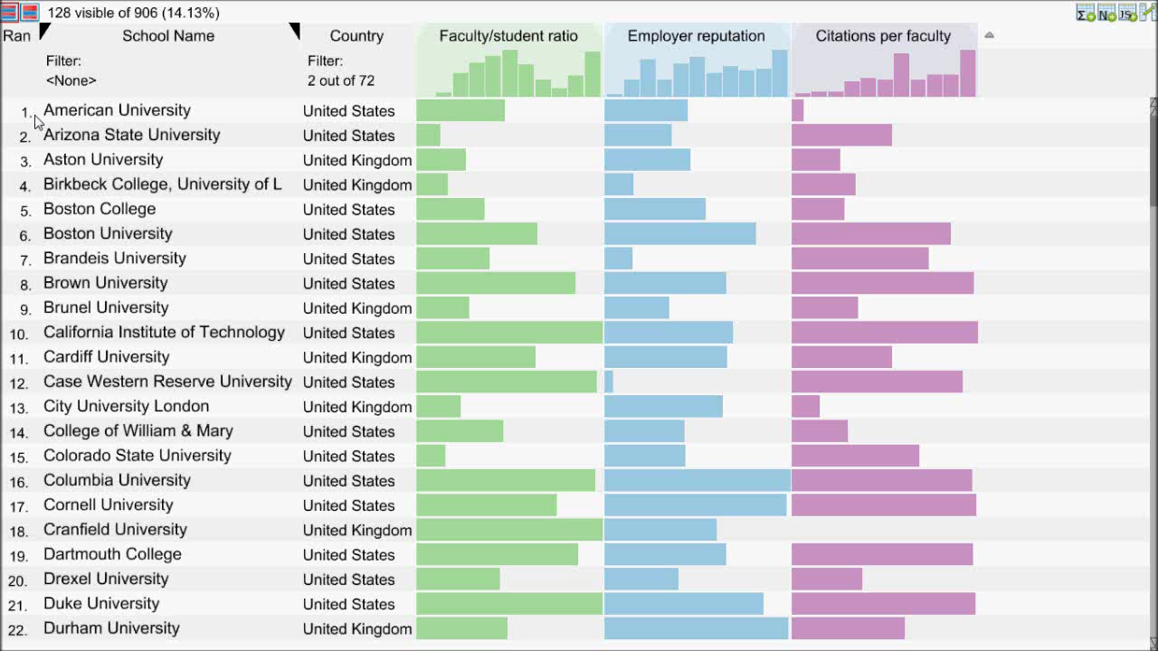
Video showing
Creating combined score
Sort by that
Change weights
Focus on animation: color & style
Notes:
Start with a LineUp video, showing: * creation of combined score
* changing weights
* animations (movement + color)

Slide 83
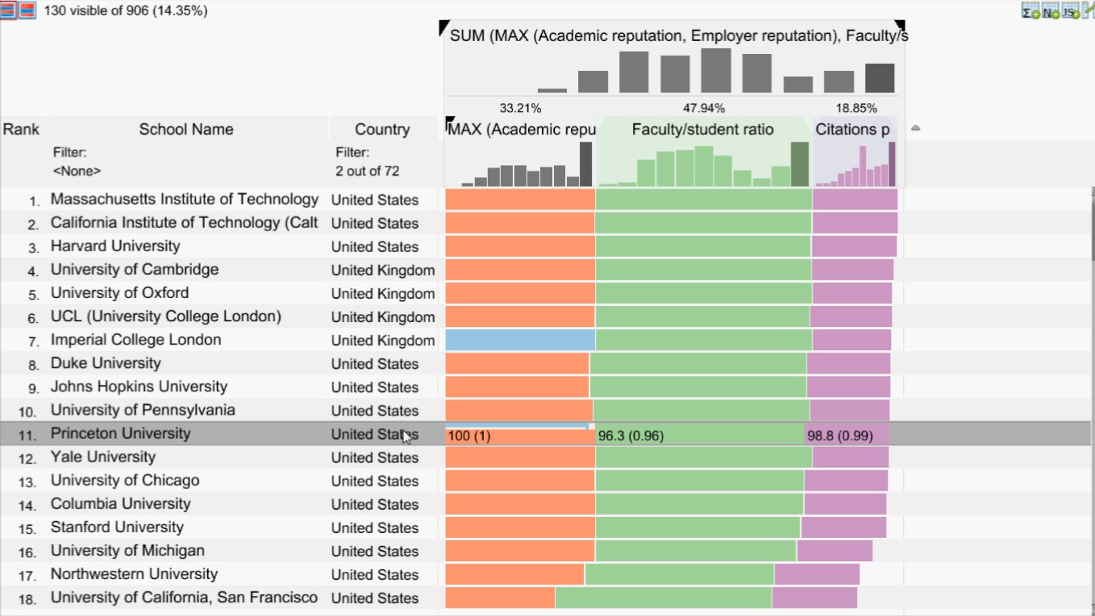
10 Requirements
Video showing
Creating combined score
Sort by that
Change weights
Focus on animation: color & style
Encode Rank
Encode Cause of Rank
Support Multiple Attributes
Interactive Refinement and Visual Feedback
Flexible Mapping of Attributes to Scores
Flexible Mapping of Attributes to Scores
Notes:
Start with a LineUp video, showing: * creation of combined score
* changing weights
* animations (movement + color)

Slide 84
10 Requirements
Video showing
Creating combined score
Sort by that
Change weights
Focus on animation: color & style
Flexible Mapping of Attributes to Scores
Encode Rank
Encode Cause of Rank
Support Multiple Attributes
Interactive Refinement and Visual Feedback
Flexible Mapping of Attributes to Scores
Notes:
Start with a LineUp video, showing: * creation of combined score
* changing weights
* animations (movement + color)

Slide 85
0
1
Max
Min
100
0

Slide 86
0
1
0
100

Slide 87
0
1
0
100
Notes:
Evaluation has show -> more difficult to interpret

Slide 88
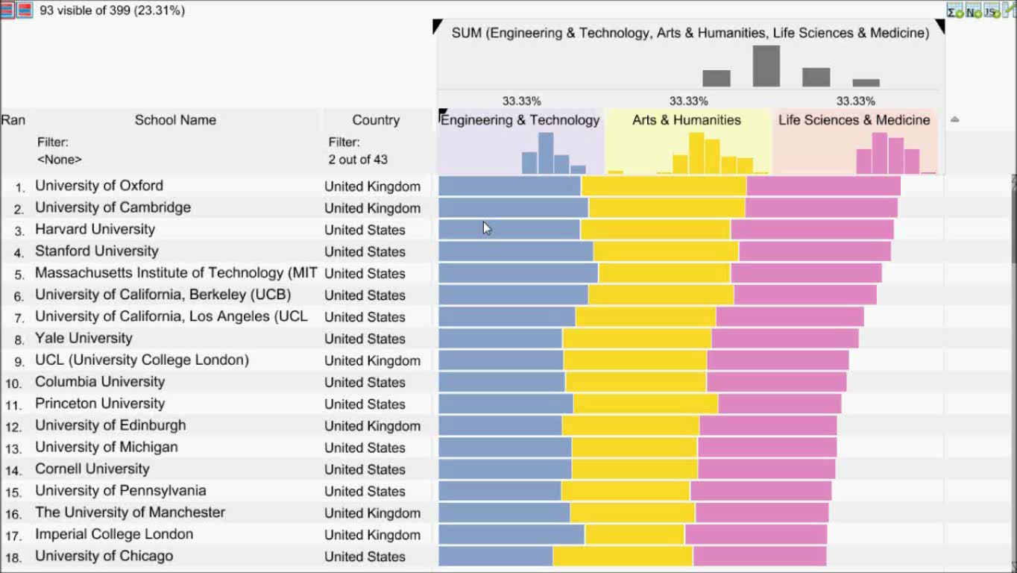
Video showing:
Scenario, manpulate mapping of attribute
Switch between two mode: hor / par
Add move points
Show java script editor
Apply A default one -> argument for compare

Slide 89
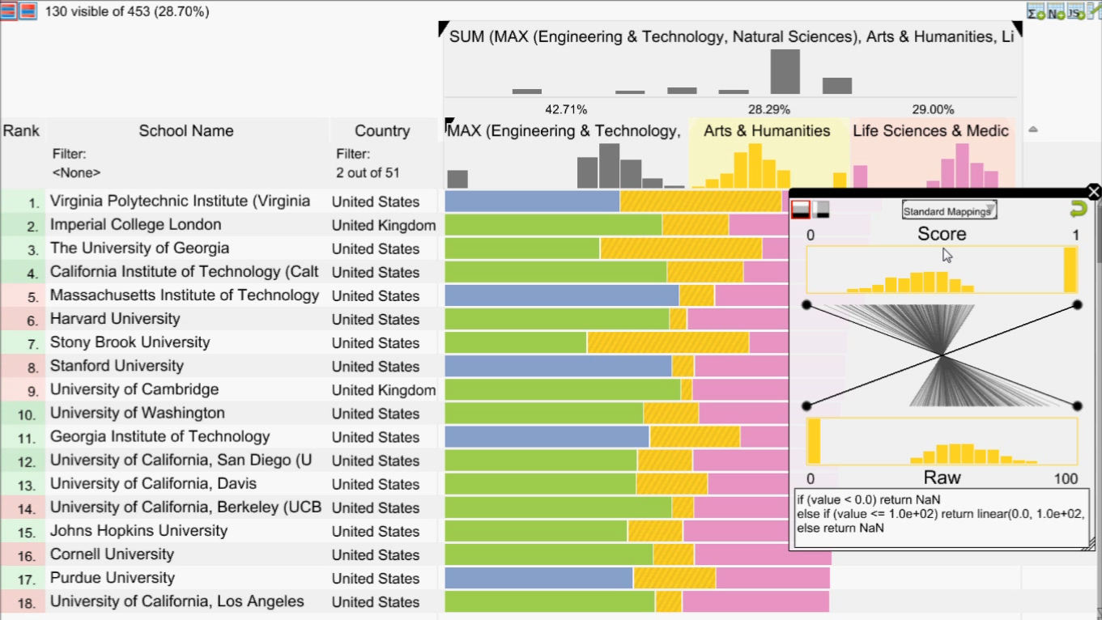
10 Requirements
Video showing
Creating combined score
Sort by that
Change weights
Focus on animation: color & style
Encode Rank
Encode Cause of Rank
Support Multiple Attributes
Interactive Refinement and Visual Feedback
Flexible Mapping of Attributes to Scores
Compare Rankings
Compare Rankings
Notes:
Start with a LineUp video, showing: * creation of combined score
* changing weights
* animations (movement + color)

Slide 90
10 Requirements
Video showing
Creating combined score
Sort by that
Change weights
Focus on animation: color & style
Encode Rank
Encode Cause of Rank
Support Multiple Attributes
Interactive Refinement and Visual Feedback
Flexible Mapping of Attributes to Scores
Compare Rankings
Compare Rankings
Notes:
Start with a LineUp video, showing: * creation of combined score
* changing weights
* animations (movement + color)

Slide 91
Bump Charts
Rank
University
Score
Rank
Score
Score
1.
MIT, USA
1.
2.
Harvard, USA
2.
(+1)
3.
Princeton, USA
3.
(+1)
4.
Cambridge, UK
4.
(-2)
5.
Oxford, UK
5.
Notes:
Same table from before, but with slopegraphs in it.
+ interpretation + arrows

Slide 92
Bump Charts
Rank
University
Score
Rank
Score
Score
1.
MIT, USA
1.
2.
Harvard, USA
2.
2.
Harvard, USA
(+1)
3.
Princeton, USA
3.
(+1)
4.
Cambridge, UK
4.
4.
(-2)
(-2)
5.
Oxford, UK
5.
Notes:
Same table from before, but with slopegraphs in it.
+ interpretation + arrows

Slide 93
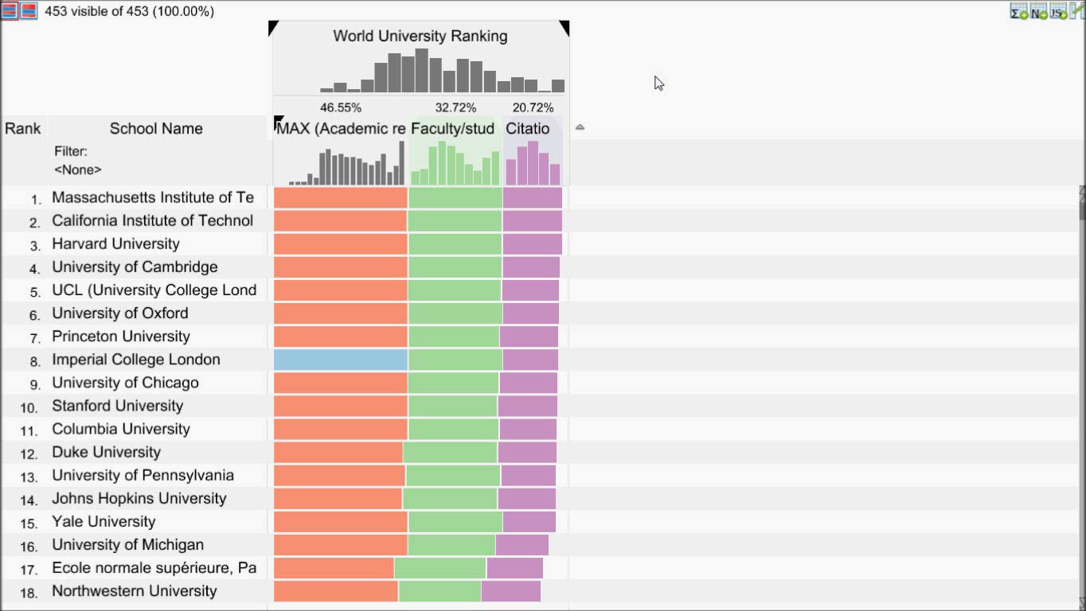
Video showing:
Creating snapshot for comparison
Play with weights
Show delta
Select by clicking on slopegraph
Notes:
Video of LineUp with snapshot and interactive changing of weights.

Slide 94
10 Requirements
Encode Rank
Encode Cause of Rank
Support Multiple Attributes
Interactive Refinement and Visual Feedback
Flexible Mapping of Attributes to Scores
Compare Rankings
Scalability
Filtering
Handle Missing Values
Optimization

Slide 95
Demos, Videos & More: http://lineup.caleydo.org

Slide 97
What is Next?

Slide 98
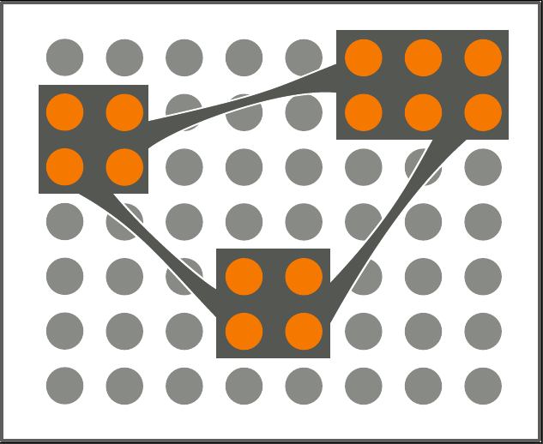
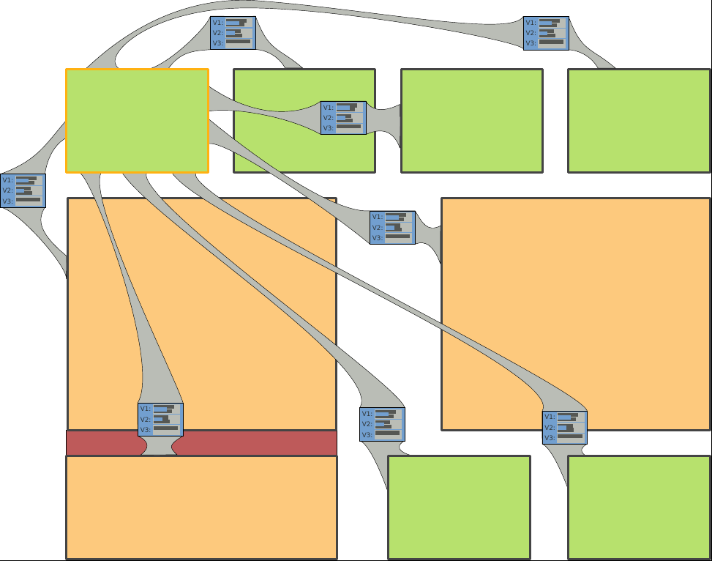
Large & Heterogeneous Data
Research Approach: Semantic Subsets
Interpretable Division (why is this a subset?)
Representing Data on Multiple Levels of Detail
Visualizing Relationships
Ensuring Coverage
Uncertainty and Ambiguity
High-Impact Domain Problems

Slide 99
Visualization Approaches for Biomolecular Data
?
Alexander Lex, Harvard University
alex@seas.harvard.edu
http://alexander-lex.com
@alexander_lex
Credits:
Marc Streit, Nils Gehlenborg, Hanspeter Pfister, Anne Mai Wasserman, Mark Borowsky, Christian Partl, Denis Kalkofen, Samuel Gratzl, Dieter Schmalstieg

