Slide 1
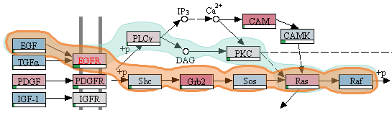


Caleydo Entourage: Visualizing Relationships between Biological Pathways
Alexander Lex
Discovery on Target
October 8, 2014

Slide 2
Who am I? alexander-lex.com
PostDoc @ Harvard, Visual Computing Group, PI: Hanspeter Pfister
Associated PostDoc @ NIBR, Scientific Data Analysis, PI: Mark Borowsky

Slide 3



Credits
Marc Streit Johannes Kepler University Linz, AT Nils Gehlenborg Harvard Medical School, Boston, USA Christian Partl Graz University of Technology, AT Samuel Gratzl Johannes Kepler University Linz, AT Hendrik Strobelt Harvard University, Cambridge, USA Anne-Mai Wassermann Novartis (NIBR), Cambridge, USA Dieter Schmalstieg Graz University of Technology, AT Mark Borowsky Novartis (NIBR), Cambridge, USA Hanspeter Pfister Harvard University, Cambridge, USA

Slide 4
Why Visualize?

Slide 5
biology & pharmacology research requires understanding data
but there is so much of it…

Slide 6
Data Visualization
… makes data accessible
… combines strengths of humans and computers
… enables insight
… communicates

Slide 7
Historical Quotes
Imagination or visualization, and in particular the use of diagrams, has a crucial part to play in scientific investigation. - René Descartes, 1637
The purpose of computing is insight, not numbers.
- Richard Wesley Hamming (Founder of the ACM), 1962
Graphics is the visual means of resolving logical problems. - Jacques Bertin, 1977

Slide 8
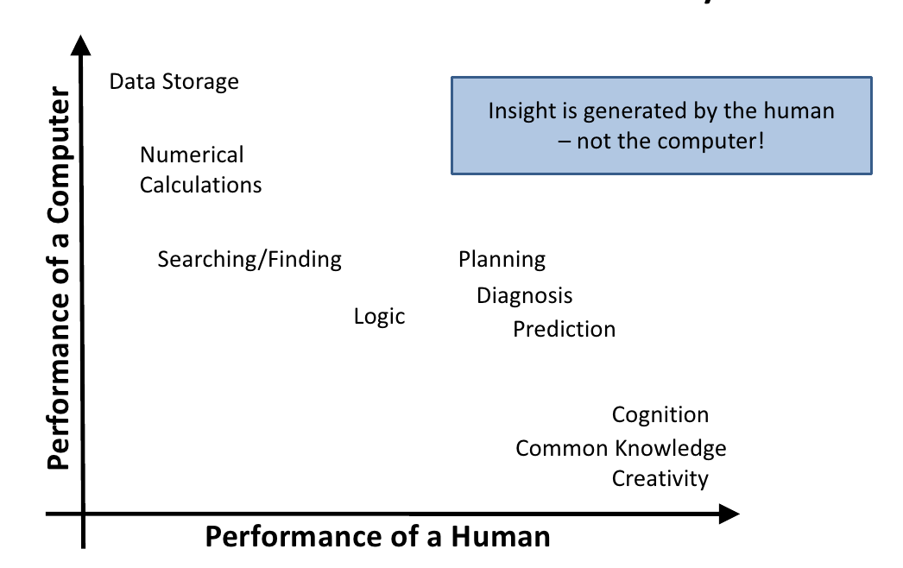
The Ability Matrix

Slide 9
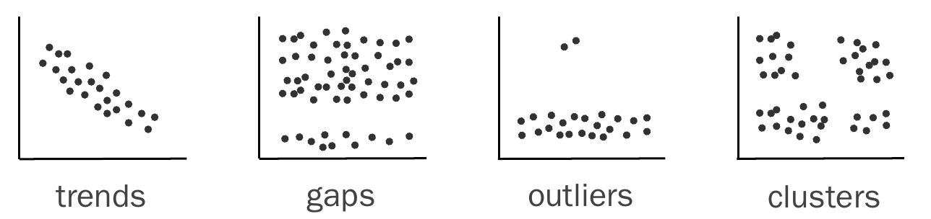
Visualization for Pattern Discovery
Notes:
Can Statistics do this for us?

Slide 10
Can We Trust Statistics?
I
x | y
10 | 8.04
8 | 6.95
13 | 7.58
9 | 8.81
11 | 8.33
14 | 9.96
6 | 7.24
4 | 4.26
12 | 10.84
7 | 4.82
5 | 5.68
II
x | y
10 | 9.14
8 | 8.14
13 | 8.74
9 | 8.77
11 | 9.26
14 | 8.1
6 | 6.13
4 | 3.1
12 | 9.13
7 | 7.26
5 | 4.74
III
x | y
10 | 7.46
8 | 6.77
13 | 12.74
9 | 7.11
11 | 7.81
14 | 8.84
6 | 6.08
4 | 5.39
12 | 8.15
7 | 6.42
5 | 5.73
IV
x | y
8 | 6.58
8 | 5.76
8 | 7.71
8 | 8.84
8 | 8.47
8 | 7.04
8 | 5.25
19 | 12.5
8 | 5.56
8 | 7.91
8 | 6.89
Mean x: 9 y: 7.50
Variance x: 11 y: 4.122
Correlation x – y: 0.816
Linear regression: y = 3.00 + 0.500x

Slide 11
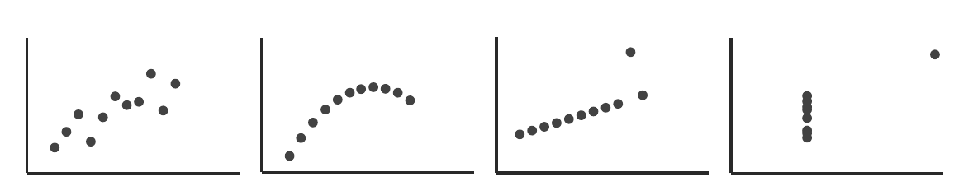
Anscombe’s Quartett
Mean x: 9 y: 7.50
Variance x: 11 y: 4.122
Correlation x – y: 0.816
Linear regression: y = 3.00 + 0.500x

Slide 12
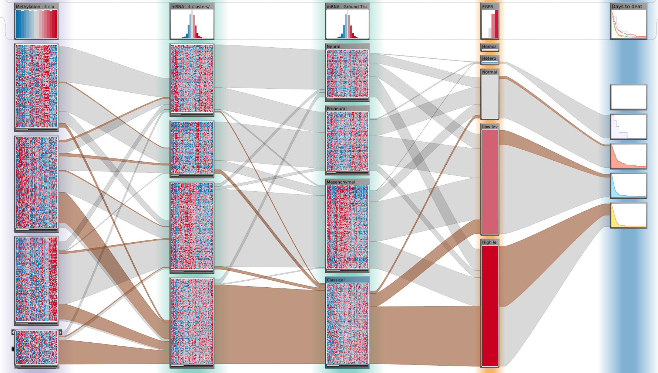
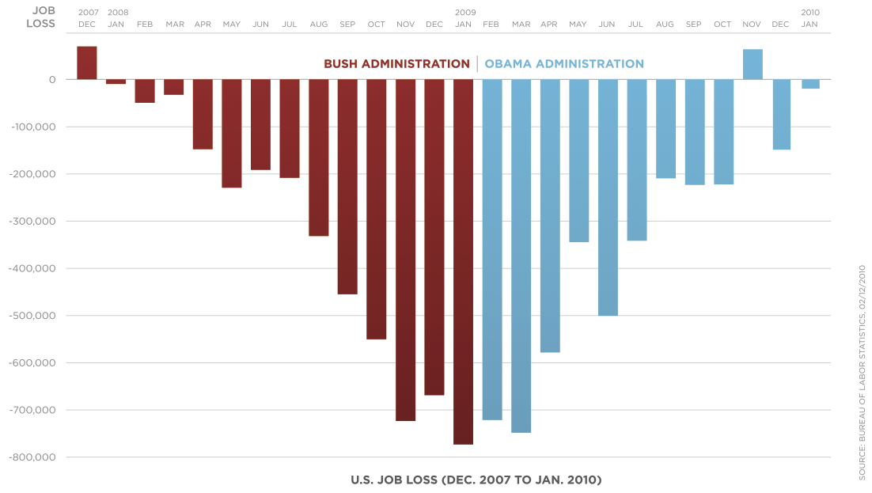
Applications of Visualization
Open Exploration
Presentation
Notes:
Exploration:
result not known
not even question
Illustration:
Know about the data
Communicate to others

Slide 13
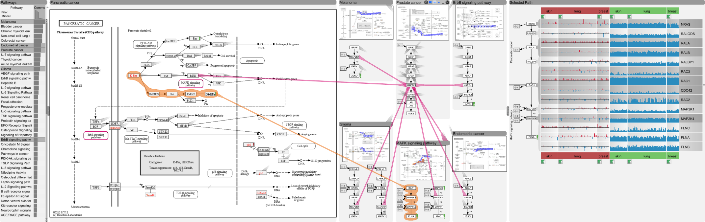
Pathways – Entourage
[Partl, BioVis ‘12]
Best Paper Award
[Partl, BMC Bioinf. ‘13]
[Lex, InfoVis ‘13]

Slide 14
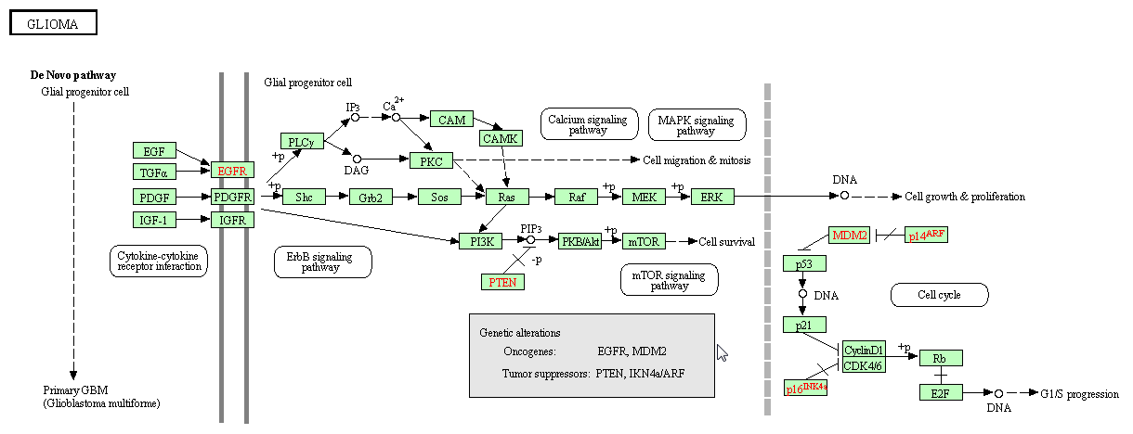
A Pathway

Slide 15
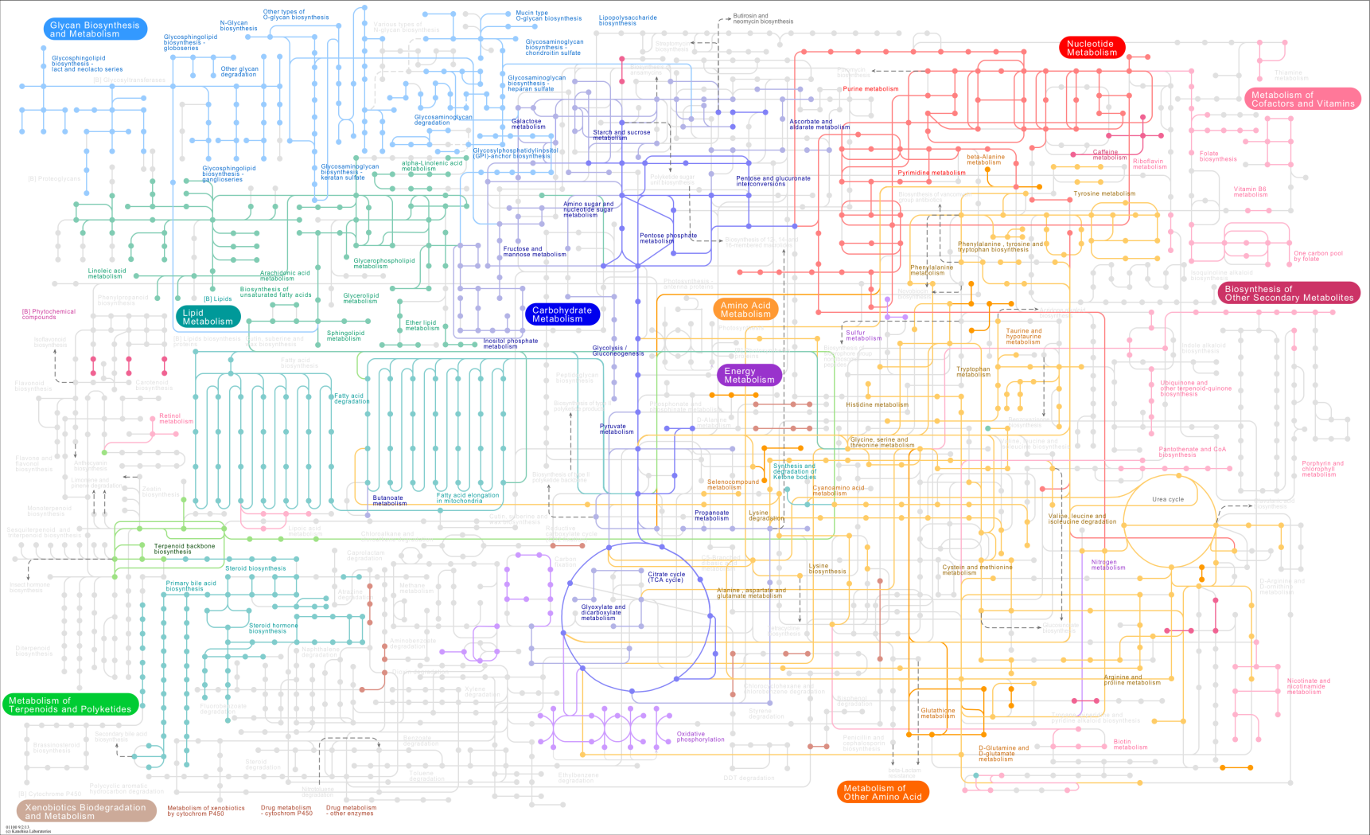
The bigger picture
Notes:
Alle prozesse im menschen im netzwerk, zuerst komplex, analyze -> understand

Slide 16
Background
Whole Network
Pathway A
B
Pathway B
Pathway C
D
I
A
E
C
C
H
J
G
L
F
G
L
P
N
K
Q
M
O

Slide 17
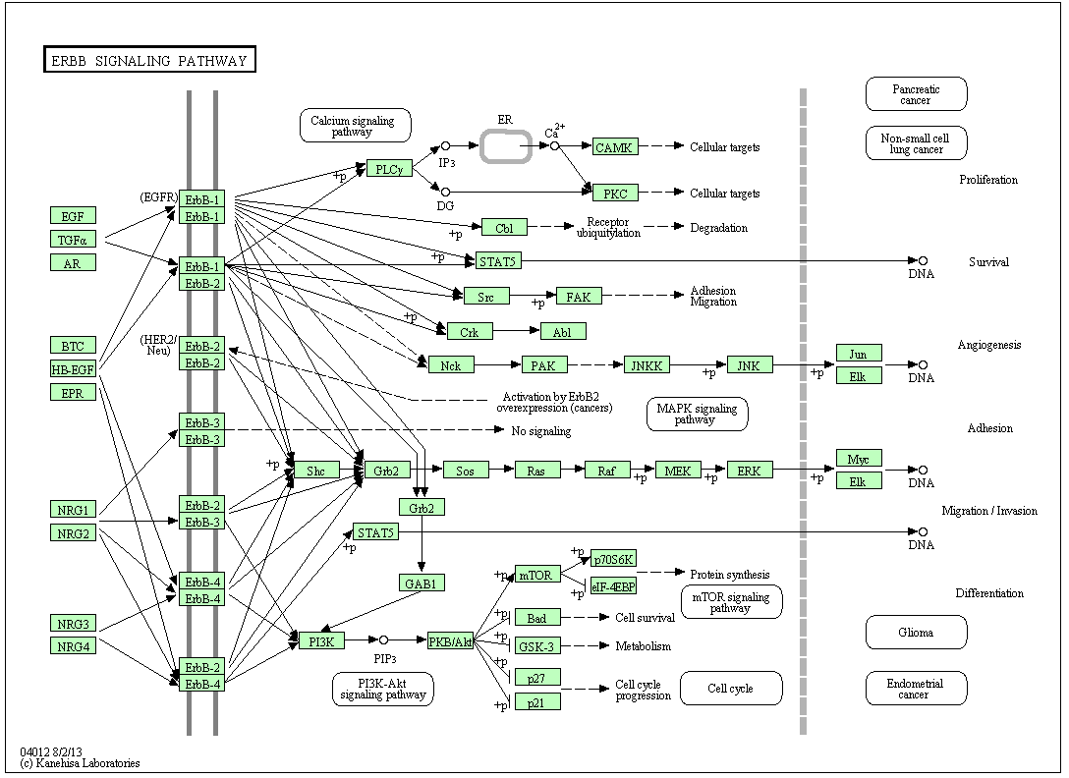
A Pathway

Slide 18

Challenges
Pathway A
Pathway B
B
D
G
G
L
Drug side-effects
A
E
C
P
N
Drug repositioning
M
O
G
F
G
Notes:
-> add bio goals

Slide 19
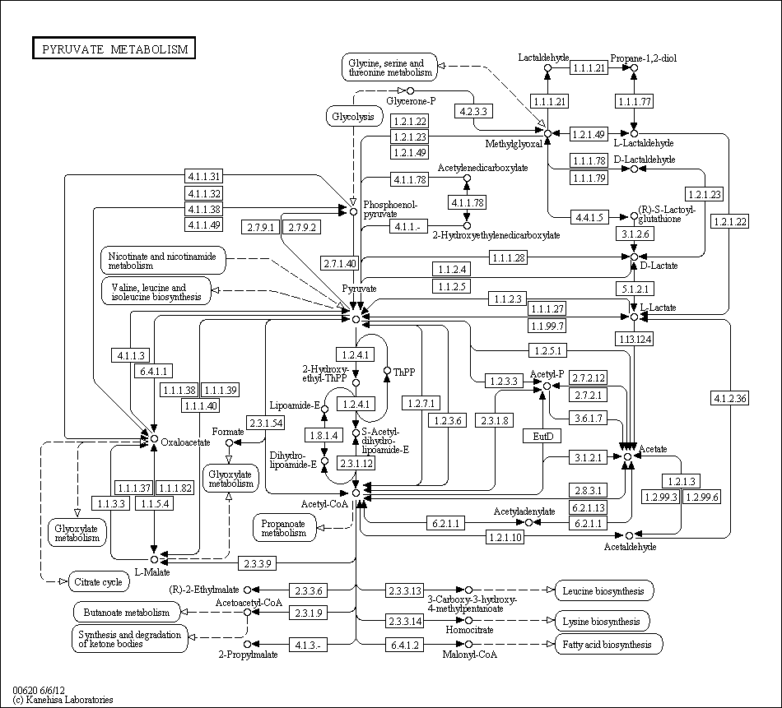
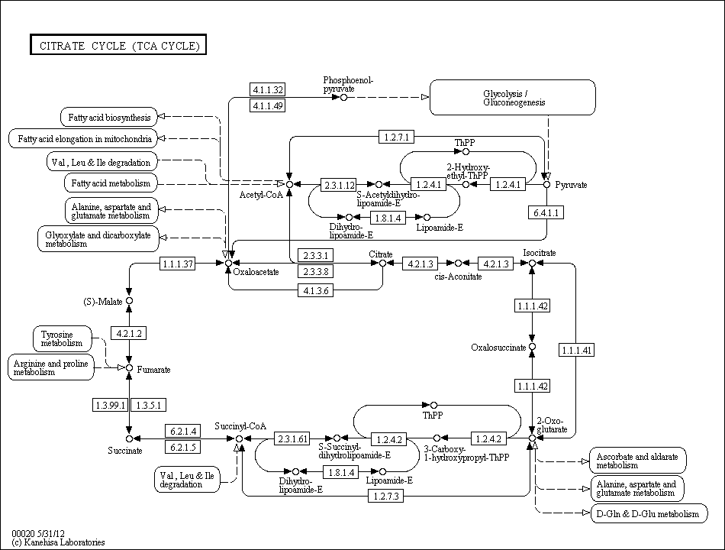
Challenges
How to visualize pathway relationships?

Slide 20
Challenges
Pathway A
Node
Sample 1
Sample 2
Sample 3
…
A
0.55
0.95
0.83
…
B
D
B
0.12
0.42
0.16
…
C
0.33
0.65
0.38
…
A
…
…
…
…
E
C
C
Node
Sample 1
Sample 2
Sample 3
…
A
low
low
very high
…
F
G
B
normal
low
high
…
How to visualize experimental data on pathways?
C
high
very low
normal
…
…
…
…
…
Notes:
… data in context of pathways, which basically means to associate multiple heterogeneous attributes…

Slide 21
How to visualize
pathway relationships?

Slide 22
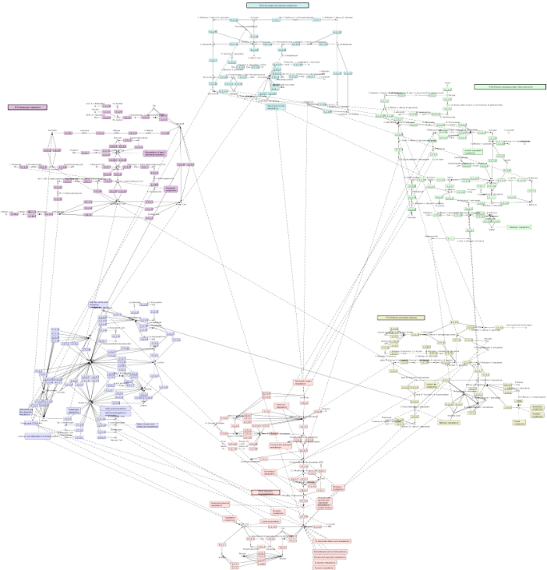
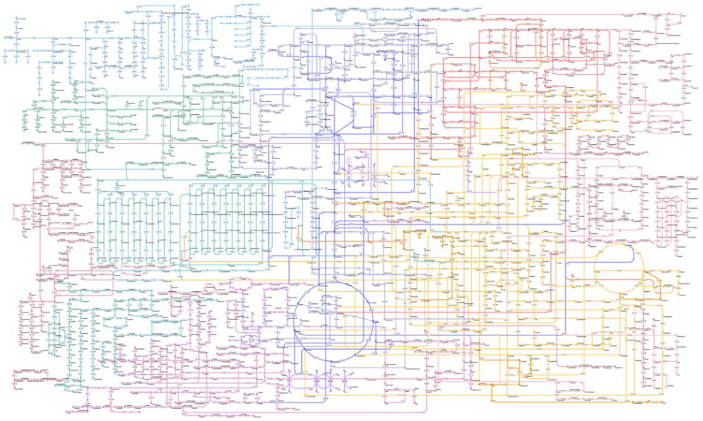
Approaches
Whole Network
Connected Pathways
[Kono2009]
[Klukas2006]

Slide 23
Finding Related Pathways

Slide 24
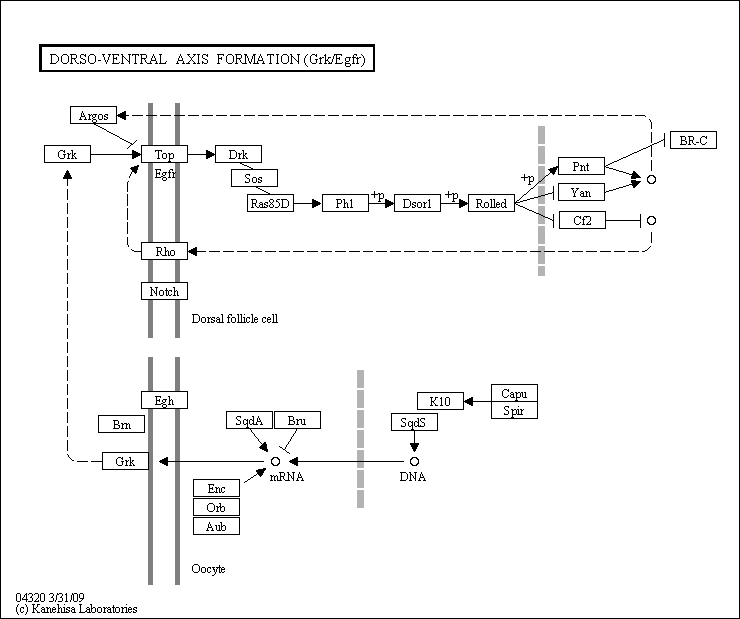
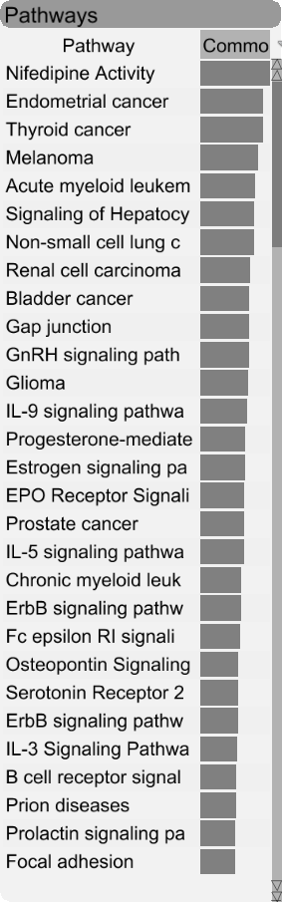
Finding Related Pathways
Notes:
Rank pathways by similarity

Slide 25
Contextual Subsets
Pathway A
Pathway B
A
G
A
G
A
PW B
B
A
G
A
C
A
E
H
A
R
D
H
I
J
I
F
I
Contextual Subset
Focus Pathway
Context Pathway
Notes:
Wo kann ich shared nodes statt portals sagen -> introduce later, vermeide „in our case“; also show branches -> look at paper for detail

Slide 26
Contextual Subsets
Pathway A
A
A
A
PW D
PW C
PW B
M
B
B
C
G
P
E
E
A
R
D
K
H
L
N
I
F
Focus Pathway
Context Pathways

Slide 27
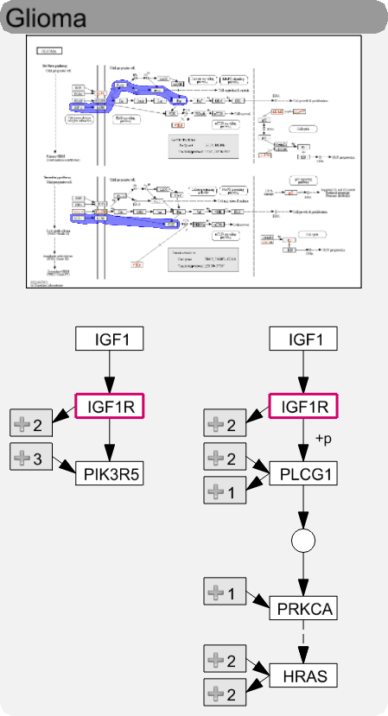
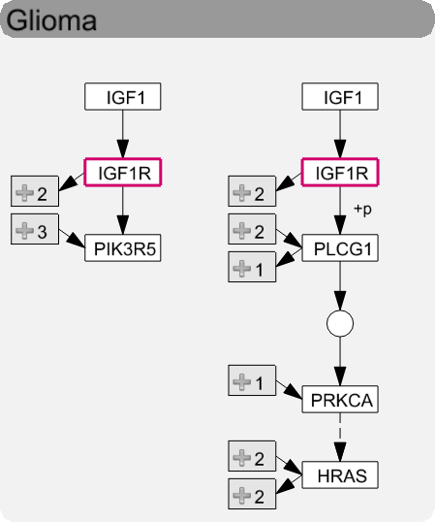
Levels of Detail
High
Medium
Low
Notes:
Kiss thumbnail, how actually looks like

Slide 28
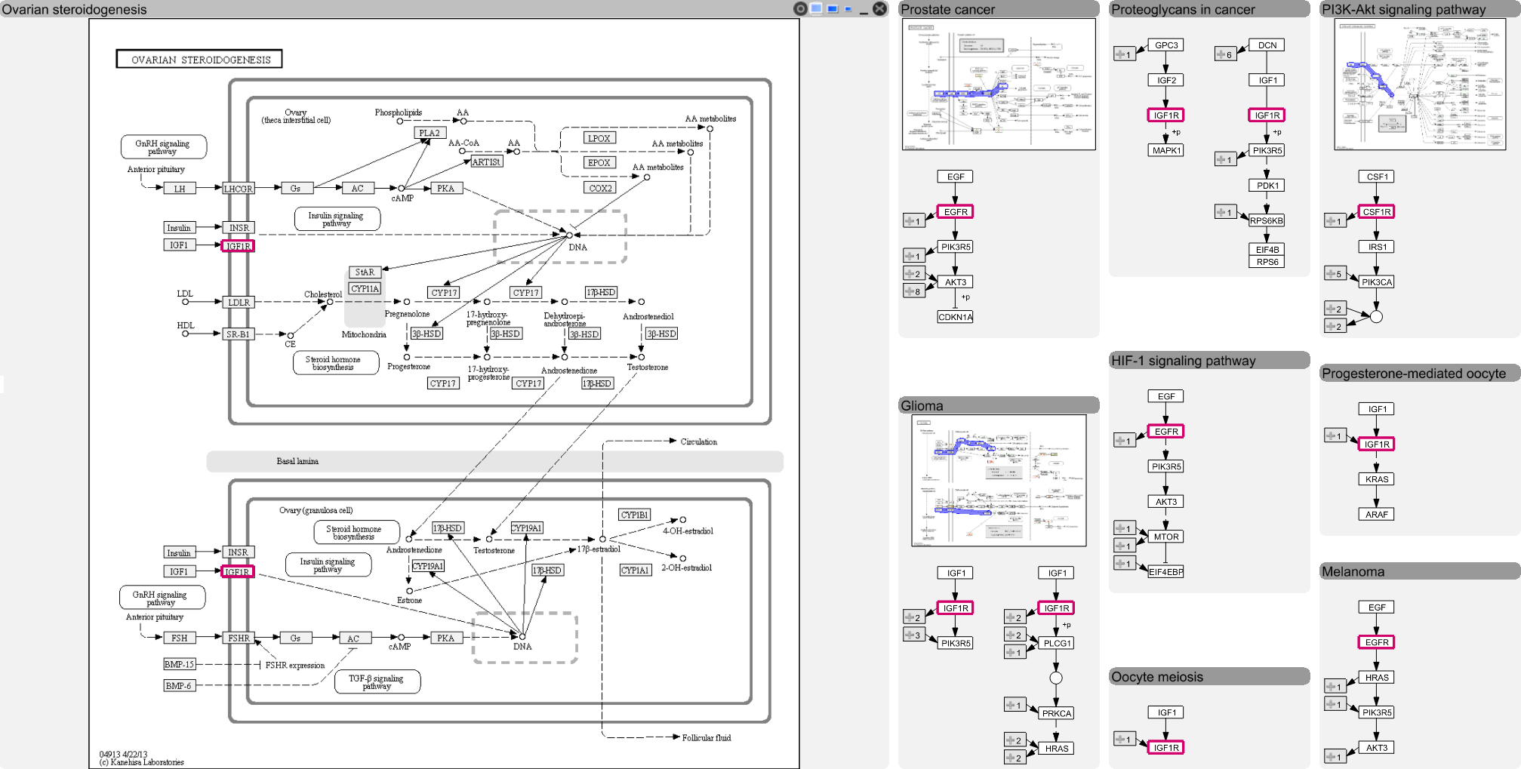
Layout

Slide 29
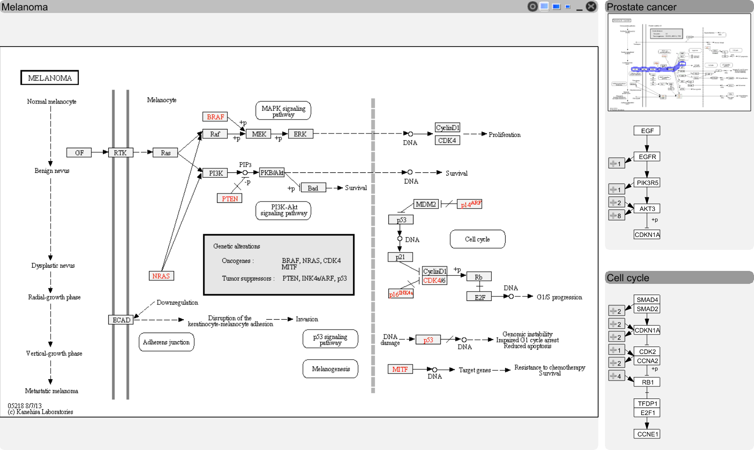
Visualizing Relationships
Notes:
Link to header gleich am anfang, overlay collins ref, stubs in detail

Slide 30
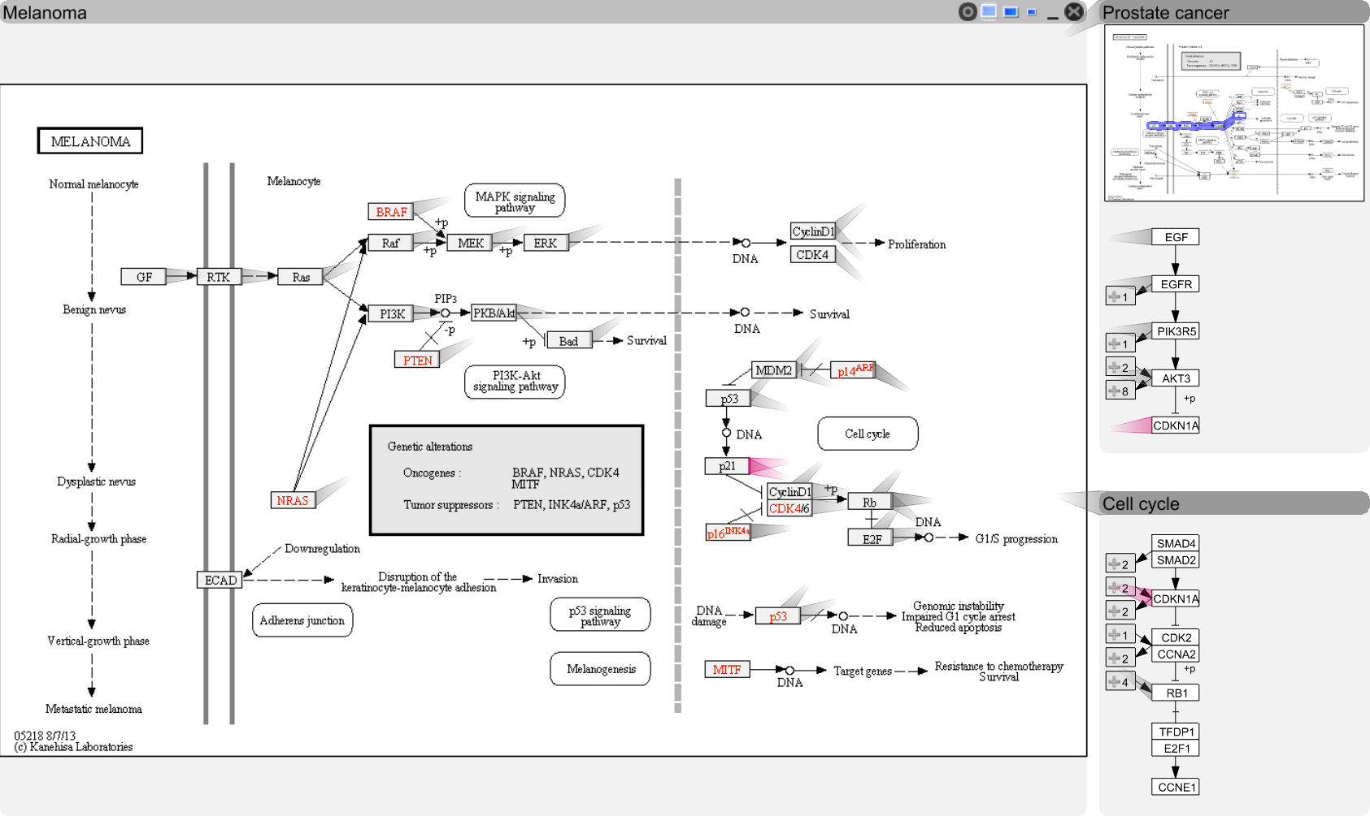
Visualizing Relationships

Slide 31
Visualizing Relationships

Slide 32
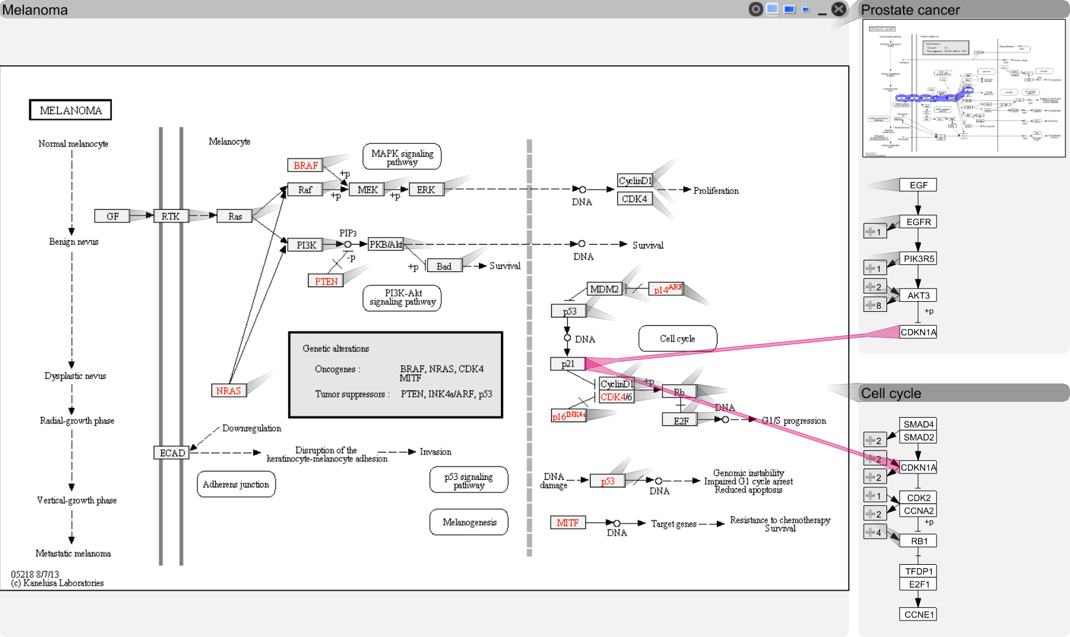
Visualizing Relationships

Slide 33

Visualizing Relationships

Slide 34
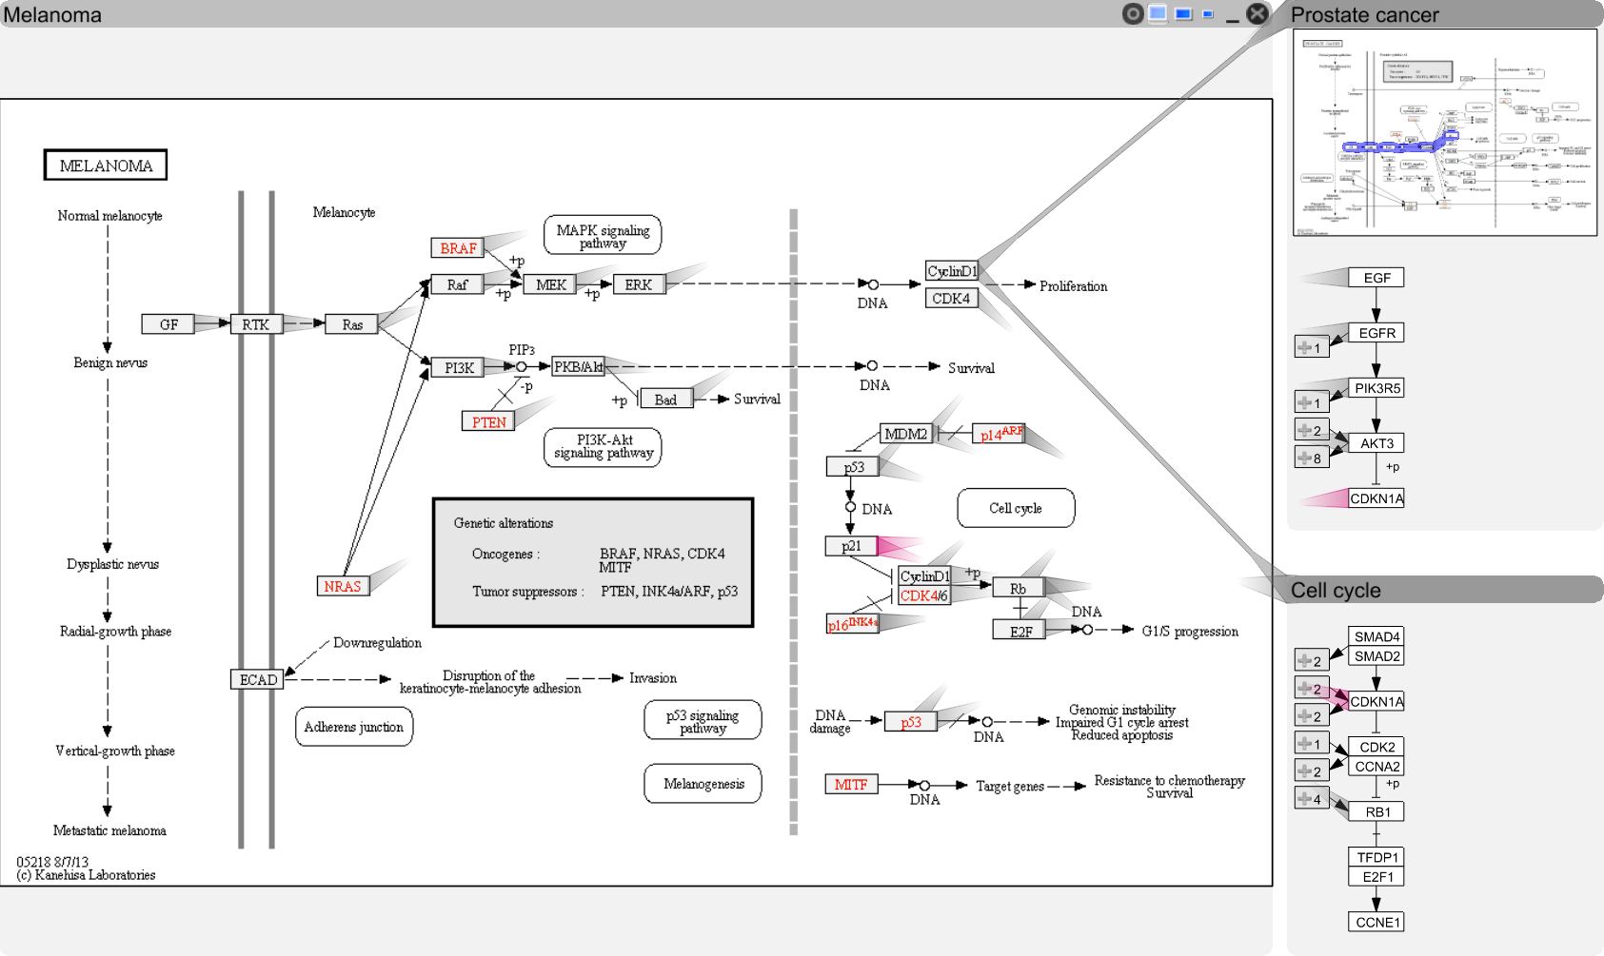
Visualizing Relationships
Notes:
hawer

Slide 35
How to visualize
experimental data on pathways?

Slide 36
Experi-mental Data and Pathways enRoute
Cannot account for variation found in real-world data
Branches can be (in)activated due to
mutation,
changed gene expression,
modulation due to drug treatment,
etc.
[Partl, BioVis ‘12]

Slide 37
Good Old Color Coding
A -3.4
B 2.8
C 3.1
D -3
E 0.5
F 0.3
4.2
1.8
-2.2
-2.8
0.3
0.3
B
A
C
D
E
F

Slide 38
Challenge: Data Scale & Heterogeneity
Large number of experiments
Large datasets have more than 500 experiments
Multiple groups/conditions
Different types of data, require different visualization techniques

Slide 39
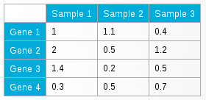
Challenge: Supporting Multiple Tasks
B
Two central tasks:
Explore topology of pathway
Explore the attributes of the nodes (experimental data)
Need to support both!
A
C
D
E
F

Slide 40
Concept
Pathway View
enRoute View
B
Non-Genetic Dataset
A
A
B
C
A
C
D
D
D
E
E
E
F
F
Group 1
Dataset 1
Group 2
Dataset 1
Group 1
Dataset 2

Slide 41
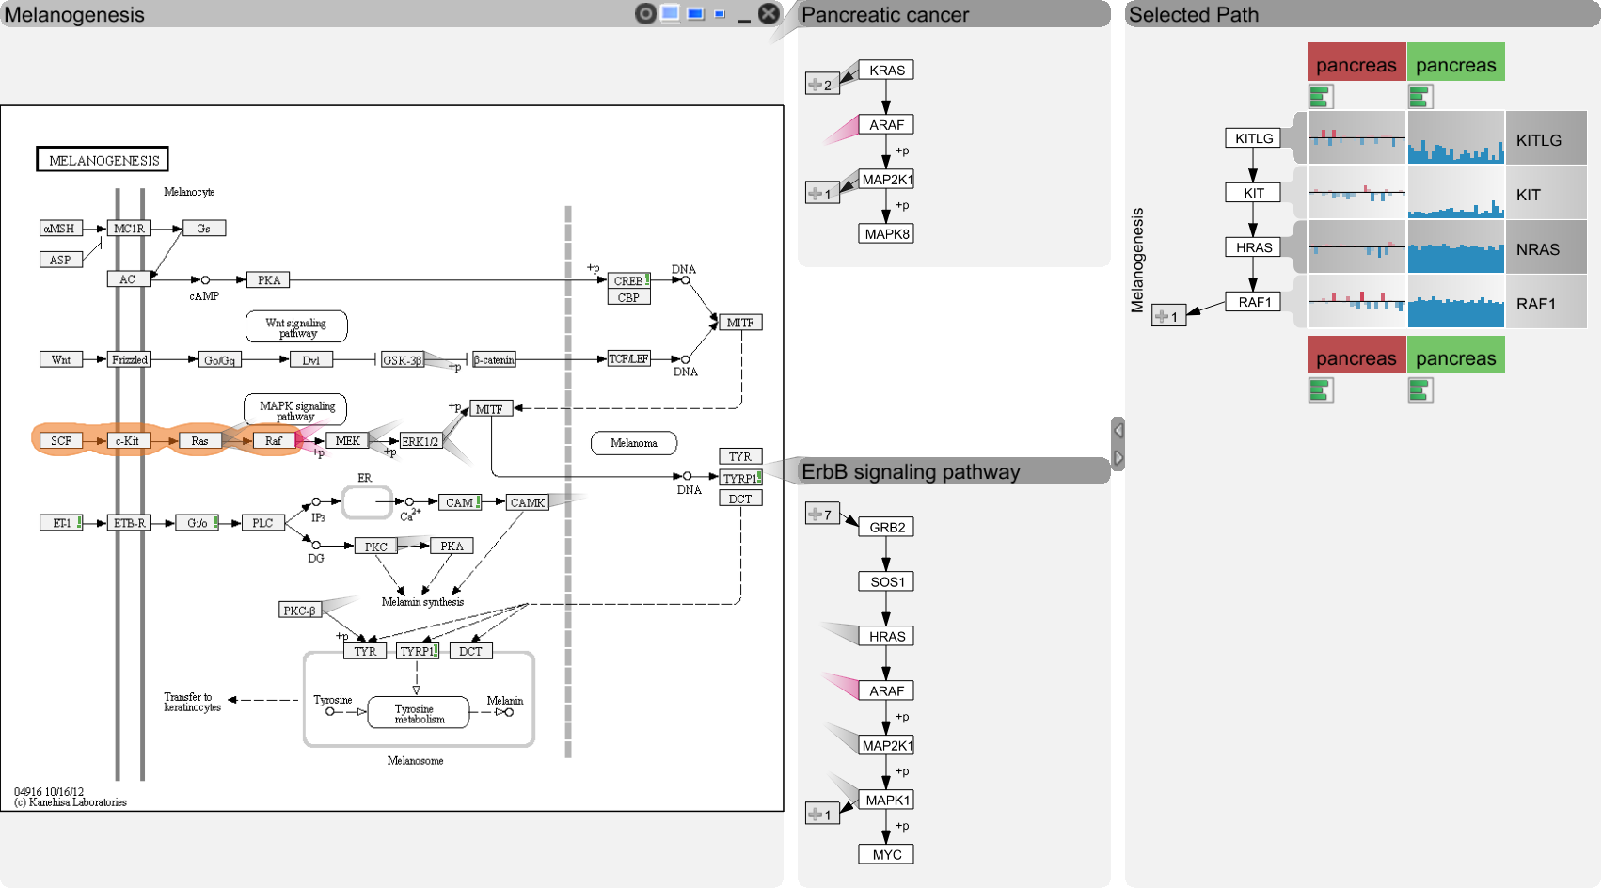
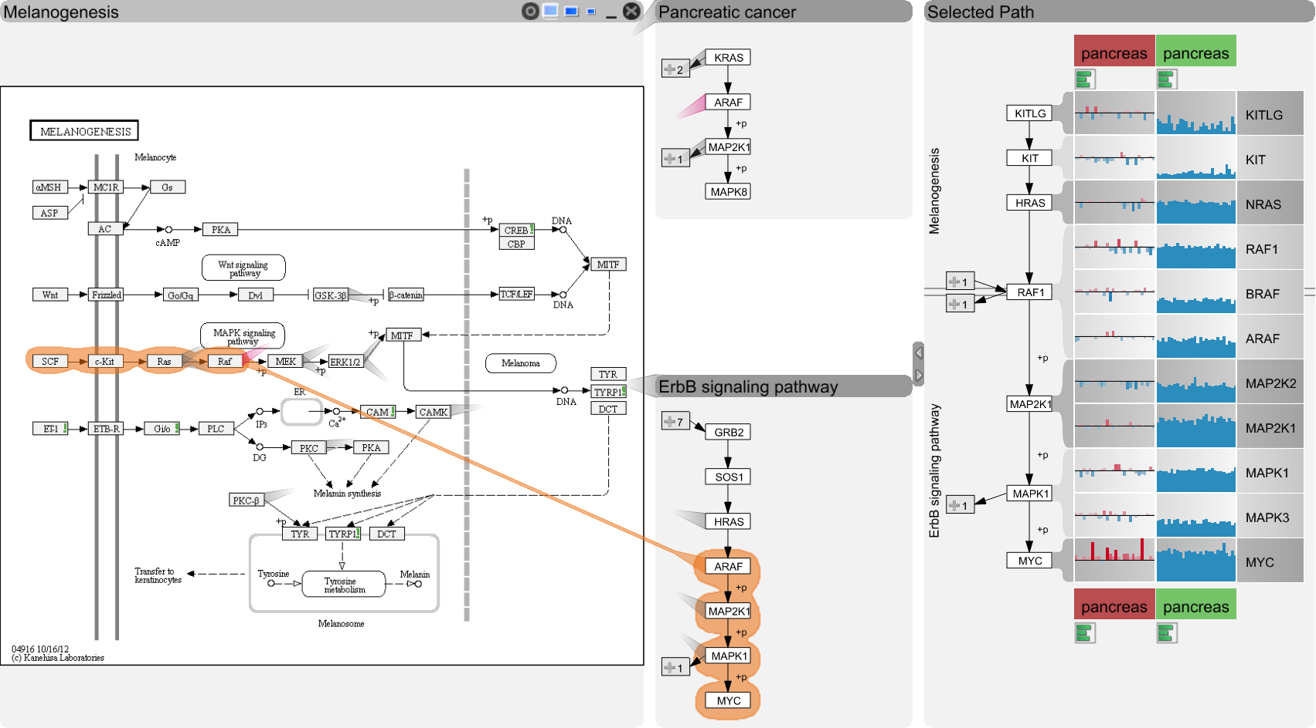
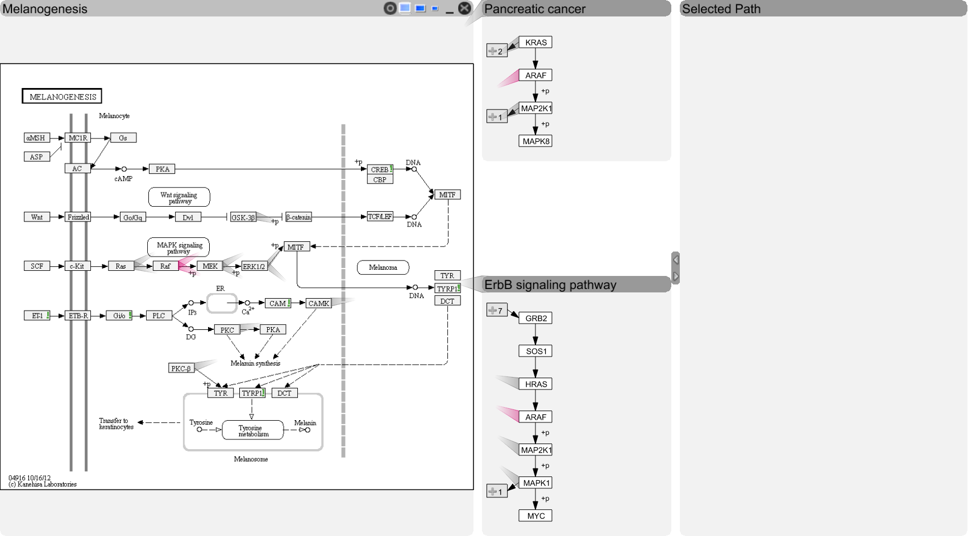
enRoute

Slide 42
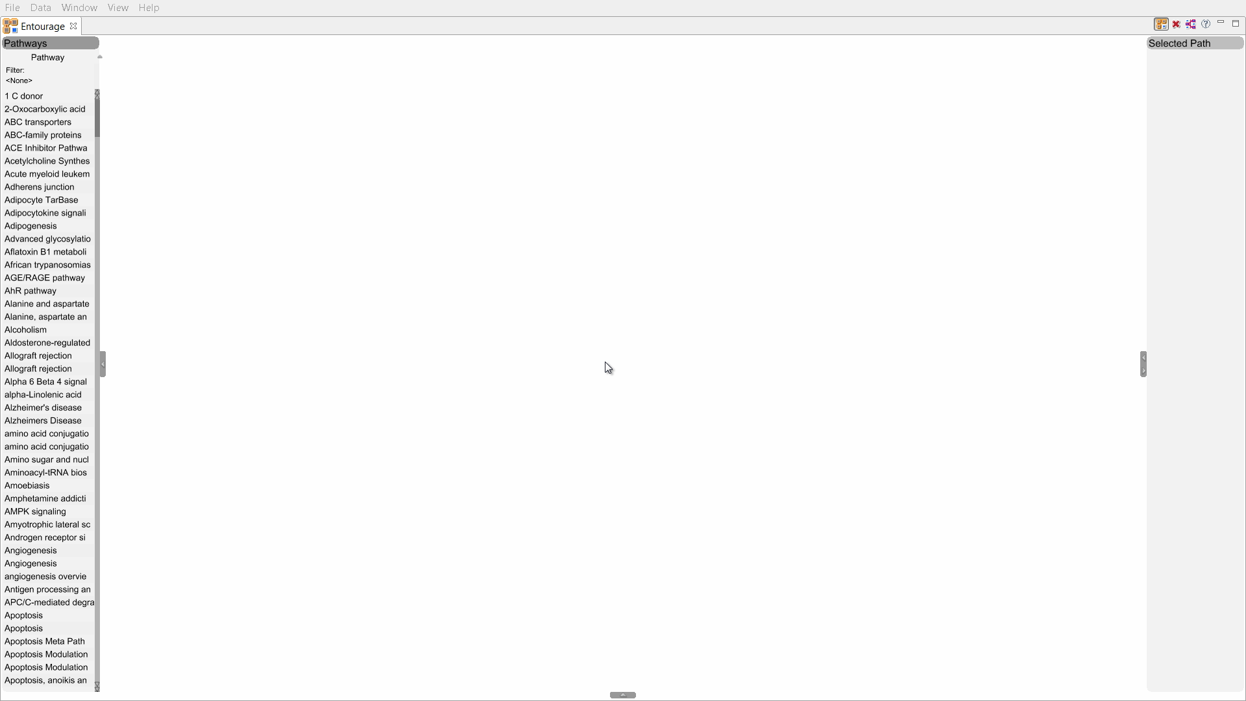
Video
Notes:
Seiteneffekte über portal -> sprung zurück zu goals, pharmacological data raus

Slide 43
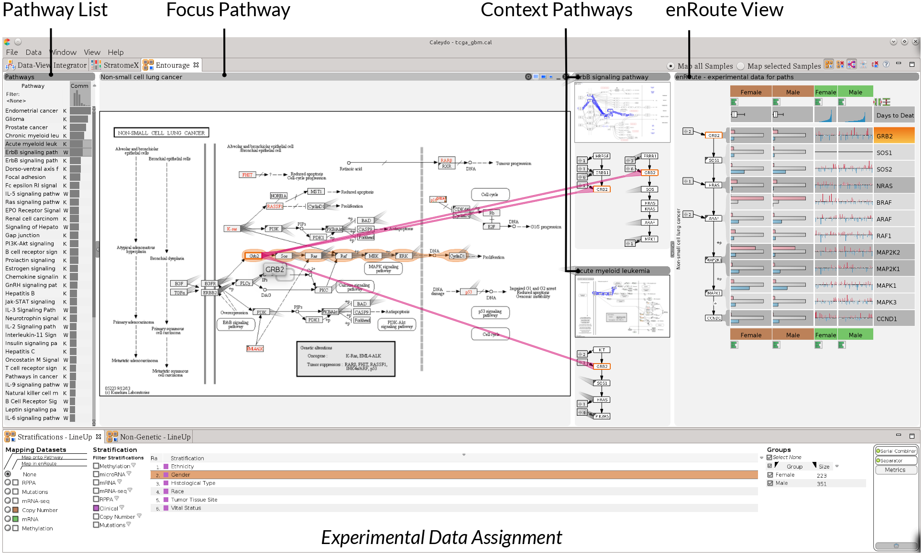

Slide 44
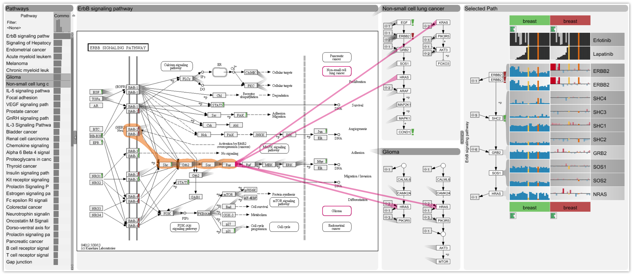
Case Study: CCLE Data
22
Notes:
Raus oder volle case study, oder „slideshow“

Slide 45
More Information:
http://entourage.caleydo.org

Slide 46
http://caleydo.org

Slide 47
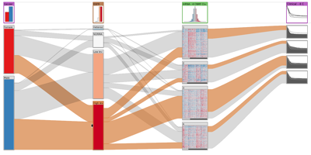
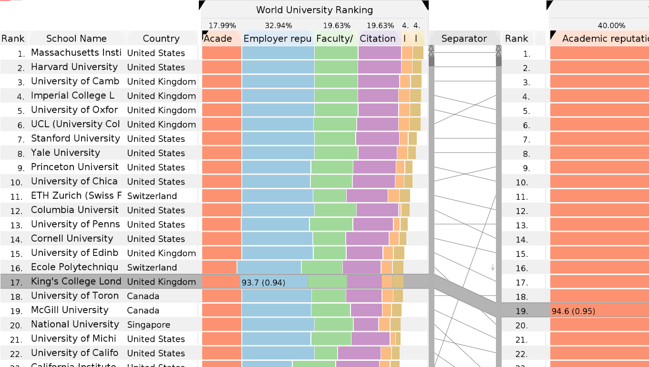
Other Caleydo Tools
StratomeX
Cancer Subtype Analysis
LineUp
Ranking of Multivariate Data
http://caleydo.org

Slide 48
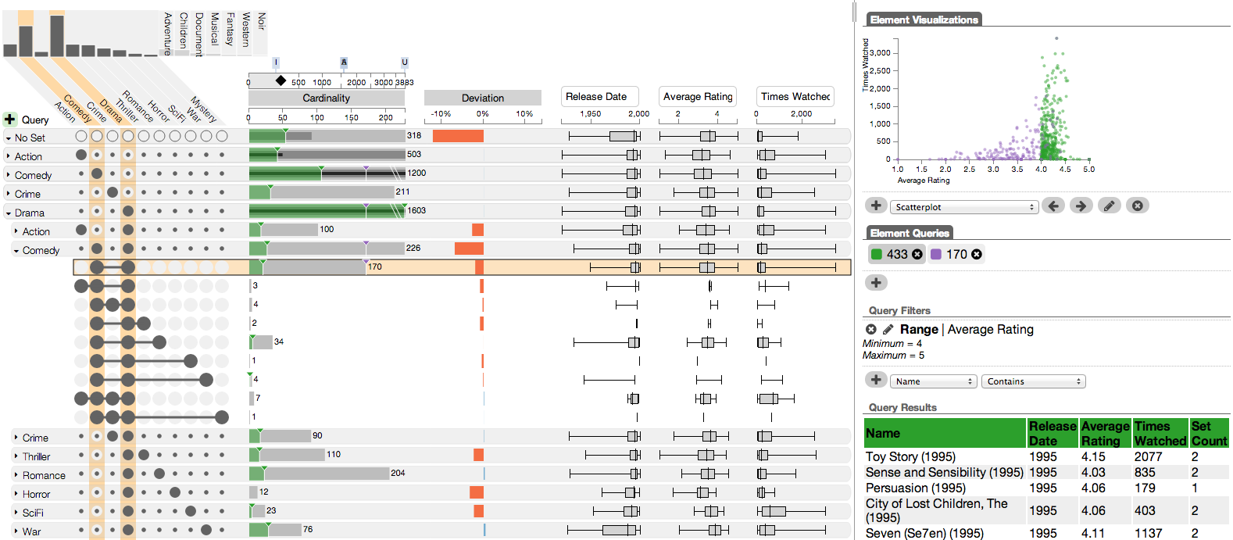
Set Visualization - UpSet
http://vcg.github.io/upset

Slide 49
Caleydo Entourage: Visualizing Relationships between Biological Pathways
?
Alexander Lex, Harvard University
alex@seas.harvard.edu
http://alexander-lex.com
@alexander_lex
Credits:
Christian Partl, Marc Streit, Samuel Gratzl, Nils Gehlenborg, Hendrik Strobelt, Hanspeter Pfister, Anne Mai Wasserman, Mark Borowsky, Denis Kalkofen, Dieter Schmalstieg

