Slide 1

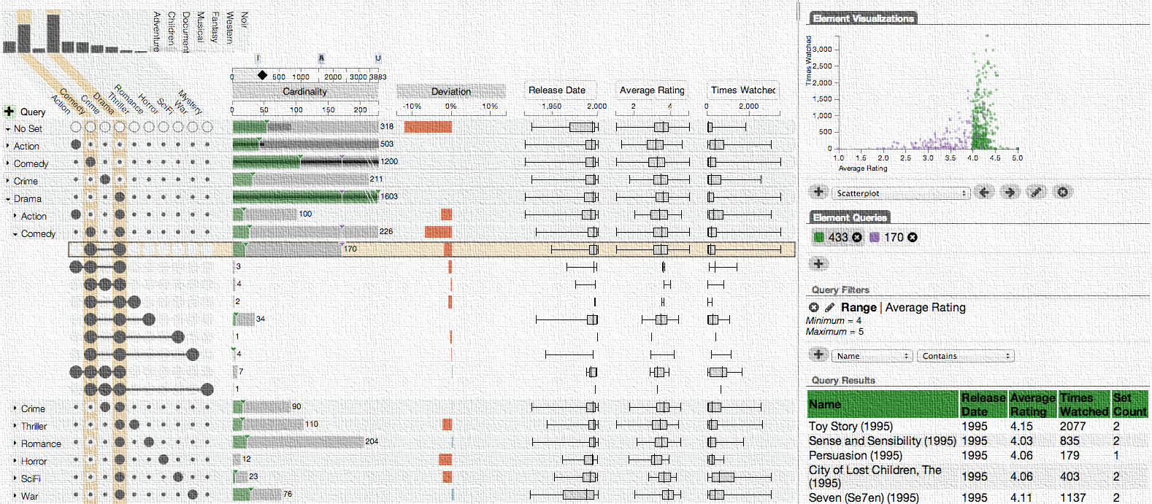
Visual Data Analysis for
Biology & Pharmacology
Alexander Lex
@alexander_lex
http://alexander-lex.com
Notes:
Thank you. Today I will be talking about my research in interactive and visual data analysis.

Slide 2
visualization
pictures
The purpose of computing is insight, not numbers.
Richard Wesley Hamming, 1962
Notes:
This is a quote that I like a lot by Richard Hamming
The purpose of computing is insight, not numbers.
I truly believe that and not many people would argue against it.
It turns out that this sentence can be adapted to also describe visualization.
The purpose of visualization is insight, not pictures.
Again, this is not a controversial statement.
Yet there are many visualizations and infographics out there that do not enable insight.

Slide 3
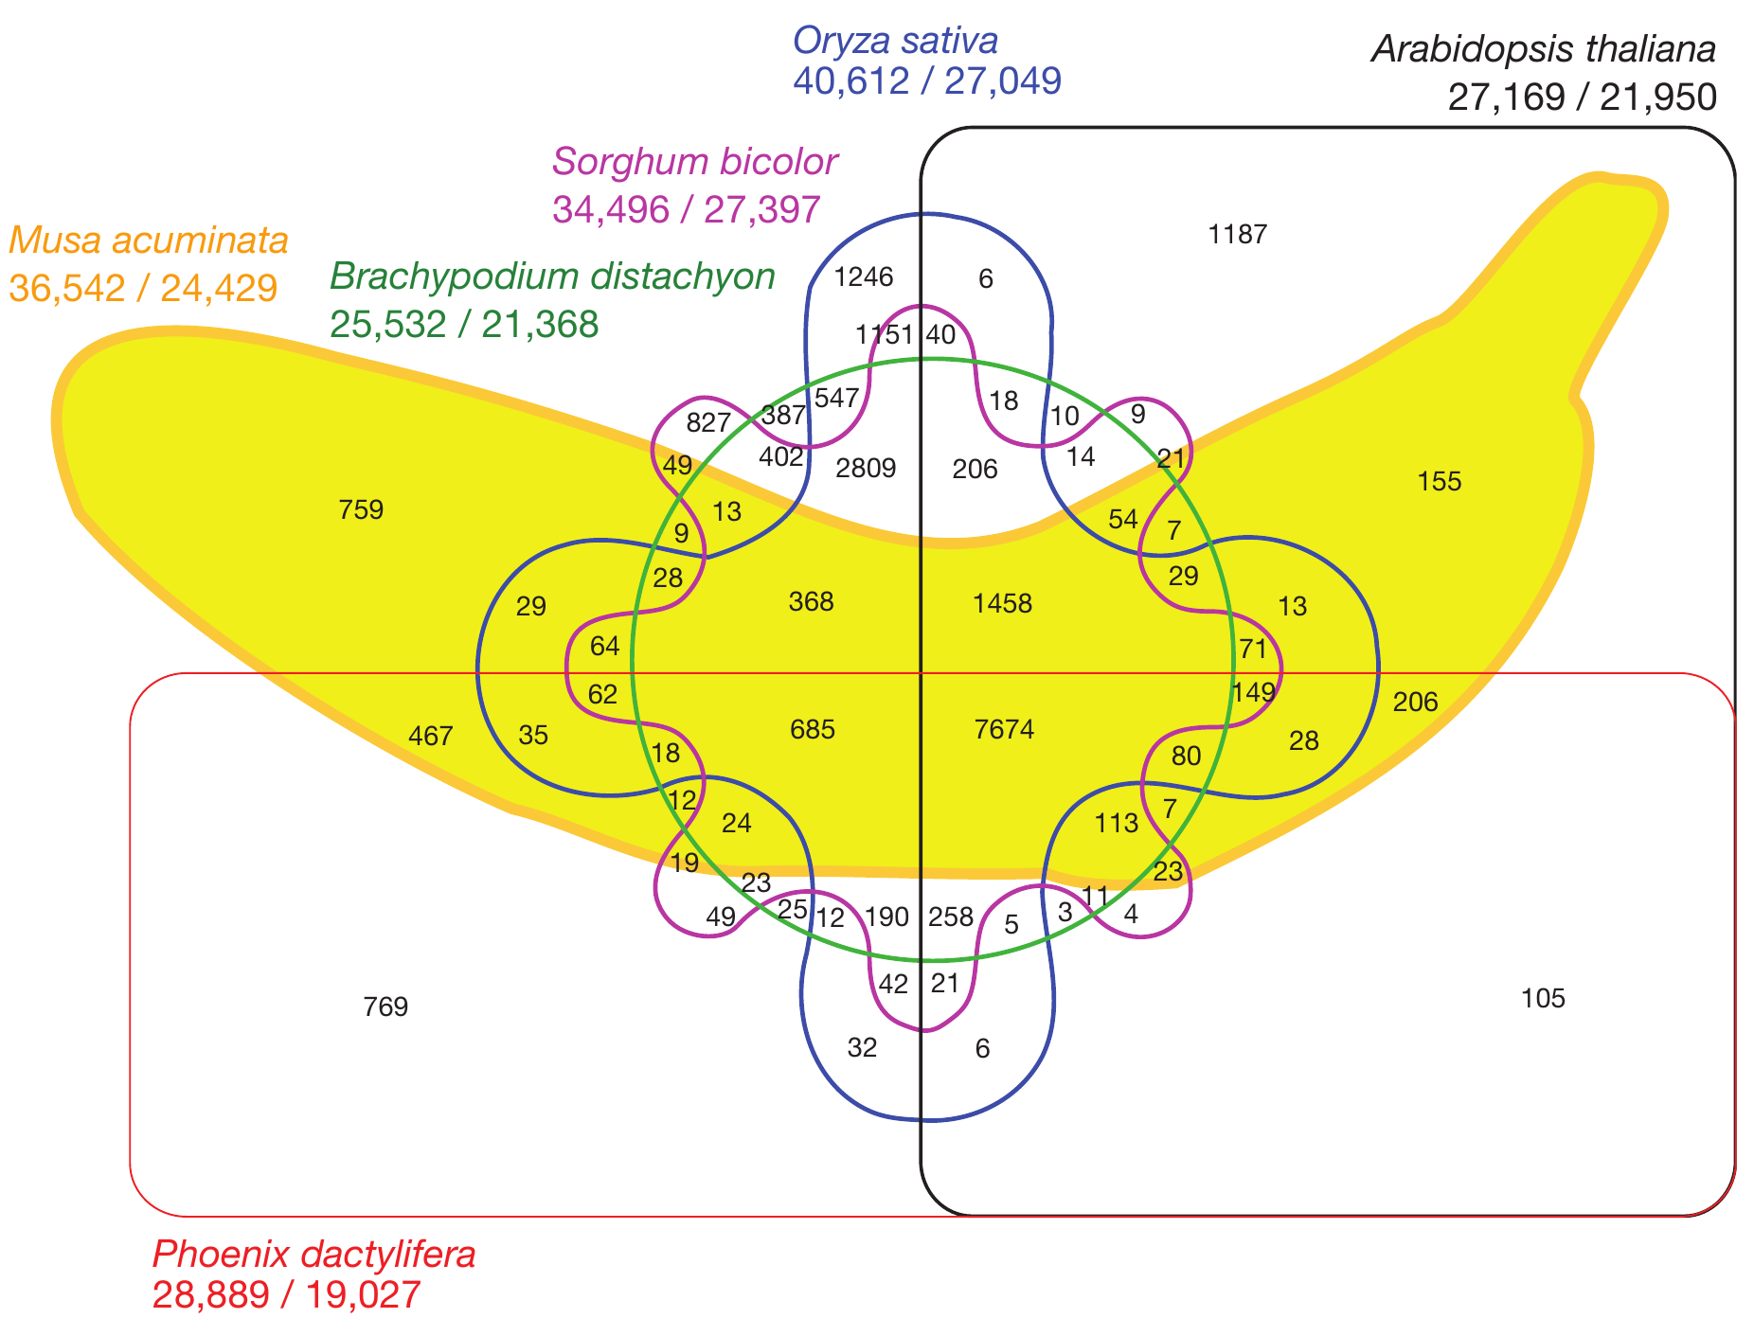
[D’Hont et al., Nature, 2012]
Notes:
Here is an example of a figure that probably obscures the data more than it helps our understanding.
This is a six-set venn diagram of the overlap of the banana genome with five other plant species. This figure was published in nature.
There are many things going wrong here.

Slide 4
Good Data Visualization
… makes data accessible
… combines strengths of humans and computers
… enables insight
… communicates

Slide 5
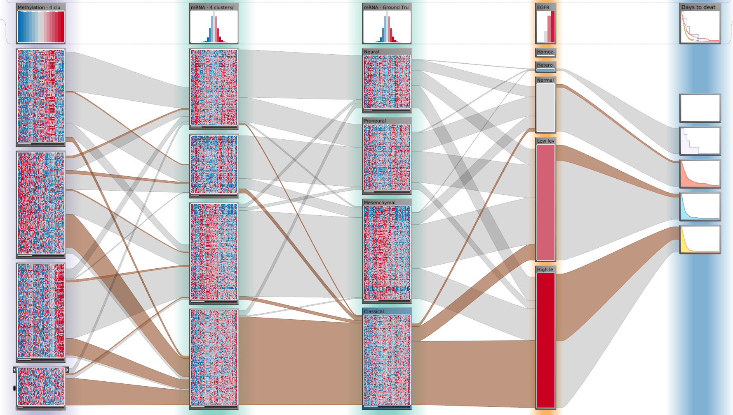
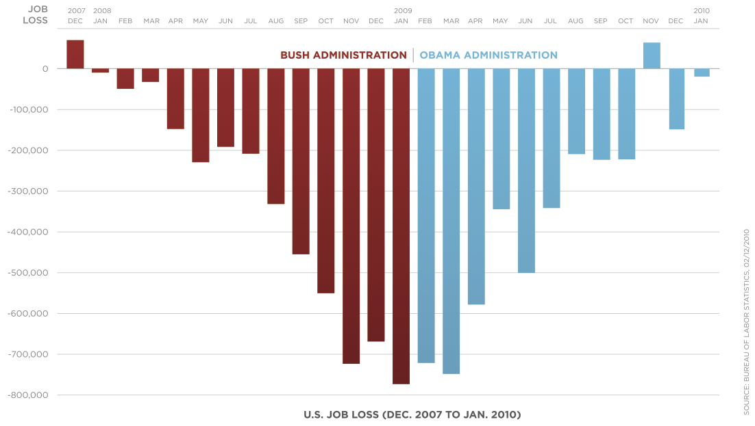
Purpose of Visualization
[Obama Administration]
Open Exploration
Communication
Notes:
Exploration:
result not known
not even question
Illustration:
Know about the data
Communicate to others
TODO: Why do I explore open exploration?

Slide 6
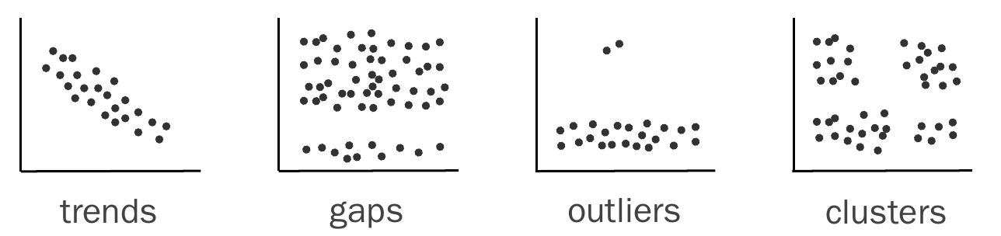
Visualization for Pattern Discovery
Notes:
Can Statistics do this for us?

Slide 7
Can We Trust Statistics?
I
x | y
10 | 8.04
8 | 6.95
13 | 7.58
9 | 8.81
11 | 8.33
14 | 9.96
6 | 7.24
4 | 4.26
12 | 10.84
7 | 4.82
5 | 5.68
II
x | y
10 | 9.14
8 | 8.14
13 | 8.74
9 | 8.77
11 | 9.26
14 | 8.1
6 | 6.13
4 | 3.1
12 | 9.13
7 | 7.26
5 | 4.74
III
x | y
10 | 7.46
8 | 6.77
13 | 12.74
9 | 7.11
11 | 7.81
14 | 8.84
6 | 6.08
4 | 5.39
12 | 8.15
7 | 6.42
5 | 5.73
IV
x | y
8 | 6.58
8 | 5.76
8 | 7.71
8 | 8.84
8 | 8.47
8 | 7.04
8 | 5.25
19 | 12.5
8 | 5.56
8 | 7.91
8 | 6.89
Mean x: 9 y: 7.50
Variance x: 11 y: 4.122
Correlation x – y: 0.816
Linear regression: y = 3.00 + 0.500x

Slide 8
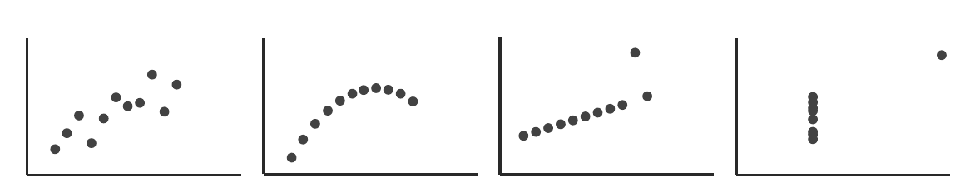
Anscombe’s Quartett
Mean x: 9 y: 7.50
Variance x: 11 y: 4.122
Correlation x – y: 0.816
Linear regression: y = 3.00 + 0.500x

Slide 9
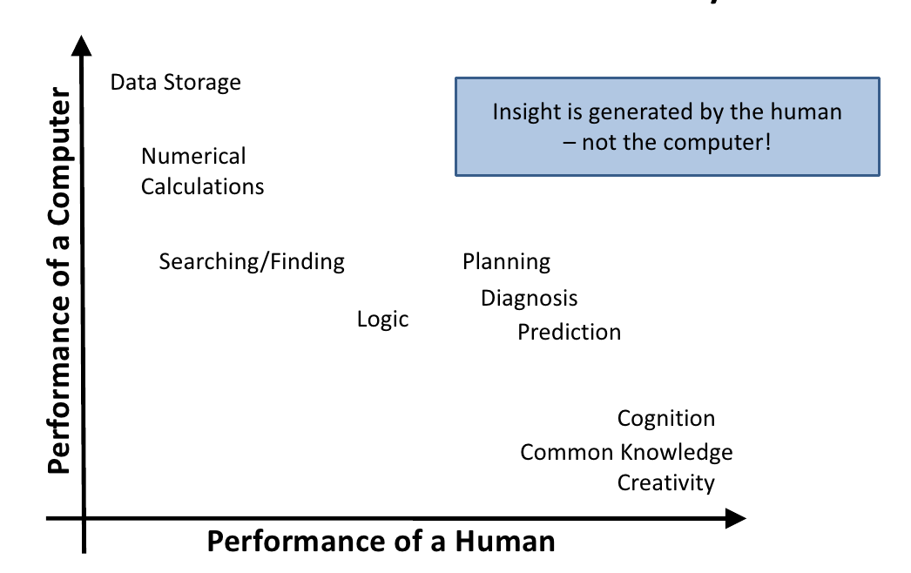
The Ability Matrix

Slide 10
Communicates
Interfaces
Selected &
Derived Data
Visualization
Human
Computation
Interaction
Insight
Actions
Context
Reasoning
Verification
Fallible
Algorithms
Statistics
Recommendations
Classifications
Aggregation
Data
Informative, Incomplete, Noisy, Conflicting
Notes:
Visualization is the language of data
It’s how computers can communicate data to us
Humans make mistakes - we see something that isn’t there

Slide 11


Who am I? alexander-lex.com @alexander_lex
PostDoc & Lecturer @ Harvard, Visual Computing Group, PI: Hanspeter Pfister
Associated PostDoc @ Novartis Institute of BioMedical Research, Scientific Data Analysis, PI: Mark Borowsky
How it looks like at home
Notes:
From here

Slide 12





Credits
Marc Streit Johannes Kepler University Linz, AT Nils Gehlenborg Harvard Medical School, Boston, USA Christian Partl Graz University of Technology, AT Samuel Gratzl Johannes Kepler University Linz, AT Hendrik Strobelt Harvard University, Cambridge, USA Dieter Schmalstieg Graz University of Technology, AT Mark Borowsky Novartis (NIBR), Cambridge, USA Hanspeter Pfister Harvard University, Cambridge, USA

Slide 13
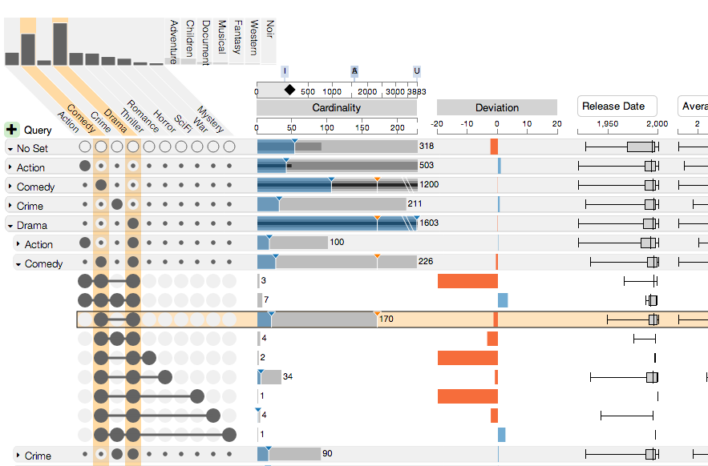
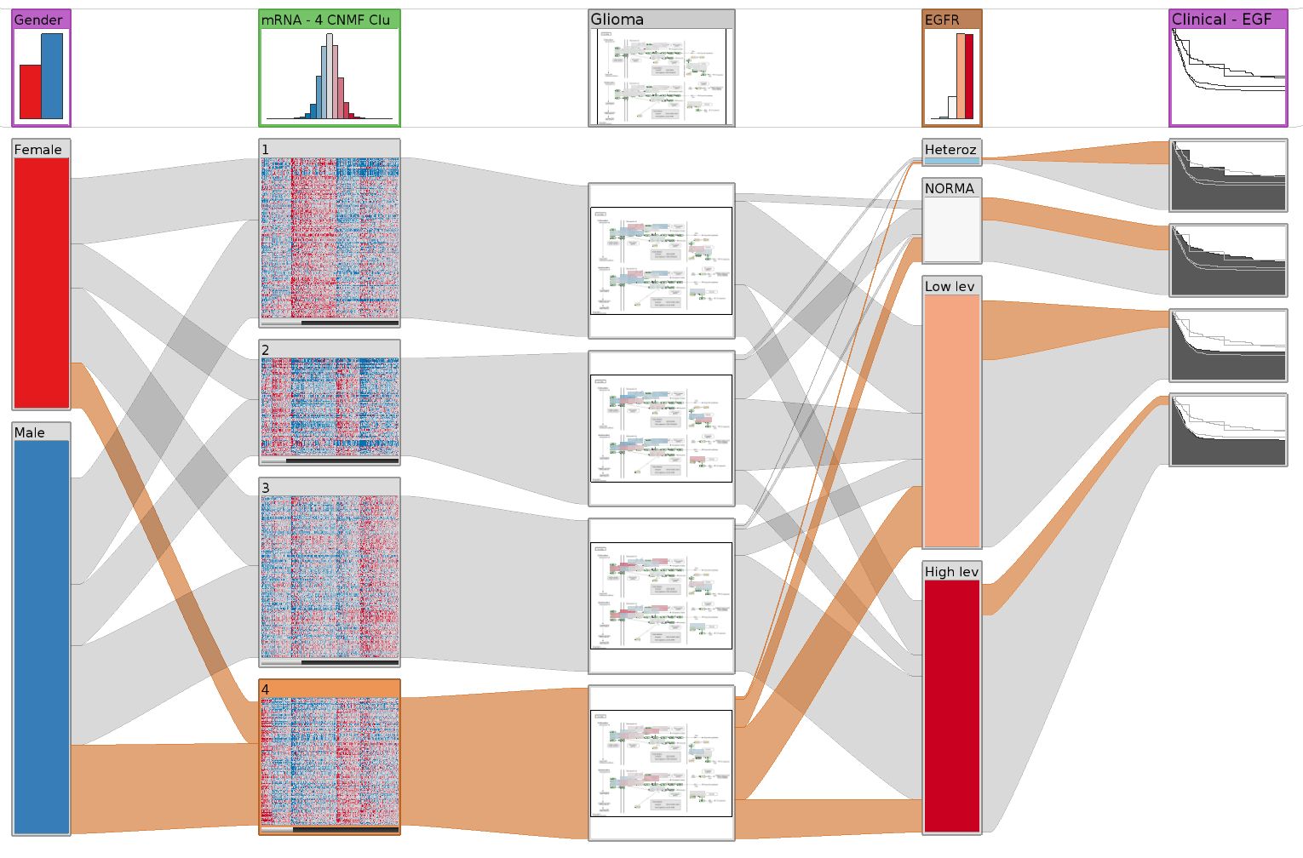
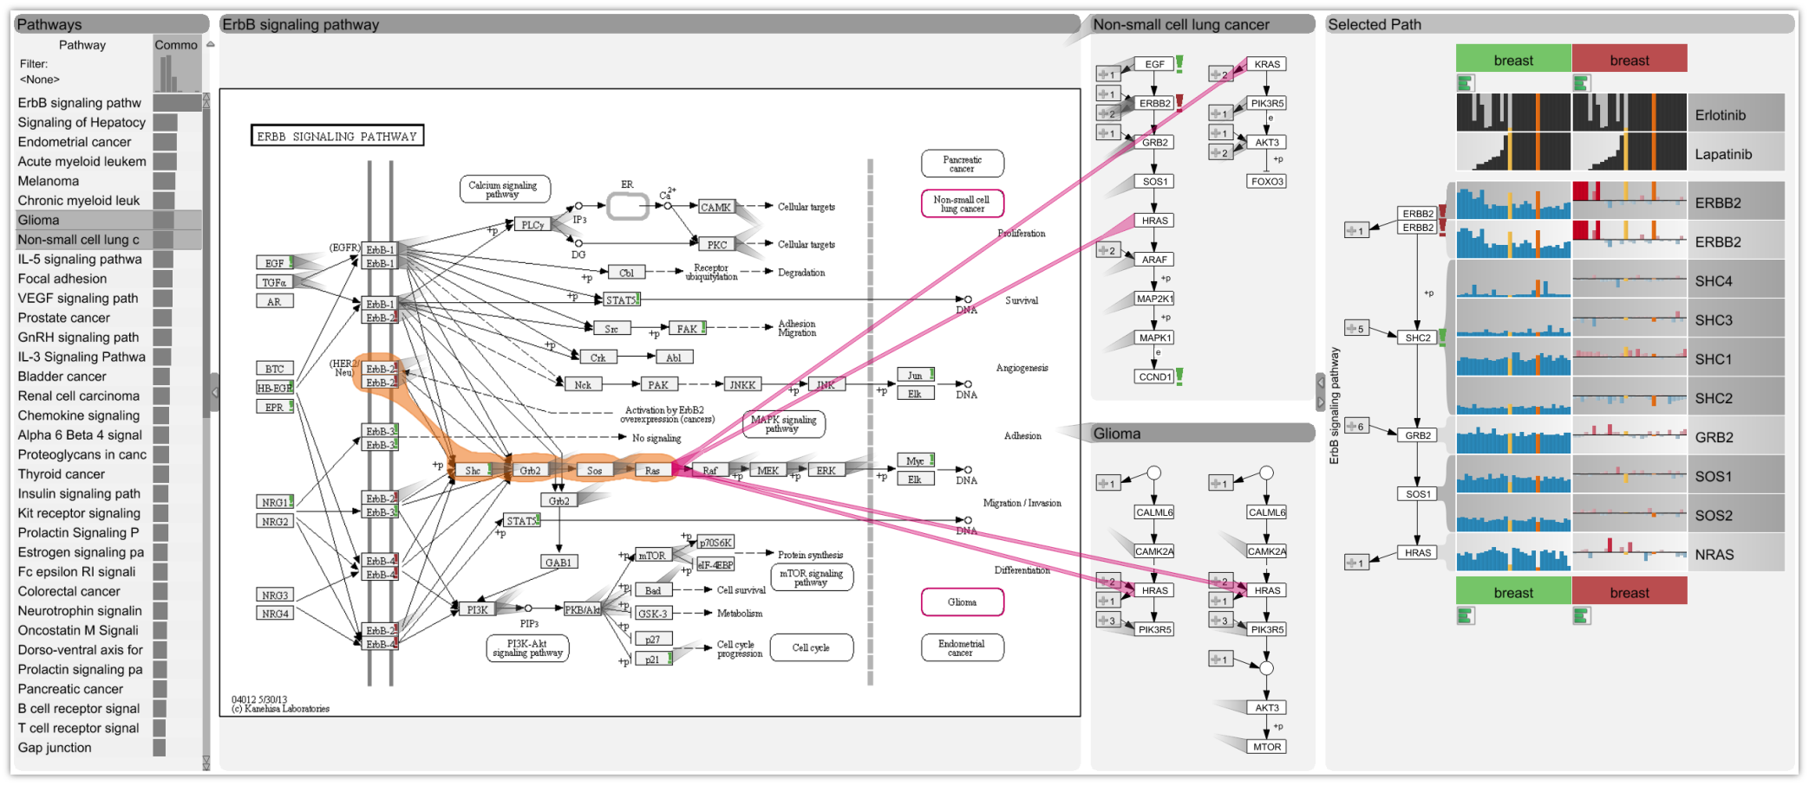
Content
Set Visualization
Heterogeneous Datasets Cancer Subtype Analysis
Multivariate Networks Pathway Analysis
Notes:
Order and label
Papers & Conferences

Slide 14
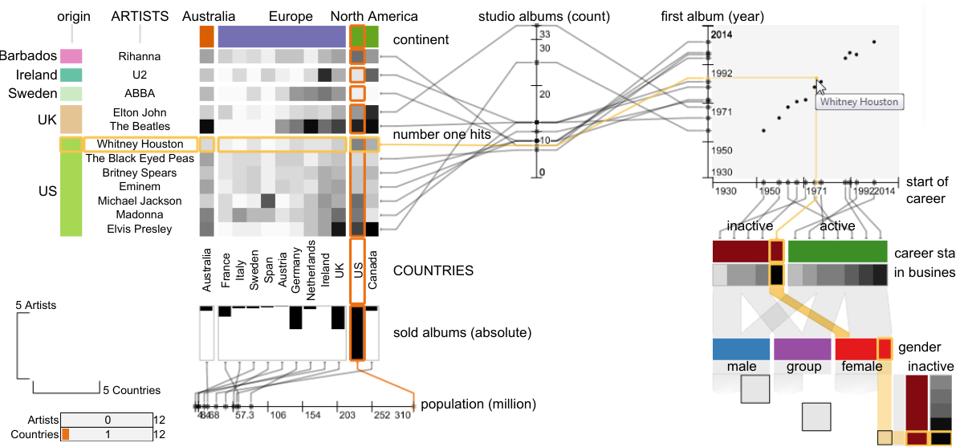
Subset Visualization
Domino: Extracting, Comparing,
and Manipulating Subsets
across Multiple Tabular Datasets
http://domino.caleydo.org
Samuel Gratzl, Nils Gehlenborg,
Alexander Lex, Hanspeter Pfister
and Marc Streit
IEEE TVCG (InfoVis '14)
HONORABLE MENTION AWARD

Slide 15
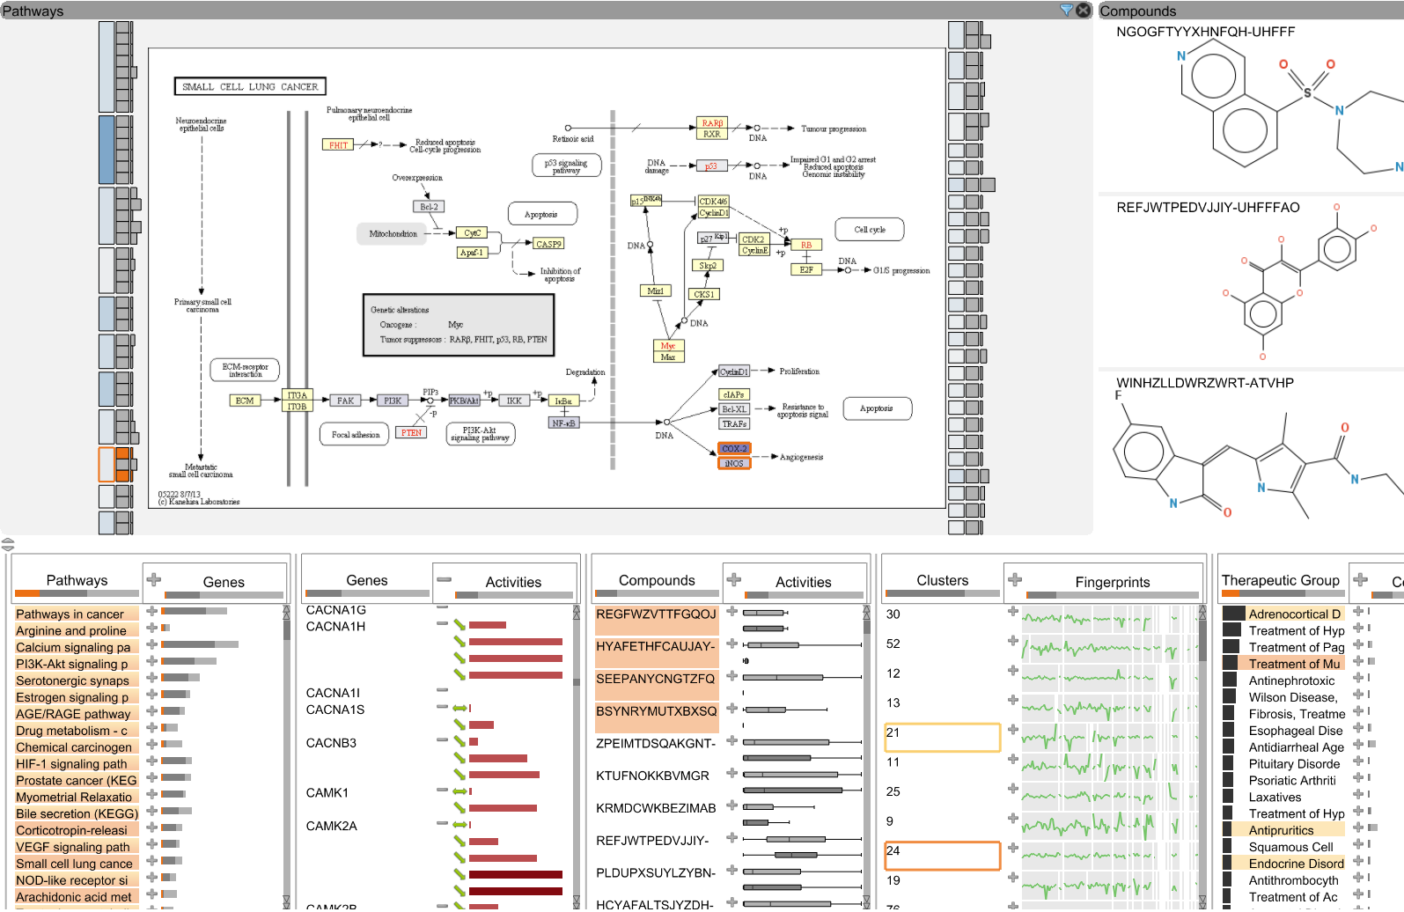
Multi-Relational Data Drug Discovery
ConTour: Data-Driven Exploration
of Multi-Relational Datasets
for Drug Discovery
http://contour.caleydo.org
Christian Partl, Alexander Lex,
Marc Streit, Hendrik Strobelt,
Anne-Mai Wasserman,
H. Pfister, and Dieter Schmalstieg
IEEE TVCG (VAST '14)

Slide 16
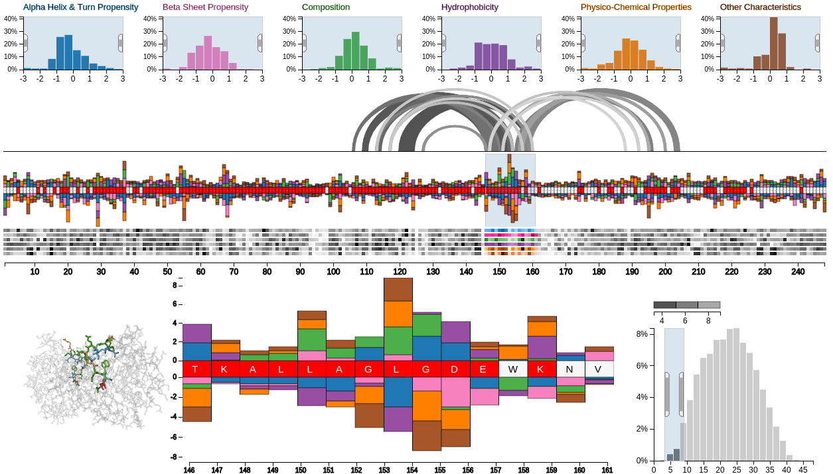
Sequence Visualization Protein Mutations
Mu-8: Visualizing Differences
between Proteins and their Families
http://mu-8.com
Johnathan D Mercer, Balaji Pandian,
Alexander Lex*, Nicolas Bonneel,
and Hanspeter Pfister
BMC Proceedings 2014

Slide 17
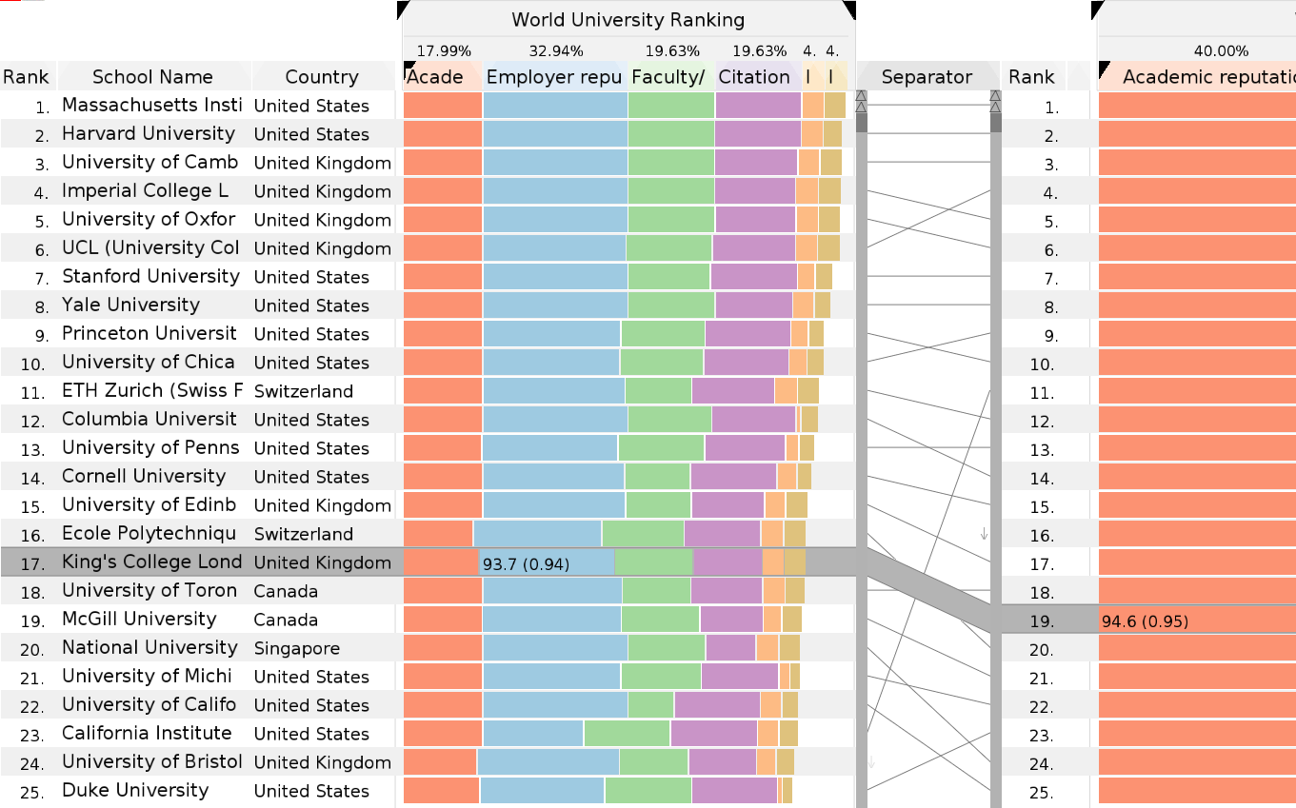
Multi-Attribute Rankings
LineUp: Visual Analysis of
Multi-Attribute Rankings
http://lineup.caleydo.org
Samuel Gratzl, Alexander Lex,
Nils Gehlenborg, Hanspeter Pfister,
and Marc Streit
IEEE TVCG (InfoVis '13)
BEST PAPER AWARD

Slide 19
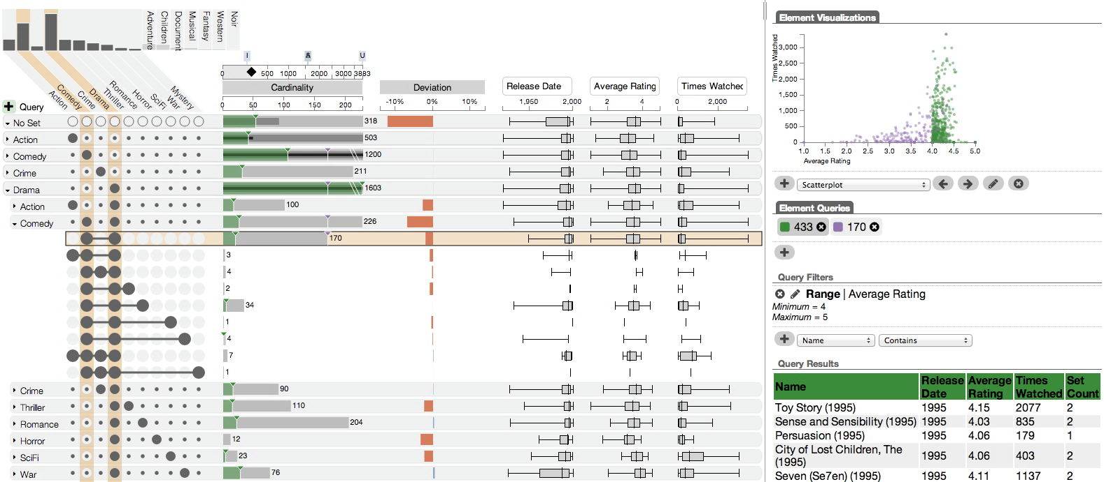
UpSet Visualizing Intersecting Sets
Alexander Lex, Nils Gehlenborg, Hendrik Strobelt, Romain Vuillemot, and Hanspeter Pfister
InfoVis’14

Slide 20


Slide 21
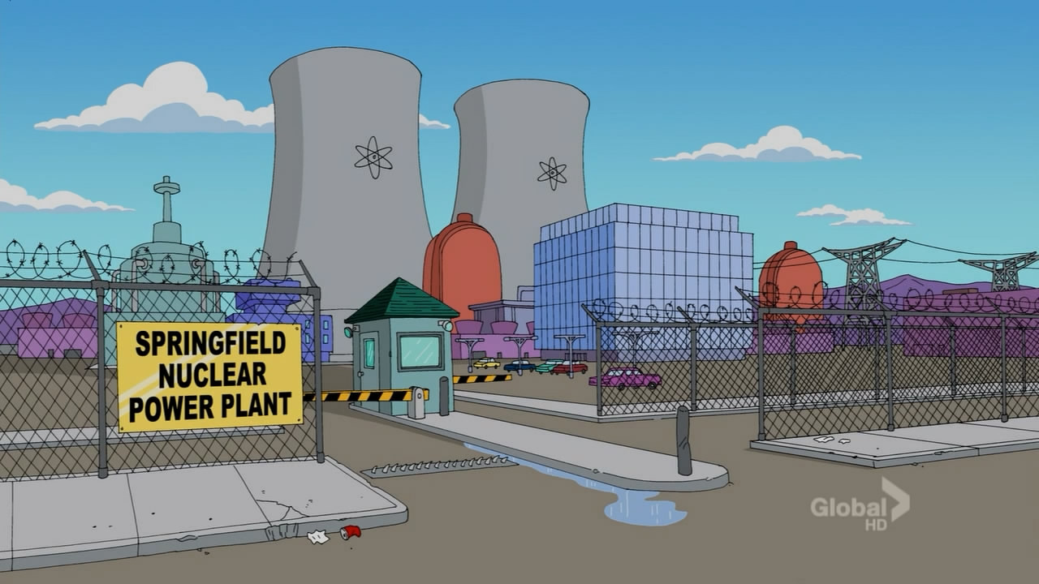

Slide 22


Evil

Slide 23
Evil
3
1
2
0
5
3
0

Slide 24
Evil
Blue Hair?

Slide 25
Evil
Blue Hair?
Duff Beer?

Slide 26
[created with EulerAPE]

Slide 27
?
>
<
43
22
19
19
5
9
41
22
44
[created with EulerAPE]
Notes:
Show as bar charts

Slide 28
A
C
B
Universal Set
A
B
C

Slide 29
A
C
B
Must
Must Not
Universal Set
A
B
C
Notes:
Auto-Pilot
Specific Examples
Jurassic Parc -> Dinosaur joke
Colors

Slide 30
A
C
B
Cardinality
5
5
17
17
7
14
20
5
10
7
7
10
14
20
7
5
Notes:
Add numbers to venn diagram

Slide 31
Plotting Attributes
Notes:
So, what’s different about UpSet

Slide 32
A
How surprising is the size of an intersection?
C
What’s the distribution of an
attribute in an intersection?
B
Additional Plots
Deviation
Attributes
Notes:
@Deviation – unclear – more details, or not show it
Visual separation of columns

Slide 33
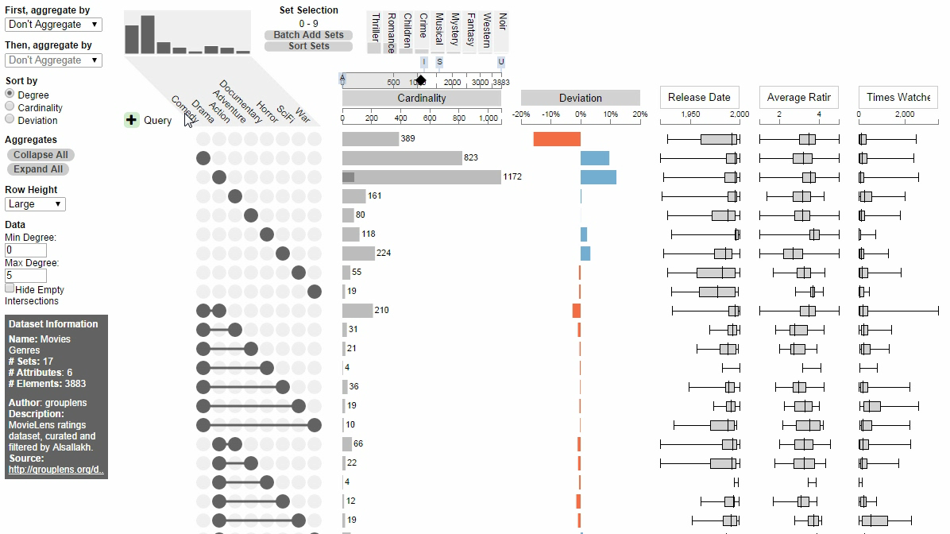
Drama-Comedy
Action-Comedy
Notes:
You can see hear that the Drama comedy combination is the most common combination, but you can also see that it is less frequent then expected.
Which makes sense, because Comedy and Drama doesn’t really go together.
This high value is here only because Comendy and Drama are such large sets.
In the attribute plots you can easily compare the ratings. We see, for example, that the ratings are typically better for the Comedy/Drama combination than the Action Comedies – again, not very surprising.
Clip menu?

Slide 34
Sorting

Slide 35
A
C
Which is the biggest intersection?
B
Sort By: Cardinality

Slide 36
A
C
Which is the most ‘surprising’ intersection?
B
Sort By: Deviation

Slide 37
A
What are the properties of the intersections involving ‘A’?
C
B
Sort By: Set

Slide 38
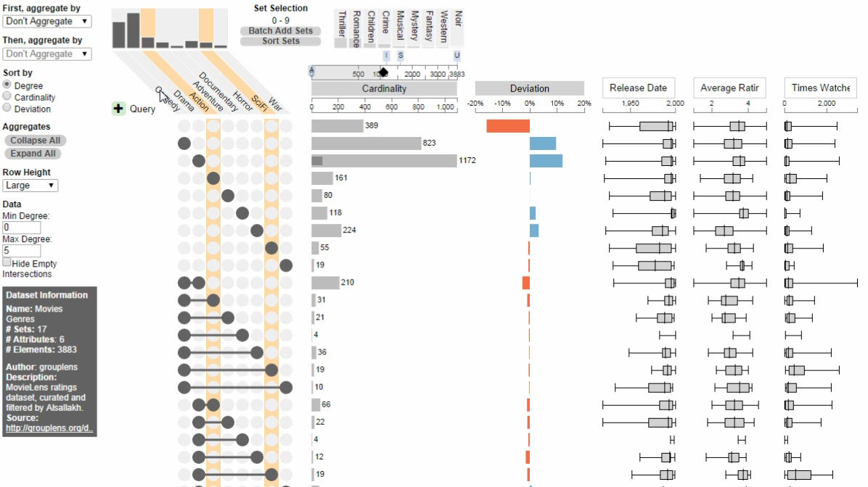

Slide 39
Aggregation

Slide 40
A
B
C
Are most elements in only one set?
Aggregate By: Degree
Notes:
Wrong title relative to next slide

Slide 41
A
B
C
Are many items shared between
two sets?
Degree 0
Aggregate By: Degree
Degree 1
Degree 2
Degree 3
Notes:
Answer is yes: Most items are shared between 2 sets
TODO: change flash to static color

Slide 42
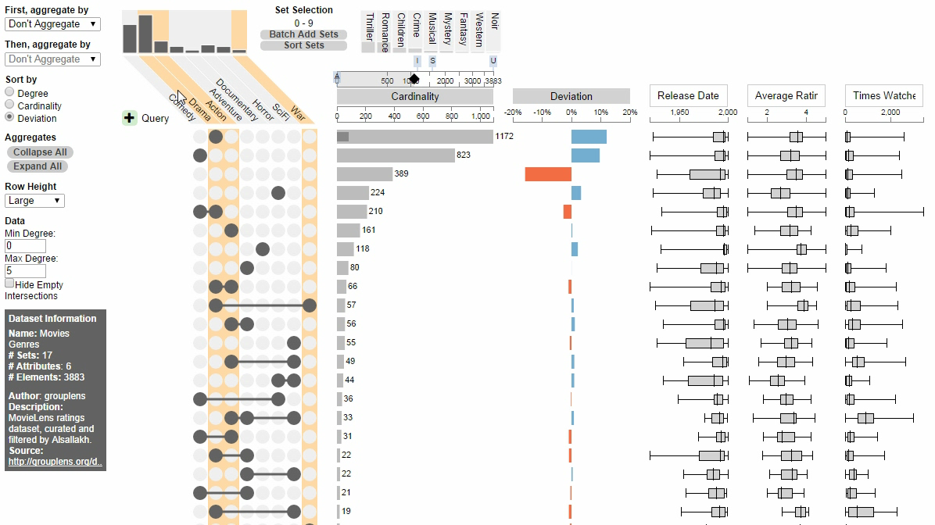

Slide 43
A
How are the elementsof ‘B’ distributed?
B
C
Aggregate By: Set
Degree 0
Degree 1
Degree 2
Degree 3

Slide 44
A
How are the items of ‘B’ distributed?
B
C
Aggregate By: Set
None
A
Must
May
Must Not
B
C
Notes:
We can see that B is the smallest set, that there are items in all intersections and that A & B is the largest intersection.
But there are a couple of details in this plot worth mentioning:

Slide 45
A
How are the items of ‘B’ distributed?
B
C
Aggregate By: Set
None
A
B
C
Notes:
The bar is too long
The scale problem is mainly between objects of different classes: aggregates and intersections
We could use a log scale, but we do want to preserve local differences better
So we use a “horizon bar” approach, where the bar is wrapped around.
That works for up to 3 wraps, after which we show that a bar is broken.
Another thing to note is that aggregates can lead to duplications

Slide 46
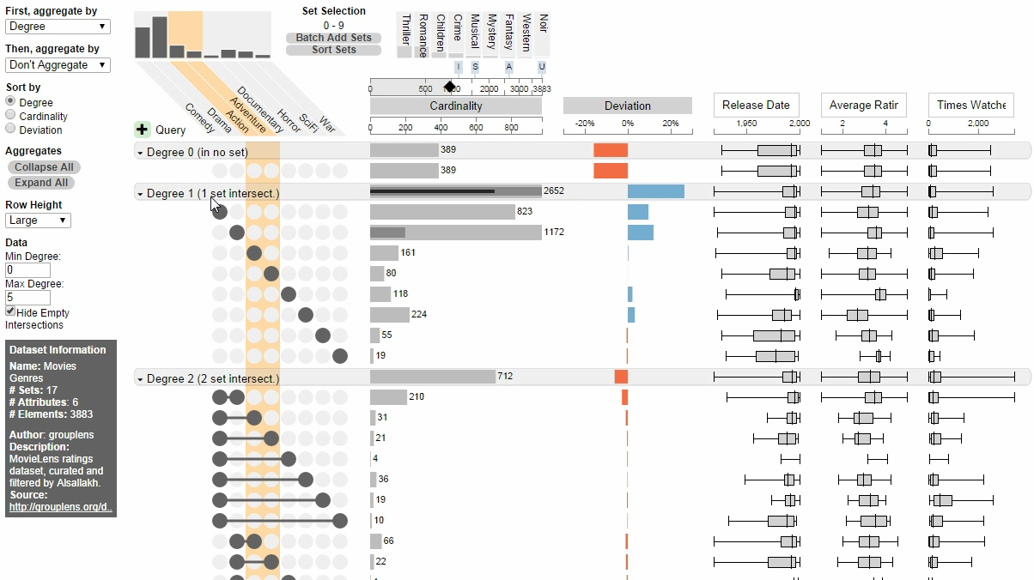

Slide 47
Queries

Slide 48
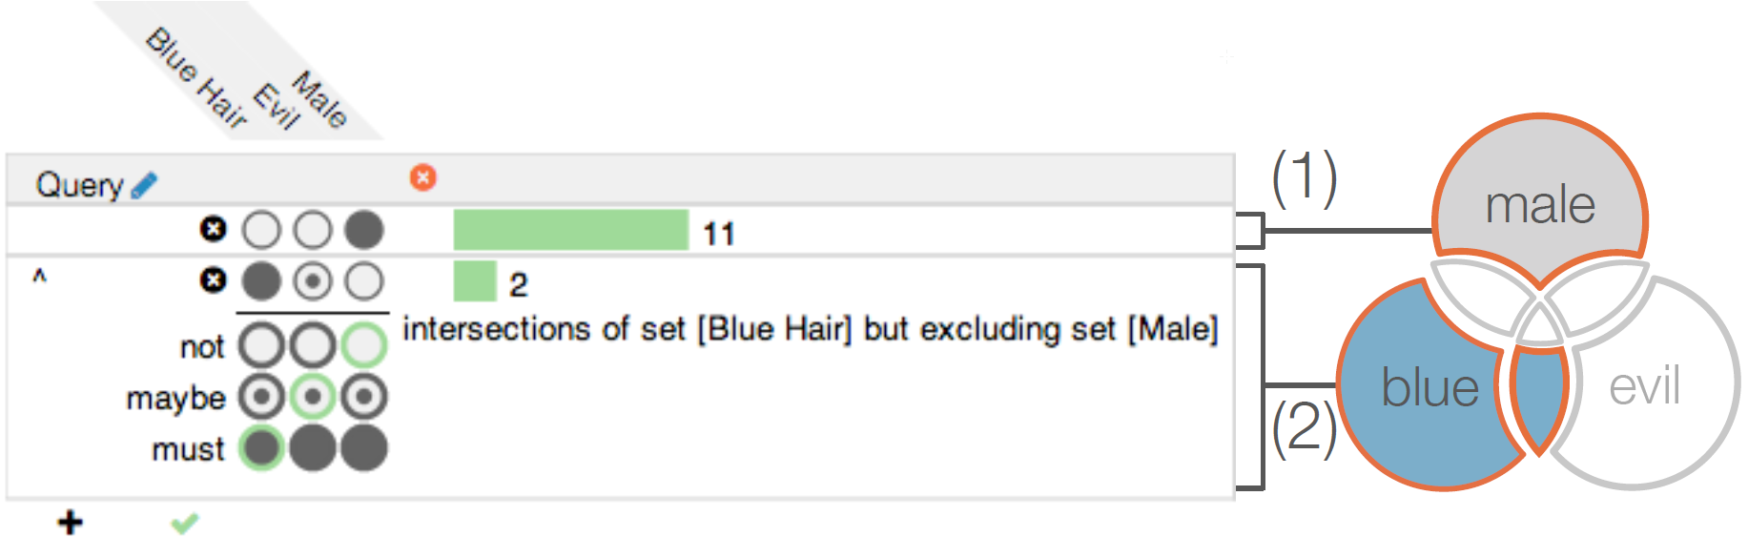
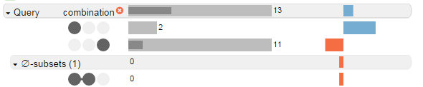
Which Simpsons characters are either male but not evil and don’t have blue hair,
or are female and have blue hair?
Answer with Queries
Notes:
Show who matches that query

Slide 50
Exploring Attributes

Slide 51
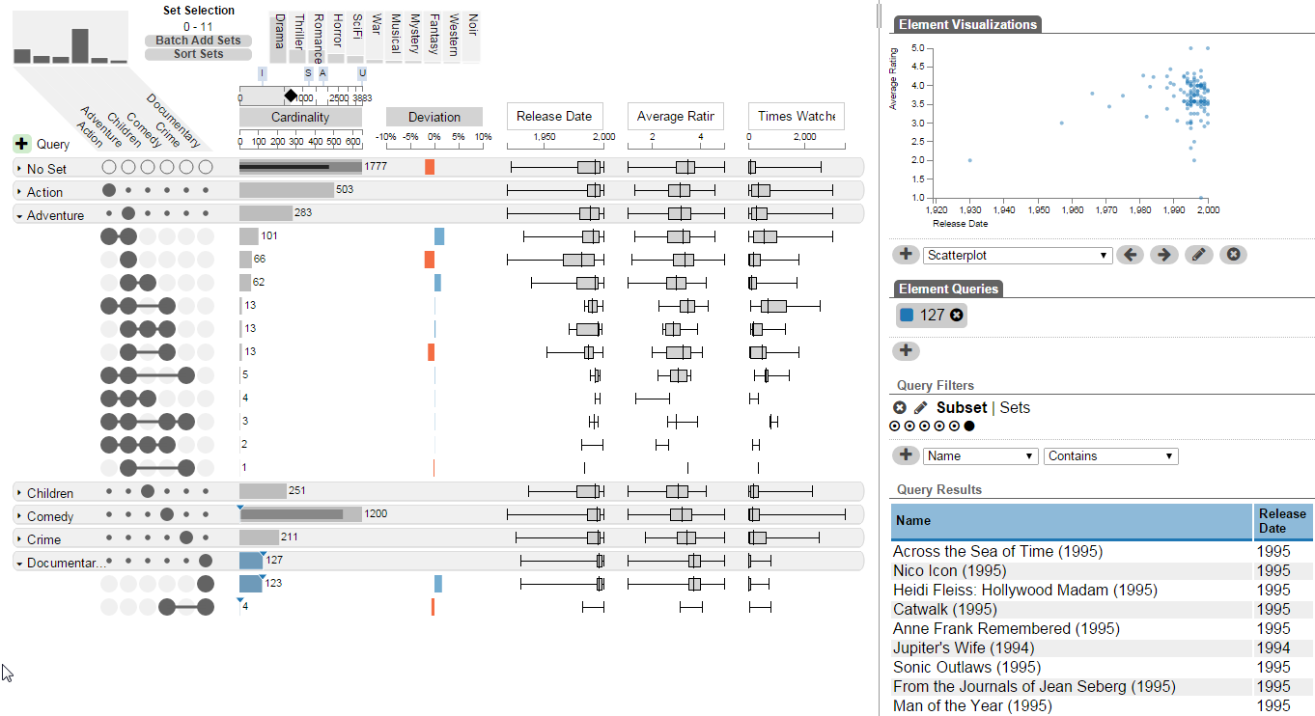
How do the attribute of two intersections compare?

Slide 52
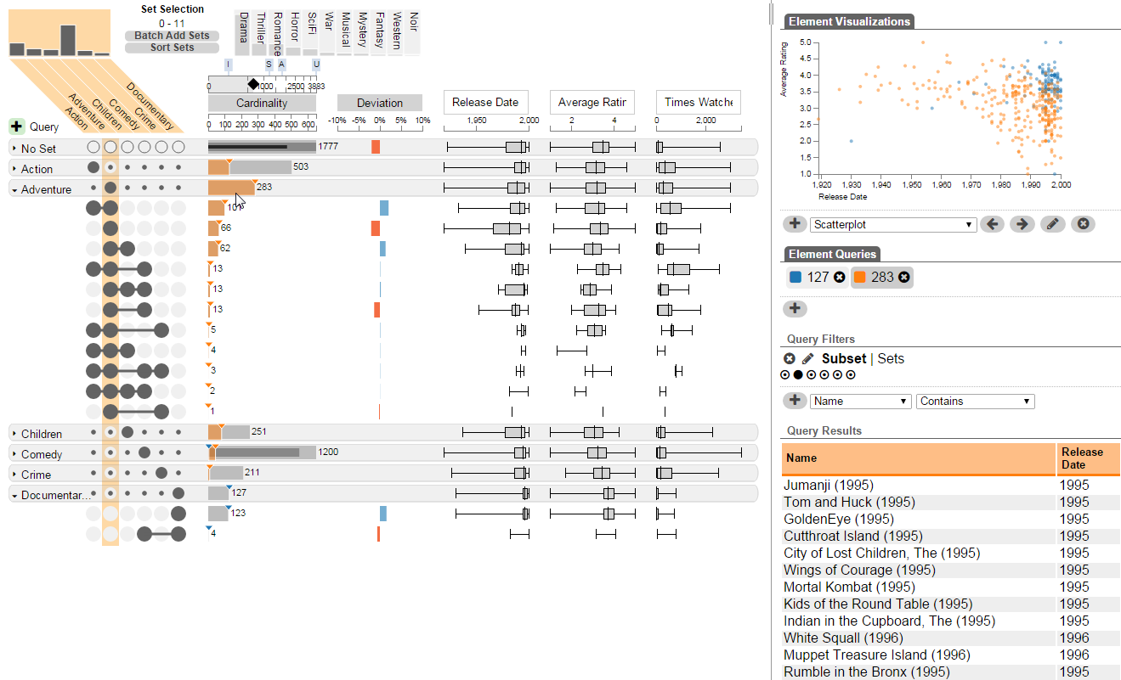
How do the attribute of two intersections compare?

Slide 53
Applications
Molecular Biology
Social Network Analysis
Economics
Drug Discovery
….
http://vcg.github.io/upset

Slide 54
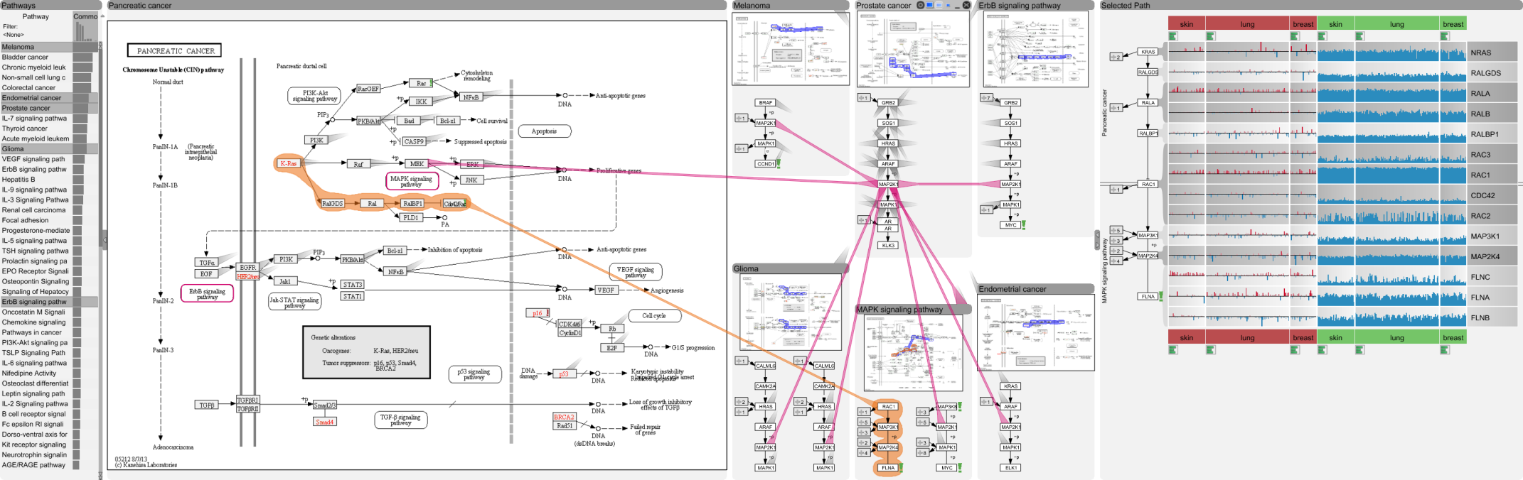
Pathways – Entourage
[Partl, BioVis ‘12]
Best Paper Award
[Partl, BMC Bioinf. ‘13]
[Lex, InfoVis ‘13]

Slide 55
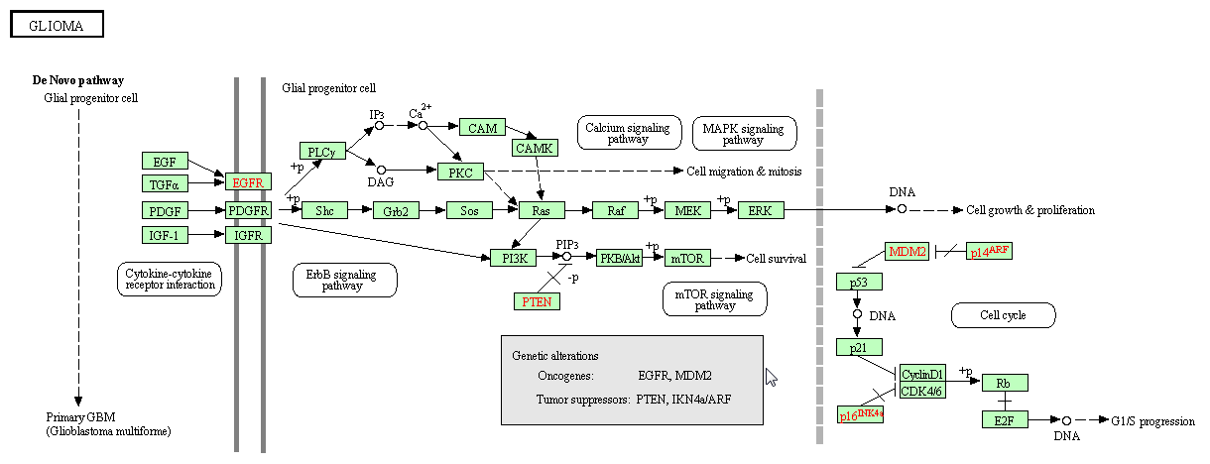
A Pathway

Slide 56
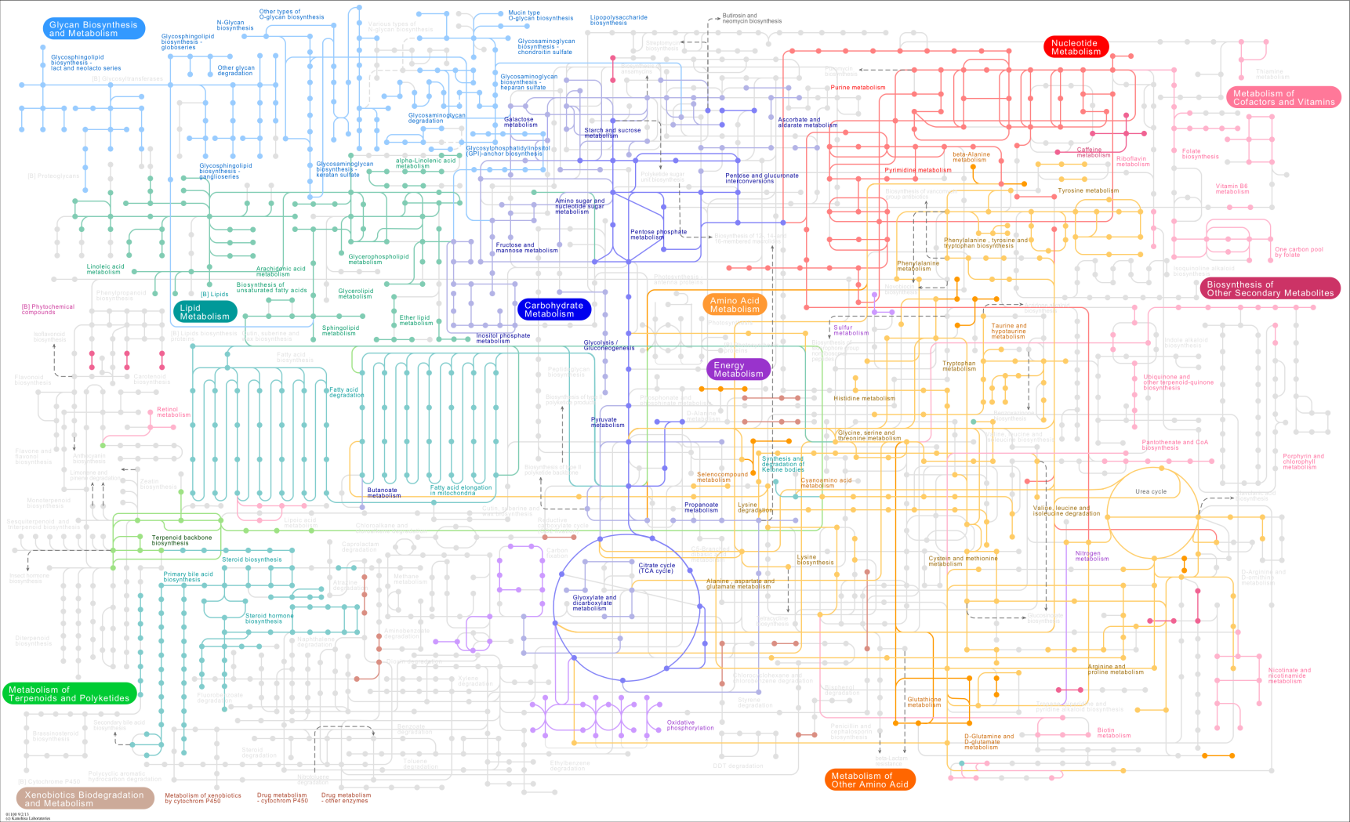
The bigger picture
Notes:
Alle prozesse im menschen im netzwerk, zuerst komplex, analyze -> understand

Slide 57
Background
Whole Network
Pathway A
B
Pathway B
Pathway C
D
I
A
E
C
C
H
J
G
L
F
G
L
P
N
K
Q
M
O

Slide 58
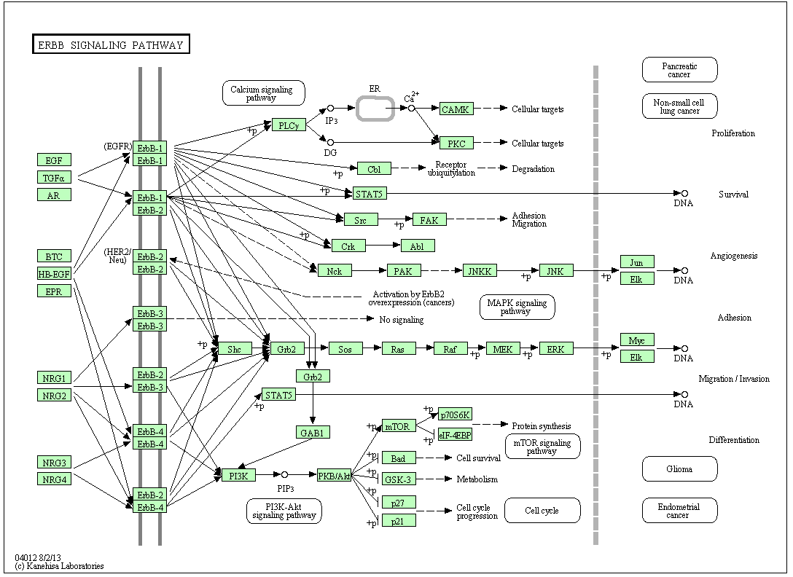
A Pathway

Slide 59

Challenges
Pathway A
Pathway B
B
D
G
G
L
Drug side-effects
A
E
C
P
N
Drug repositioning
M
O
G
F
G
Notes:
-> add bio goals

Slide 60
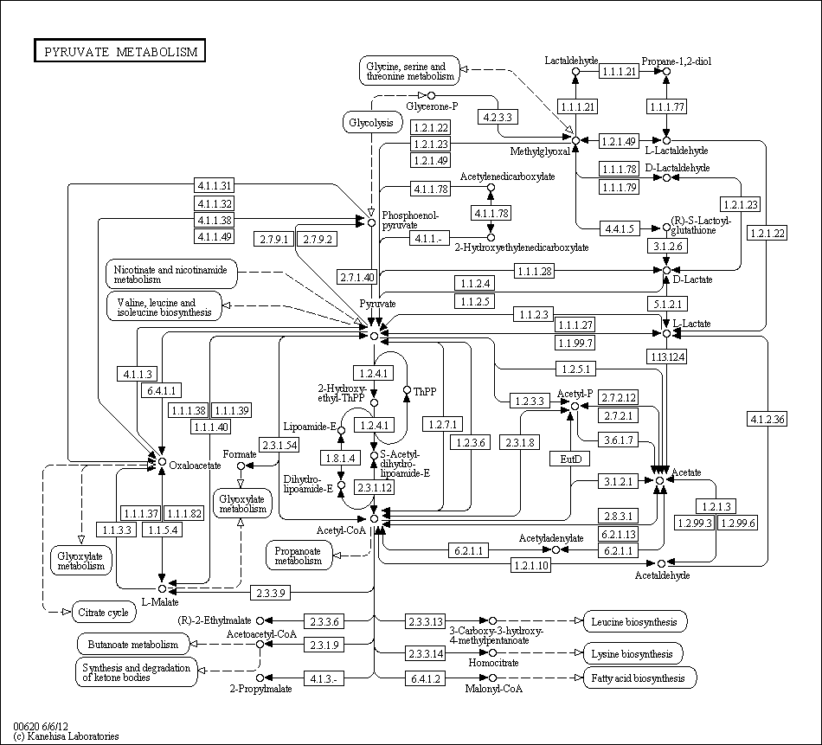
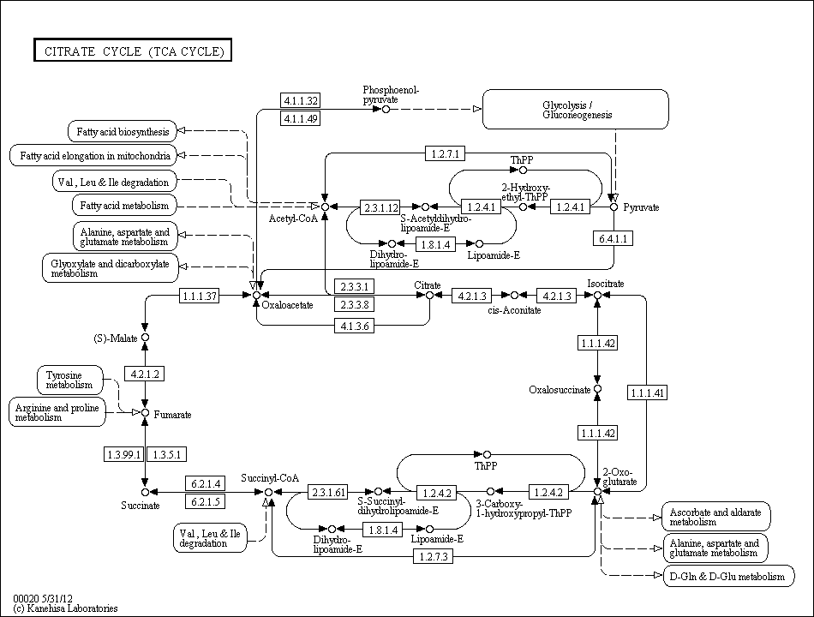
Challenges
How to visualize pathway relationships?

Slide 61
Challenges
Pathway A
Node
Sample 1
Sample 2
Sample 3
…
A
0.55
0.95
0.83
…
B
D
B
0.12
0.42
0.16
…
C
0.33
0.65
0.38
…
A
…
…
…
…
E
C
C
Node
Sample 1
Sample 2
Sample 3
…
A
low
low
very high
…
F
G
B
normal
low
high
…
How to visualize experimental data on pathways?
C
high
very low
normal
…
…
…
…
…
Notes:
… data in context of pathways, which basically means to associate multiple heterogeneous attributes…

Slide 62
How to visualize
pathway relationships?

Slide 63
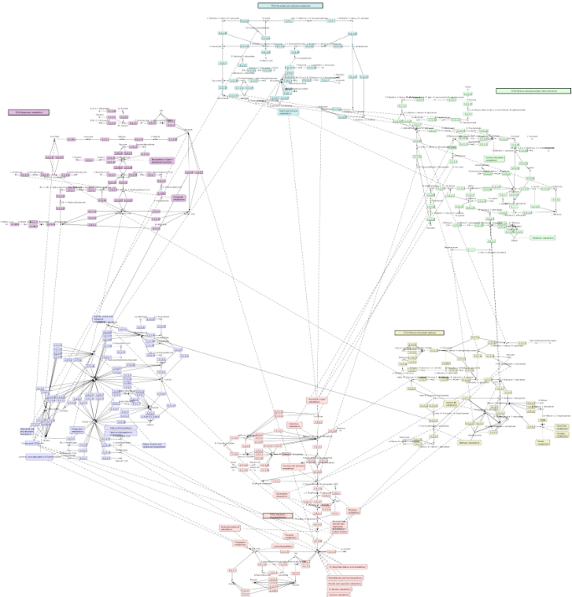
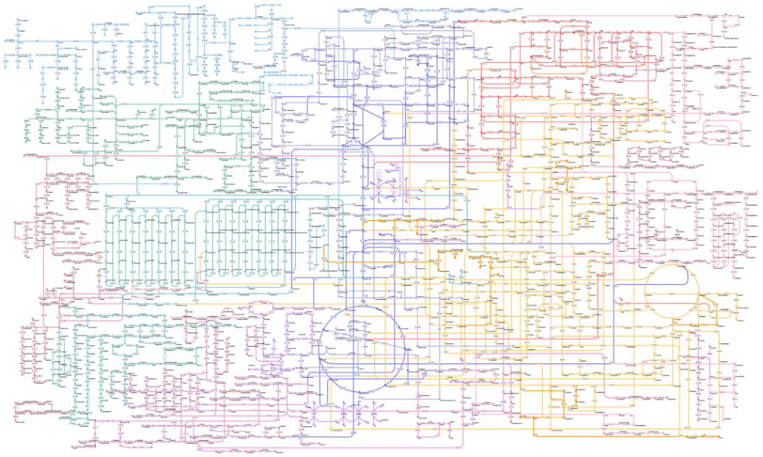
Approaches
Whole Network
Connected Pathways
[Kono2009]
[Klukas2006]

Slide 64
Finding Related Pathways

Slide 65
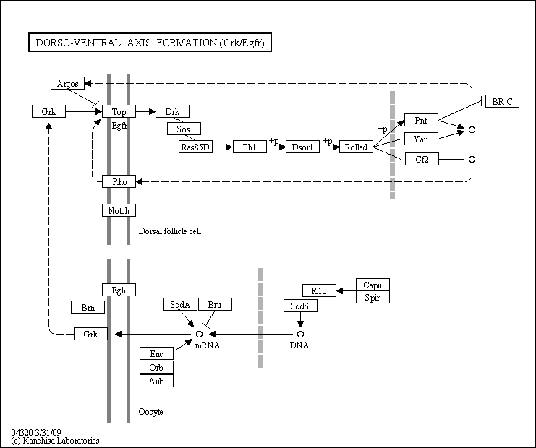
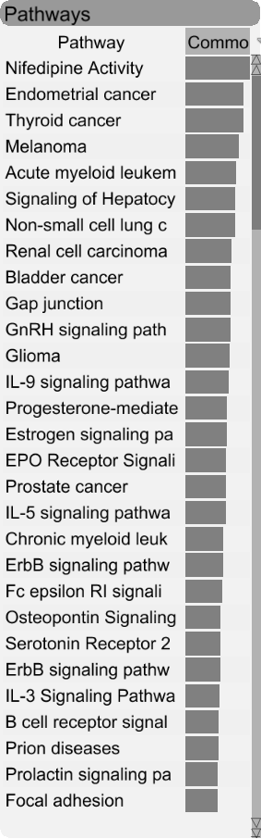
Finding Related Pathways
Notes:
Rank pathways by similarity

Slide 66
Contextual Subsets
Pathway A
Pathway B
A
G
A
G
A
PW B
B
A
G
A
C
A
E
H
A
R
D
H
I
J
I
F
I
Contextual Subset
Focus Pathway
Context Pathway
Notes:
Wo kann ich shared nodes statt portals sagen -> introduce later, vermeide „in our case“; also show branches -> look at paper for detail

Slide 67
Contextual Subsets
Pathway A
A
A
A
PW D
PW C
PW B
M
B
B
C
G
P
E
E
A
R
D
K
H
L
N
I
F
Focus Pathway
Context Pathways

Slide 68
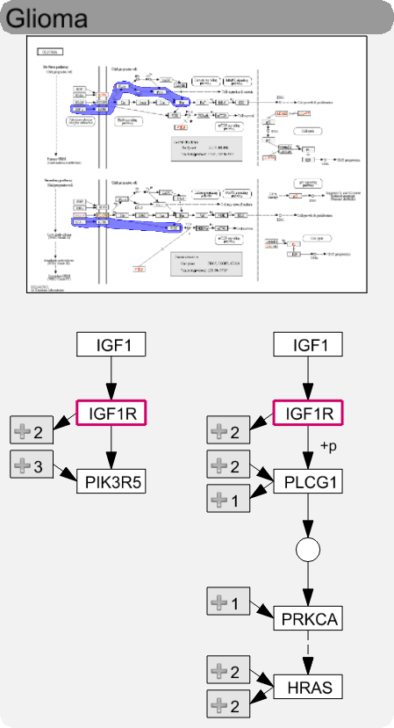
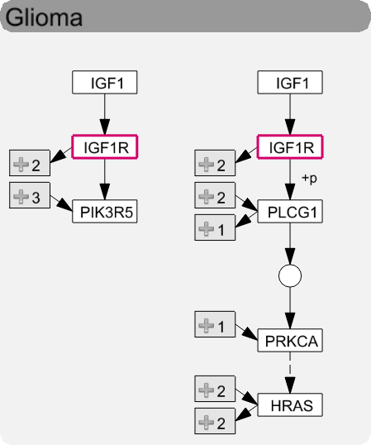
Levels of Detail
High
Medium
Low
Notes:
Kiss thumbnail, how actually looks like

Slide 69
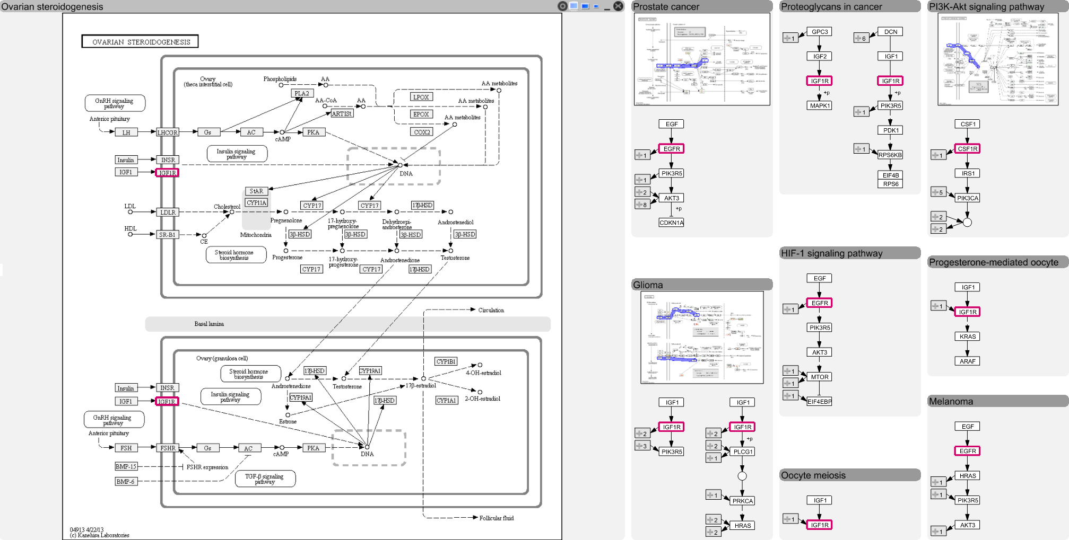
Layout

Slide 70
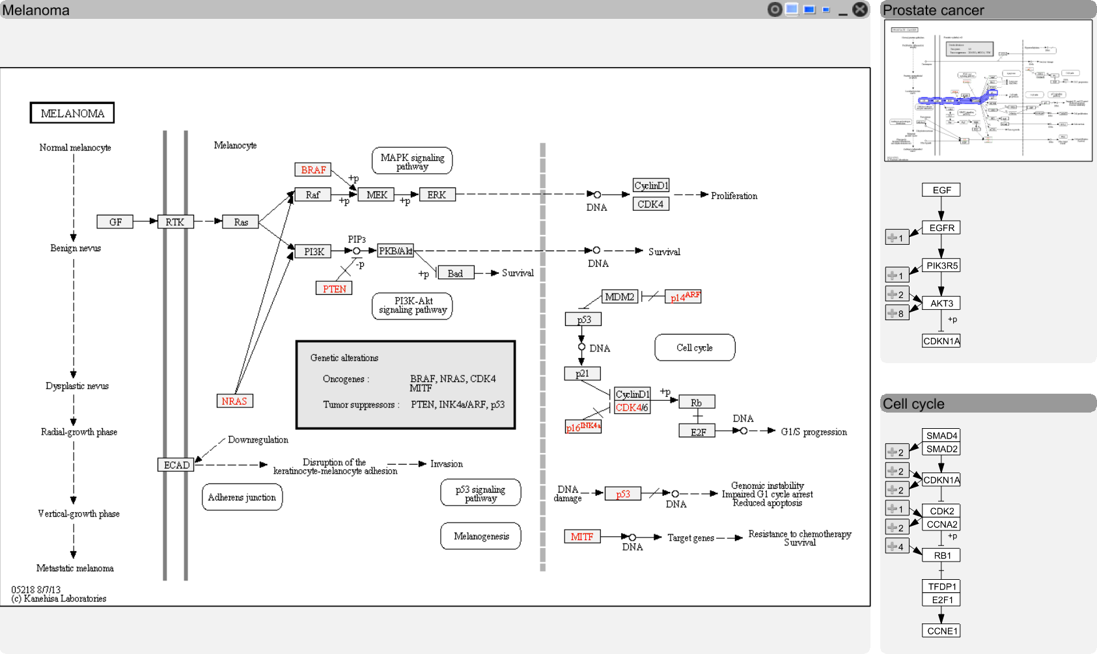
Visualizing Relationships
Notes:
Link to header gleich am anfang, overlay collins ref, stubs in detail

Slide 71
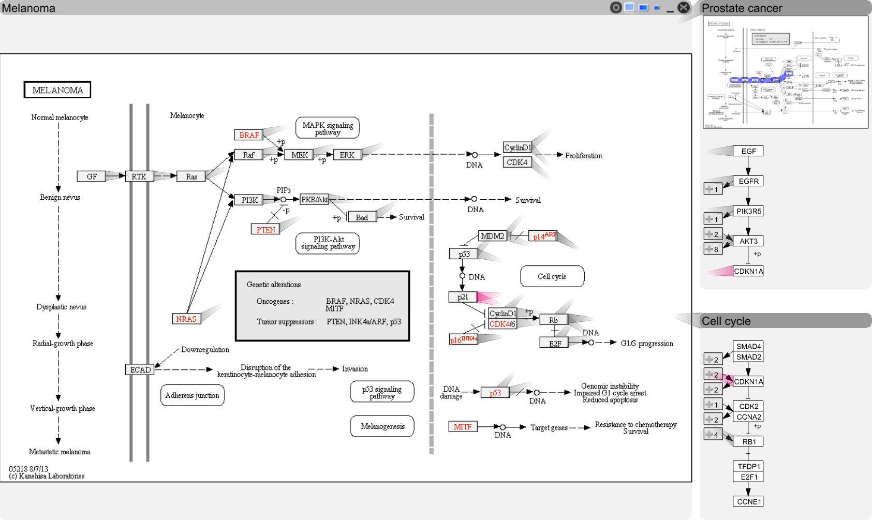
Visualizing Relationships

Slide 72
Visualizing Relationships

Slide 73
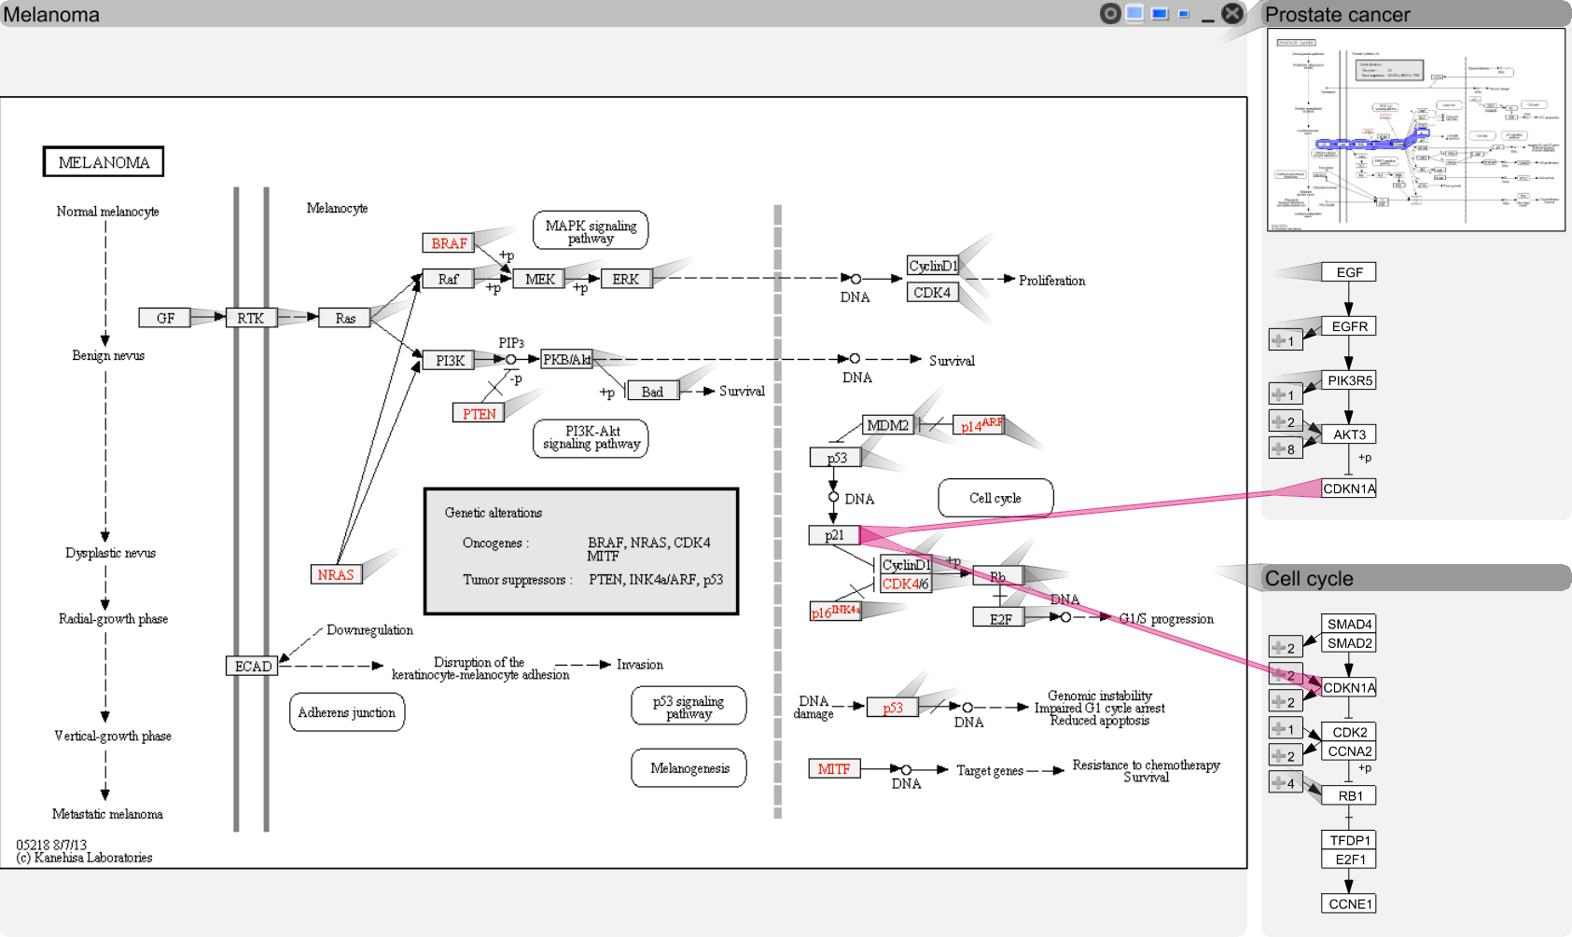
Visualizing Relationships

Slide 74

Visualizing Relationships

Slide 75
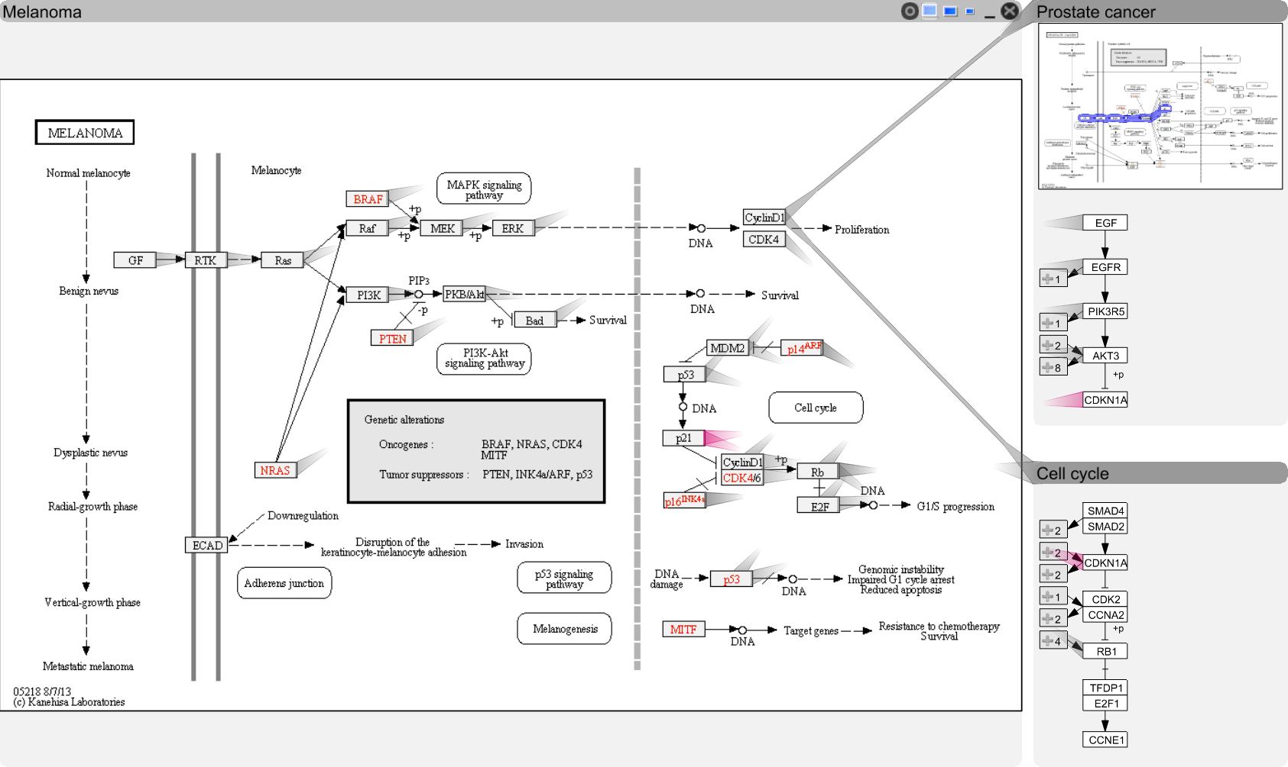
Visualizing Relationships
Notes:
hawer

Slide 76
How to visualize
experimental data on pathways?

Slide 77
Experi-mental Data and Pathways enRoute
Cannot account for variation found in real-world data
Branches can be (in)activated due to
mutation,
changed gene expression,
modulation due to drug treatment,
etc.
[Partl, BioVis ‘12]

Slide 78
Good Old Color Coding
A -3.4
B 2.8
C 3.1
D -3
E 0.5
F 0.3
4.2
1.8
-2.2
-2.8
0.3
0.3
B
A
C
D
E
F

Slide 79
Challenge: Data Scale & Heterogeneity
Large number of experiments
Large datasets have more than 500 experiments
Multiple groups/conditions
Different types of data, require different visualization techniques

Slide 80
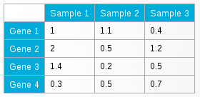
Challenge: Supporting Multiple Tasks
B
Two central tasks:
Explore topology of pathway
Explore the attributes of the nodes (experimental data)
Need to support both!
A
C
D
E
F

Slide 81
Concept
Pathway View
enRoute View
B
Non-Genetic Dataset
A
A
B
C
A
C
D
D
D
E
E
E
F
F
Group 1
Dataset 1
Group 2
Dataset 1
Group 1
Dataset 2

Slide 82
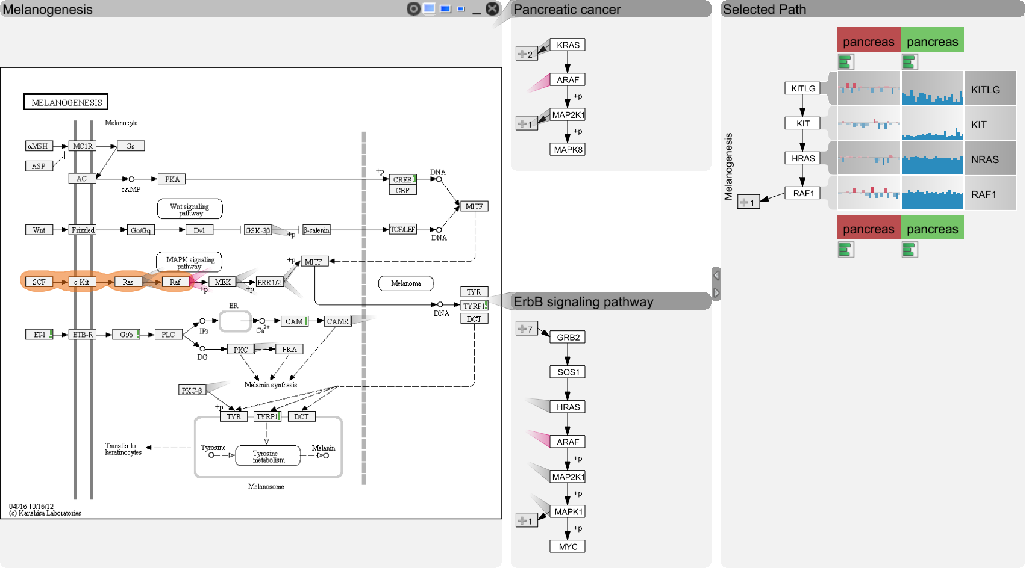
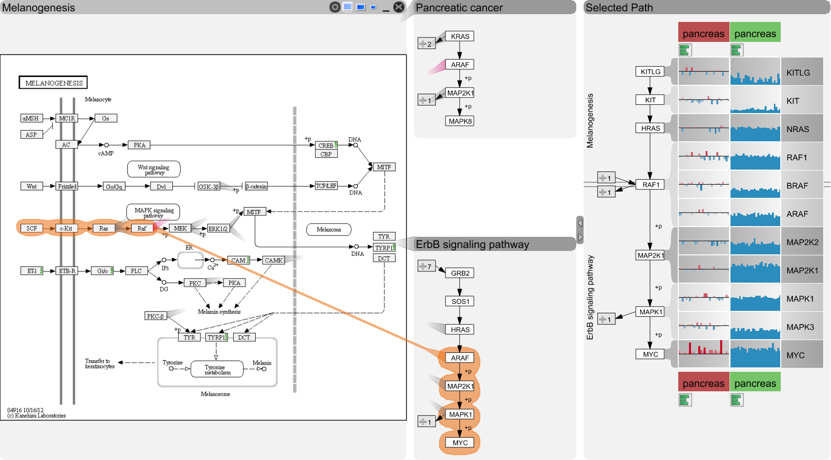
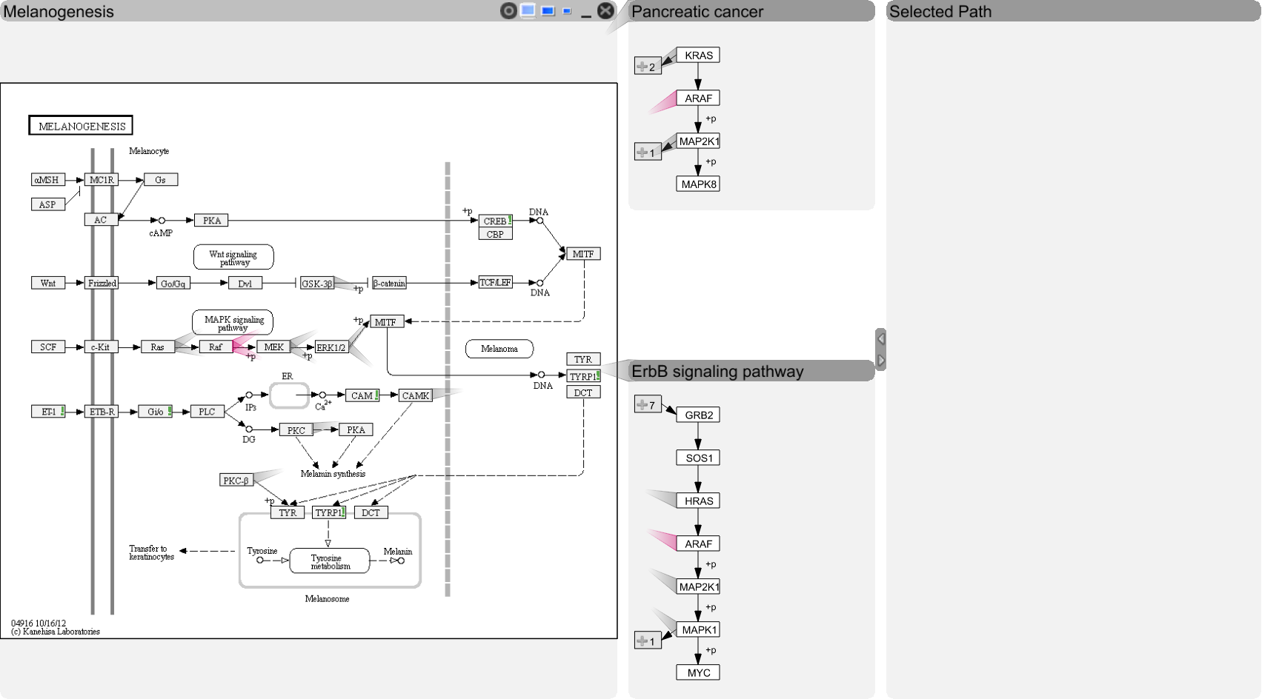
enRoute

Slide 83
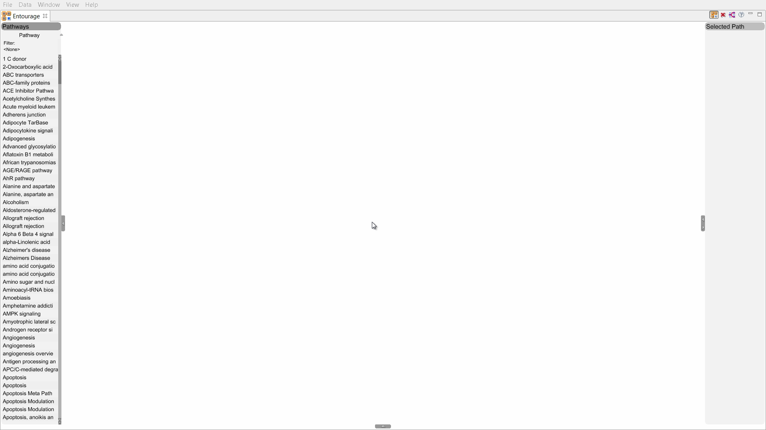
Video
Notes:
Seiteneffekte über portal -> sprung zurück zu goals, pharmacological data raus

Slide 84
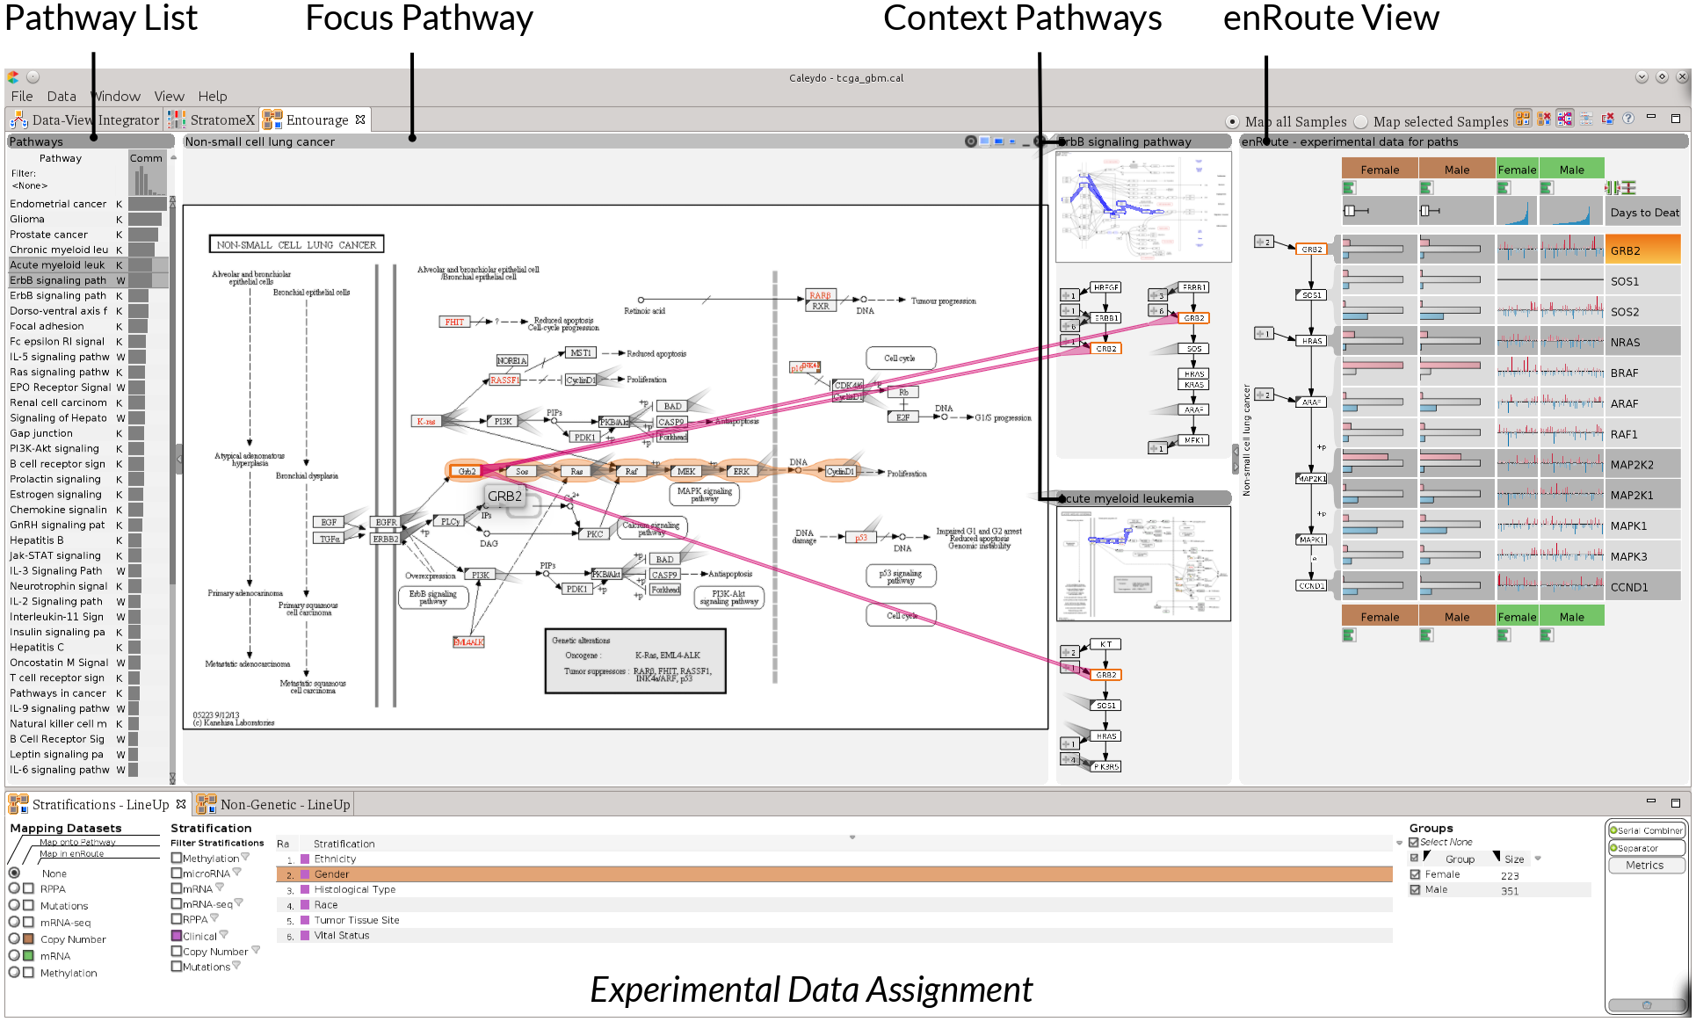

Slide 85
Case Study: CCLE Data
22
Notes:
Raus oder volle case study, oder „slideshow“

Slide 86
More Information:
http://entourage.caleydo.org

Slide 87
Heterogeneous Data
Cancer Subtypes
[Lex, EuroVis ‘12]
3rd Best Paper Award
[Streit, Nature Methods ‘14]
To appear

Slide 88
Cancer Subtypes
Cancer is not homogeneous
different histology
different molecular alterations
Subtypes have serious implications
different treatment for subtypes
prognosis varies between subtypes

Slide 89
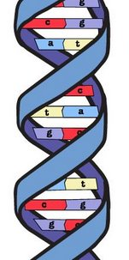
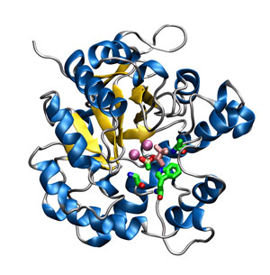

expression
Gene
Protein
microRNA expression
clinical parameters
mRNA expression
pathways
methylation levels
mutation status
copy number status
Notes:
Add datasets later, introduce protein functions

Slide 90
… the relationships between multiple heterogeneous datasets
… the data within the datasets
… alternative clusterings & groupings
… the effect of groupings on clinical parameters & biological processes
StratomeX
visualizes…

Slide 91
Stratifying Patients
Cluster A1
Subtypes are identified by stratifying datasets, e.g.,
based on an expression pattern
a mutation status
a copy number alteration
a combination of these
Cluster A2
Cluster A3

Slide 92
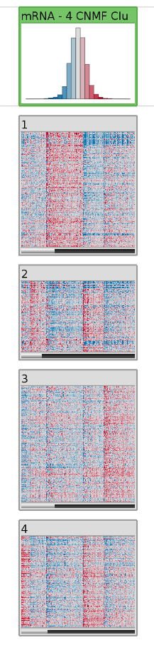
Header / Summary of
whole Stratification
Patients
Candidate Subtype /
Heat Map
Genes
Notes:
Introduce patient stratifications

Slide 93
Comparing Stratifications
Cluster A1
B1
B2
Cluster A2
Cluster A3
Tabular e.g., mRNA
Categorical,
e.g., mutation status

Slide 94
Comparing Stratifications
Cluster A1
B1
B2
Cluster A2
Cluster A3
Tabular e.g., mRNA
Categorical,
e.g., mutation status
[Parallel Sets, Kosara]

Slide 95

Many shared Patients
Clustering of mRNA Data
Stratification on Copy Number Status

Slide 96
Other Data – Same Stratification
Cluster A1
B1
Dep. C1
B2
Cluster A2
Dep. C2
Cluster A3
Tabular e.g., mRNA
Categorical,
e.g., mutation status
Dependent Data, e.g. clinical data

Slide 97

Survival data in Kaplan Meier plots

Slide 98

Detail View

Slide 99
Stratification based on clinical variable (gender)

Slide 100
Knowledge Driven Approach
Data Driven Approach

Slide 101
Finding Relevant Stratifications
~ 10 datasets
~ 15 clusterings per matrix
~ 15,000 stratifications for copy number & mutations
~ 500 pathways
~ 20 clinical variables
Calculate scores for matches
Rank the results

Slide 102

Integrating Computation
Query column
Result column
Data Visualization
Algorithms
Algorithm Output
Visualization
Ranked Stratifications

Slide 103


Slide 104
More Information:
http://stratomex.caleydo.org

Slide 105

http://caleydo.org

Slide 106
Interactive Visual Data Analysis
Alexander Lex
@alexander_lex
http://alexander-lex.com
?
Credits:
Marc Streit, Nils Gehlenborg, Christian Partl, , Samuel Gratzl, Markus Steinberger, Manuelea Waldner, Hendrik Strobelt, Romain Vuillemot, Dieter Schmalstieg, Denis Kalkofen, Mark Borowsky, Anne Mai Wasserman, Hanspeter Pfister

