Slide 1

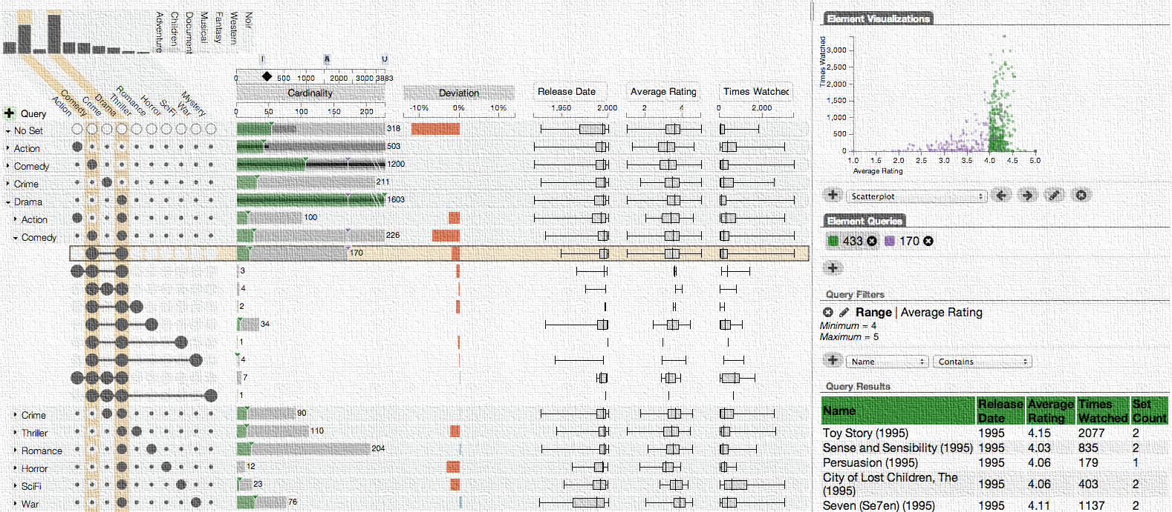
UpSet: Visualization of Intersecting Sets
Alexander Lex
@alexander_lex
http://alexander-lex.com
April 23, 2015

Slide 2
visualization
pictures
The purpose of computing is insight, not numbers.
- Richard Wesley Hamming
- Card, ‎ Mackinlay, ‎Shneiderman
Notes:
This is a quote that I like a lot by Richard Hamming
The purpose of computing is insight, not numbers.
I truly believe that and not many people would argue against it.
It turns out that this sentence can be adapted to also describe visualization.
The purpose of visualization is insight, not pictures.
Again, this is not a controversial statement.
Yet there are many visualizations and infographics out there that do not enable insight.

Slide 3
Banana
Date
Cress
Rice
Sorghum
Brome
M. acuminata
P. dactylifera
Arabidopsis thaliana
Oryza sativa
Sorghum bicolor
Brachypodium distachyon
Notes:
To give you an example: What do a Banana, Date, Cress Riche, Sorghum and Brome have in common?
They all are plants, and
they all share interesting latin names.
But they are also evolutionary related. And biologists are interested in how strong this relationship is by analyzing how many genes they share.

Slide 4
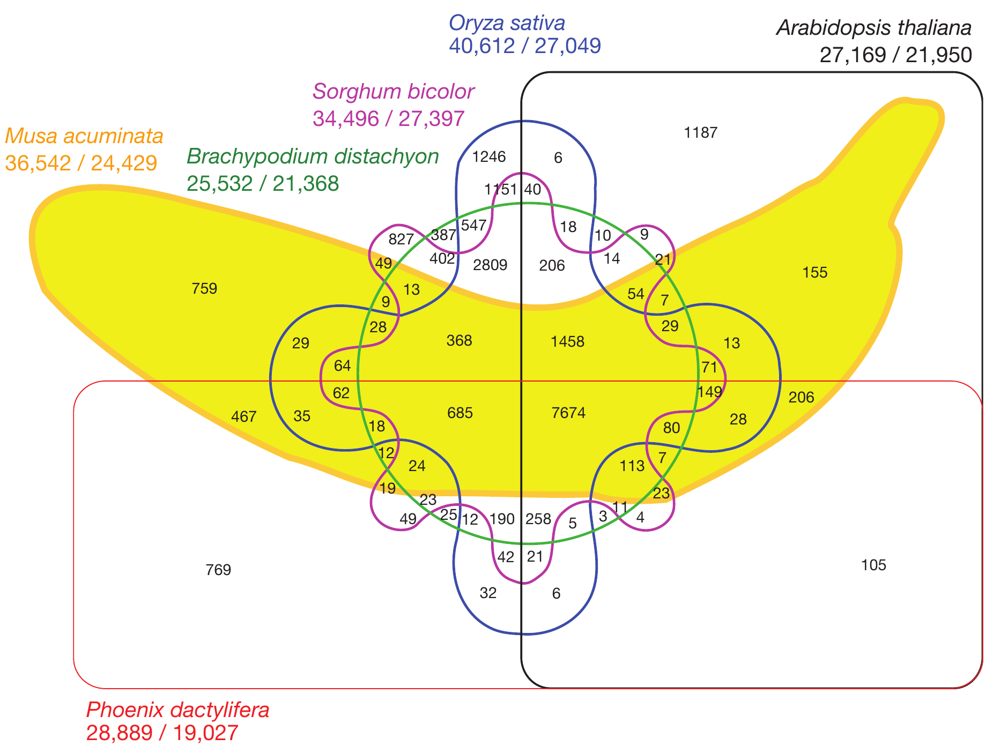
[D’Hont et al., Nature, 2012]
Notes:
In practice, this leads to diagrams like this here
That shows the shared genes of the banana genome and 5 other plant species
You can’t see which intersection is made up from which sets
And this little segment here corresponds to 1151 genes
While this giant segment corresponds to 105 genes
The problem is: you can’t make area proportional venn diagrams for most cases

Slide 5
Good Data Visualization
… makes data accessible
… combines strengths of
humans and computers
… enables insight
… communicates

Slide 6
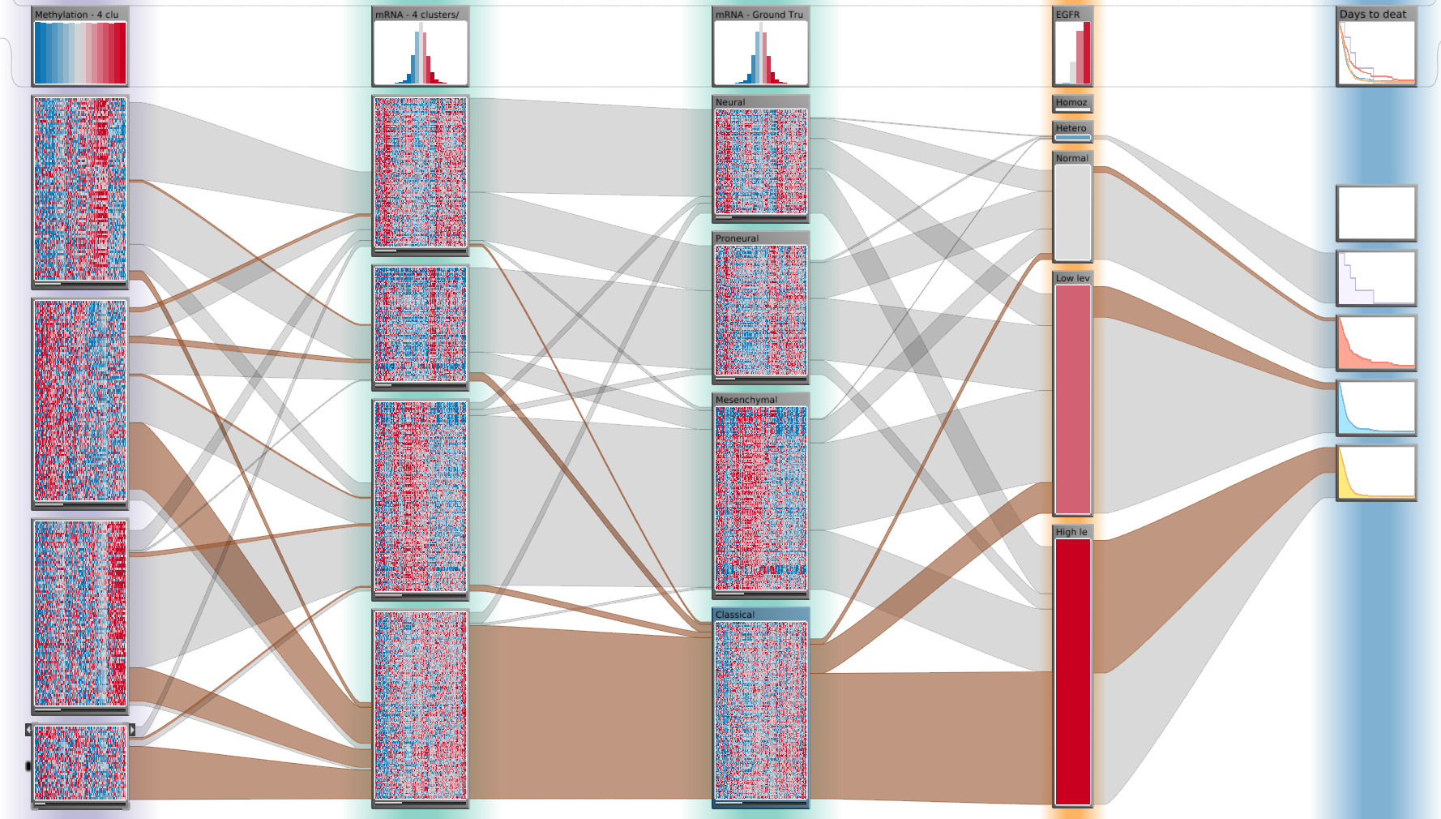
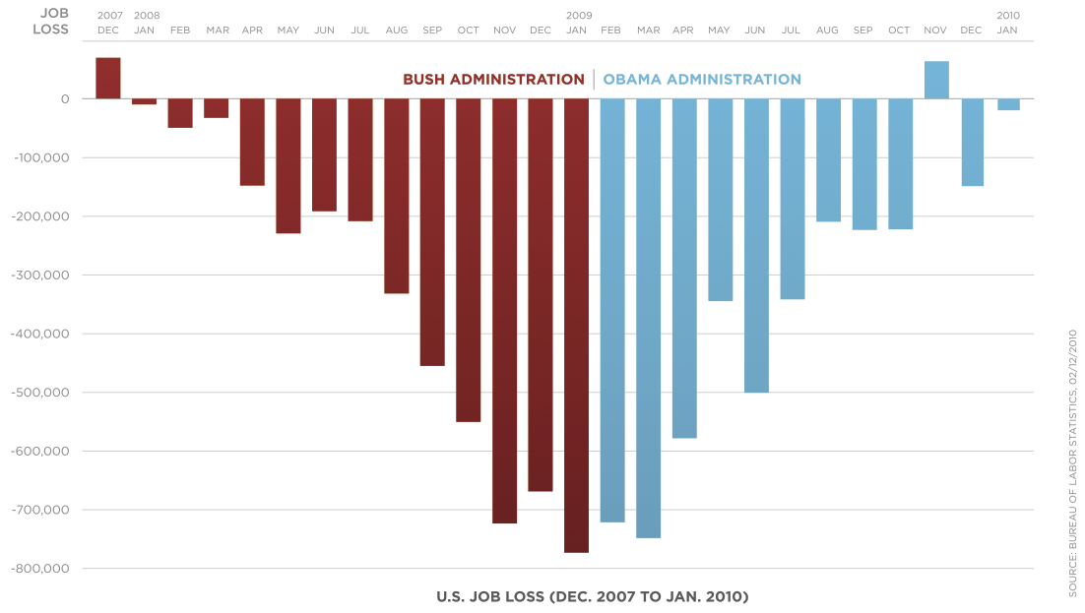
Purpose of Visualization
[Obama Administration]
Open Exploration
Communication

Slide 7
Interacting with Data
The Future of Data Analysis
is (also) Interactive
Communicates
Interfaces
Selected &
Derived Data
Visualization
Human
Computation
Interaction
Insight
Actions
Context
Reasoning
Algorithms
Statistics
Recommendations
Classifications
Aggregation
Data
Informative,
Incomplete,
Noisy, Conflicting

Slide 8

School

Slide 9
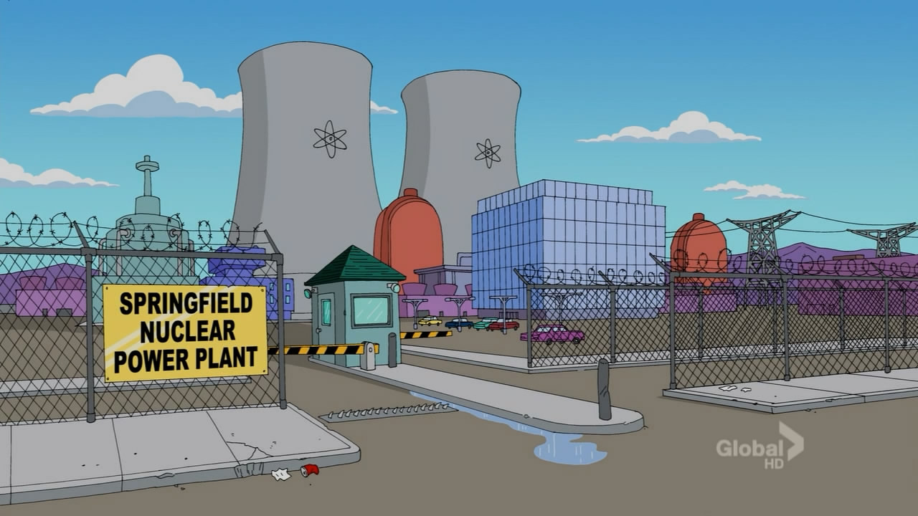
School
Power Plant

Slide 10


Evil
School
Power Plant

Slide 11
Evil
3
1
2
0
5
3
0
School
Power Plant

Slide 12
Evil
Blue Hair?
School
Power Plant

Slide 13
Evil
Blue Hair?
Duff Beer?
School
Power Plant

Slide 14
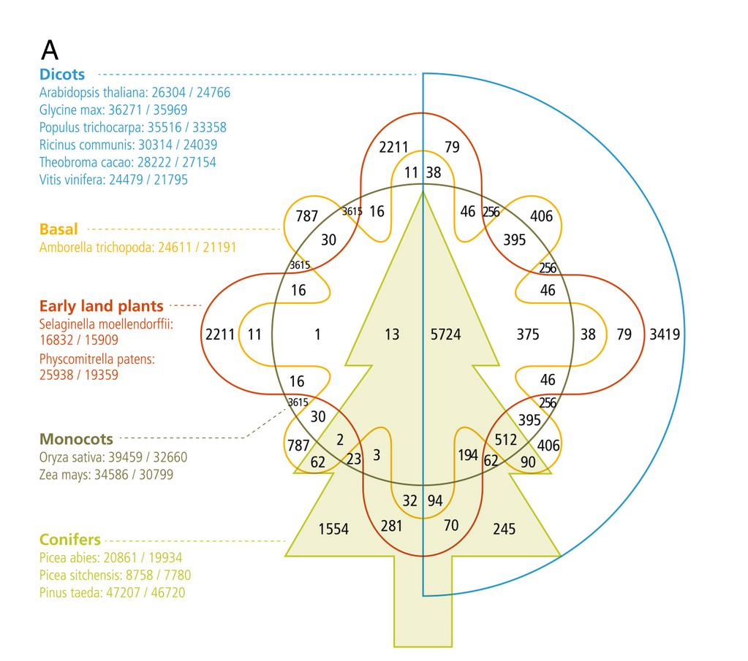
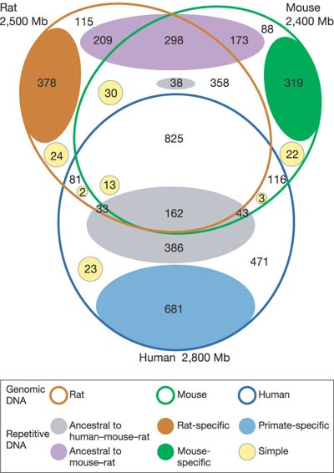
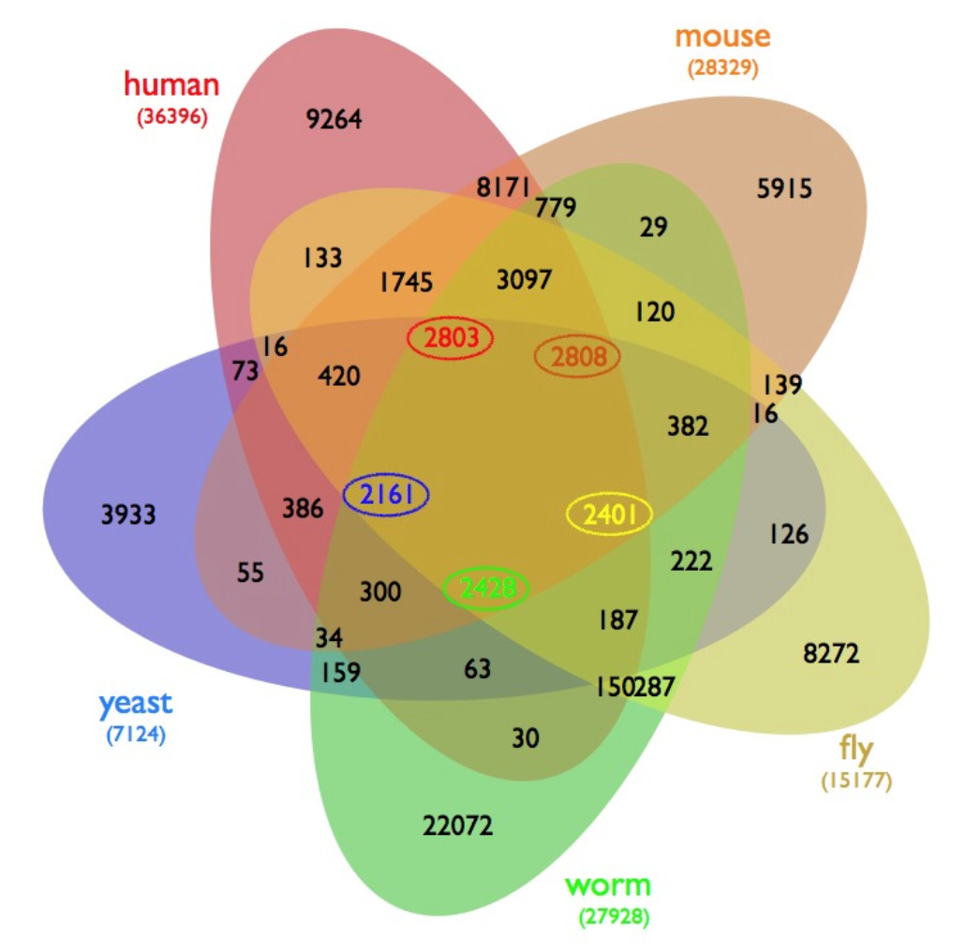
[Neale et al., BMC Genome Biology, 2014]
[Gibbs et al., Nature, 2004]
[D’Hont et al., Nature, 2012]
[Wiles et al., BMC Systems Biology]

Slide 15
[created with EulerAPE]

Slide 16
?
>
<
43
22
19
19
5
9
41
22
44
[created with EulerAPE]

Slide 17
Set Vis Goals
1. Efficient visual encoding
vs.
2. Creating complex
slices of a dataset
3. Visualize attributes

Slide 18
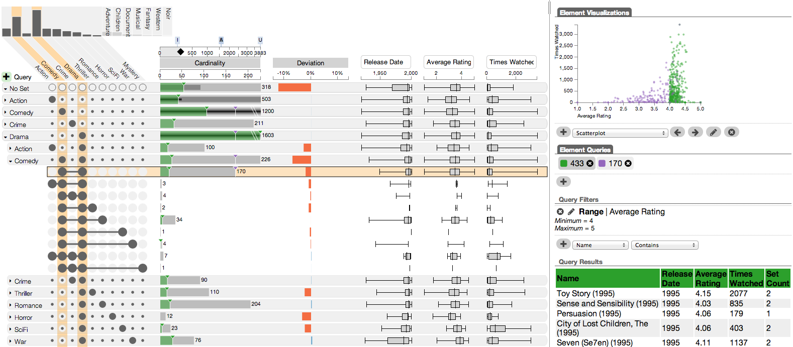
[Movie Lens Dataset]
Attribute Details
Visualizing Intersections
Visualizing Properties
Element List & Queries

Slide 19
Visualizing
Intersections

Slide 20
A
C
B
Universal Set
A
B
C

Slide 21
A
C
B
Must
Must Not
Universal Set
A
B
C

Slide 22
A
C
B
Cardinality
5
5
17
17
7
14
20
5
10
7
7
10
14
20
7
5

Slide 23
Plotting Attributes

Slide 24
A
How surprising is the size of an intersection?
C
B
What’s the distribution of an
attribute in an intersection?
Additional Plots
Deviation
Attributes

Slide 25
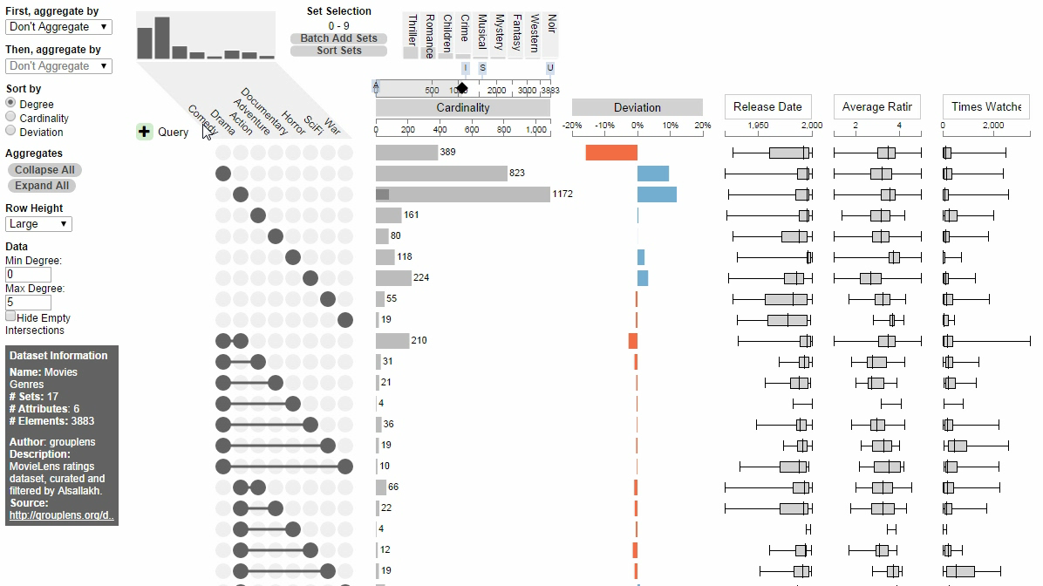

Drama-Comedy
Action-Comedy

Slide 26
Sorting

Slide 27
A
C
Which is the biggest intersection?
B
Sort By: Cardinality

Slide 28
A
C
Which is the most ‘surprising’ intersection?
B
Sort By: Deviation

Slide 29
A
What are the properties of the
intersections involving ‘A’?
C
B
Sort By: Set

Slide 30
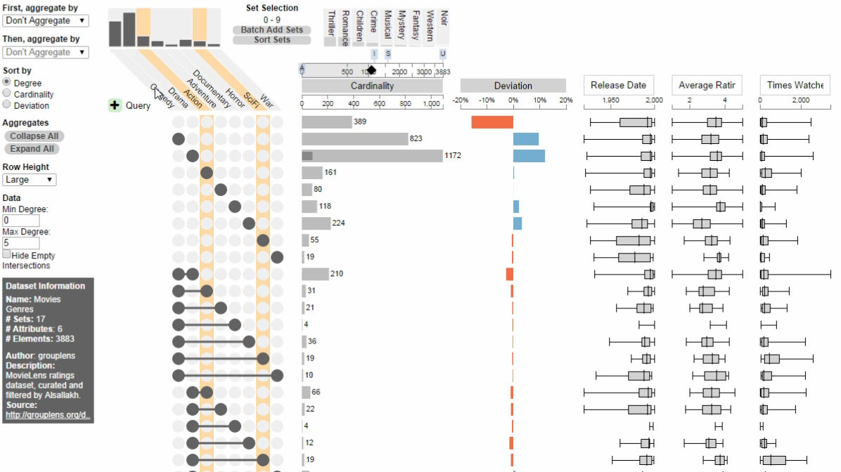

Slide 31
Aggregation

Slide 32
A
B
C
Are many items shared between
two sets?
Aggregate By: Degree

Slide 33
A
B
C
Are many items shared between
two sets?
Degree 0
Aggregate By: Degree
Degree 1
Sum of children
Degree 2
Degree 3

Slide 34
A
How are the elements of ‘B’ distributed?
B
C
Aggregate By: Set
Degree 0
Degree 1
Degree 2
Degree 3

Slide 35
A
How are the elements of ‘B’ distributed?
B
C
Aggregate By: Set
None
A
Must
May
Must Not
B
C

Slide 36
A
How are the elements of ‘B’ distributed?
B
C
Aggregate By: Set
None
A
B
C

Slide 37
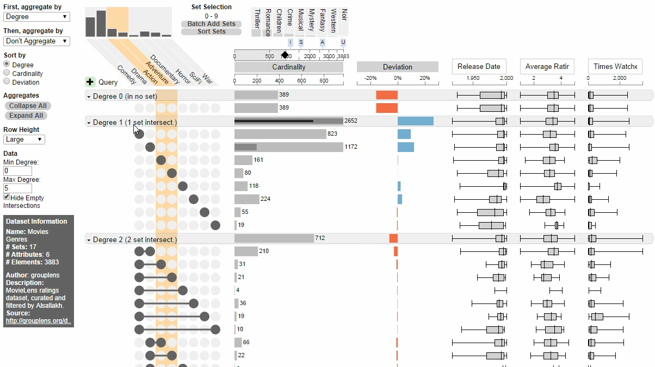

Slide 38
Queries

Slide 39
A
B
C
Must
May
Must Not

Slide 40
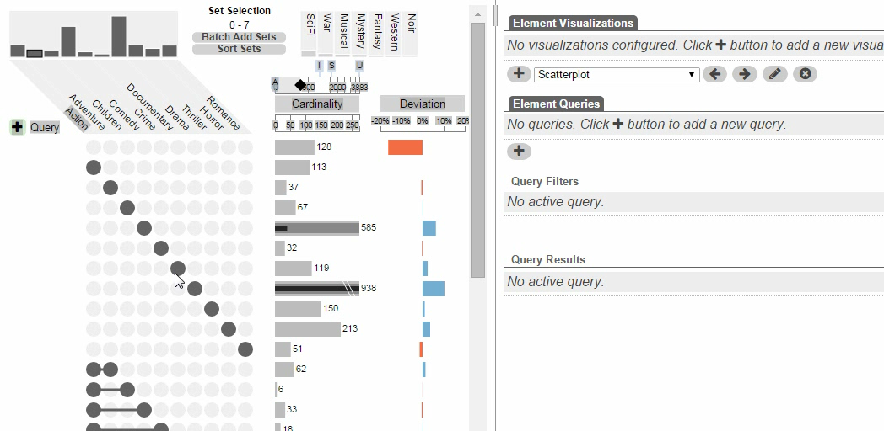

Slide 41
Elements & Attributes

Slide 42
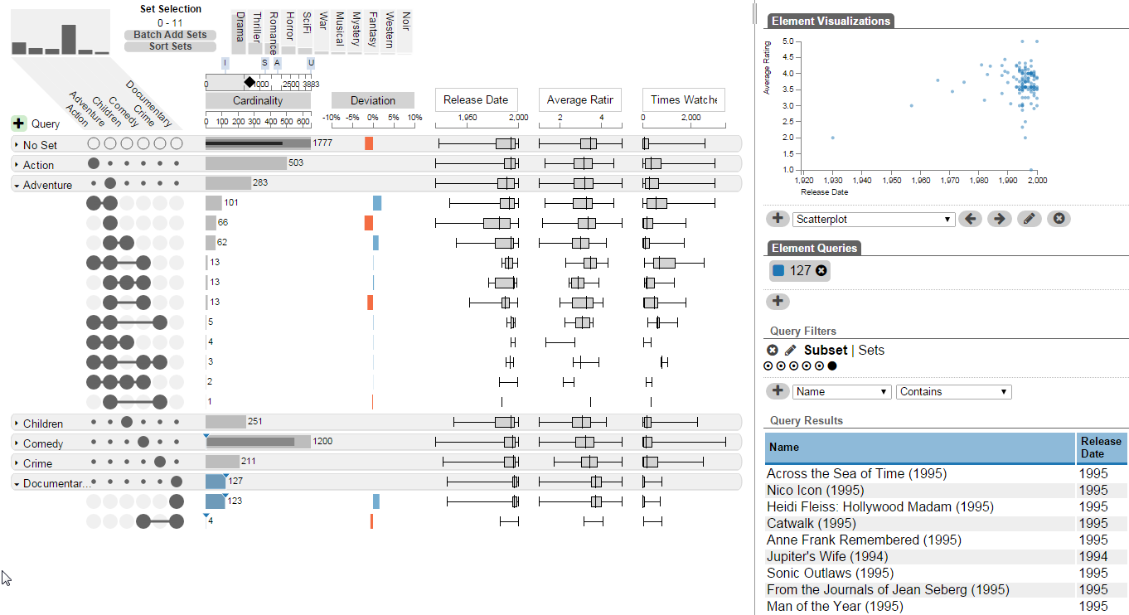
How do documentaries compare to adventure movies?

Slide 43
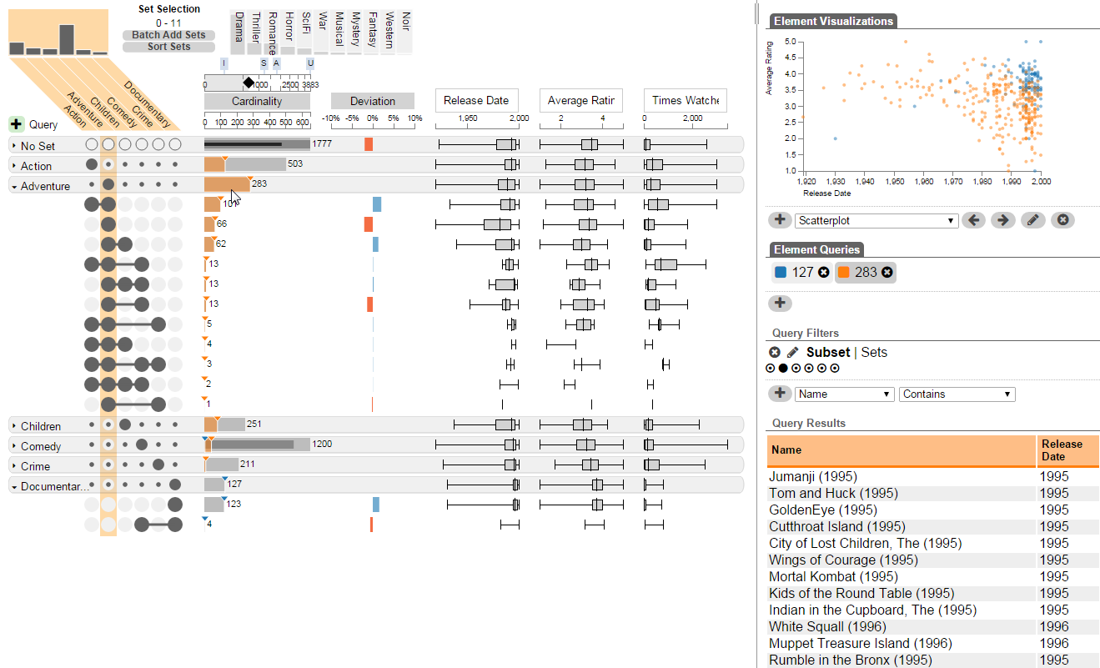
How do documentaries compare to adventure movies?

Slide 44
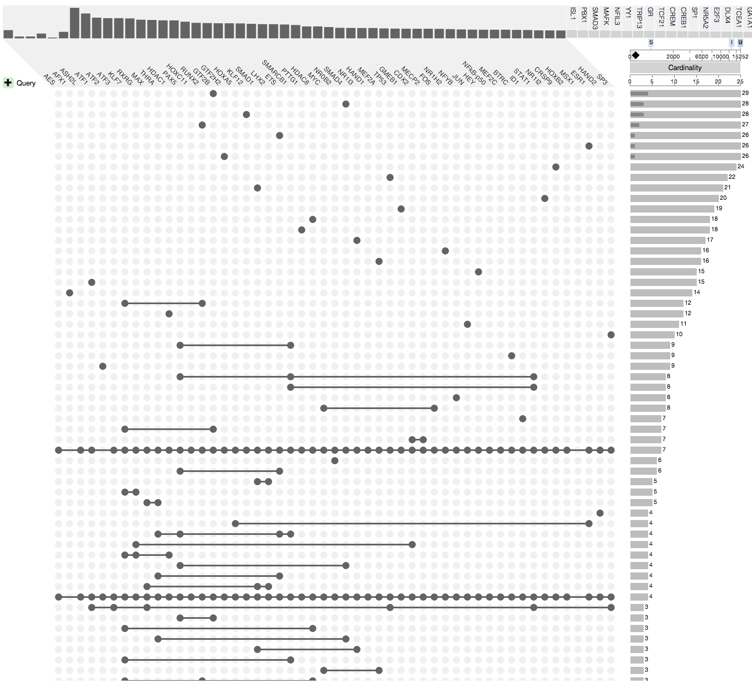
Scalability
Comfortable: ~15 sets
Possible: ~40 sets
Scales with the number of
non-empty intersections
  Most datasets are sparse

Slide 45
Applications

Slide 46
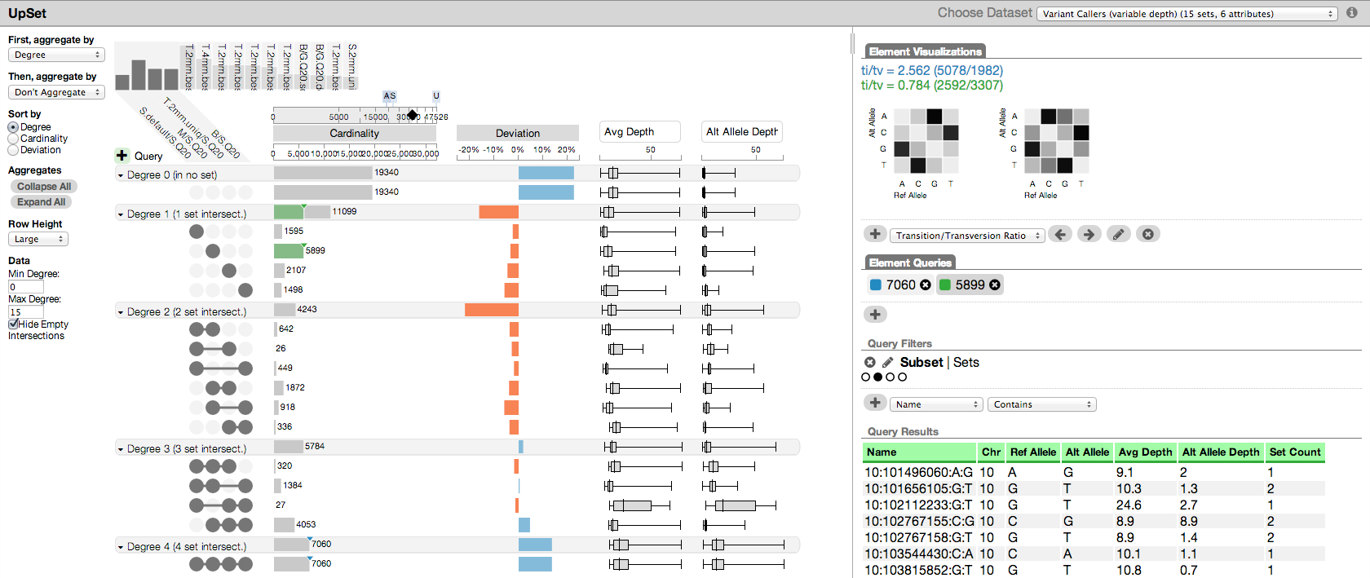
Applications
Genetics
Pharmacology
Economics
Social Networks

Slide 47

Deviation Measure
Expected if A and B independent
A
50%
A $∩$ B
25%
B
50%
Observed 1
40%
> then expected
Observed 2
10%
< then expected
[Alsallakh 2013]

Slide 48
http://vcg.github.io/upset

Slide 49
UpSet: Visualization of Intersecting Sets
Alexander Lex
@alexander_lex
http://alexander-lex.com
April 23, 2015
Credits:
Nils Gehlenborg, Hendrik Strobelt, Romain Vuillemot, Anne Mai Wasserman, Hanspeter Pfister
?

